Slide 1

Summary of Sprint 1 Dataxcelator
17.11.2023.

Slide 2

Sprint goal
To develop a Minimum Viable Product (MVP) ETL pipeline that successfully extracts, transforms, and loads data from a CSV file to a PostgreSQL database.

Slide 3
Tools and Technologies
Python
PostgreSQL
Docker
Adminer
VS CODE

Slide 4

Our tickets
Setup docker-compose file to create network of containers
Design schema to model data
Extract data from CSV file
Transform - Normalise data to 3NF
Create SQL script to generate database
Load - Load data into database
https://trello.com/b/joRhJGR6/team-2-dataxcelerator

Slide 5
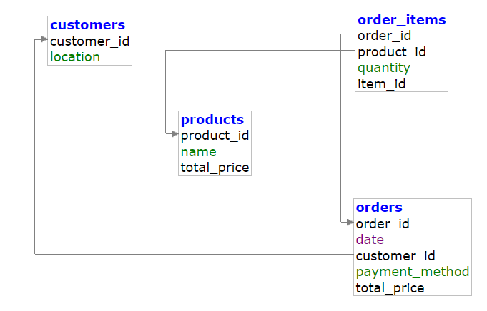
Design Schema

Slide 6

challenges we faced
Tickets
Team collaboration
communication
Transforming the Data
Maintain Integrity and Consistency of data while loading into Database

Slide 7
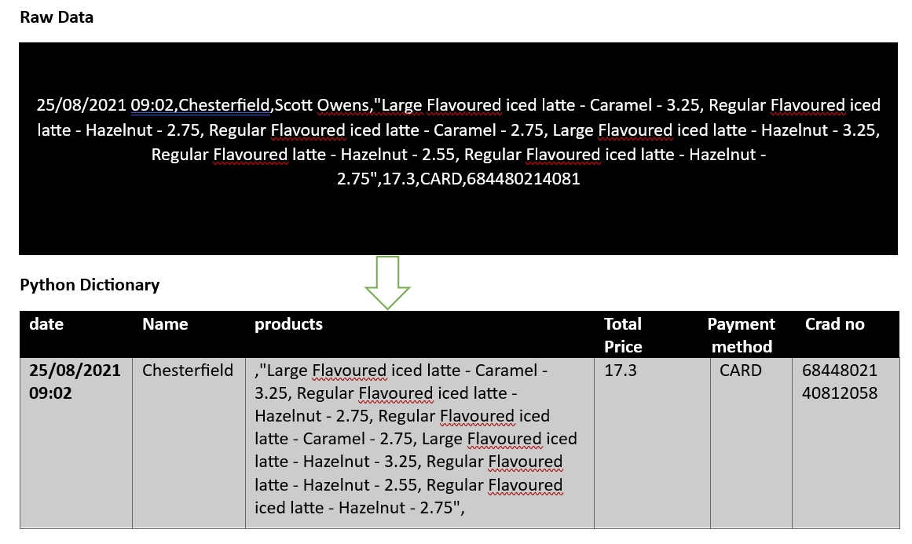
Transformations

Slide 8
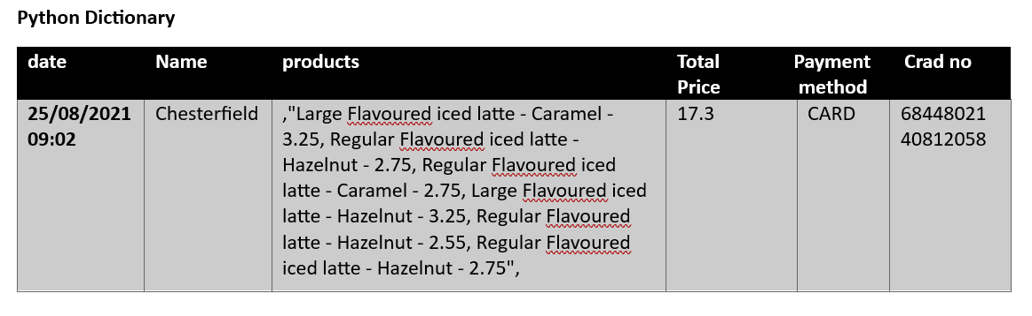
Transformations
Name
Price
Duplicates
Sensitive Data

Slide 9

Demo time
LOOKING inside

Slide 10
Thank you Dataxcelator
17.11.2023.

