Slide 1
Intelligent Transportation System
Supervised by Dr. Emad Nabil
Name | ID
Omar Abdulaziz Saeed | 20140377
Asseel Ahmed Mohamed | 20140367
Mahmoud Mosaad Abdelwahed | 20140256
Ziad Aamer Abdalhai | 20140341
Hameed Mohammed Abdullah | 20140375

Slide 2
Project Idea
Is to solve the Travelling Salesman problem.
To minimize the distance and cost of delivering orders.
This is done by providing the correct order in which salesman should deliver orders.

Slide 3
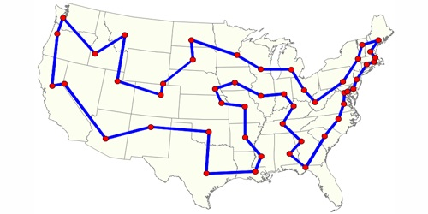
Problem Significance
Problem Definition:
TSP is a common NP hard problem.

Slide 4
Problem Significance cont.
Problem Variants:
Symmetric (STSP)
Asymmetric (ATSP)
The online TSP
The price collecting TSP
Bus, truck, vehicle routing
Edge/arc & node routing with capacities

Slide 5

Problem Significance cont.
Motivation:
Assume that you are the driver of a delivery vehicle with a certain set of stops that need to be made each day.
How would you determine the order in which to make the stops?

Slide 6
Problem Significance cont.
TSP Available Solution
Exact
Heuristic
Meta Heuristic
Brute force
Dynamic Programming
Nearest Neighbor
Cheapest Link
Depth first tree tour
Genetic Algorithm

Slide 7
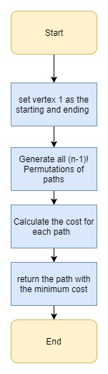
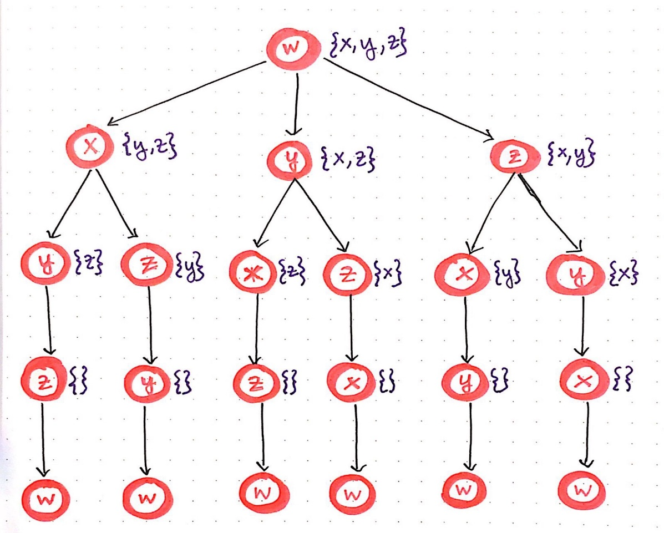
TSP Available Solutions cont.
1- Exact Approach:
1- Brute Force:
generate all possible paths choose the minimum cost path.
Complexity: O(n!)

Slide 8
Problem Significance cont.
TSP Available Solution
Exact
Heuristic
Meta Heuristic
Brute force
Dynamic Programming
Nearest Neighbor
Cheapest Link
Depth first tree tour
Genetic Algorithm

Slide 9
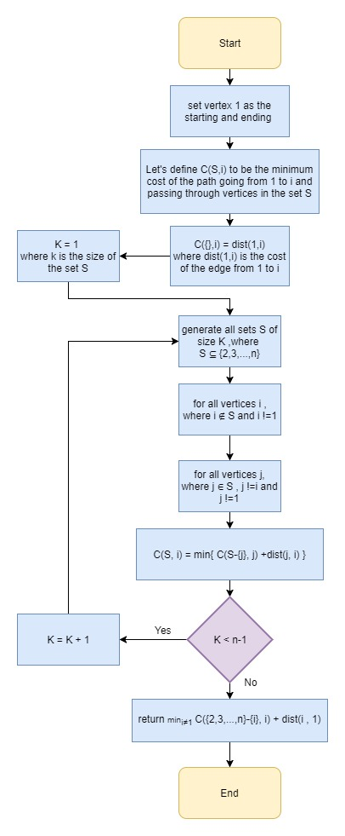
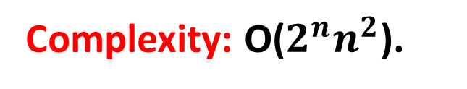
TSP Available Solutions cont.
1- Exact Approach:
2- Dynamic Programming (Held Karp Algorithm):
"Every sub-path of a path of minimum
distance is itself of minimum distance”.
Complexity: O($2^{n}n^{2}$).

Slide 10

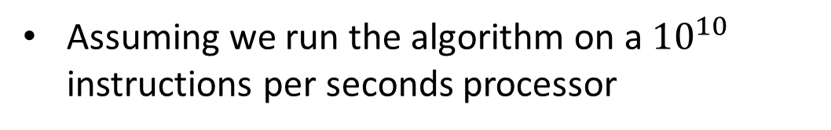
TSP Available Solutions (DP) cont.
Complexity: O($2^{n}n^{2}$).
Assuming we run the algorithm on a ${10}^{10}$ instructions per seconds processor
#Of Cities | Time
10 | 0.00001024 Seconds
20 | 0.04 Seconds
25 | 2 Seconds
30 | 1.6 Minutes
35 | 1.16 hours
40 | 2.03 Days
50 | 8.9 years !!
Feasible

Slide 11
Problem Significance cont.
TSP Available Solution
Exact
Heuristic
Meta Heuristic
Brute force
Dynamic Programming
Nearest Neighbor
Cheapest Link
Depth first tree tour
Genetic Algorithm

Slide 12
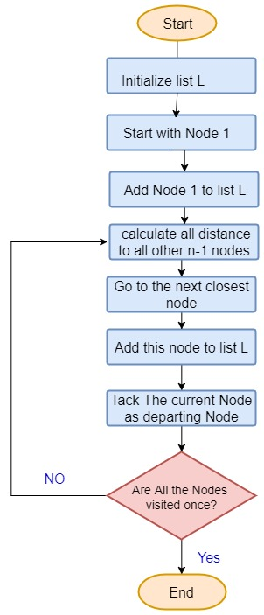

Problem Significance cont.
2-Heuristic Approach:
1- Nearest Neighbor Algorithm:
is an Algorithm that choose
the best choice that ‘reachable’
at current State .
$$n^{2}$$
Complexity: O( ).

Slide 13



Problem Significance cont.
A
Cost | Path
20 | AB
34 | BD
30 | BC
42 | CA
12 | CD
35 | DA
B
C
D

Slide 14
Problem Significance cont.
TSP Available Solution
Exact
Heuristic
Meta Heuristic
Brute force
Dynamic Programming
Nearest Neighbor
Cheapest Link
Depth first tree tour
Genetic Algorithm

Slide 15
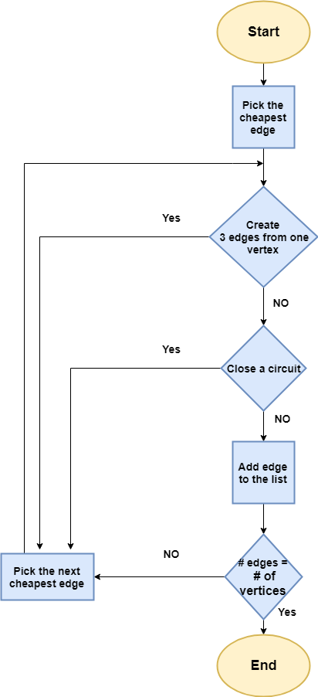
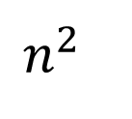
TSP Available Solutions cont.
2-Heuristic Approach:
2- Cheapest Link Algorithm:
O( )
Complexity:
$$n^{2}$$

Slide 16
A
Cost | Path
2 | AD
3 | BC
4 | CE
5 | BE
7 | AB
8 | CD
9 | BD
10 | AE
11 | DE
13 | AC
D
B
E
C

Slide 17
Problem Significance cont.
TSP Available Solution
Exact
Heuristic
Meta Heuristic
Brute force
Dynamic Programming
Nearest Neighbor
Cheapest Link
Depth first tree tour
Genetic Algorithm

Slide 18
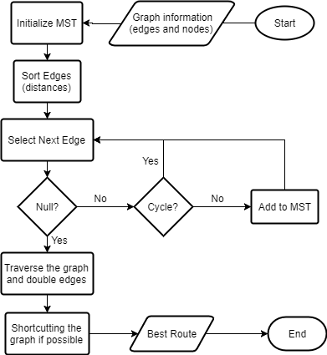
TSP Available Solutions cont.
2-Heuristic Approach:
3- Depth first tree tour Link :
Complexity: Θ(n log(n))

Slide 19
TSP Available Solutions cont.
A Minimum Spanning Tree Based Heuristic
Step 1: Construct a minimum spanning tree.
Step 2: Let the root be an arbitrary vertex.
Step 3: Double all arcs and Traverse all the vertices by depth-first search, record the sequence of vertices (both visited and unvisited).
Step 4: Use shortcut strategy to generate a feasible tour.

Slide 20
TSP Available Solutions cont.
Step 1: Construct a minimum spanning tree
3
2
2
3
2
2
3
MST could be solved in O(n log(n)).
which is also a Lower bound for TSP, W* ≤ L*.

Slide 21
TSP Available Solutions cont.
Step 2: Let the root be an arbitrary vertex
D
B
C
A
E

Slide 22
TSP Available Solutions cont.
Step 3: Double arcs then Traverse all the vertices
D
B
C
A
E
The sequence is A-B-C-D-C-E-C-B-A, the length of this tour is 2W*.

Slide 23
TSP Available Solutions cont.
Step 4: Use shortcut to generate the MST tour A-B-C-D-(C)-E-(C-B)-A
D
B
C
A
E
The MST tour is A-B-C-D-E-A, the length of this TSP tour is less or equal to 2W*.

Slide 24
TSP Available Solutions cont.
Worst-case Analysis
Let L^{MST} denotes the length of the tour generated by above strategy, then we have
L^{MST} ≤ 2W* ≤ 2L*
Where W* denotes the length of the minimum spanning tree.
And this bound is tight.

Slide 25
TSP Available Solutions cont.
Time Complexity
Sort Edges | Θ(E log(E)) | Θ(n log(n))
Find/union | Θ(log(V)) | Θ(log(n))
Overall find/union | Θ(E log(V)) | Θ(n log(n))
Overall (Kruskal) | Θ(E log(E) + E log(V)) | Θ(n log(n))
DFS | Θ(V) | Θ(n)
Eulerian path (Hierholzer's algorithm) | Θ(E) | Θ(n)
Overall DFTT | Θ(E log(E) + E log(V) + V + E) | Θ(n log(n))

Slide 26
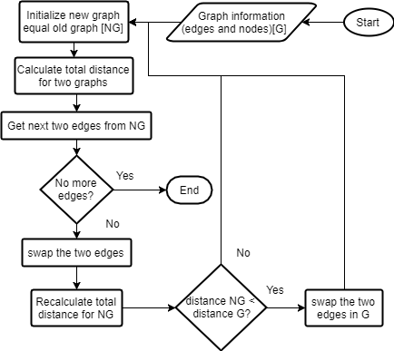
TSP Available Solutions cont.
2-Heuristic Approach:
3- 2-optimal :

Slide 27
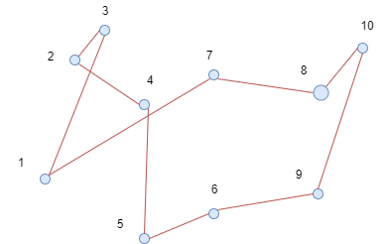
TSP Available Solutions cont.
Look for an improvement obtained by deleting two edges and adding two
edges.

Slide 28
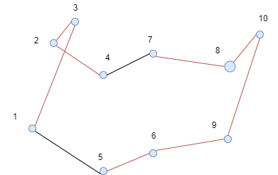
TSP Available Solutions cont.
Deleting arcs (4,7) and (5, 1) flips the subpath from node 7 to node 5.

Slide 29
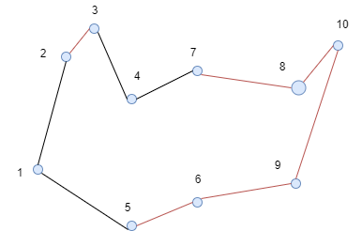
TSP Available Solutions cont.
Deleting arcs (1,3) and (2, 4) flips the subpath from 3 to 2.

Slide 30
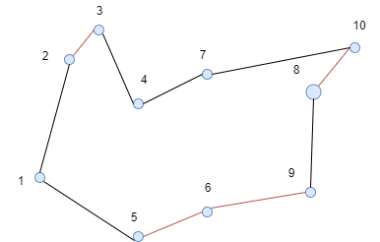
TSP Available Solutions cont.
Deleting arcs (7,8) and (10, 9) flips the subpath from 8 to 10.

Slide 31
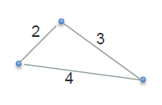
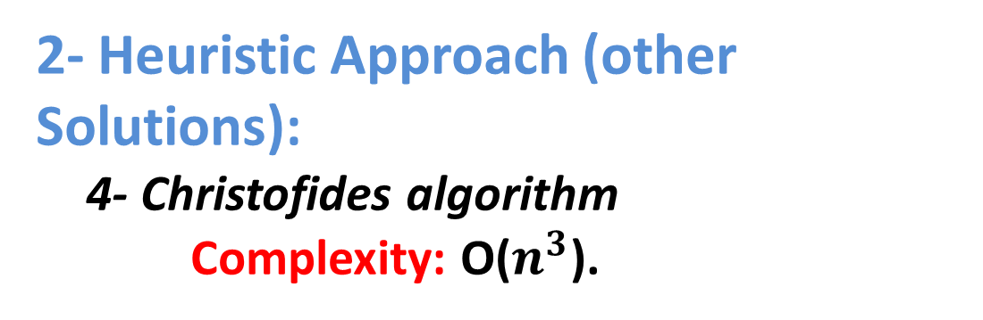
TSP Available Solutions cont.
2- Heuristic Approach (other Solutions):
4- Christofides algorithm
Complexity: O($n^{3}$).
It provides a very good heuristic solution, but unfortunately it is impractical because of the constraints it have.

Slide 32
Problem Significance cont.
TSP Available Solution
Exact
Heuristic
Meta Heuristic
Brute force
Dynamic Programming
Nearest Neighbor
Cheapest Link
Depth first tree tour
Genetic Algorithm

Slide 33
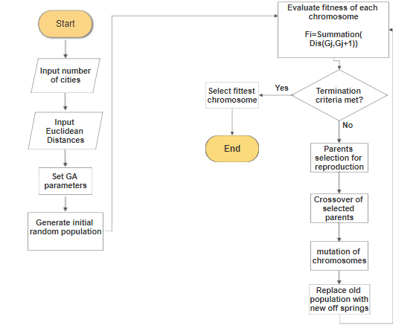
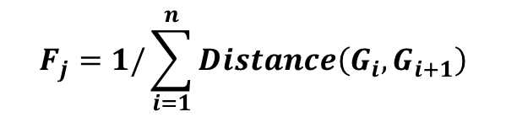
TSP Available Solutions cont.
3-Meta Heuristic :
1-Genatic Algo.
Sample Population:
A | C | B | D
C | B | D | A
Fitness Function:
$$F_{j}=1/\sum_{i=1}^{n}{Distance\left(G_{i},G_{i+1}\right)}$$
Complexity:
O(maxGeneration*population*
chromosomeSize)

Slide 34
TSP Solver Modules
TSP solver
Clustering
Module
Route Creation
Module

Slide 35
TSP solver
Clustering Module
Route Creation Module
TSP Solver Modules cont.
Clustering Module
Automation
e.g K-Means
Clustering By Region
Manual

Slide 36
TSP solver
Clustering Module
Route Creation Module
TSP Solver Modules cont.
If #of cities<=21 then
Run Exact Algorithm to get best route
Else
Run all heuristic and meta heuristic
algorithms and return the best route resulted
from all algorithms

Slide 37
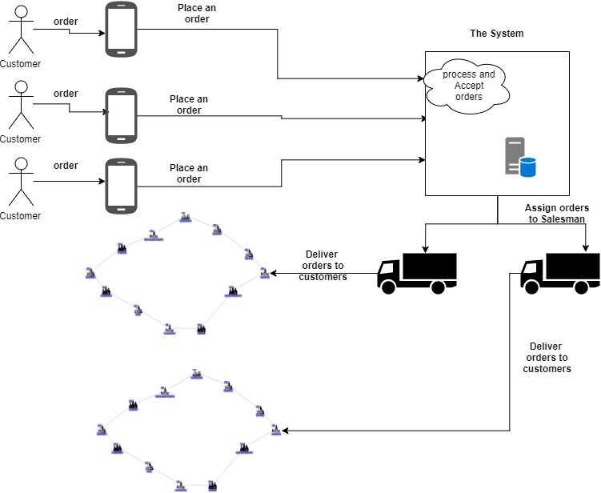
System Analysis and Design
System Architecture:

Slide 38

System Analysis and Design
Stakeholders:
A stakeholder can be internal or external.
System
Salesman
Admin
Customer
External
Internal

Slide 39

System Analysis and Design
Stakeholders (Customer) :
Customer (also known
As a client ,buyer, or
Purchaser) .
External-Operational
Stakeholders ,who
makes the order.
This stakeholders interact with system via (Android Application)

Slide 40

System Analysis and Design
Stakeholders (Admin) :
Admin(also known
As a admin officer) .
Internal-Operational
Stakeholders , who
receives the orders and
assigns them to the
Salesmen.
This stakeholders interact with system via (web application).

Slide 41
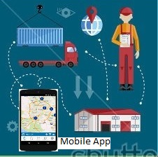
System Analysis and Design
Stakeholders (Salesman) :
Salesman (also known
As a delivery man ).
Internal-Operational
Stakeholders
how distributes the orders
them to the customers.
This stakeholders interact
with system via (Android Application)

Slide 42
System Design and Analysis cont.
Functional
Requirement
Customer
Make Order
Update Order
Admin
Reject Requests
Run TSP Solver
Cancel Order
Add Salesman
Salesman
View Path
Confirm Request Delivery
View Requests
Check Availability

Slide 43
System Design and Analysis cont.
Non-Functional Requirements:
Security:
authorization
Avoid SQL injection
Usability:
Friendly User Interface
Performance:
Login
Peak load
Reliability:
The system has to be reliable.
Availability:
The system will be available most of the time .

Slide 44
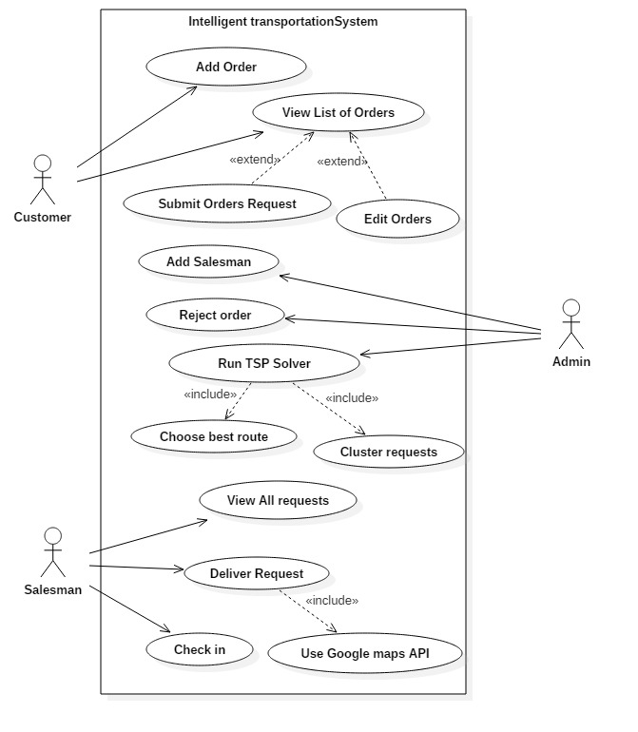
System Design and Analysis cont.
Use Case Diagram:

Slide 45
System Design and Analysis cont.
Use Case Tables
1- Customer:
Use Case ID: | 1_Customer
Use Case Name: | Add an Order
Actors: | Customer
Pre-conditions: | 1- Logged in as Customer
Post-conditions: | 1-An Order is added to the List of Customers’ Orders
Flow of events: | User Action | System Action
 | 1- User clicks on view items to order
 |  | 2-System displays the list of available items to be order
 | 3- Customer selects an item and can choose its quantity or leave it (default 1)
 | 4- The customer then clicks on order button to add the order to the orders list
 |  | 5- System receive the order and its quantity, and then save it in the order list
Exceptions: | User Action | System Action
 | 1-The customer selects a negative, zero quantity or choose a very large number
 |  | 2-The system print that the quantity selected is not available

Slide 46
System Design and Analysis cont.
Use Case Tables
2- Admin:
Use Case ID: | 1_Admin
Use Case Name: | Reject Requests
Actors: | Admin
Pre-conditions: | 1- Logged in as Admin.
Post-conditions: | 1-Reject Requests that are greater than capacity
Flow of events: | User Action | System Action
 |  | 1-System retrieves all requests that arrive from customers.
 | 2-Admin rejects all requests that are greater than the available capacity.
 |  | 3-System delete all request that are greater than the available capacity
 |  | 4-System shows the new list of requests.

Slide 47
System Design and Analysis cont.
Use Case Tables
3- Salesman:
Use Case ID: | 1_Salesman
Use Case Name: | Deliver Request
Actors: | Salesman
Pre-conditions: | 1- Logged in as Salesman .
Post-conditions: | 1-Finishing request fulfillment
Flow of events: | User Action | System Action
 | 1- Salesman asks the directions for the coming request.
 |  | 2-System displays the directions by using Google Map API.
 | 3- Salesman reaches to the desired customer location and delivers his request.
 | 4- Salesman checks on the request as delivered request.
 |  | 5- System returns the next request location.

Slide 48
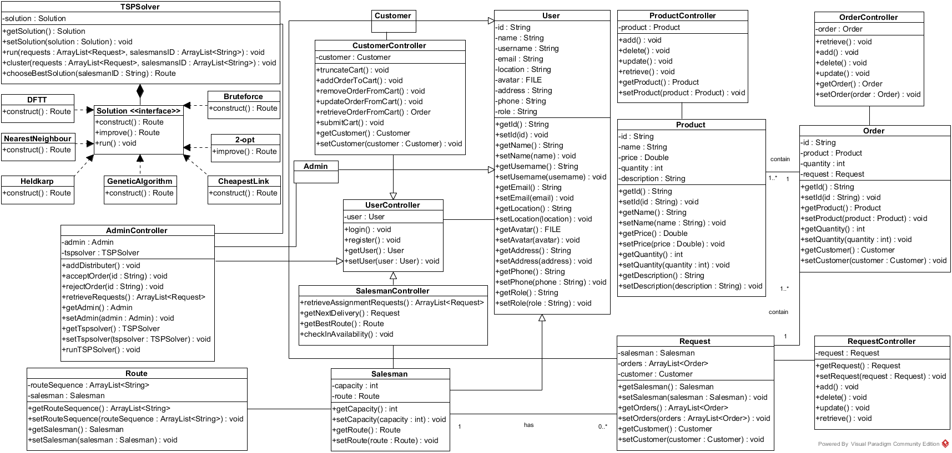
System Design and Analysis cont.
Class Diagram

Slide 49
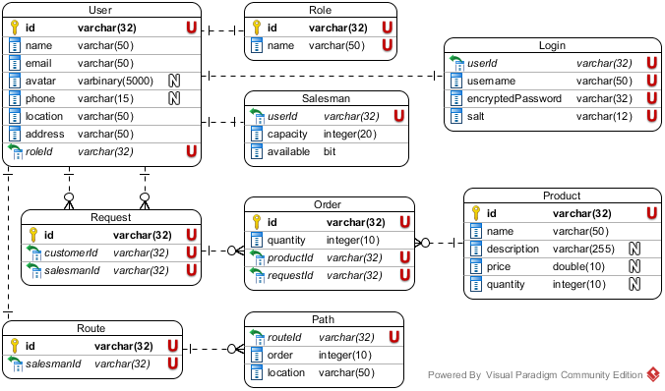
System Design and Analysis cont.
ERD Diagram

Slide 50
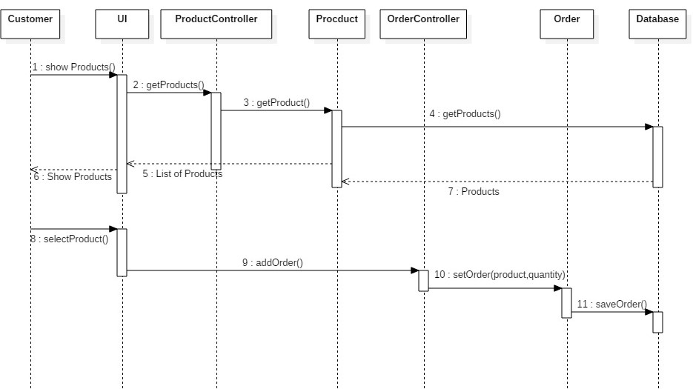
System Design and Analysis cont.
Sequence Diagram
1-Add Order:

Slide 51
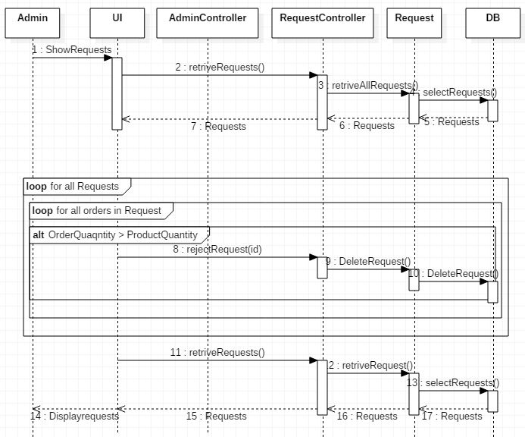
System Design and Analysis cont.
Sequence Diagram
2- Reject Requests:

Slide 52
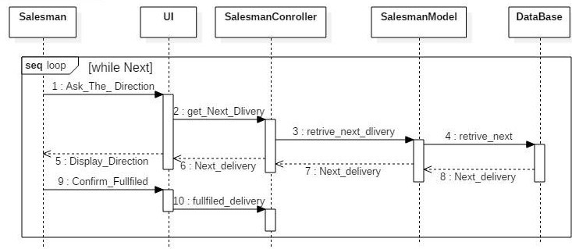
System Design and Analysis cont.
Sequence Diagram
5-Deliver orders:

Slide 53
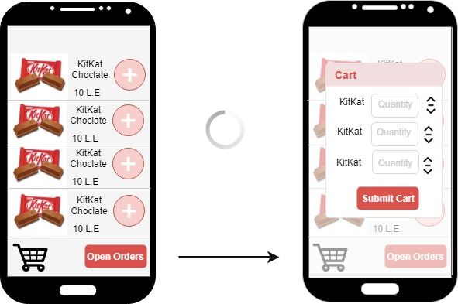
Prototype
Customer Interface

Slide 54
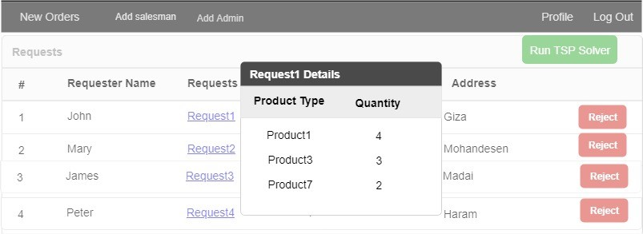
Prototype
Admin Interface

Slide 55
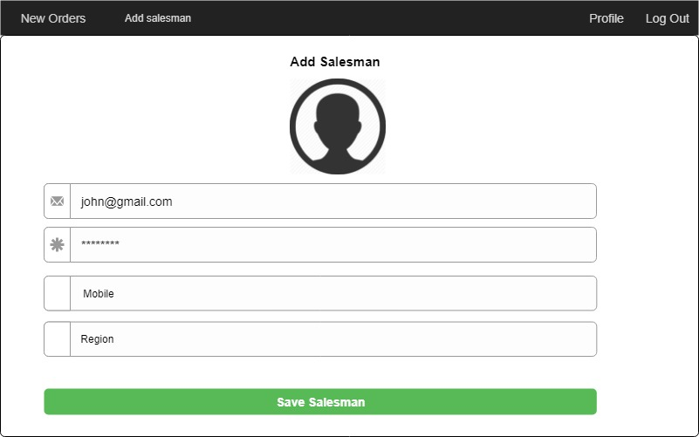
Prototype
Admin Interface

Slide 56
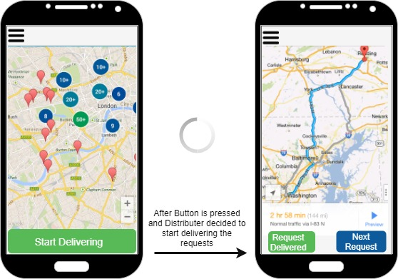
Prototype
Salesman Interface

Slide 57
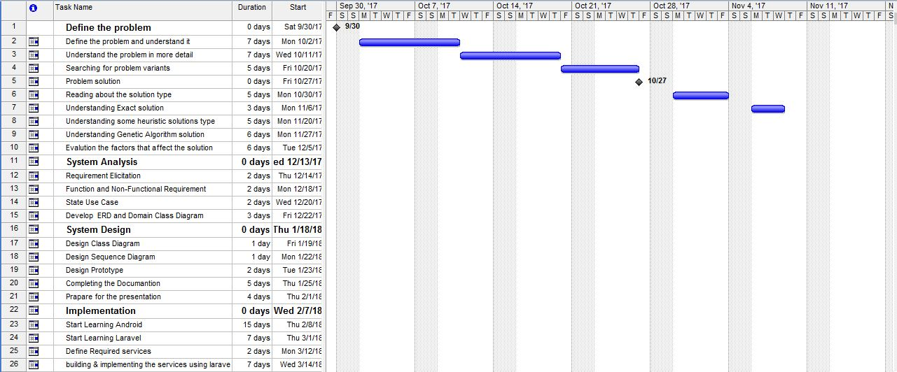
Gantt Chart

Slide 58
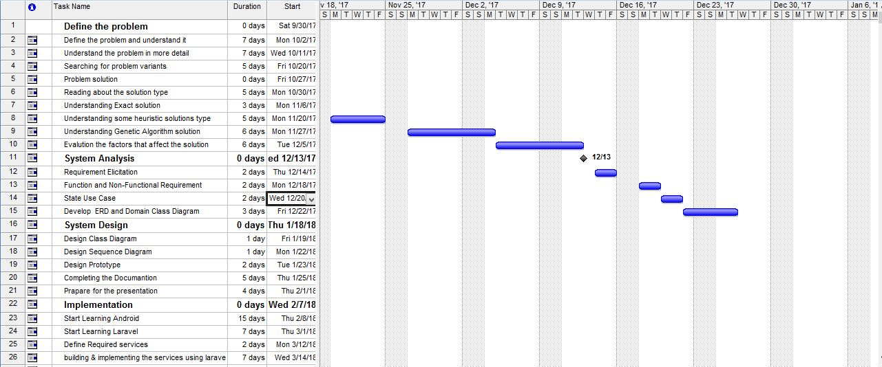
Gantt Chart cont.

Slide 59
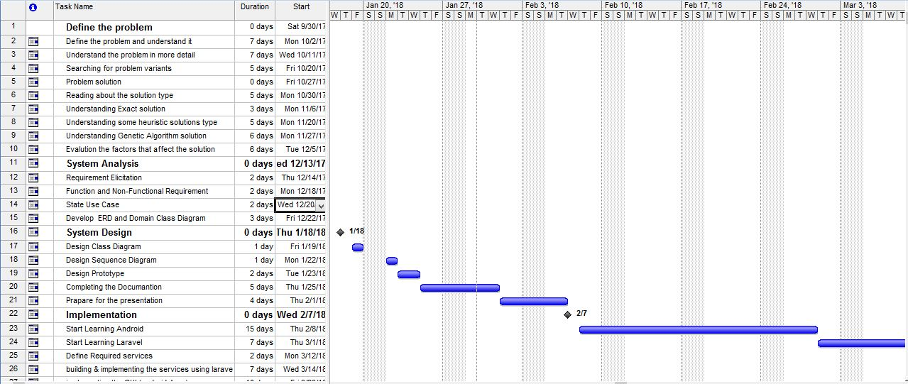
Gantt Chart cont.

Slide 60
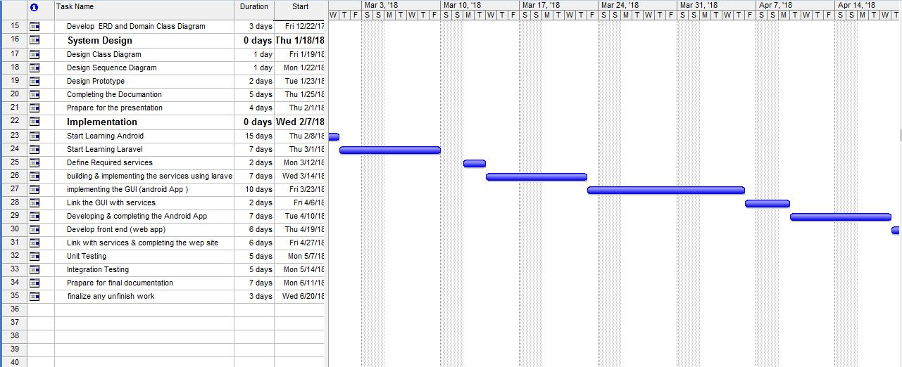
Gantt Chart cont.

Slide 61
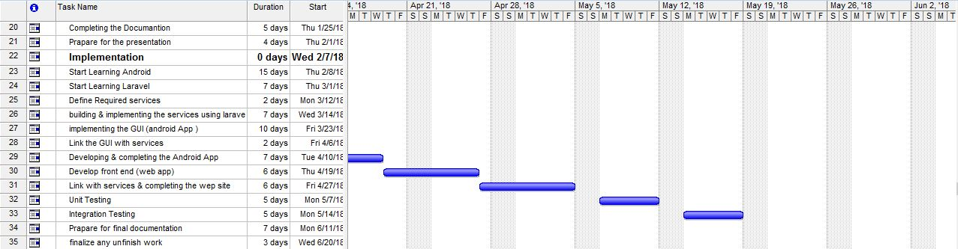
Gantt Chart cont.

Slide 62
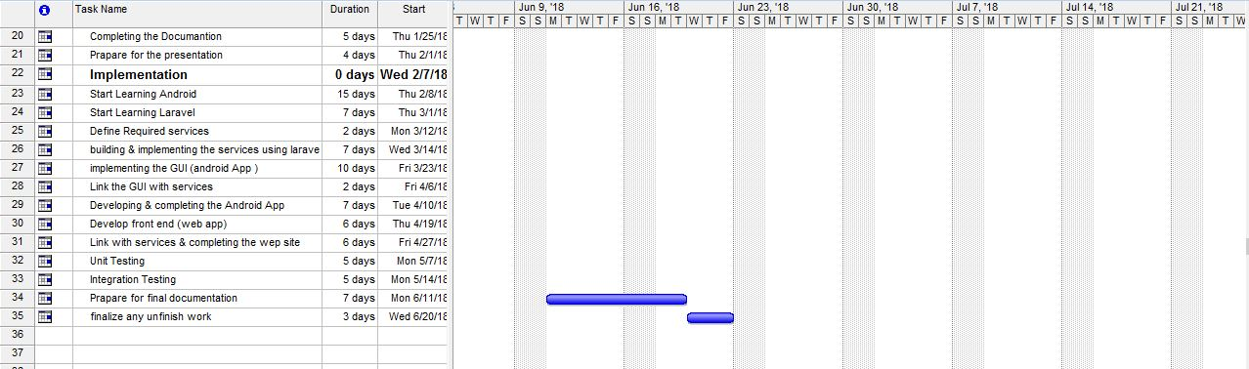
Gantt Chart cont.

Slide 63
Conclusion
We can see now that this project will help a lot by saving money, time and efforts for the companies that have a transportation system.
In this project we considered one of the factors that is the distance between different requests which is constant factor.

Slide 64
Future Work
Take into consideration online TSP variant.
There are other factors that taking them into consideration will make better results like traveling time, traffic , taking these factors well help in making the solution more precise.
Take in consideration the capacity of trucks.

