Slide 1


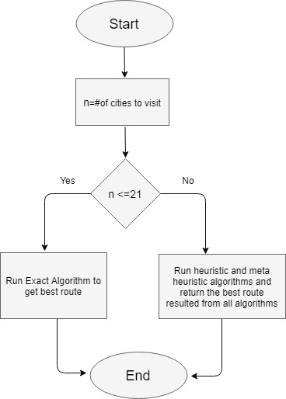




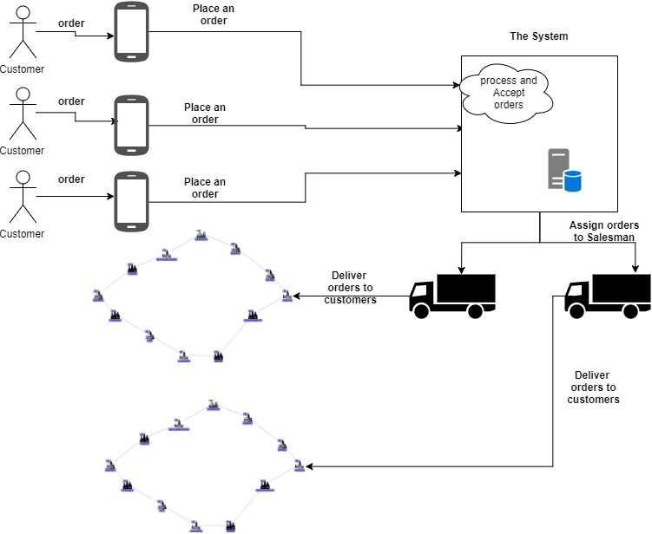
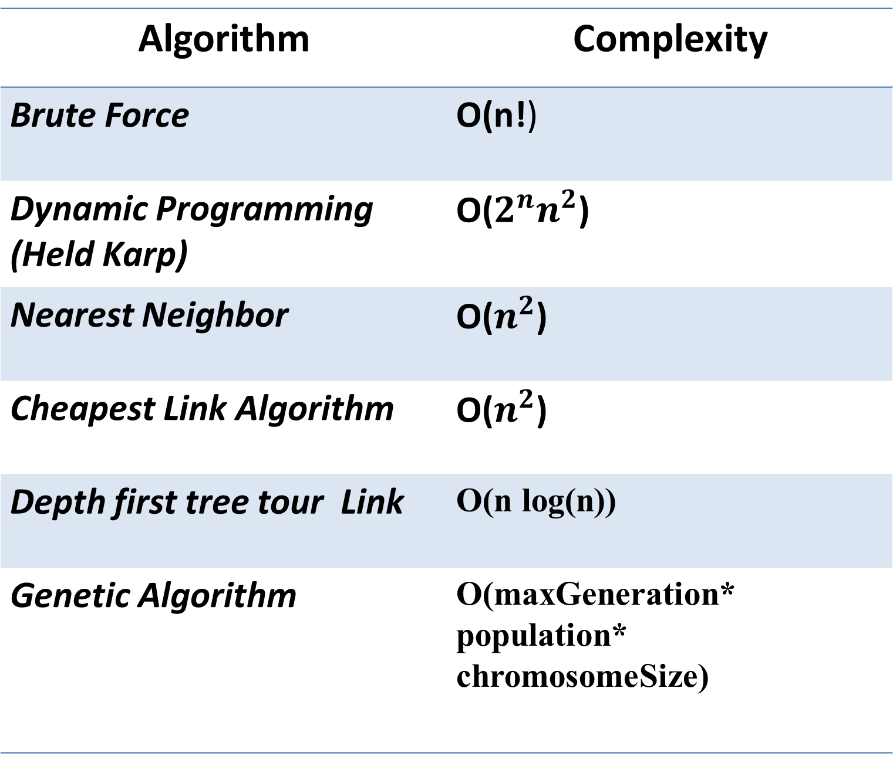
An Intelligent Transportation System
Supervisor: Dr. Emad
Omar, Hamed, Ziad, Asseel and Mahmoud
Abstract
Methods
Methodology | Technologies | Tools
We’ve used Waterfall methodology the sequential phases are: | Java Spring Boot Framework for building web services. | Eclipse Spring Tool Suite
Requirement Gathering: understanding the problem | Java for Android development | Eclipse Spring Tool Suite
System Design: specifying system stakeholders and their functionality | Hibernate Framework ( ORM ) | Postman
Implementation: in this phase we divided the system to modules then we started coding and at the end of this phase we integrated the modules . | MySQL. | MySQL work bench
Verification: applying unit testing for services and system testing. | Typescript Angular 5. | Google maps Google maps API
Our project idea is to get best or approximate solutions for Travelling Salesman problem, this problem appears in Companies that have transportation system and want to minimize the cost of delivering the orders, and this is done by providing the correct order in which Salesmen should deliver orders.
Primarily Design
Introduction
The traveling salesman problem is a common NP hard problem and consists of a salesman and a set of cities. The salesman has to visit each one of the
cities starting from a certain one (e.g. the hometown) and returning to the same city. The challenge of the problem is that the traveling salesman wants
to minimize the total length of the trip.
We will be using the following algorithms to solve TSP:
Algorithm | Complexity
Brute Force | O(n!)
Dynamic Programming (Held Karp) | O($2^{n}n^{2}$)
Nearest Neighbor | O($n^{2}$)
Cheapest Link Algorithm | O($n^{2}$)
Depth first tree tour Link | O(n log(n))
Genetic Algorithm | O(maxGeneration* population* chromosomeSize)
Stakeholders:
1) Admin: who receives the orders and assigns them to the Salesmen.
2) Salesman: who distributes the orders to customers.
3) Customer: who makes the order.
Conclusion
We can see now that this project will help a lot by saving money, time and efforts for the companies that have a transportation system especially the ones with large transportation systems, as the application will choose the path with the most minimum distance approximately instead of travelling longer distances, and this is done by using one of the mentioned algorithms. In this project we considered one of the factors that affect the path to choose which is the distance between different requests which is constant factor, there are other factors that taking them into consideration will make better results like traveling time, traffic, the speed limit and the types of the streets chosen whether they are highways, freeways or small streets, taking all these factors will help in making the idea more effective, but it will make the
project more complex ,so we can consider them later on as a better upgrade to the project for latter versions.

