Slide 1
Analysis of Digital Security Threats in Healthcare
Mahmoud Saad, Rylie Schroers, Jamal Allan, Sahil Shah

Slide 2
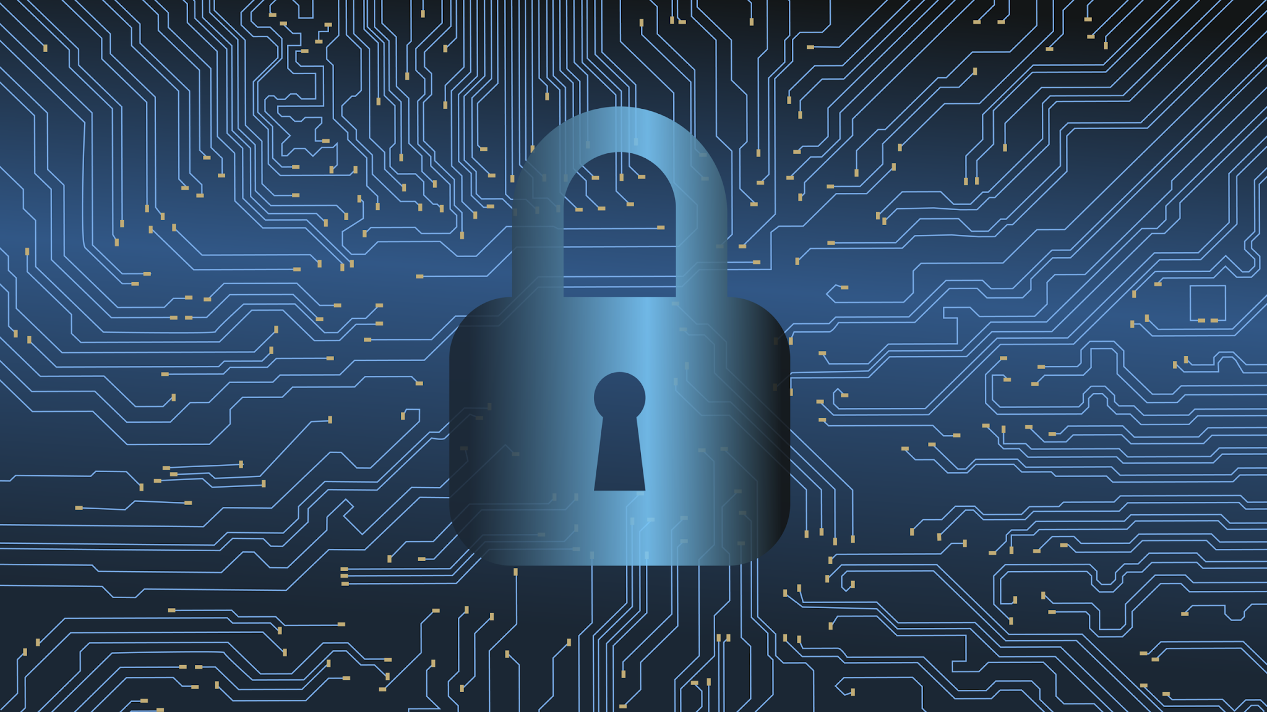
Addressing Digital Security Threats in Healthcare
Healthcare organizations are increasingly targeted by cyberattacks due to sensitive patient data and critical operational reliance.
Cyber threats are evolving, with tactics like ransomware, phishing, and supply chain attacks causing significant harm.
This presentation will cover:
The current threat landscape in healthcare.
Methods attackers use to compromise systems.
Strategies to strengthen digital defenses.
The importance of partnerships and compliance.

Slide 3
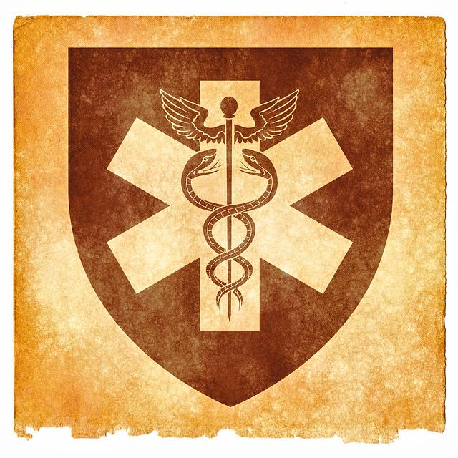
Why Healthcare is a Prime Target
Sensitive Data: Patient records (medical histories, SSNs, financial data) are highly valuable.
Operational Reliance: Hospitals require continuous operations; disruptions directly impact patient care.
Expanding Attack Surface: Digital transformation and reliance on IoT devices increase vulnerabilities.

Slide 4
Major Cyber Threats in Healthcare
Malware and Ransomware Attacks:
Encrypt critical systems, demanding ransom to restore access.
Rising sharply, causing operational downtime and financial loss.
Data Breaches:
Steal sensitive patient data for black market resale.
Impacts include financial damage and loss of trust.
Phishing Attacks:
Email-based schemes to compromise staff credentials.
Entry point for other cyberattacks.
Supply Chain Attacks:
Exploiting vulnerabilities in third-party vendors.
IoT and Medical Device Vulnerabilities:
Connected devices (e.g., pacemakers) can be exploited to harm patients or steal data.

Slide 5
Various Modes of Cyberattacks
Malware and Ransomware - Delivered through methods such as phishing emails or infected software updates. Can lead to data loss, operational downtime, and financial loss.
Phishing and Social Engineering - Attackers impersonate trusted entities to trick employees into divulging important information such as login credentials. Which can lead to an unauthorized party gaining access to important systems.
Distributed Denial of Service - Overloads networks with traffic, leading to outages. Which can lead to a patient’s care being interrupted and critical operations being delayed.

Slide 6
Various Modes of Cyberattacks Cont.
Insider Threats - Malicious or negligent employees may lead to systems being compromised, either on purpose or accidentally.
Advanced Persistent Threats - Long-term, often unnoticed, targeted attacks that focus on stealing valuable data.
Both of these can lead to sensitive patient data being stolen.

Slide 7
The Role Of Cybersecurity Partnership
Collaborate with government agencies
Work with agencies like the Cybersecurity and Infrastructure Security Agency (CISA)
Utilize government resources and expertise
Leverage available government resources, such as threat intelligence and best practices.
Stay informed about national security updates and protocols
Keep up-to-date with the latest security updates and protocols issued by relevant agencies.

Slide 8
Engage with Cybersecurity Firms
Hire firms for penetration testing
Select Reputable Firms: Choose firms with proven track records and industry certifications such as absolute
Regular Testing: Schedule penetration tests periodically to identify and address new vulnerabilities.
Detailed Reports: Ensure the testing firm provides detailed reports with actionable recommendations.
Conduct comprehensive risk assessments
Evaluate Threats and Vulnerabilities: Assess potential threats and vulnerabilities to these assets.
Mitigation Plans: Develop and implement plans to mitigate identified risks.
Risk Scoring: Assign risk scores to prioritize mitigation efforts.
Implement recommendations to fortify defenses
Prioritize Actions: Focus on the most critical vulnerabilities first.
Allocate Resources: Ensure adequate resources are allocated to implement recommendations.
Monitor Progress: Track the implementation process and adjust as needed.

Slide 9
Participate in Threat Intelligence Sharing
Join intelligence sharing initiatives
Stay Ahead of Emerging Threats: Participate in intelligence-sharing initiatives to stay informed about new and emerging threats.
Collaborate with Other Organizations: Work with other hospitals and healthcare organizations to share knowledge and strategies.
Stay ahead of emerging threats
Regular Briefings: Attend regular briefings and seminars on national security updates.
Subscribe to Alerts: Subscribe to government and industry alert services for real-time updates.
Policy Reviews: Regularly review and update your policies to align with national security protocols.
Collaborate with other organizations to share knowledge and strategies

Slide 10
Healthcare System Preparation
Strengthen technology solutions
Train staff for cyber attacks
Understand how to respond and recovery for incidents
Managing third-party vendor

Slide 11
Training Staff Awareness
Regular training to recognize attempts and threats
Culture the vigilance of cybersecurity professionals
Developing and testing response planes to bandele efficiently
Maintain offline backups

Slide 12
Management and Regulatory Compliances
The security practices asses third party vendors
Contracts supply cybersecurity
Regular audits to ensure regulatory compliances

Slide 13
References
National Institute of Standards and Technology (NIST)
Framework for Improving Critical Infrastructure Cybersecurity (Version 1.1).
URL: https://www.nist.gov
Health and Human Services (HHS): Cybersecurity Guidance
Guidelines for healthcare organizations on HIPAA compliance and cybersecurity.
URL: https://www.hhs.gov/hipaa
Cybersecurity and Infrastructure Security Agency (CISA)
Alerts and resources on healthcare cyber threats.
URL: https://www.cisa.gov
IBM X-Force Threat Intelligence Report
Annual insights into cybersecurity threats, including healthcare-specific findings.
URL: https://www.ibm.com/security/services/threat-intelligence

Slide 14
Question?

