Slide 1
By: Mahmoud Elgendy
PACKETLENS NIPS
Next-Generation Network Intrusion Prevention
github

Slide 2

THE PROBLEM & IMPACT
LEGACY SIGNATURES ARE FAILING
Traditional IDS/IPS rely on static signatures (e.g., Snort). They cannot detect zero-day attacks, polymorphic malware, or slow-rate application layer DoS without exact matches.
THE PACKETLENS IMPACT
We transition from Signature-based to Behavioral AI. By analyzing flow statistics, PacketLens detects the intent of the traffic, catching 33 distinct attack classes.
100,000+ PPS:
Line-rate processing without dropping packets.
O(1) Memory:
Online variance calculation prevents RAM explosion during DDoS.
Actionable UI:
SOC analysts see prioritized incident streams, not just raw logs.

Slide 3
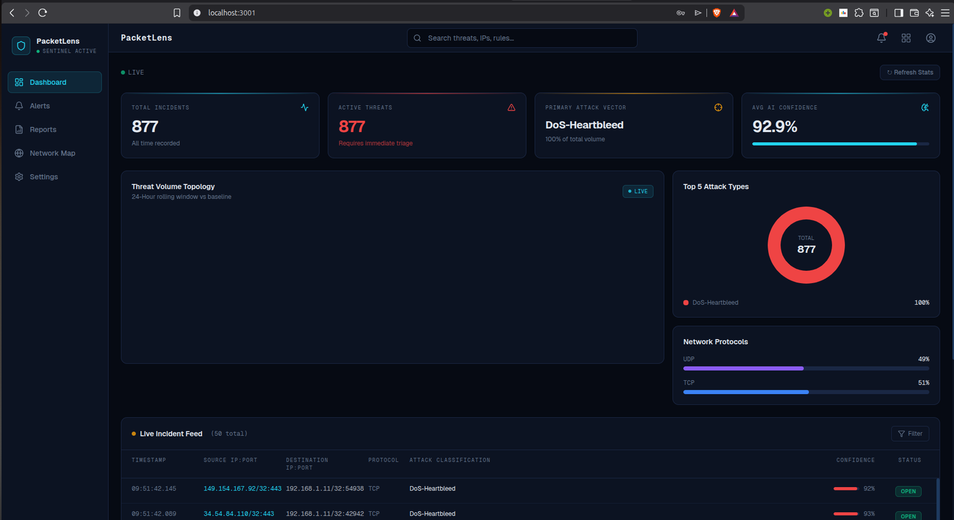
SOC DASHBOARD EXPERIENCE
Real-time incident streaming via Server-Sent Events (SSE).
Virtualization renders 10k+ rows instantly without lag.
Dynamic charts using Recharts for traffic telemetry.
Protected by Next.js Edge Middleware and JWT auth.

Slide 4
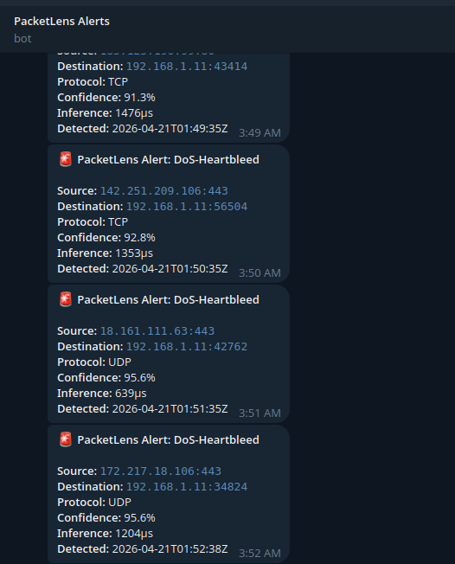
AUTOMATED THREAT ALERTING
Critical events bypass the dashboard and go straight to SecOps via Telegram.
Buffered via a non-blocking Go channel (cap: 10,000) to survive DDoS floods without blocking the capture thread.
Contains actionable context: Attacker IP, Target, Confidence, and Attack Type.

Slide 5
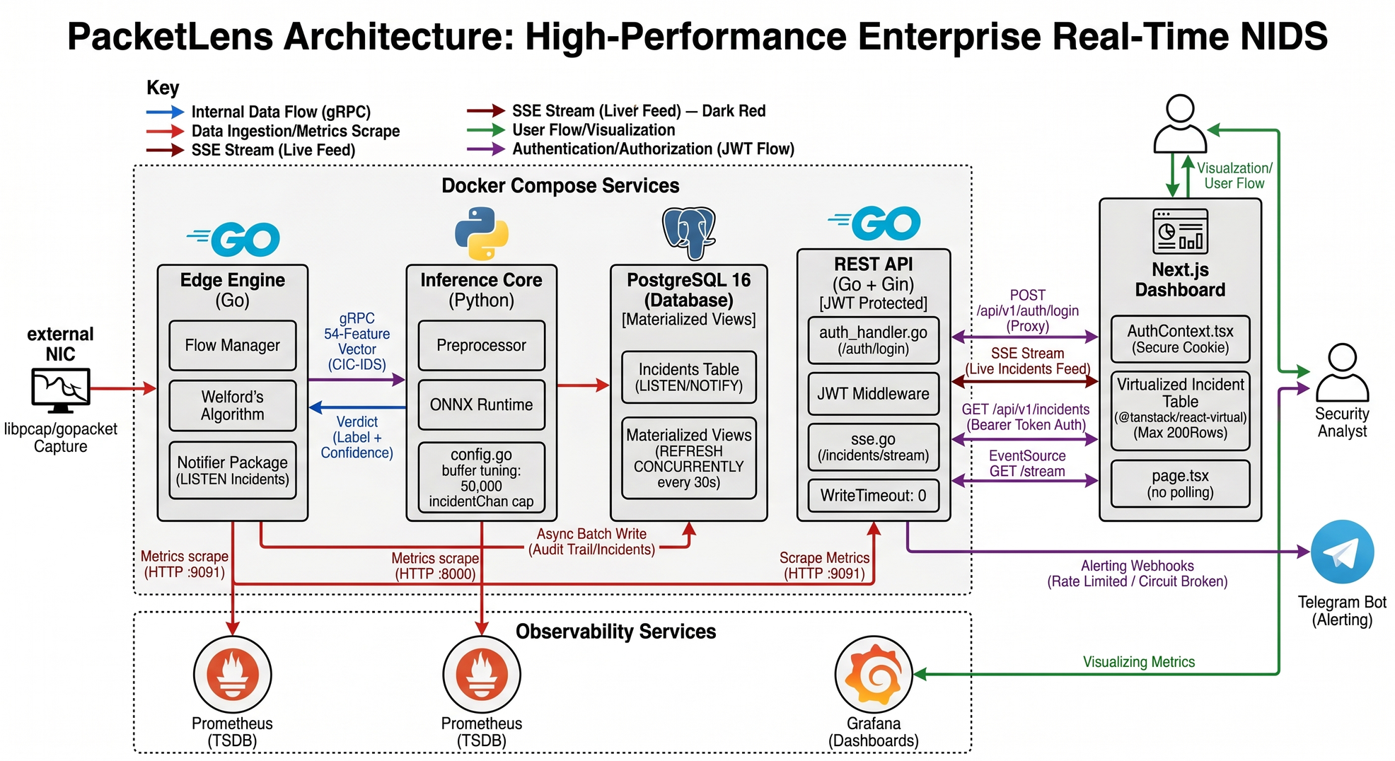
MICROSERVICES ARCHITECTURE

Slide 6
FULL PREPROCESSING PIPELINE
Step 1 — Load & Basic Cleaning
Standardize column names: strip whitespace, lowercase, replace spaces with _
Drop identity/metadata columns that would leak info:
flow_id, source_ip, src_ip, source_port destination_ip, dst_ip, timestamp, date
Replace ±inf → NaN, then dropna() to remove rows with infinite or missing values

Slide 7
FULL PREPROCESSING PIPELINE
Step 2 — Label Encoding
Maps every attack class string (e.g., "DDoS", "PortScan", "BENIGN") → a stable integer
Drops the original string label column — only label_encoded remains
Saves label_mapping.json

Slide 8
FULL PREPROCESSING PIPELINE
Step 3 — Feature Engineering
Remove physically impossible negative values
Remove zero-variance columns (original notebook only)
Columns with nunique() <= 1 carry no information — dropped.
Drop known redundant / highly correlated columns
Save feature_map.json (original notebook, Cell 5)

Slide 9
FULL PREPROCESSING PIPELINE
Step 4 — Log-Transform
18 features that follow Power-Law (Pareto) distributions get log1p applied.
Why: These features span 6+ orders of magnitude. StandardScaler on raw values compresses 99% of normal traffic to near-zero. log1p(x) = ln(1+x) brings the range from [0, 1e6] down to [0, ~14], making the distribution log-normal and suitable for IQR-based scaling.

Slide 10
FULL PREPROCESSING PIPELINE
Step 5 — Outlier Clipping
Why: DDoS attacks produce extreme outliers (e.g., 1e6 packets/s) that dominate scaler statistics. Without clipping, gradient magnitudes vary by 6 orders of magnitude → training instability.
Bounds are computed only from training data and applied to test — no data leakage.

Slide 11
FULL PREPROCESSING PIPELINE
Step 6 — Class Weights
Formula: w_c = n_samples / (n_classes × n_samples_c)
Saved as class_weights.json: { "0": 0.64, "1": 4.2, ... }
Why: With 78% Benign traffic, a naive model achieves 78% accuracy by predicting "Benign" for everything — useless for a NIDS. Balanced weights force each class to contribute equally to the loss, making the model learn rare attack patterns.

Slide 12
FULL MODEL TRAINING PIPELINE
Step 1 — Compute Per-Sample Weights
Why this step exists: class_weights.json stores one weight per class (e.g., class 20 → weight 23679). But XGBoost's sample_weight argument needs one weight per row of training data.
Without this, extremely rare classes (weight > 1000) can cause gradient explosion — the loss for a handful of samples overwhelms everything else. Capping at 1000 keeps training stable while still heavily emphasizing rare attacks.
Why not scale_pos_weight? That XGBoost parameter only works for binary classification (one positive class vs. one negative class). With 33 attack types, sample_weight is the only correct approach.

Slide 13
FULL MODEL TRAINING PIPELINE
Step 2 — Temporal Validation Split (for Early Stopping)
Why temporal (not random)?
The data comes from a time-ordered capture. Using the last 10% as validation simulates what happens in production — the model trains on earlier traffic and is validated on later traffic. This gives a more realistic early stopping signal than a randomly shuffled validation set.
Both X_train and X_val slices also carry their sample_weights — w_train and w_val — so the weighted loss is consistent across both.

Slide 14
FULL MODEL TRAINING PIPELINE
Step 3 — Train XGBoost (Native API)
Why the Native API instead of the sklearn wrapper?
The sklearn wrapper (XGBClassifier) has strict label validation that fails when a temporal validation split drops label classes (e.g., if a rare attack appears in X_train but not in X_val). The native xgb.train() API handles this cleanly.
Early stopping logic
If the validation mlogloss does not improve for 15 consecutive boosting rounds, training stops and the best iteration is retained. This model stopped at round 207, saving ~293 unnecessary trees.

Slide 15
FULL MODEL TRAINING PIPELINE
Step 4 — Evaluate on Temporal Holdout
Why Macro F1 is the primary metric for a NIDS:
If the model perfectly classifies Benign and DDoS (the two big classes) but misses SQL Injection entirely, Weighted F1 stays high (0.98) but Macro F1 drops to ~0.64. For a security system, a missed attack class is a critical failure — Macro F1 exposes this.

Slide 16
FULL MODEL TRAINING PIPELINE
Step 5 — Save Native Model (Backup)
Saves the XGBoost Booster in XGBoost JSON format (not pickle). This is human-readable, version-stable,
and can be loaded by any XGBoost version ≥ 1.0.
File size: 38.8 MB (38 MB for 207 trees × 8 depth levels)
This is a backup/debug format — production uses ONNX.

Slide 17
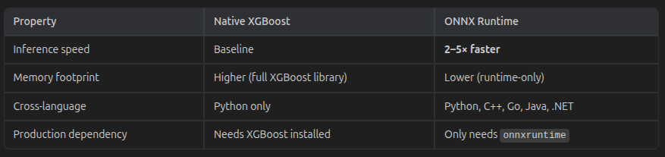
FULL MODEL TRAINING PIPELINE
Step 6 — Export to ONNX
File size: 19.6 MB (roughly half the JSON format, due to binary encoding)
Why ONNX?

Slide 18
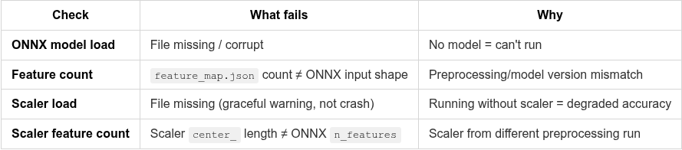
INFERENCE ENGINE — STARTUP VALIDATION
When the engine initializes, it runs 4 validation checks before accepting any traffic:

Slide 19
GRPC SERVER ARCHITECTURE
The server.py wraps the InferenceEngine in an async gRPC service with bidirectional streaming:
Go Sniffer Python gRPC Server
│ │
│── stream FeatureVector ──────────► │ async for request in stream:
│ │ features = np.array(request.features)
│ │ label, conf, time = await to_thread(engine.predict, features)
│ ◄───────── stream Verdict ─────────│ yield Verdict(label=label, confidence=conf)
│ │

Slide 20
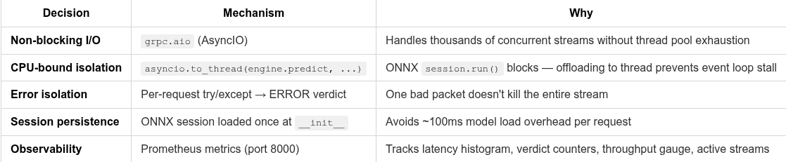
KEY ARCHITECTURAL DECISIONS:

Slide 21
DOCKER COMPOSE STACK
All 7 services use network_mode: host.
This means every container shares the host's network namespace — no Docker bridge, no NAT, no DNS resolution between containers. All services talk via localhost.
Why host mode?
Sniffer needs raw socket access to the physical NIC for libpcap. Bridge mode would isolate it from real traffic.
Zero-config inter-service communication — INFERENCE_ADDR=localhost:50051, no service discovery needed.
Prometheus scraping works without container-to-container DNS — just localhost:8000, localhost:9091.
The trade-off: port conflicts with host services. All ports are configurable via .env.

Slide 22
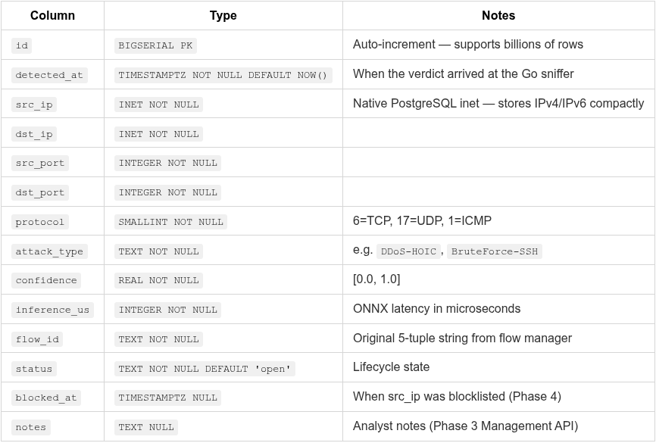
DATABASE SCHEMA
The only table. Every non-Benign verdict above the confidence threshold is persisted here via pgx.CopyFrom.

Slide 23
THANK
YOU
Secure Your Digital Life Today

