Slide 1
MENAT INDUSTRY AI ACCELERATOR
ShopSphere
Retail Personalization Engine — Data & AI on AWS
From clickstream to an agentic, bilingual shopping assistant.
Fictional retailer · synthetic data · me-central-1 (UAE)-ready.

Slide 2
Why personalization, why now
The shift to conversational, AI-guided shopping is accelerating. Shoppers no longer have an attention problem — they have a relevance expectation.
The retailers who break through deliver experiences tailored to each customer, surfacing needs shoppers didn't even know they had.
~4,700%
+31%
YoY growth in AI-platform retail traffic
higher conversion from AI-sourced shoppers
~35%
$240-390B
of Amazon sales credited to recommendations
GenAI value for retail (McKinsey)

Slide 3
Grounded in Amazon's 2026 retail breakthroughs
Agentic Shopping Assistant on AWS
Rufus — ~$12B incremental
Long-term memory, multimodal photo search, voice-to-voice (Nova Sonic), cart awareness — shipped Sept 2026.
Shoppers ~60% more likely to buy in session. Reasoning-based discovery at Amazon scale.
Mapped to ShopSphere
Runs in your account
Our agent mirrors these: memory, semantic search, bilingual guidance, grounded recommendations.
Retailers own the code; customer data never leaves their AWS account; brand voice preserved.

Slide 4
The 5 pillars of modern personalization
Coresight Research · the demo maps one component to each pillar
1
2
3
4
5
Unified Customer
Intelligence
Next-Best-Action
Hyper-Personalized
Content
Real-Time
Orchestration
Continuous
Relationship Mgmt
Merge CRM, web, in-store, loyalty into one profile
Optimal offer, channel and timing
GenAI creative + recommendations at machine speed
Agents respond to behavior, location, inventory
Adapt as customer needs and life stages evolve

Slide 5
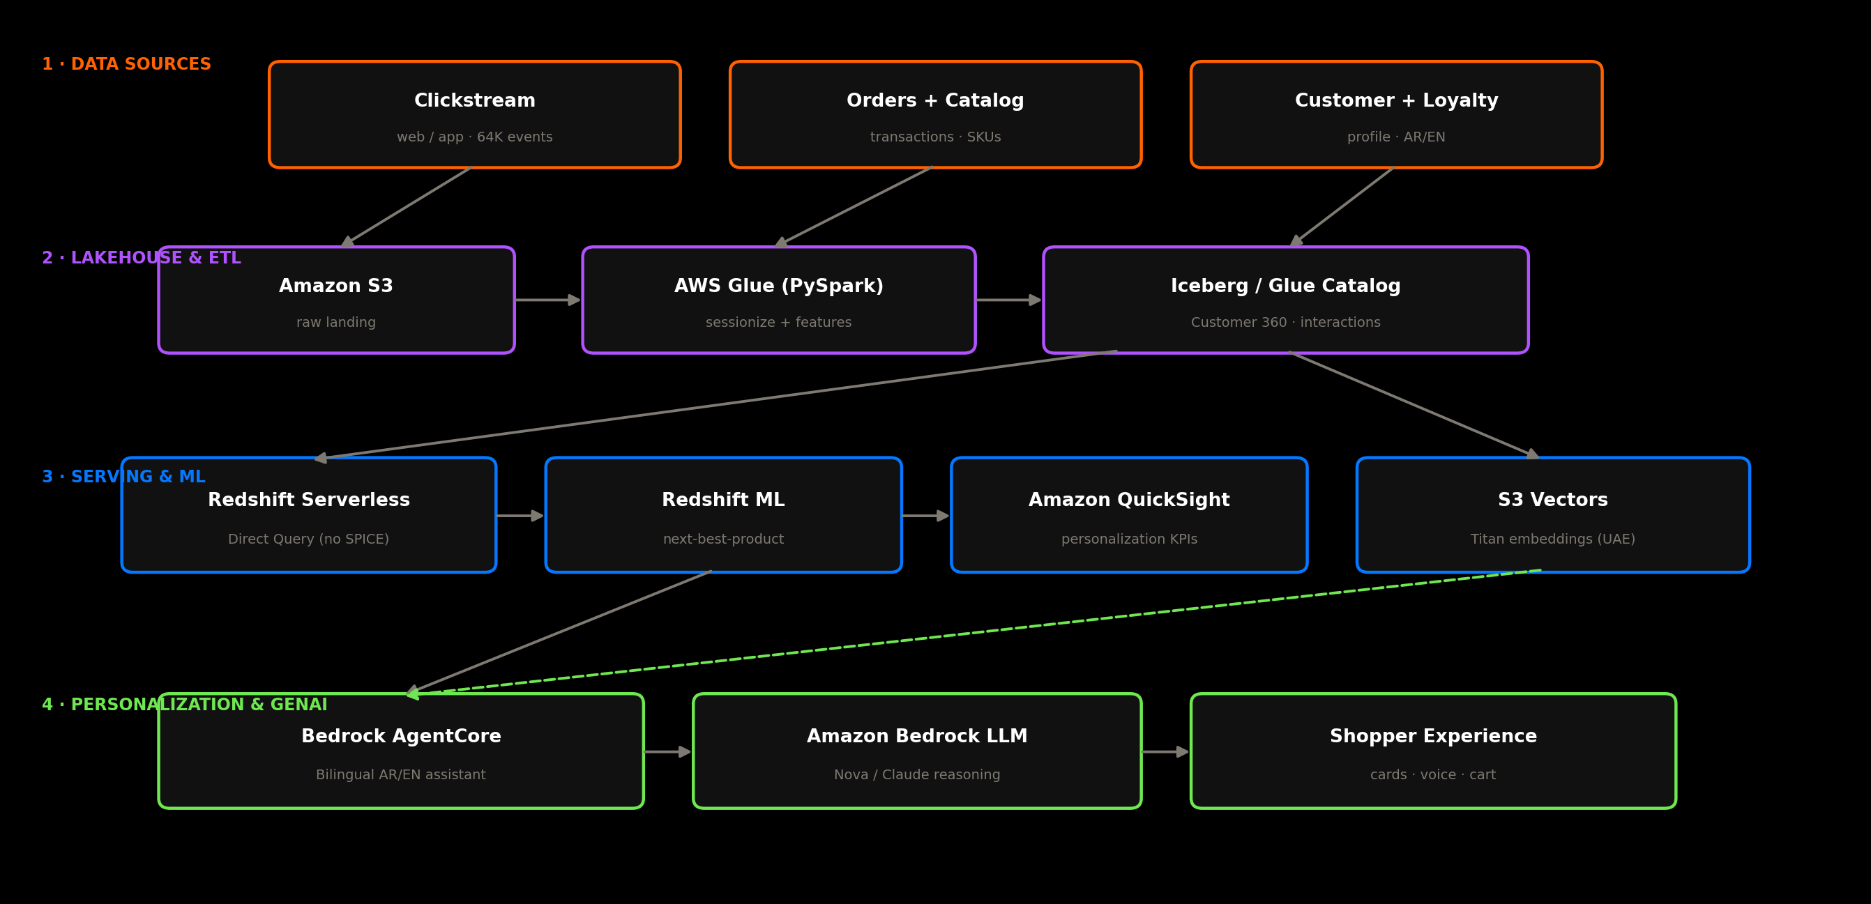
ShopSphere reference architecture

Slide 6
The 5 demo components
1
Customer 360 Lakehouse
S3 → Glue → Iceberg
Unified Intelligence
2
Next-Best-Product ML
Redshift ML propensity
Next-Best-Action
3
Semantic / Multimodal Search
Titan embeddings → S3 Vectors
Hyper-Personalized
4
Agentic Shopping Assistant
Bedrock AgentCore AR/EN
Real-Time Orchestration
5
Personalization Dashboard
Redshift Direct Query → QuickSight
Continuous Relationship

Slide 7
The recommendation engine
Redshift ML trains a propensity model on behavioral, monetary and demographic features — entirely inside the warehouse.
It scores every customer × category, ranks categories, then joins to top products the customer hasn't bought yet — a top-5 next-best-product list per shopper.
No separate ML platform. No data egress.
Binary
Top-5
propensity model (ordered-in-category)
next-best-product per customer
In-DB
~35%
runs inside Redshift — no data movement
the 'share of sales' engine, reimagined

Slide 8
The agentic shopping assistant
Bedrock AgentCore — inspired by Amazon's Agentic Shopping Assistant
Bilingual AR / EN
Long-term memory
Semantic + multimodal
Detects and replies in the shopper's language
Remembers preferences across sessions
Grounded in the S3 Vectors catalog — no hallucinated products
Tool-use
Voice-ready
In your account
search · recommendations · customer profile
Nova Sonic voice-to-voice capable
Runs in the retailer's own AWS environment

Slide 9
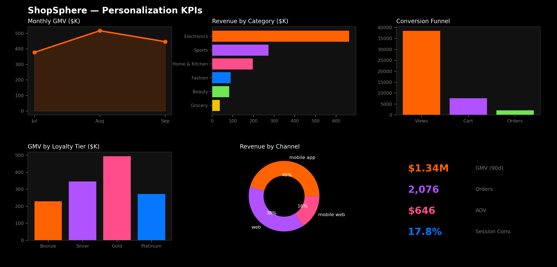
Personalization in action — the dashboard

Slide 10
Built for the UAE region (me-central-1)
Iceberg on Glue Catalog
S3 Vectors
Open, multi-engine lakehouse — vs Databricks (Azure-only in UAE)
Retrieval grounding — Bedrock Knowledge Bases not yet in UAE
Redshift Direct Query
Data stays in-account
Dashboards reflect new data instantly — avoids SPICE refresh limits
All customer data remains in the retailer's own account & region

Slide 11
Where to start
Start with one pillar and expand — each maps to a managed AWS service.
Entry points: Customer 360 lakehouse · recommendation engine · agentic assistant.
Let's scope your prototype.

