Slide 1

FALCON EYE
Independent forward-looking collision awareness for the next 100 years of flight
Team Falcon Eye
HTCJ Aviation Futures Innovation Challenge — Aviation Safety Track
Research demonstration · sensor-fusion simulation prototype

Slide 2




Situational awareness fails exactly when it's needed most
Visibility degrades
Instruments and single sensors fail
No dedicated forward redundancy
Fog, haze, and low light quietly erode the range and reliability of optical/visual situational awareness — without any explicit failure signal.
Onboard systems and any single sensing modality can drop out, drift, or return false data. Aircraft need an independent layer, not a single point of failure.
Existing systems focus on separation assurance and terrain — there's no purpose-built, always-on forward collision layer that keeps working when conditions degrade.
Regulatory tailwind: the FAA's Part 108 beyond-visual-line-of-sight (BVLOS) framework explicitly requires detect-and-avoid capability for routine drone and advanced-air-mobility operations — this category of system is becoming a compliance requirement, not just a nice-to-have.

Slide 3




Falcon Eye: an always-on forward sensing layer
LiDAR + radar fusion, tracked and triaged in real time, escalating only when a target is genuinely on a collision course.
→
→
→
→
Sense
Detect
Track
Triage
Warn
LiDAR + radar
emission & return
Fog-aware
detection model
Multi-target
state estimation
Slack-priority sort
+ reflex fast-path
Risk-graded
warning output
Research-simulation prototype — Python/NumPy/SciPy pipeline validated end-to-end from raw sensor return through warning output, before any migration to flight hardware.
Fog-honest sensing
Sensor fusion
Priority triage
Detection probability actually degrades with atmospheric attenuation — no assumption LiDAR 'sees through' dense fog.
Radar's near-fog-invariant propagation backstops LiDAR exactly where optical sensing fails.
A reflex fast-path surfaces a genuinely critical target before lower-priority tracks are even scored.

Slide 4
LiDAR alone fails in fog. Fusion doesn't.
Detection rate on genuinely dangerous encounters, 200 randomized Monte Carlo trials per condition (2,400 trials total)
0%
LiDAR-only detection in dense fog
100%
Fusion detection across every fog level tested
2,400
Randomized Monte Carlo trials run

Slide 5
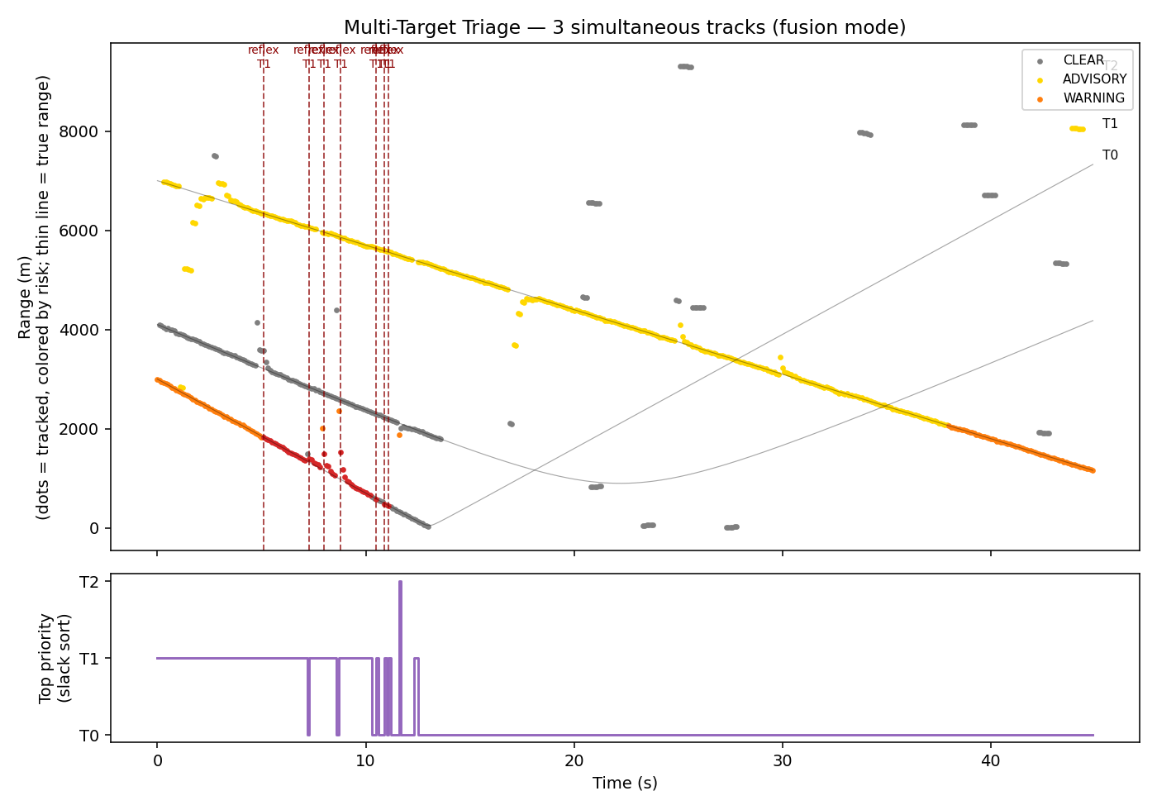
Priority triage: act on the real threat first
A slack-priority sort plus a reflex fast-path (adapted from real-time scheduling research) means a genuinely critical target is flagged before lower-priority tracks are even scored.
Reflex fast-path
The single most time-critical target is identified in one pass — before the full multi-target list is sorted or scored.
Slack-priority sort
Every tracked target is ranked by urgency (time-to-collision minus processing budget), so attention always goes to the tightest deadline first.
Validated on 3 simultaneous tracks
Fast head-on target correctly escalates to critical; slow and off-corridor traffic correctly stay clear — no false alarms, no missed threat.

Slide 6
Tested like it matters
Every claim on this deck traces to a specific simulation run, not an assumption.
2,400
8
4
3
Monte Carlo trials
(3 sensor modes × 4 fog levels × 200 trials)
Failure modes independently
injected and tested
Fog densities modeled with
Beer-Lambert atmospheric extinction
Simultaneous targets tracked
and triaged in real time
Even under simulated hardware dropout, biased range, false-detection bursts, added latency, data-link loss, and interference, 6 of 7 failure scenarios still produced a valid warning — evidence of graceful degradation rather than silent failure.

Slide 7


A compliance-driven market, arriving now
$14–18B
FAA Part 108 (BVLOS)
The FAA's beyond-visual-line-of-sight framework explicitly requires detect-and-avoid capability for routine commercial drone and AAM operations — turning this category from optional to load-bearing for anyone flying BVLOS.
Global Advanced Air Mobility market size, 2026 — industry estimates place ~20%+ CAGR growth through the early 2030s
Who needs an independent forward-collision layer
eVTOL / UAM operators
BVLOS cargo drones
GA retrofit
Airport ground & approach ops
Dense low-altitude corridors with limited onboard redundancy budget
Direct regulatory requirement under Part 108 detect-and-avoid rules
Independent redundancy layer for aircraft without modern TCAS/EGPWS
Low-visibility taxi, apron, and approach-corridor awareness

Slide 8
From validated simulation to flight-ready system
01
Simulation-Validated Prototype
Done
Full sense-to-warning pipeline, 2,400-trial Monte Carlo validation, fog-honest sensor modeling, multi-target triage — this submission.
02
Hardware-in-the-Loop
Next 6 months
Calibrate sensor and fog models against real LiDAR/radar datasheets and bench hardware; upgrade fusion to track-confirmation logic.
03
Flight Test Partnership
6–18 months
Partner with a GA, UAM, or drone operator for real-world flight data collection and closed-loop validation.
04
Certification & OEM Integration
18+ months
Pursue a certification pathway and integrate with avionics/UAM OEMs as a licensable safety layer.

Slide 9


Team Falcon Eye
Update this slide with your team's names, backgrounds, and roles.
Name
Name
Name
Systems & Algorithms
Sensor & Aerospace Domain
Business & Partnerships
Sensor modeling, tracking, and collision-risk logic
Sensor physics, fog/atmospheric modeling, aviation context
Go-to-market, regulatory strategy, industry connections

Slide 10
Join us in building the next
layer of aviation safety
What we're looking for:
Mentorship from aerospace safety & avionics experts
Access to flight-test data or a pilot partner for hardware-in-the-loop validation
Introductions to UAM / BVLOS operators and OEMs
Team Falcon Eye · [contact email] · [GitHub repository link]

