Slide 1
Email Phishing Analysis and Detection
Presented by:
Mahmoud Ahmed
Youssef Ahmed Fouad
Mohamed Ayman
Gamal Abd Elnaser
Supervisorer :
Eng/ Noureldin Essam

Slide 2

What is Phishing?
Phishing is a type of fraudulent activity carried out by cyber criminals whereby they send disguised e-mails to people or organisations purporting to be from reputable sources to influence the reader to click on links to dodgy websites or to give sensitive information away such as bank details, account passwords or credit card information. Phishing is a type of fraudulent activity carried out by cyber criminals whereby they send disguised e-mails to people or organisations purporting to be from reputable sources to influence the reader to click on links to dodgy websites or to give sensitive information away such as bank details, account passwords or credit card information.
Some phishing emails may contain viruses disguised as harmless attachments, which are activated when opened by the victim. The aim of this type of phishing attack could be something more specific, such as the theft of a business’s sensitive data.
Criminals will use multiple mediums for delivering phishing lures such as:
Email Phishing: Malicious content delivered through email.
Smishing: SMS text messages to a mobile phone.
Vishing: Fraudulent voice phone calls.
Each of these lures will be designed to look genuine, and the sender will usually claim to be a person or organisation that you are familiar with to make it easier for them to gain your trust. It is becoming increasingly difficult to identify these social engineering
attempts as attackers become more sophisticated. Attackers take advantage of people’s social instincts, such as being helpful and efficient or their emotions such as fear or anger.

Slide 3
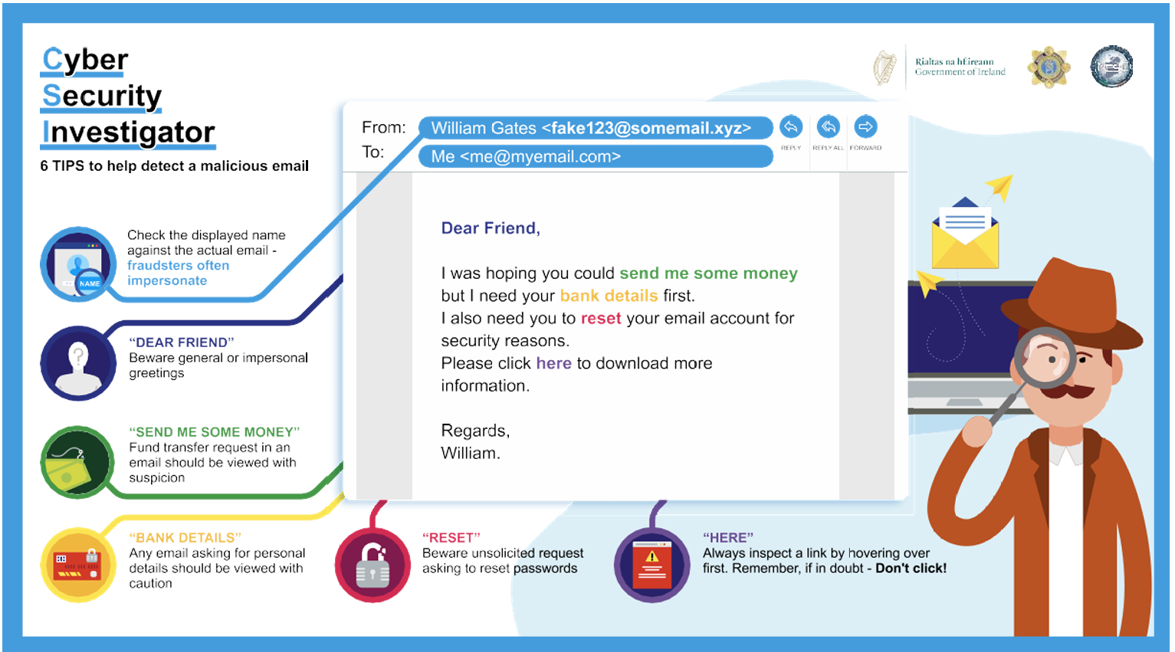

Criminals will use multiple mediums for delivering phishing lures such as:
Email Phishing: Malicious content delivered through email.
Smishing: SMS text messages to a mobile phone.
Vishing: Fraudulent voice phone calls.
Each of these lures will be designed to look genuine, and the sender will usually claim
to be a person or organisation that you are familiar with to make it easier for them to
gain your trust. It is becoming increasingly difficult to identify these social engineering
attempts as attackers become more sophisticated. Attackers take advantage of people’s
social instincts, such as being helpful and efficient or their emotions such as fear or anger

Slide 4



Avoid Being Phished
Criminals will check the internet for peoples publicly available information to make their phishing e-mails more convincing. By thinking about what personal information you and others have about you online there are some easy steps to take to make you a less likely target for a phishing e-mail attack.
All social media platforms provide in depth privacy settings for their users. You can review these settings within your social media accounts and make sure your information isn’t publicly viewable.
It’s not only you who can post information about yourself online. Be wary of what information your family, friends or work colleagues have posted about you. If necessary, ask them to remove any information about you.
Make a simple checklist you can remember easily by using our giveaway phishing signs (below) to help you to quickly scan e-mails that you aren’t too sure about. If you are suspicious of an email that you have received, then report it to your IT administrator or e-mail provider and then delete the suspicious e-mail.

Slide 5



Giveaway Signs of Phishing
As cyber criminals make their phishing e-mails more convincing to try to quickly gain your trust, always pause to consider if an e-mail makes you suspicious. You can still stay one step ahead of them by remembering to scan for one or more of these giveaway phishing signs that could signify you are being targeted by a phishing e-mail.
Does the e-mail begin with a general or impersonal greeting such as ‘Dear Friend’ or ‘valued customer’? If you aren’t addressed by your name, then this could signal that the sender does not know you and should not have your e-mail address.
Check the senders email address by hovering your mouse over the ‘from’ address or clicking the down arrow beside the senders name to reveal more details about the sender. Does the name match the e-mail address and do they look legitimate? If not, the sender could be trying to impersonate somebody.
Is there a sense of urgency to the e-mail such as a request for your bank details or an action to take to avoid losing a service? Your bank or other familiar organisations will never make such requests from you in an e-mail.

Slide 6


Always check password reset or authentication requests sent to you by e-mail or SMS. You should only receive these requests if you have requested a password change or attempted to authenticate through your online account. Cyber criminals can send unsolicited requests to steal your passwords, if in doubt, don’t click and report it to your account provider.
Are you being offered something for free or at a very well discounted rate? Ask yourself does this sound too good to be true? This tactic is used to panic you into thinking you might miss out on a good opportunity if you don’t follow the e-mails instructions. If it sounds too good to be true, it probably is.
Some of these giveaway signs can also be present in text message scams (smishing) and fraudulent telephone voice calls (vishing). The general advice for these types of scams is as follows:
• Shortened and unrecognisable links are a sure giveaway, don’t click the bait.
• Honest communications will never ask you to provide personal details.
• If it feels too good to be true or you aren’t totally sure of something, then don’t engage.
• Contact the organisation directly using their official phone number which should be on their official website to check if they have tried to contact you.

Slide 7



Have You Clicked the Bait?
If you think you’ve been the victim of a phishing e-mail and have already clicked a link, attachment or provided sensitive information then you can still take these actions to minimise the disruptive effects of the attack.
If you have provided sensitive information such as your password or bank details then change your passwords on all your accounts and contact your bank to get advice on what you should do next.
Use an antivirus software program to run a full scan of your device so it can attempt to uncover any possible viruses and try to remove them.
If you have been victim of a fraud, then you should report this to your local Garda station.

Slide 8
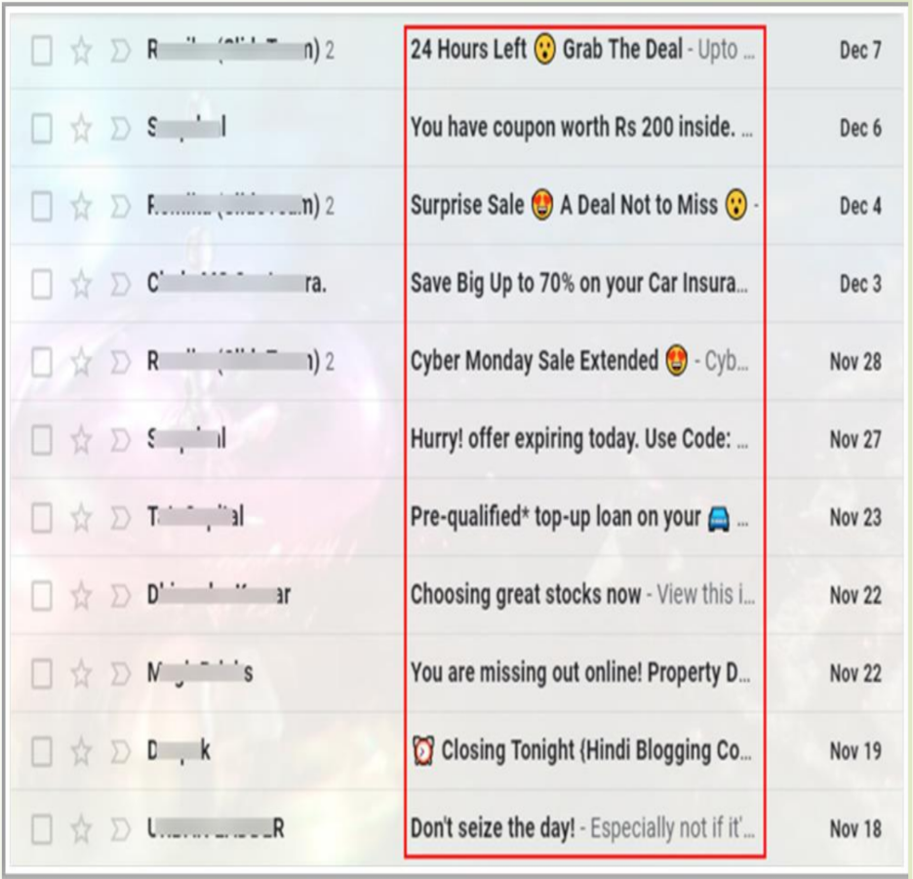
Spamming
Spam refers to undesired emails used to distribute malicious links and attachments, cause network congestion, perform phishing and financial frauds and so on. • The spam may also consume bandwidth of the email servers causing DoS conditions. • In the example the email address doesn't match the sender name or the content of message

Slide 9
How to spot spam emails
While some spammers are particularly adept at masking their emails, there are a few giveaways that can help recipients identify spam emails:
• Asking for personal information: Attackers constantly try to get information they can use out of their victims. Unless this is a request the recipient is expecting to receive, a message seeking personal information could be a sign of spam.
• Generic or misspelled email addresses: Sometimes spammers will claim to be someone from a recipient’s workplace but send the email from an address that is not part of the corporate domain. Or they may trick recipients by using a domain with a slight misspelling, like “Cloudfiare.com” instead of “Cloudflare.com.”

Slide 10
• Messages labeled ‘urgent’: Attackers will often try to establish a sense of urgency to encourage the recipient to act quickly by incorporating phrases like “act now” or using artificial deadlines. This way, they can get the information they need before the recipient becomes suspicious.
• Grandiose promises: If an email is promising something that feels too good to be true, it probably is. Be wary of any emails telling recipients they have won or are being gifted something they did not explicitly sign up for.
• Messages from organizations that do not generally use email: Be suspicious of messages that appear to come from institutions that do not traditionally use email. For example, the IRS has stated that they do not use email to discuss debts or refunds with taxpayers.

Slide 11
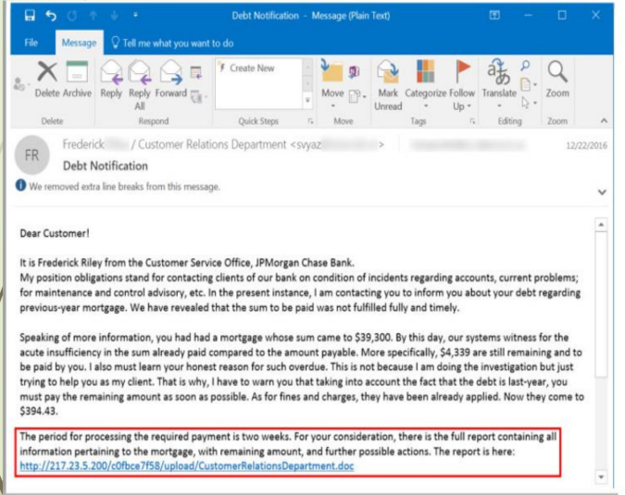
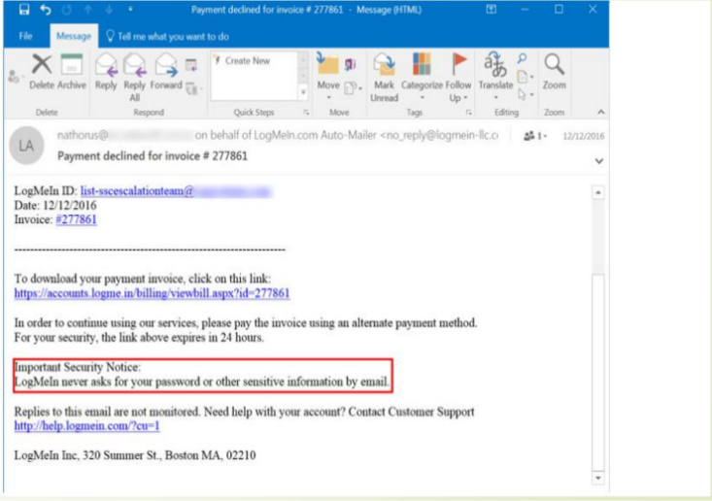
Examples of phishing

Slide 12

Thank You

