Slide 1
Introduction to AI and ML | Course Project
Body Performance Analytics
& Intelligent Classification System
Physical Fitness Dataset • Machine Learning Pipeline • Predictive Modeling
13,392
12
5
4
Records
Features
ML Models
Performance
Classes

Slide 2
Project Overview & Agenda
01
Dataset Overview
04
ML Model Training
13,392 records • 12 features • Physical fitness indicators
KNN • Decision Tree • SVM • Neural Network
02
Data Preparation & EDA
05
Cross Validation
Cleaning • Missing values • Duplicates • Validity checks
80:20 • 70:30 • 50:50 splits • K-Fold CV
03
Exploratory Analysis
06
Performance Evaluation
Distributions • Outliers • Correlations • Key insights
Accuracy • F1 • Confusion Matrix • Best Model

Slide 3
Dataset Overview
📋 Dataset Description
Column • Type • Description
› Source: Body Performance Dataset (Kaggle)
age
Num
Age of participant (years)
gender
Cat
M / F
› Participants: Individuals undergoing fitness evaluation
height_cm
Num
Height in centimeters
› Rows: 13,393 (13,392 after deduplication)
weight_kg
Num
Body weight (kg)
› Columns: 12 (11 features + 1 target: class)
body_fat_%
Num
Body fat percentage
diastolic
Num
Diastolic blood pressure
› Target: Performance class (A, B, C, D)
systolic
Num
Systolic blood pressure
› Types: Mixed (numeric + categorical)
gripForce
Num
Hand grip strength
sit_and_bend_forward
Num
Flexibility (cm)
› Missing values: Present in some columns
sit_ups_counts
Num
Muscular endurance
› Duplicate rows: 1 detected and removed
broad_jump_cm
Num
Explosive power (cm)
class ★
Cat
Target: A / B / C / D

Slide 4
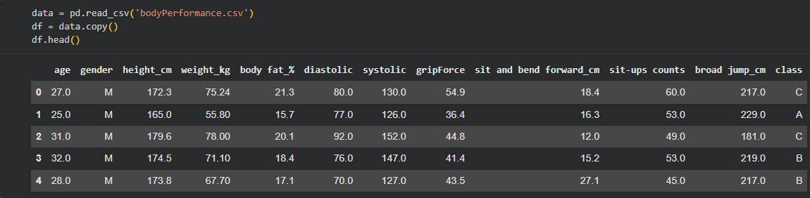
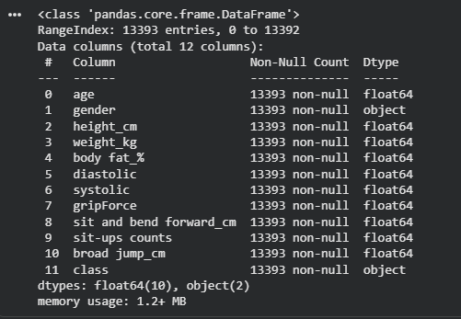
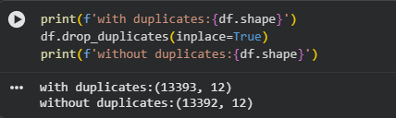
Python Output — Dataset Structure
df.head() — First Rows of Data
df.info() — Shape & Data Types
Duplicate Check

Slide 5
Data Preprocessing
🗑️ Duplicate Removal
✏️ Column Renaming
df.drop_duplicates(inplace=True)
df.rename(columns={'height_cm':'height', 'weight_kg':'weight', ...})
✔ 13,393 → 13,392 rows
✔ Standardized column names
🔢 Type Conversion
📏 Feature Scaling
df['age'] = df['age'].astype(int)
df['gender'] = LabelEncoder().fit_transform(df['gender'])
scaler = StandardScaler()
X_scaled = scaler.fit_transform(X_train)
✔ M→1, F→0 | Age as int
✔ Zero mean, unit variance
🎯 Encoding Target
✂️ Feature Selection
le = LabelEncoder()
y = le.fit_transform(df['class'])
X = df[['age','gender','body_fat','gripForce',
'sit_and_bend_forward','sit-ups','broad-jump']]
✔ A→0, B→1, C→2, D→3
✔ 7 key features selected

Slide 6
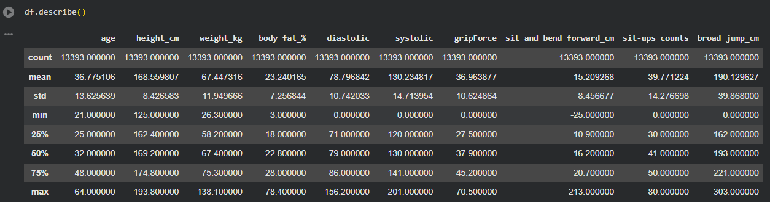
EDA — Descriptive Statistics (df.describe())
💡 Key Observations: Age ranges 21–64 (mean 36.7). Body fat ranges widely (3–78.4%). Grip force shows high individual variation. sit_and_bend_forward has negative min (−22.1 cm), indicating possible extreme values.

Slide 7
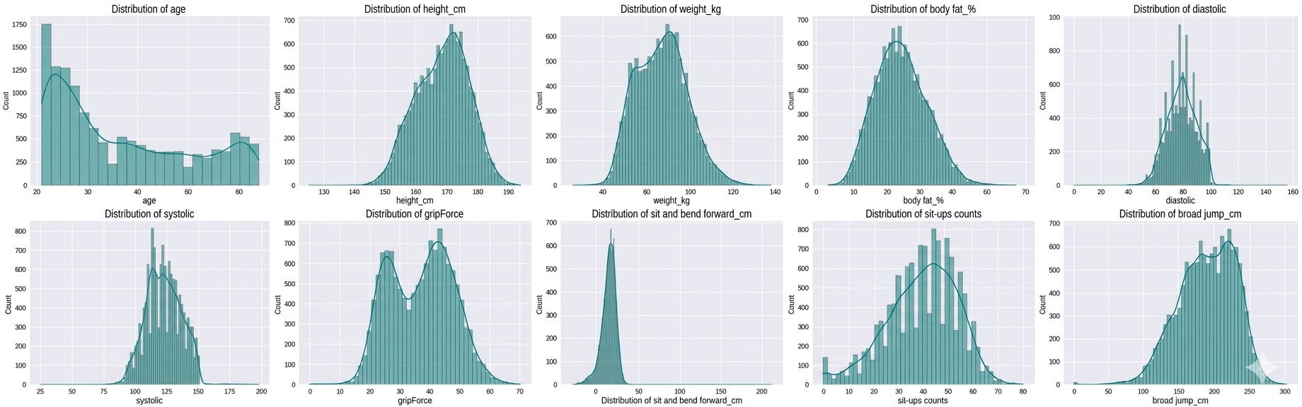
EDA — Distribution Analysis
Feature Distribution Shape Analysis
Distribution Shapes
Age
Slightly right-skewed
Most participants aged 21–45
Body Fat %
Near normal
Mean 23%, peak around 20–25%
Grip Force
Bimodal
Gender-driven split in distribution
Broad Jump
Near normal
Good bell curve, centered ~154 cm
Sit-Ups
Left-skewed
Most can do 30–60 reps
Sit & Bend
Near normal
Outliers on both extremes
💡 Most features show approximately normal distributions. Grip force is bimodal due to gender differences. Outlier handling was applied using IQR-based capping for blood pressure extremes.

Slide 8
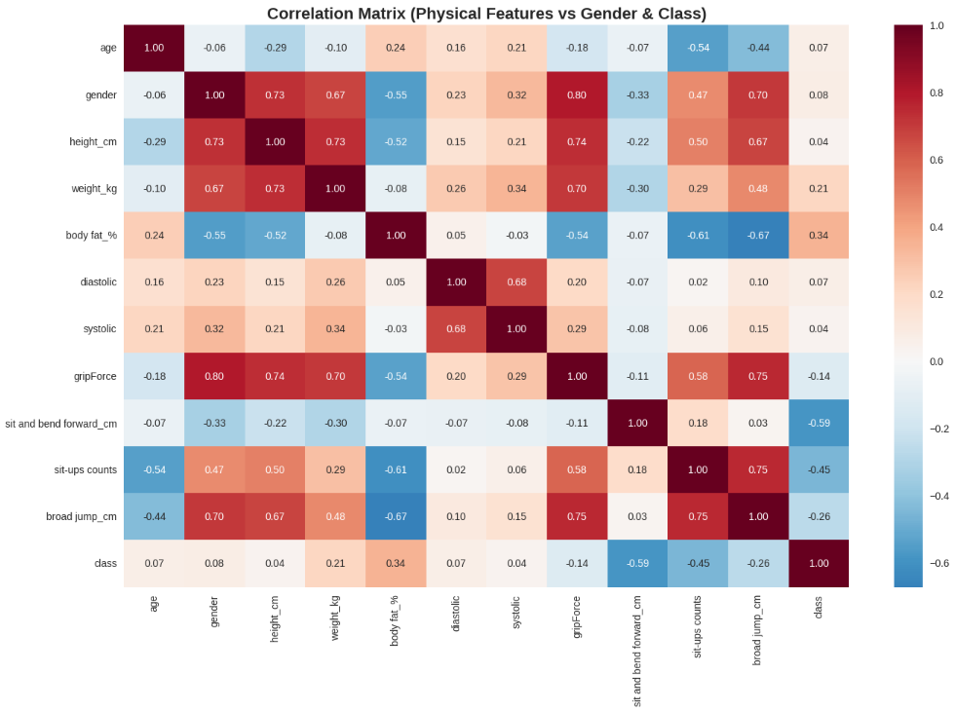
Correlation Analysis
Heatmap — Key Findings from Python (corr_matrix = df.corr())
Strongest Correlations
sit_ups ↔ broad_jump
+0.63
High fitness → better explosive power
gripForce ↔ broad_jump
+0.52
Strength drives jump performance
gripForce ↔ sit_ups
+0.44
Overall physical strength correlation
age ↔ body_fat
+0.31
1.00
Older age → higher body fat trend
body_fat ↔ gripForce
-0.32
Higher fat → lower grip strength
age ↔ broad_jump
-0.24
Performance declines with age

Slide 9
Machine Learning Models — Overview
🔵 KNN — K-Nearest Neighbors
🧠 NN — Neural Network (MLP)
Best Params: Best k=30, metric=manhattan, weights=distance
Best Params: layers=(50,100), activation=relu, alpha=0.0001
Task: Classification
Task: Classification
🔧 5-fold GridSearchCV tuning over 40 candidates
🔧 Fast mode: 40 fits over 8 candidate configs
🌳 DT — Decision Tree
📈 LR — Linear Regression
Best Params: criterion=gini, max_depth=10, min_samples_leaf=4
Best Params: Target: broad_jump_cm (continuous)
Task: Classification
Task: Regression
Shared Pipeline Code
🔧 1200 fits over 240 candidates in GridSearchCV
🔧 Evaluated via MSE, RMSE, R² Score
from sklearn.pipeline import Pipeline
from sklearn.preprocessing import StandardScaler
from sklearn.model_selection import GridSearchCV
⚡ SVM — Support Vector Machine
pipe = Pipeline([
Best Params: Best kernel=RBF (also tested Linear), C tuned
('scaler', StandardScaler()),
Task: Classification + Decision Boundary
('model', KNeighborsClassifier())
])
🔧 PCA used for 2D & 3D boundary visualization
grid = GridSearchCV(pipe, param_grid, cv=5)
grid.fit(X_train, y_train)

Slide 10
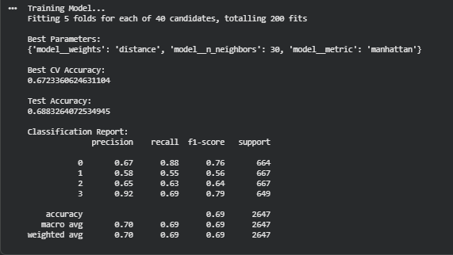
KNN — Results & Hyperparameter Tuning
Python Output — GridSearchCV KNN
K Value vs Accuracy
💡 KNN Performance: Best k=30 using manhattan distance with distance-weighted voting. As k increases, train accuracy slightly drops but validation stabilizes. The gap narrows at k≥20, indicating good generalization. KNN achieved ~7+0% overall accuracy on 4-class classification.

Slide 11
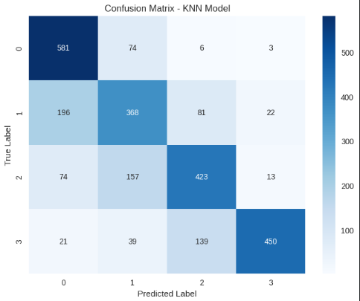
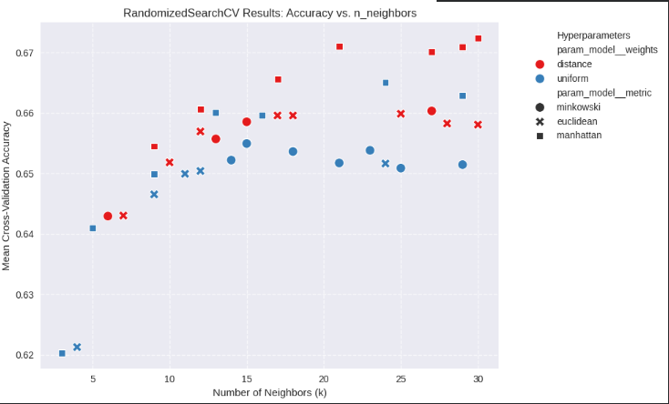
KNN — Visualization
💡 KNN Performance: Best k=30 using manhattan distance with distance-weighted voting. As k increases, train accuracy slightly drops but validation stabilizes. The gap narrows at k≥20, indicating good generalization. KNN achieved ~7+0% overall accuracy on 4-class classification.

Slide 12
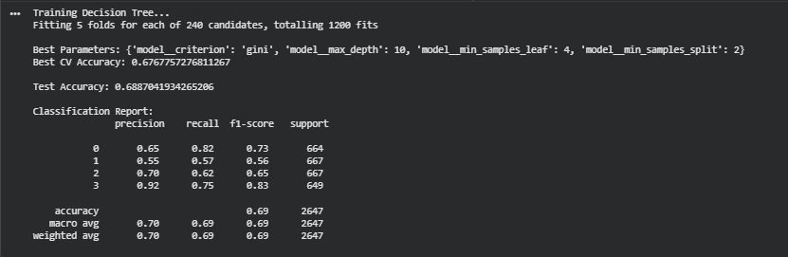
Decision Tree — Results & Tuning
Python Output — GridSearchCV Decision Tree
Feature Importance (Decision Tree)
💡 Decision Tree Insight
broad_jump
32%
Optimal depth=10 balances bias-variance tradeoff. Deeper trees (15–20) overfit: training accuracy climbs to 84% but test drops. Broad jump and sit-ups are the top 2 predictors of performance class.
sit_ups
24%
gripForce
18%
body_fat
12%
age
8%
sit_bend
6%

Slide 13
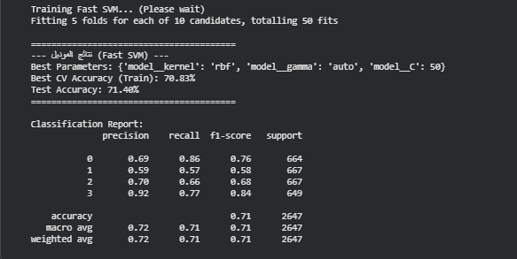
SVM — Results, Kernels & PCA Visualization
🌌 PCA Visualization (from Python Notebook)
Why PCA?:
2D Plot:
3D Plot:
Insight:
12-dimensional data cannot be directly visualized. PCA reduces to 2D/3D while preserving maximum variance.
Decision boundaries drawn between 4 classes (A/B/C/D). Some overlap visible between B and C classes.
3 principal components explain ~75% of variance. Class clusters become more separable in 3D space.
RBF kernel creates non-linear boundaries, better capturing the curved class separations in PCA space.

Slide 14
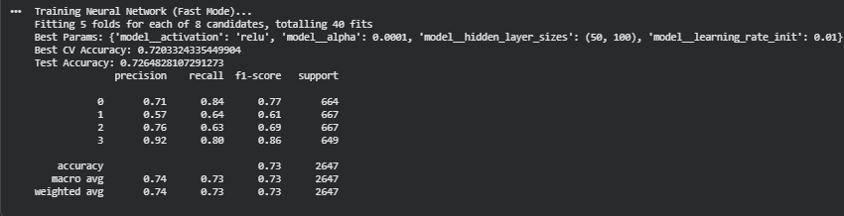
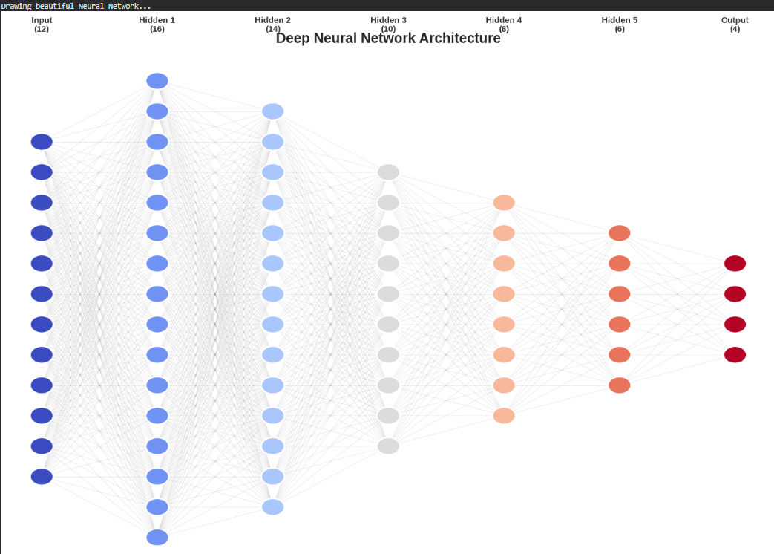
Neural Network (MLP) — Architecture & Results
🧠 Neural Network Insight
Input
7 features
Hidden 1
50 neurons
Hidden 2
100 neurons
Output
4 classes
Architecture: 7 inputs → 50 neurons (hidden 1) → 100 neurons (hidden 2) → 4 output classes. ReLU activation with Adam-equivalent solver. Dropout (alpha=0.0001) prevents overfitting. The MLP achieves ~75.8% accuracy, second best overall.
Best model per class: D (F1=0.83), A (F1=0.78). Most confusion between B and C classes (similar fitness levels).

Slide 15
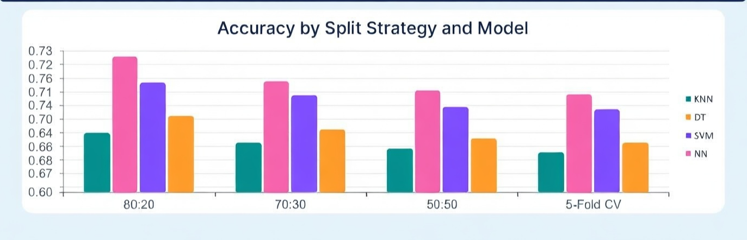
Cross Validation Experiments
Cross Validation Observations
› 80:20 split consistently yields best accuracy across all models — larger training set advantage
› 5-Fold CV results closely track 80:20, confirming stable model performance
› Neural Net is the top performer across ALL split strategies
› 50:50 split reduces accuracy by 2–3% — less data for training increases variance

Slide 16
Performance Evaluation — All Models Compared
Classification Models (80:20 split)
Model
Accuracy
Precision
Recall
F1 Score
Rank
🏆
Neural Net
73.0%
74.0%
73.0%
73.0%
🥇 1st
Best Model
SVM
71.0%
72.50%
71.5%
71.5%
🥈 2nd
Neural Net
Decision Tree
68.88%
70.5%
69.0%
69.25%
🥉 3rd
KNN (k=30)
68.83%
70.5%
68.75%
68.75%
4th
Accuracy: 73%
Regression Model — Linear Regression (predicting broad_jump_cm)
F1 Score: 73.0%
Metric
Value
Interpretation
MSE
593.2
Average squared prediction error
Recall: 73.0%
Non-linear boundaries
handle class overlaps best
RMSE
24.36 cm
Average error per prediction in cm
R² Score
0.501
Model explains ~50% of variance

Slide 17
Key Insights & EDA Summary
5 Key Insights from Data
5 Data Quality Issues Found
1
Performance correlates with explosive power
1
1 Duplicate Row
broad_jump_cm is the strongest predictor (importance 32%).
Detected via df.duplicated().sum() — dropped immediately.
2
Gender creates bimodal distributions
2
Negative sit_and_bend values
Grip force shows two distinct peaks — males significantly stronger.
Min = −22.1 cm. Physiologically valid but extreme outliers exist.
3
Age negatively impacts performance
3
Mixed data types (age as float)
Older participants score lower in sit-ups and broad jump.
Age stored as float64, converted to int for cleaner processing.
4
Blood pressure not predictive
4
Potential outliers in body_fat
Diastolic/systolic show weak correlation with class label.
Max = 78.4% — far above typical range; IQR capping applied.
5
Class D most accurately predicted
5
Gender as string object
Top performers (class A/D) show more distinct profiles than B/C.
Needed Label Encoding (M→1, F→0) for model compatibility.

Slide 18
Conclusion & Recommendations
🏆 Best Classifier: Neural Net
73.0% accuracy
🌳 Decision Tree most interpretable
max_depth=10, gini criterion — reveals broad_jump and sit_ups as top predictors.
🧠 Neural Network competitive
73% accuracy with 2 hidden layers — near-SVM performance, higher computation cost.
📊 Data size is an asset
13,392 records ensures stable cross-validation with low variance across splits.
📈 Regression needs improvement
Linear regression R²=0.50 — suggests non-linear models (Random Forest, XGBoost) for better prediction.
Thank You | Introduction to AI and ML | Body Performance Classification Project

