Slide 1
Cisco Cyber security track Final Project team 4
Implementing Network Security with ACLs and NAT

Slide 2
Team members
Omar Osama
Mahmoud Eltayar
Mahmoud Alashwal
Ibrahim Yasser
Ibrahim Elkhateb

Slide 3
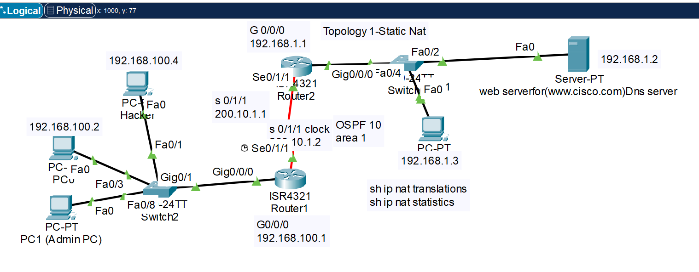
Topology 1-Static Nat

Slide 4
configurations
1-Static Nat example:-it is mean every host must take one public ip statically
-----------------------------------------------------------------------------------------------
R2(config)#int G 0/0/0
#ip address 192.168.1.1 255.255.255.0
#no shut
#ip nat inside (to tell router this side is the local private network)
#int S 0/1/1
#ip address 200.10.1.1 255.255.255.0
#no shut
#ip nat outside (to tell router this is the outside network like wan or internet side)
#exit
#ip nat inside source static 192.168.1.2 200.10.1.1
(local inside) (global inside)
private ip public ip
#exit
(to delete it put no before it--no ip nat inside source static 192.168.1.2 200.10.1.1
----------------------------------
R2#sh ip nat translation
R2#sh ip nat statistics
R2#clear ip nat translation *
R2#clear ip nat statistics (not work in packet tracer)
---------------------------------------
Standard ACL (to control the trrafic that raech web server )
---------
R1(config)#access-list 1 permit host 192.168.100.2
R1(config)#access-list 1 permit host 192.168.100.3
R1(config)#int g0/0/0
R1config-int)#ip access group 1 in

Slide 5
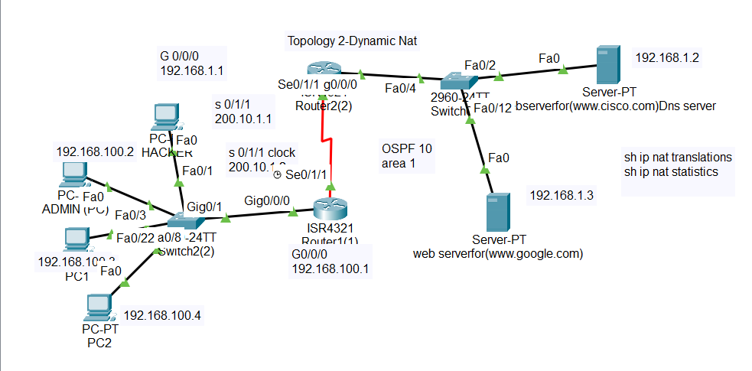
Topology 2-Dynamic Nat

Slide 6
configurations
2.1) Dynamic Nat example:-it is mean we have group or pool of public ip
and we need to distribute it to group of hosts but not staticLy (dynamicly)
it is mean any host connect to the internet will take any public ip address
from the pool.
---------------------------------------------------------------------------------------
For example:- hosts to nat 192.168.1.2 , 192.168.1.3 (2 hosts)
- nat pool 200.10.1.10 to 200.10.1.11 (2 public ip)
---------------------------------------------------------------------------------------
the same configuration of static nat:-
R2(config)#int G 0/0/0
#ip address 192.168.1.1 255.255.255.0
#no shut
#ip nat inside (to tell router this side is the local private network)
#int S 0/1/1
#ip address 200.10.1.1 255.255.255.0
#no shut
#ip nat outside (to tell router this is the wan or internet side)
#exit
#access-list 1 permit 192.168.1.2 or (access-list 1 permit 192.168.1.0 0.0.0.255 to allowed all network)
#access-list 1 permit 192.168.1.3
#access-list 1 deny any
#ip nat pool (xx name of the pool) 200.10.1.10 200.10.1.11 netmask 255.255.255.252
#ip nat inside source list 1 pool (xx name of the pool)
Note:- in this kind of nat there is one ip will go the router interface and will not go to any host

Slide 7
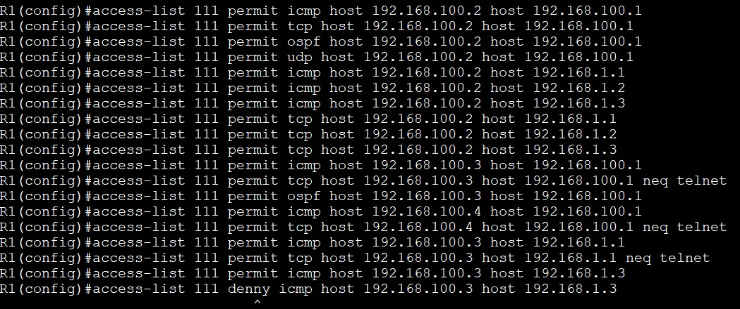
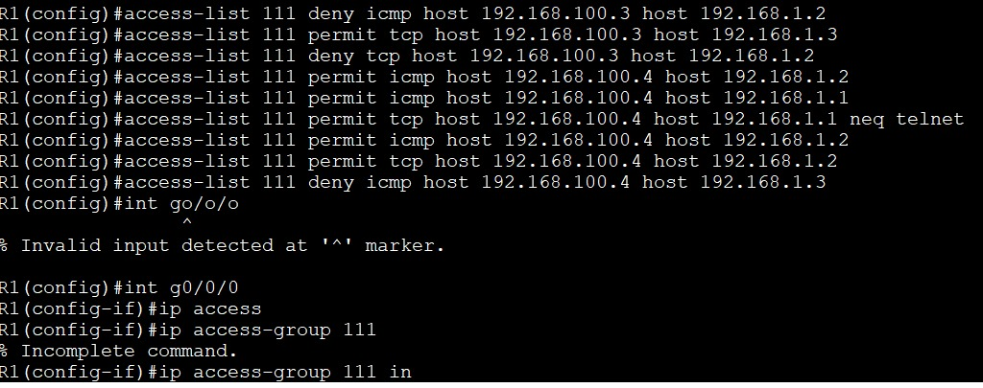
configurations
2.2)topology 2 extended numbered ACL on router 1

Slide 8
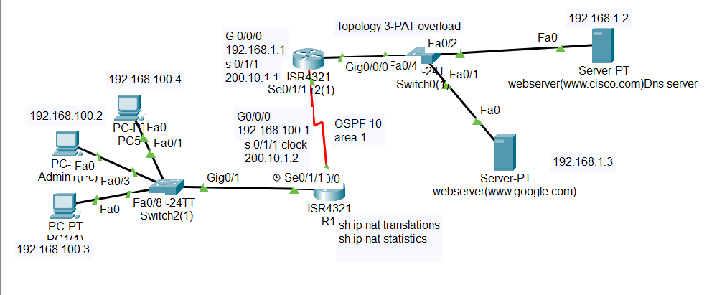
Topology 3-PAT overload

Slide 9
configurations
3-PAT (port address translation)- port Overload
---------------------------------
it is kind of dynamic nat but with it we can make group of hosts connect
to the internet in the same time with only one public ip address
192.168.1.2-----------200.10.1.1
192.168.1.3----------200.10.1.1
the same configuration of static nat:-
R2(config)#int G 0/0/0
#ip address 192.168.1.1 255.255.255.0
#no shut
#ip nat inside (to tell router this side is the local private network)
#int S 0/1/1
#ip address 200.10.1.1 255.255.255.0
#no shut
#ip nat outside (to tell router this is the wan or internet side)
#exit
#access-list 1 permit 192.168.1.2
#access-list 1 permit 192.168.1.3
#access-list 1 deny any
#ip nat inside source list 1 interface S 0/1/1 overload
(to translate all ip address to one public ip address)
OR #ip nat inside source list 1 pool xxx (name of pool) overload
(to translate all ip address to a few public ip address)

Slide 10
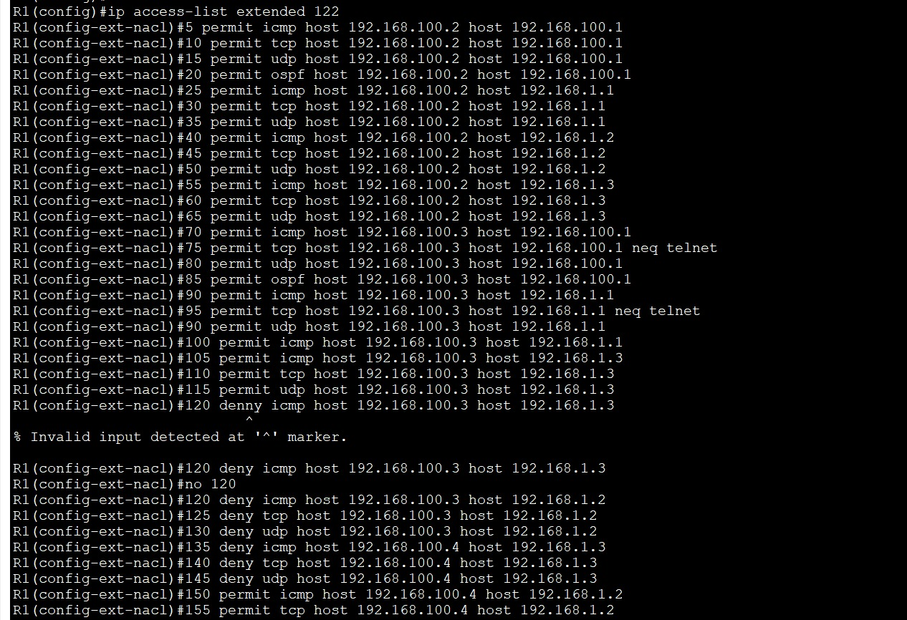
configurations
topology 3 named ACL

Slide 11
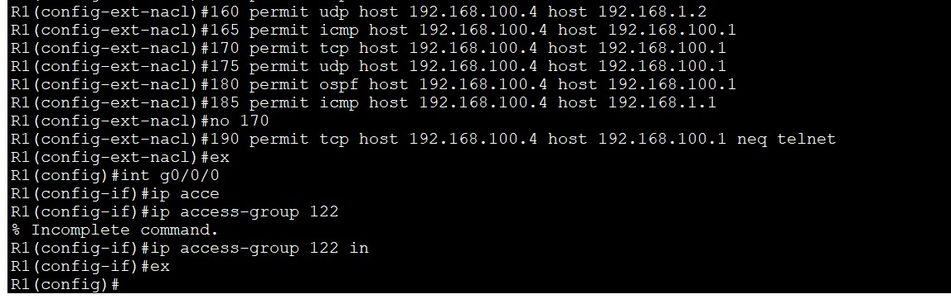
configurations
topology 3 named ACL

Slide 12
THANK YOU

