Slide 1


LOOMAI PLATFORM X AUTOTRADER CONNECT
AI ENABLEMENT, NOT ANOTHER CHATBOT
One AI enablement layer. Four product behaviours.
LoomAI supports conversational, event-driven and agentic products inside a governed, dealer-isolated deployment.
LOOMAI PRODUCT BEHAVIOURS
AUTHORISED DATA
GOVERNED ENABLEMENT
DEALER OUTCOMES
Conversational AI
1
User-led dialogue, grounded answers and governed actions.
Smart Brain
2
Events trigger fixed plans, task queues and durable analysis.
Multi-agent teams
3
A conversation manager coordinates specialist workers.
Sequential + parallel plans
4
Declarative workers run in order or concurrently.
Templates + plugins + policies -> one isolated dealer deployment
CONFIDENTIAL PARTNERSHIP DISCUSSION
01
Notes:
Open by correcting the category assumption: LoomAI is not a chatbot product. It is an AI enablement and deployment layer that can productise four behaviours from the same governed primitives. Conversational AI handles user-led journeys. Smart Brain runs fixed analysis or operational plans from system events and queues. Multi-agent deployments coordinate genuinely distinct specialists through a conversation manager. Declarative plans execute workers sequentially or in parallel. For Autotrader, authorised data can power any of these behaviours while every dealer remains isolated and governed.

Slide 2
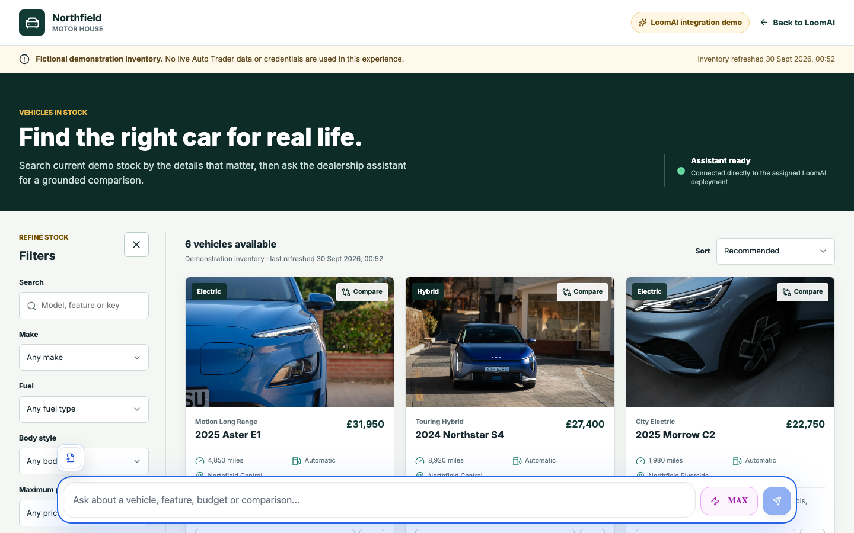
THE BUYER EXPERIENCE
FROM INTENT TO ACTION
One journey, from a vague need to a qualified handoff.
The buyer can search naturally, understand the trade-offs and move forward without repeating the conversation.
Describe
1
Everyday needs, budget, journey and preferences
LIVE DEMO
Discover
2
Semantic shortlist from this dealer's permitted stock
Compare
3
Consistent facts, evidence and visible trade-offs
Verify
4
Re-read current price, availability and key facts
Handoff
5
Customer-approved context plus a durable receipt
Demonstration inventory is fictional and clearly disclosed in the experience.
Customer surface
Docked chat for quick questions | Max workspace for search, comparison, sources and confirmed actions
loomai.pro/demos/dealership-ai
CONFIDENTIAL PARTNERSHIP DISCUSSION
02
Notes:
Demo the docked composer first, then Max Mode. Emphasise that chat is only the surface: the differentiated value is dealer-scoped discovery, explicit evidence and a structured handoff. Do not imply the visible inventory is live Autotrader data.

Slide 3
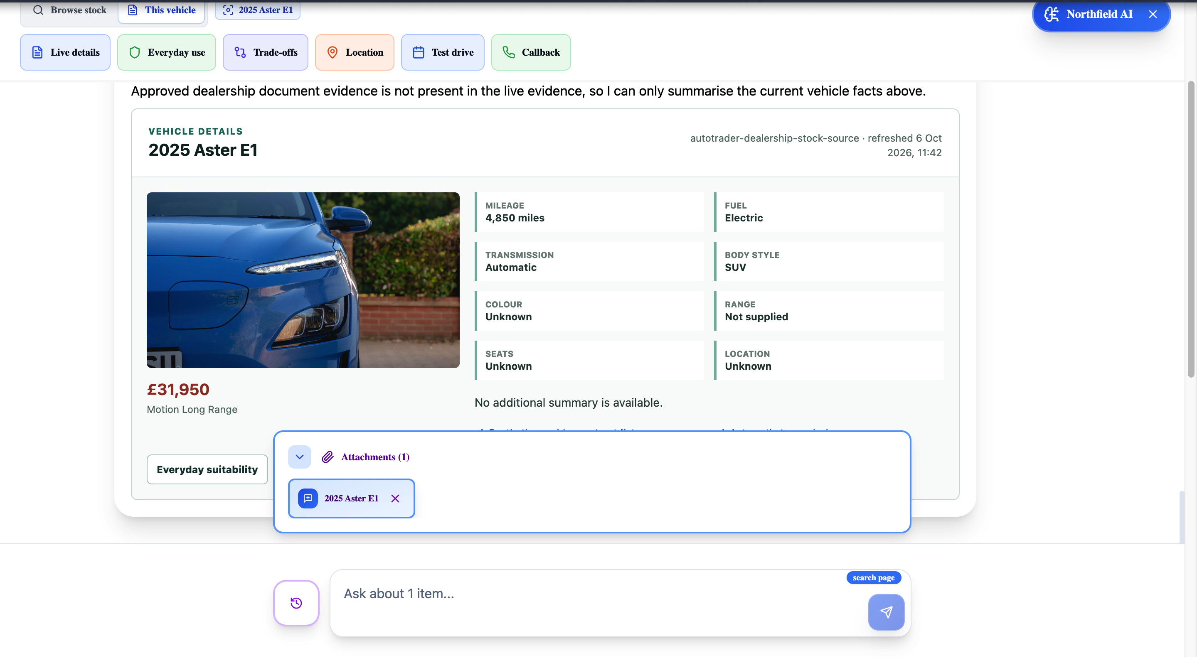
THE AI-ENABLED WORKSPACE
BEYOND CHAT
Transform the dealership website into an AI-enabled workspace.
The assistant carries context, evidence and governed tools through the customer's journey.
1
Persistent context
2
Adaptive tools
MAX WORKSPACE
Conversation, selected vehicles and attached pages persist across navigation.
Browse stock or switch to vehicle-specific tools without losing either scope.
Live vehicle facts + dealer policy evidence + governed actions
3
Visible evidence
4
Governed actions
Combine live provider facts, indexed stock, dealership documents and attachments.
Request a test drive, callback or handoff with confirmation and a durable receipt.
Dealer website
Shared context
AI workspace
Live facts + policy evidence
Customer-approved outcome
CONFIDENTIAL PARTNERSHIP DISCUSSION
03
Notes:
This is the experience transformation: AI is no longer a separate support bubble. It becomes a persistent workspace around the dealer's real pages, selected items, evidence and approved actions. Point out that the generic chat application accepts dealership-specific tools and presentations without embedding automotive logic in the generic component.

Slide 4
DATA FRESHNESS AND GROUNDED REASONING
DATA FRESHNESS AND GROUNDED REASONING
Live data stays live. Indexed data stays useful.
LoomAI separates discovery evidence from operational truth, then revalidates important facts before a decision.
Autotrader Connect
DATA plugin
Dealer projection
Semantic index
Grounded answer
Dealer-scoped baseline + stock events
Authenticate, normalise, reconcile and delete
Typed current records with source identity
Derived discovery evidence, rebuildable
Source, freshness and unsupported-field honesty
EVENT PATH
DECISION PATH
Stock change -> verified notification -> targeted stockId fetch -> upsert or delete -> indexing completion
Use the index to find candidates. Use a typed live action to confirm price, availability or evidence before presenting or handing off.
1 advertiser
Permitted fields
No cross-dealer
Deterministic
Model is never
per deployment
only
retrieval
deletion
the authority
CONFIDENTIAL PARTNERSHIP DISCUSSION
Architecture proposed for a granted Connect capability; production rights and contracts remain to be agreed.
04
Notes:
The key phrase is: index for discovery, re-read for decisions. A full baseline is the recovery path; targeted event reconciliation keeps an individual stock record current. Dealer policies remain a separately attributed knowledge source.

Slide 5
WHY PARTNER
EXTEND AUTOTRADER'S PLATFORM WITHOUT COMPETING WITH IT.
Autotrader remains the data and automotive-product authority. LoomAI provides the governed AI experience and repeatable deployment layer.
AUTOTRADER BRINGS
LOOMAI BRINGS
JOINT OUTCOME
Trusted automotive authority
Governed AI enablement
Better-qualified buyers
Authorised data and advertiser scope
Connect capabilities and real-time contracts
Marketplace reach and retailer relationships
Deal Builder, Co-Driver and conversion journeys
+
Dealer-isolated deployments and lifecycle
Grounded reasoning across stock and policy
Governed actions, confirmations and receipts
Reusable templates, plugins and UI surfaces
Relevant dealer-only shortlists
Fewer stale or unsupported answers
Consented context into the next journey
Measurable conversion and trust evidence
FLEXIBILITY WITHOUT ONE-OFF BUILDS
One reusable dealership template
Plugins compile only granted capabilities
Approved model, vector and storage choices
Embed script or native host integration
Deployment-local traffic and secrets
Not proposing: a new marketplace, a data-resale layer, a replacement for Deal Builder, or another generic chatbot.
CONFIDENTIAL PARTNERSHIP DISCUSSION
Sources: autotrader.co.uk/partners/retailer/platform/autotrader-connect | help.autotrader.co.uk Dealer Websites
05
Notes:
Position LoomAI as complementary. Autotrader owns trusted data, automotive products and the retailer relationship. LoomAI makes those approved assets usable inside a governed AI journey on dealer-owned surfaces.

Slide 6

PILOT PROPOSAL AND PARTNERSHIP ASK
START WITH ONE BOUNDED, MEASURABLE PILOT.
A read-first Connect pilot can prove usefulness, freshness, isolation and conversion value before any broader rollout.
PILOT SCOPE
WHAT WE NEED FROM AUTOTRADER
SUCCESS GATES
One dealer. One advertiser. One isolated deployment.
Named product sponsor and Connect Integration Manager
Sandbox credentials, capability grants, test advertiser and representative stock
Written rights for retention, embeddings, inference, display and attribution
Notification registration, retries and test-event path
Preferred Deal Builder, enquiry, CRM or appointment handoff
Go-live checklist and one candidate design-partner dealer
Useful-result rate
Shortlist and comparison completion
Fact-support and freshness
Qualified handoff rate
Zero cross-dealer access
Deletion and rollback proof
Read-first stock discovery and comparison
Dealer-owned policy knowledge
Live validation of selected facts
One confirmed callback, test-drive or agreed handoff
No provider write unless explicitly granted
Open live demo
THE ASK
Approve an architecture and data-rights workshop, then define a one-dealer Autotrader Connect pilot.
CONFIDENTIAL PARTNERSHIP DISCUSSION
Discussion basis: Autotrader Connect official product, partner and advertiser guidance reviewed 5 Oct 2026.
06
Notes:
Close on a decision, not a generic follow-up. Ask for the sponsor, integration manager, sandbox/grants, written data rights, the preferred handoff path and one design-partner dealer. The next working session should be architecture plus data rights.

