Slide 1
Food Mart Retail
Analyze the data

Slide 2
Point of Views:
Cleaning Data
Making the diagram and relationships
Making the required measures
Customer Insights Dashboard
Product Insights Dashboard
Main Figure Dashboard

Slide 3
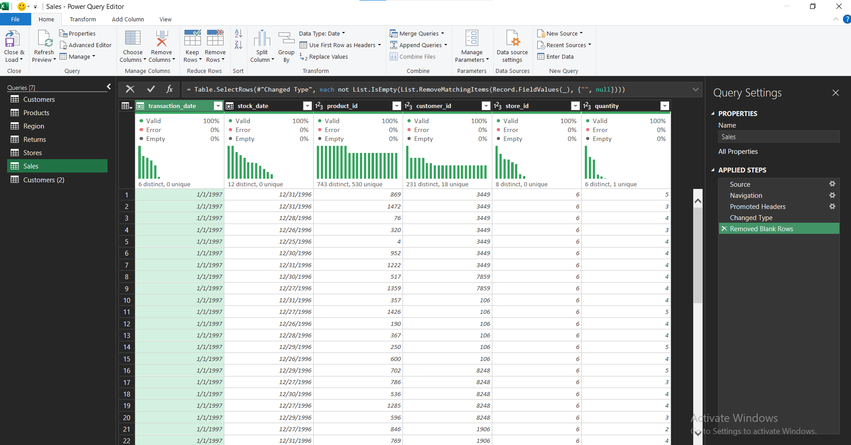
Cleaning Data:
We cleaned the data and combine files together and added the required columns

Slide 4
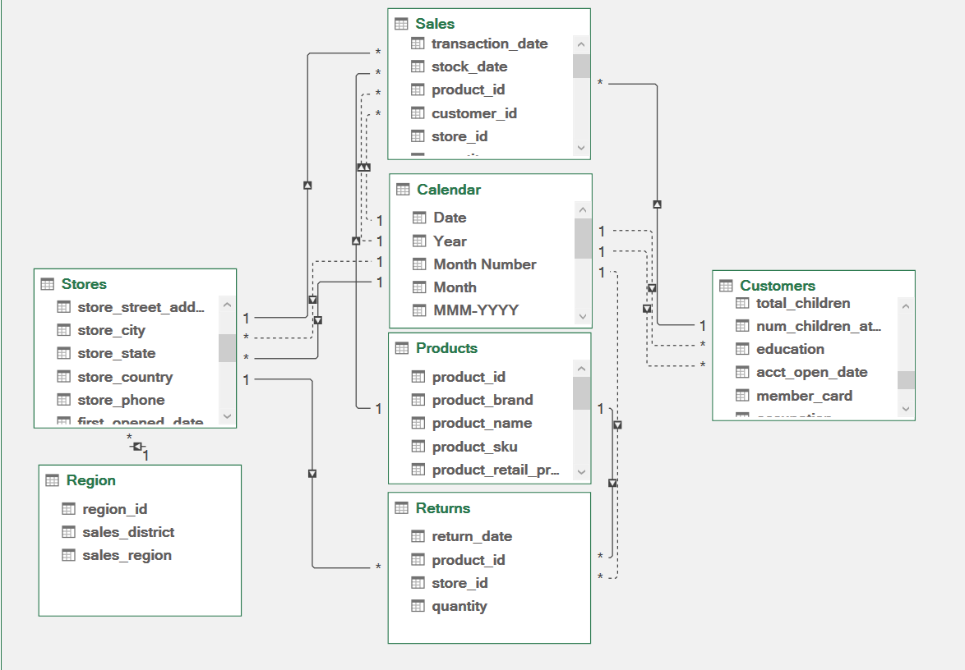
Making the diagram and relationships:
We made the relationships between different entities

Slide 5
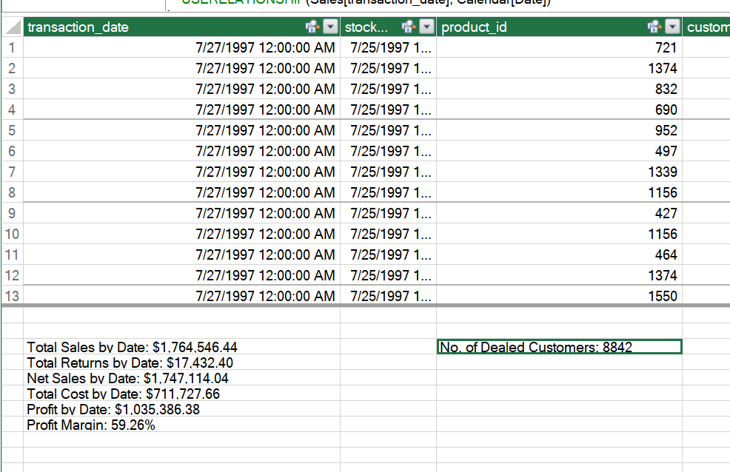
Making the required measures:
We made the measures that will help us in analyzing the data

Slide 6
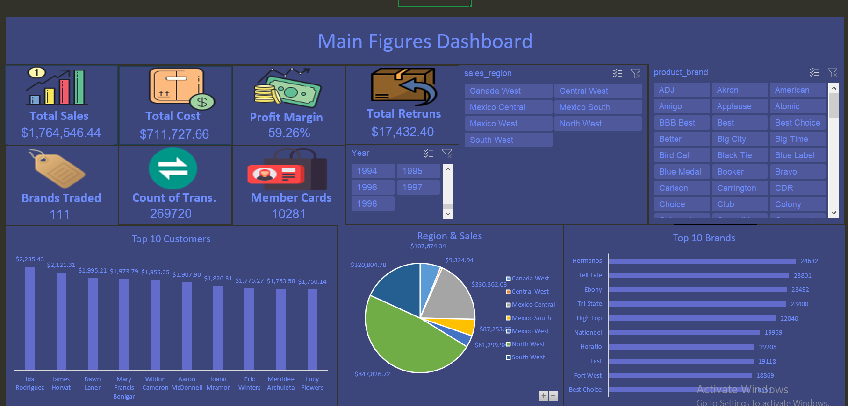
Main Figure Dashboard:
The first dashboard that describe the general Work

Slide 7
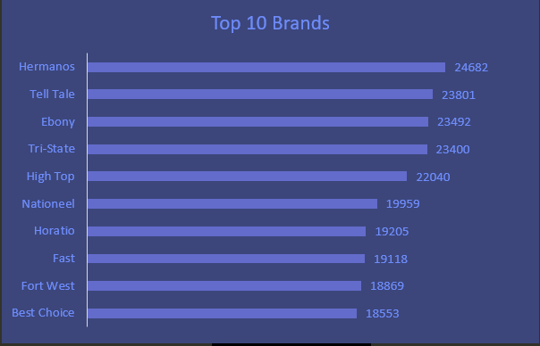
Our traded Brands:
We notice that Hermanos is the most required brand so we should focus on it and try to develop it

Slide 8
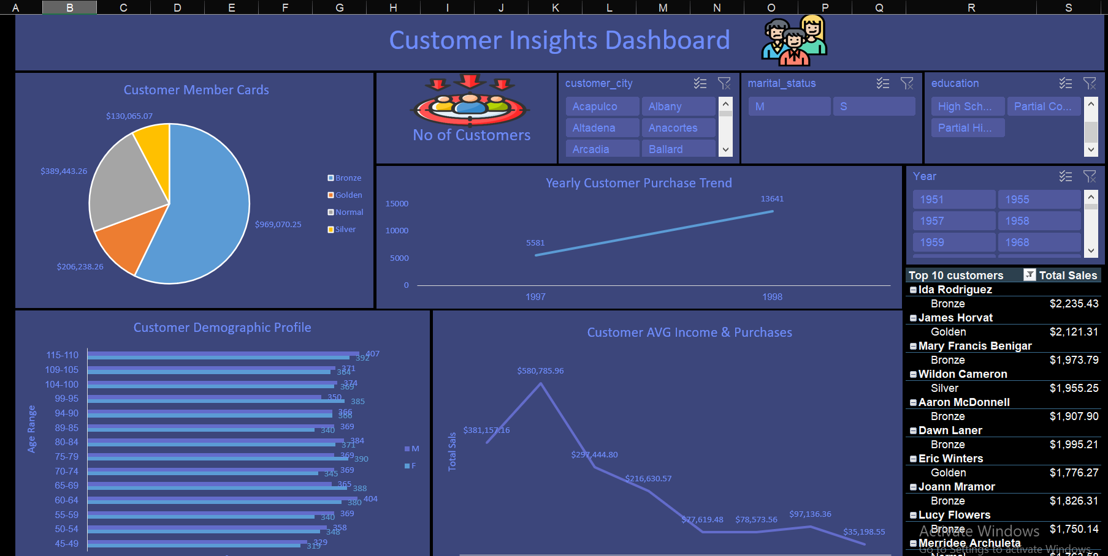
Customer Insights Dashboard:
This Dashboard describe our customer behaviors

Slide 9
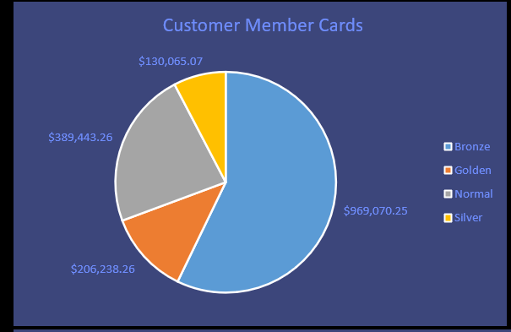
Member Cards:
We notice that Bronze card made the highest sales, so we should offer gifts

Slide 10
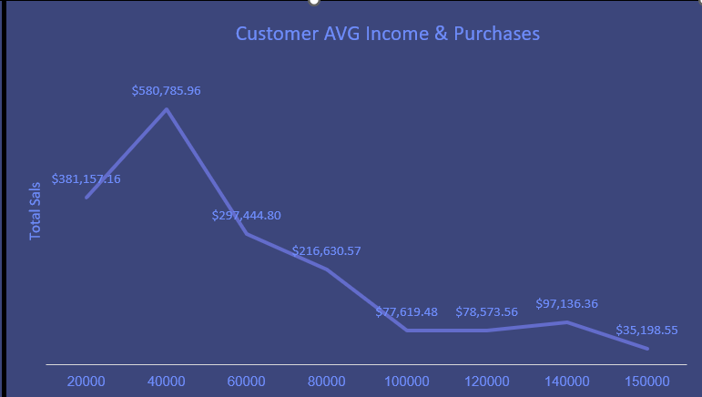
We notice that customers with Avg Income $ 40,000 made the highest Purchases

Slide 11
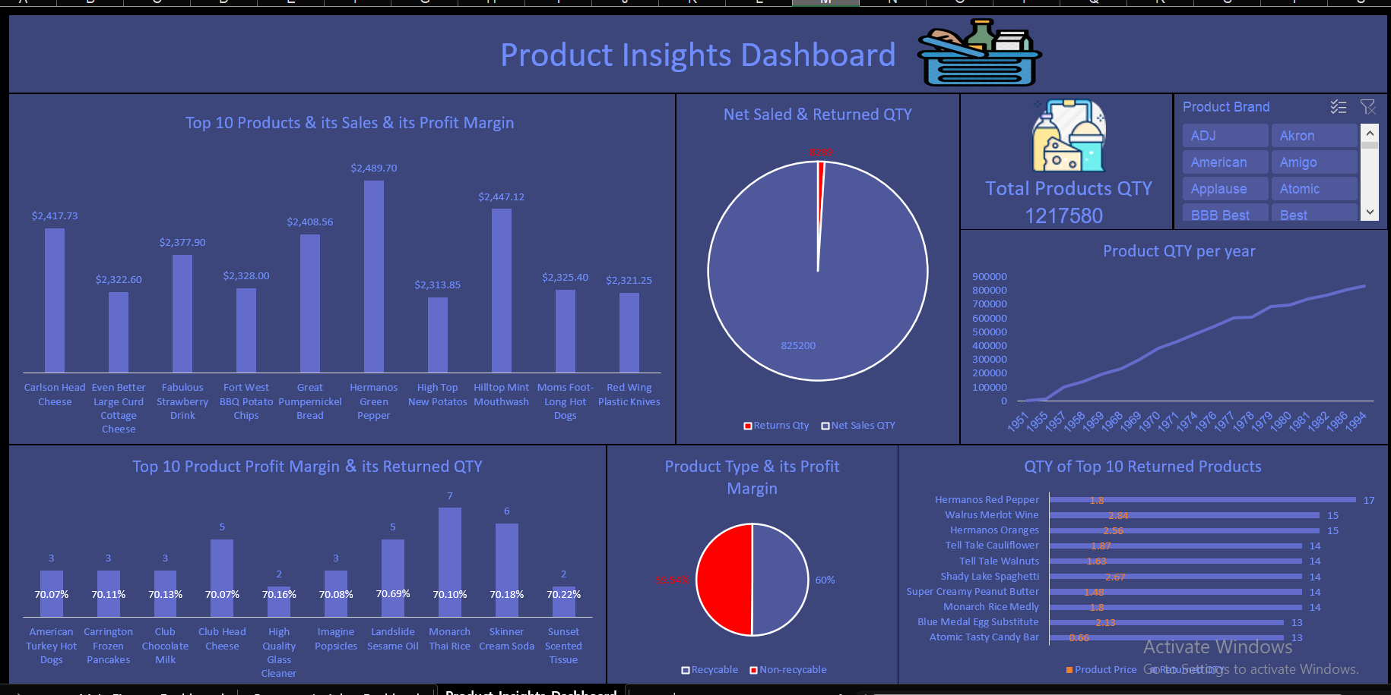
Product Insights Dashboard:
This dashboard describe our products

