Slide 1

AMERICAN UNIVERSITY OF CULTURE AND EDUCATION · SENIOR PROJECT 2026
AI-Powered Network Traffic Analyser & Anomaly Detector
NDR Platform v1.0.0 — Detect · Understand · Respond · Explain
STUDENT
SUPERVISOR
DEFENSE
Mahmoud Talal Kanaan Computer Science
Dr. Hassan Noureddine AUCE
Implementation + Evaluation Local SOC / NDR prototype
AI Network Analyzer · Title · AUCE 2026 · v1.0.0
01 / 32
Notes:
Pause 3 seconds. State your name, AUCE, and the project as an NDR platform — not only a classifier.

Slide 2
ROADMAP · SAME CHAPTERS AS THE PAPER
The defense follows the thesis.
01
02
03
Ch. 1 Introduction
Ch. 2 Literature
Ch. 3 Architecture
Problem, objectives O1–O6, proposed solution
Twenty platforms and the remaining gap
Pipeline, hybrid AI, MITRE, SOAR
04
05
06
Ch. 4 Implementation
Ch. 5 Evaluation
Ch. 6–8 Close
Stack and all 16 SOC pages
12,000-row holdout — Table 9 / Table 11
Deploy, limits, demo, conclusion
AI Network Analyzer · Agenda · AUCE 2026 · v1.0.0
02 / 32
Notes:
Same order as the research paper. Chapter 1 to conclusion.

Slide 3
CH. 1 · INTRODUCTION
Attacks are live. Most student labs still watch logs.
Signature IDS
AI without SOC
Snort-style rules fail on unseen variants and encrypted or novel campaigns.
A classifier that cannot alert, ticket, hunt, or block is not operations.
Enterprise NDR cost
Broken loop
Commercial platforms are out of reach for labs, SMEs, and teaching.
Capture, detect, notify, and respond usually live in separate products.
AI Network Analyzer · Problem · AUCE 2026 · v1.0.0
03 / 32
Notes:
Do not list tools. State the pain: signatures miss novelty; NDR is expensive; labs have no SOC loop.

Slide 4
CH. 1 · WHY THIS PROJECT
Build a SOC you can run on a laptop — and defend with evidence.
Academic need
Supervisor guidance: move from design-only writing to a running system plus evaluation.
Operational need
Analysts need one glass: traffic, detections, incidents, hunting, and response.
Pedagogical need
Students must see the full kill-chain loop: inject → detect → alert → block → explain.
Local control
On-prem FastAPI + Streamlit + SQLite (Postgres optional). No cloud lock-in for the prototype.
AI Network Analyzer · Motivation · AUCE 2026 · v1.0.0
04 / 32
Notes:
Why AUCE should care: a teaching-grade NDR that is implemented, not only designed.

Slide 5
CH. 1 · PROBLEM AND SOLUTION
Four pains. Four answers in the product.
PROBLEM
SOLUTION IN THIS PROJECT
Signature IDS miss novel traffic
Hybrid models score known and unknown flows
AI without a SOC workflow
16 pages: alerts, incidents, hunting, reports
Enterprise NDR is too costly
Runs locally: FastAPI + Streamlit + SQLite (Postgres optional)
Detect with no response
SOAR, block, Telegram, XAI, Copilot, approvals
AI Network Analyzer · Problem-solution · AUCE 2026 · v1.0.0
05 / 32
Notes:
Read left then right. Each pain has a matching capability.

Slide 6
CH. 1 · RESEARCH OBJECTIVES
Six objectives. Same O1–O6 as the paper.
O1
Monitor network traffic and extract useful security features (39 CICIDS-style flow features).
O2
Detect known attacks using supervised models: Random Forest and XGBoost.
O3
Detect unknown anomalies using Isolation Forest and Autoencoder.
O4
Use LSTM to analyze sequential behavior and support attack prediction.
O5
Improve transparency using stored per-prediction XAI (this-flow evidence + tree importances).
O6
Support incident response: IP blocking, Telegram, webhooks, and reports (no email).
AI Network Analyzer · Objectives · AUCE 2026 · v1.0.0
06 / 32
Notes:
Read the same six objectives as Table 2 in the paper.

Slide 7
CH. 1 · PROPOSED SOLUTION
One product. Four verbs.
01
02
03
04
DETECT
UNDERSTAND
RESPOND
PROVE
Live capture + hybrid models + threat score + severity.
MITRE ATT&CK, threat intel, host risk, stored XAI, Copilot.
SOAR playbooks, allow/block, approvals, Telegram, SIEM/Jira hooks.
Reports, live-versus-simulation evidence, and the 12k holdout.
AI Network Analyzer · Solution · AUCE 2026 · v1.0.0
07 / 32
Notes:
One sentence: a local NDR that detects with hybrid AI and operates like a mini SOC.

Slide 8
CH. 2 · LITERATURE GAP
Existing tools solve a slice. This project closes the loop.
Approach
Strength
What is still missing
Signature IDS
Fast known threats
Weak on novel / zero-day patterns
SIEM / EDR
Logs & endpoints
Not a packet-level NDR with hybrid AI
Cloud NDR
Scale & intel
Cost, privacy, not a student-lab stack
This work
Local NDR + SOC
Implemented pipeline + measured models
AI Network Analyzer · Gap · AUCE 2026 · v1.0.0
08 / 32
Notes:
Position against Snort, Wazuh, and cloud NDR. Your gap is integration + hybrid AI + local SOC.

Slide 9
CH. 2 · HOW THE GAP IS CLOSED
One local NDR. Capabilities usually split across several tools.
End-to-end loop
Hybrid AI
Capture, detect, alert, hunt, and block in one prototype — typically split across IDS, SIEM, and a notebook.
Supervised + anomaly + deep + sequence + online learning that does not overwrite core models.
Same path for demos
Operate, then explain
Threat simulation injects into the real pipeline. The jury sees true SOC behaviour.
MITRE, SOAR, per-alert XAI, Copilot, Telegram, and human-approval mode — not accuracy alone.
AI Network Analyzer · Difference · AUCE 2026 · v1.0.0
09 / 32
Notes:
This is the 'why us' slide. Four differences. Do not rush.

Slide 10
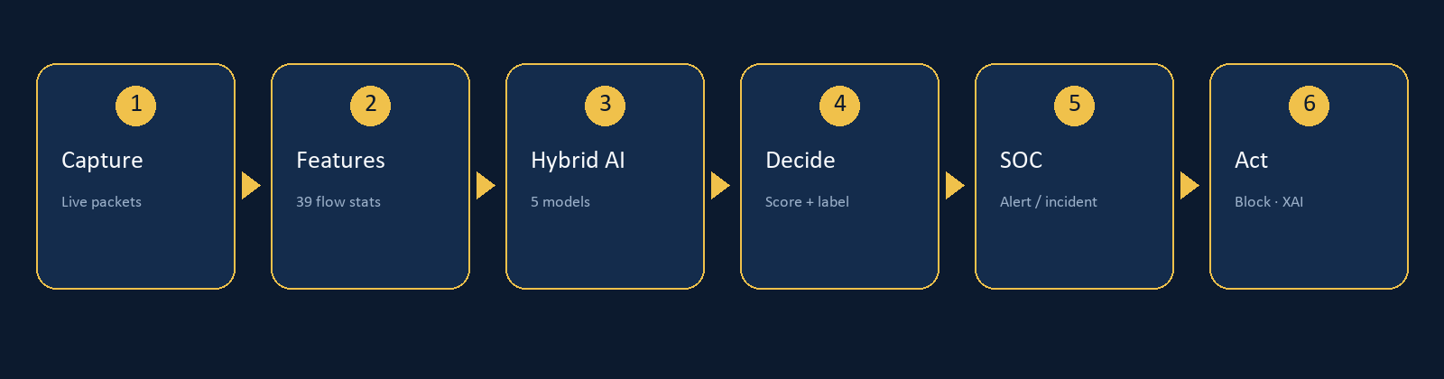
CH. 3 · ARCHITECTURE
From packet to playbook — on one machine.
run.bat starts FastAPI (:8000) and Streamlit (:8501). SQLite stores flows, predictions, alerts, XAI, blocks, and incidents. PostgreSQL is optional. A supervisor can auto-recover; run_capture.bat is the 24/7 sensor.
AI Network Analyzer · Architecture · AUCE 2026 · v1.0.0
10 / 32
Notes:
Walk left to right. Click each stage. This is the backbone of the oral defense.

Slide 11
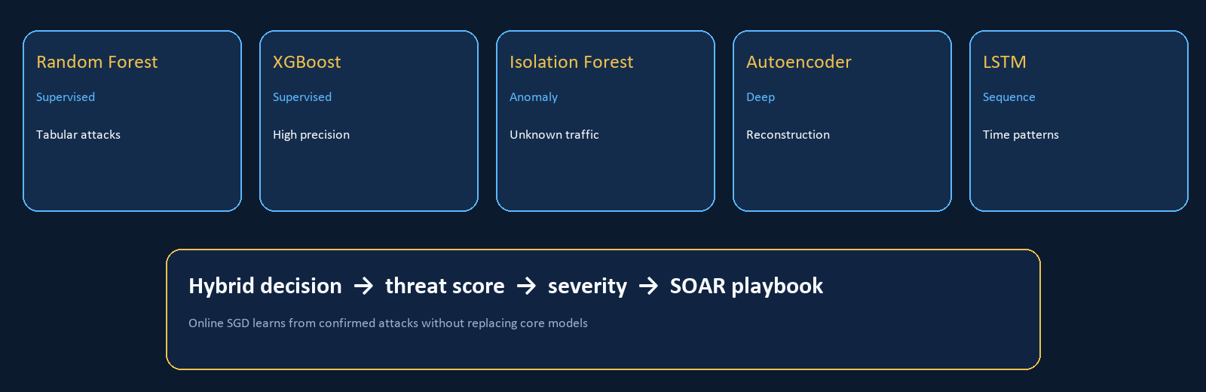
CH. 3 · HYBRID AI ENGINE
Five brains. One decision.
AI Network Analyzer · Hybrid AI · AUCE 2026 · v1.0.0
11 / 32
Notes:
Emphasize hybrid: supervised + anomaly + deep + sequence + online learning that does not overwrite cores.

Slide 12
CH. 4 · TECHNOLOGY STACK
A stack a senior can defend.
Python 3
FastAPI
Streamlit
SQLite
Core language
REST API :8000
SOC UI :8501
Local store · Postgres optional
Scikit-learn
XGBoost
PyTorch
Scapy
RF / Isolation Forest
Gradient boosting
AE / LSTM
Live capture
Telegram
MITRE map
SOAR
Reports
Analyst notify
ATT&CK linkage
Playbook actions
CSV / JSON export
AI Network Analyzer · Stack · AUCE 2026 · v1.0.0
12 / 32
Notes:
Keep it visual. Python is the spine. FastAPI + Streamlit + SQLite is the body.

Slide 13
CH. 4 · DASHBOARD PAGES 01–08
Every page, with its job.
01
Home
SOC pulse: KPIs, charts, shortcuts, recent alerts and blocks
02
Live Monitoring
Select NIC, start/stop capture, live-evidence snapshot
03
AI Detection
Hybrid inference, labels, threat score, stored per-flow XAI
04
Threat Simulation
Inject lab campaigns into the same live detection path
05
Threat Intelligence
IP reputation, geo, stored intel records
06
Alerts
Analyst inbox: status, MITRE, true/false-positive notes
07
Blocked IPs
Manual and automatic block, reason, unblock
08
AI Models
Accuracy table, retrain from CSV, online learning status
AI Network Analyzer · SOC catalog · AUCE 2026 · v1.0.0
13 / 32
Notes:
Name each page and its job. Home through AI Models.

Slide 14
CH. 4 · DASHBOARD PAGES 09–16
Operations, hunting, and response.
09
Reports
Detection, Incidents, Export, Compliance, Live Evidence
10
Settings
General, Telegram, AI Config, NDR/Response, Clear Data, Company
11
SOC Ops
MITRE, SOAR playbooks, online learning, server health, ML registry
12
Incidents
Group related alerts into one case; owner, status, recommendation
13
Assets
Inventory, risk, topology, host profile, identity / UEBA
14
Hunting
Query by IP/attack/protocol; PCAP; DNS/TLS forensics
15
Response
IOC, allow/block, approvals, webhooks, distributed sensors
16
Copilot
Natural-language questions, incident summary, per-alert XAI
AI Network Analyzer · SOC catalog · AUCE 2026 · v1.0.0
14 / 32
Notes:
Finish the 16. Tabs matter: SOC Ops, Settings, Reports, Assets, Hunting, Response.

Slide 15
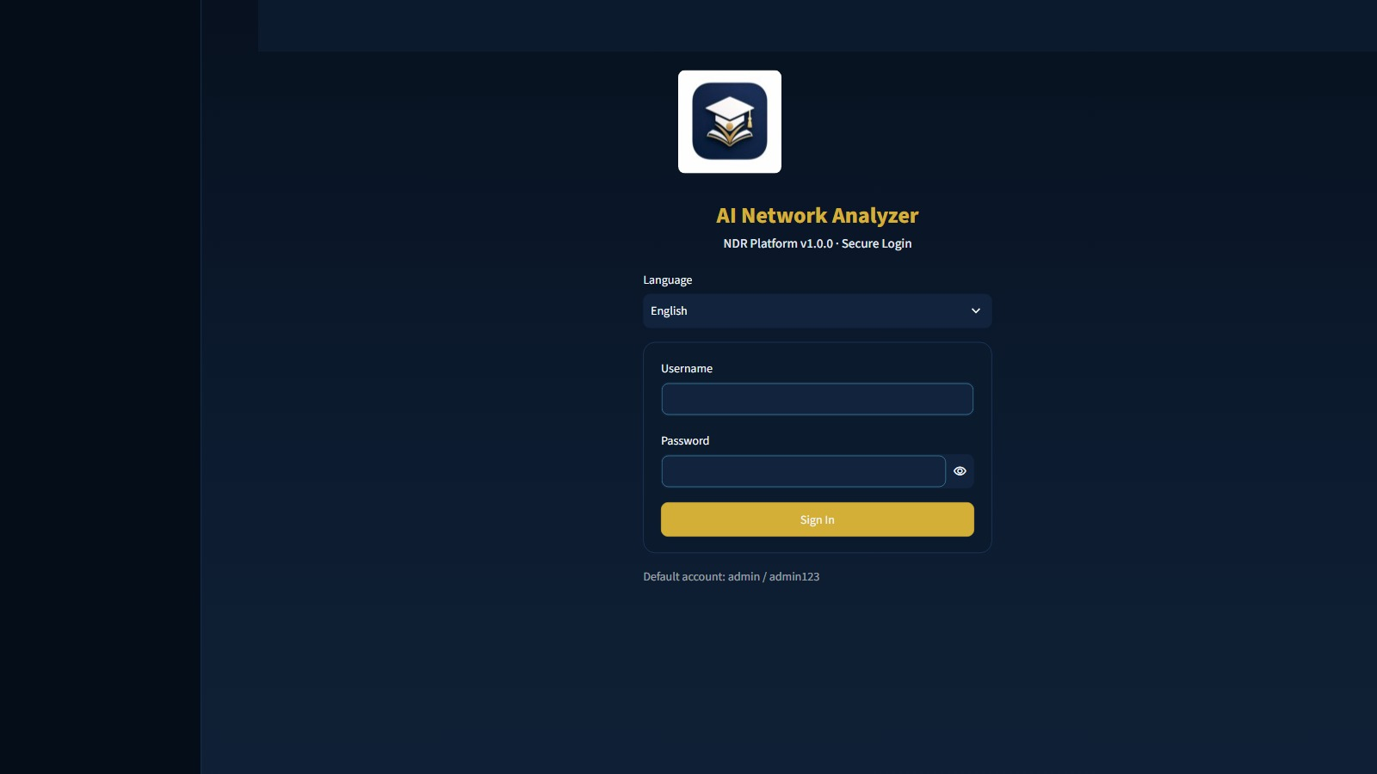
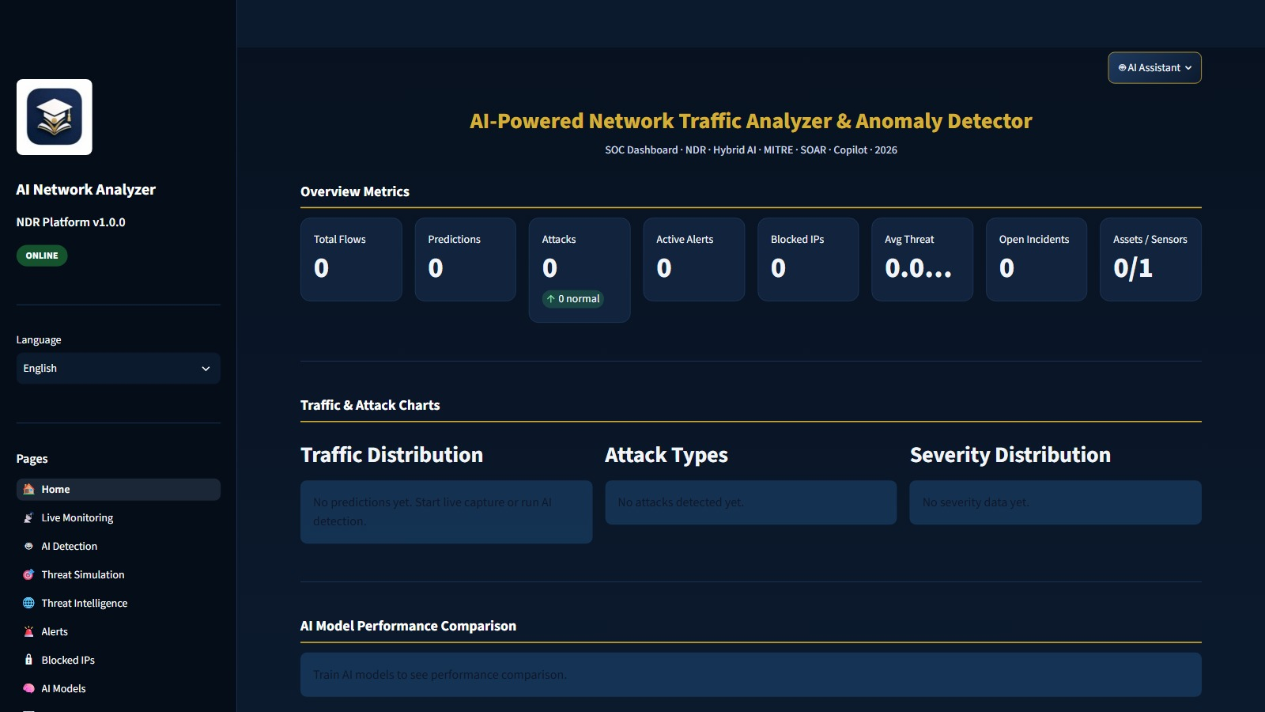
CH. 4 · PAGE 01
Login, then the SOC pulse.
Login · v1.0.0 · administrator
01 Home · KPIs, charts, shortcuts
AI Network Analyzer · Live path · AUCE 2026 · v1.0.0
15 / 32
Notes:
Administrator session. Home is page 01 — the operator glass.

Slide 16
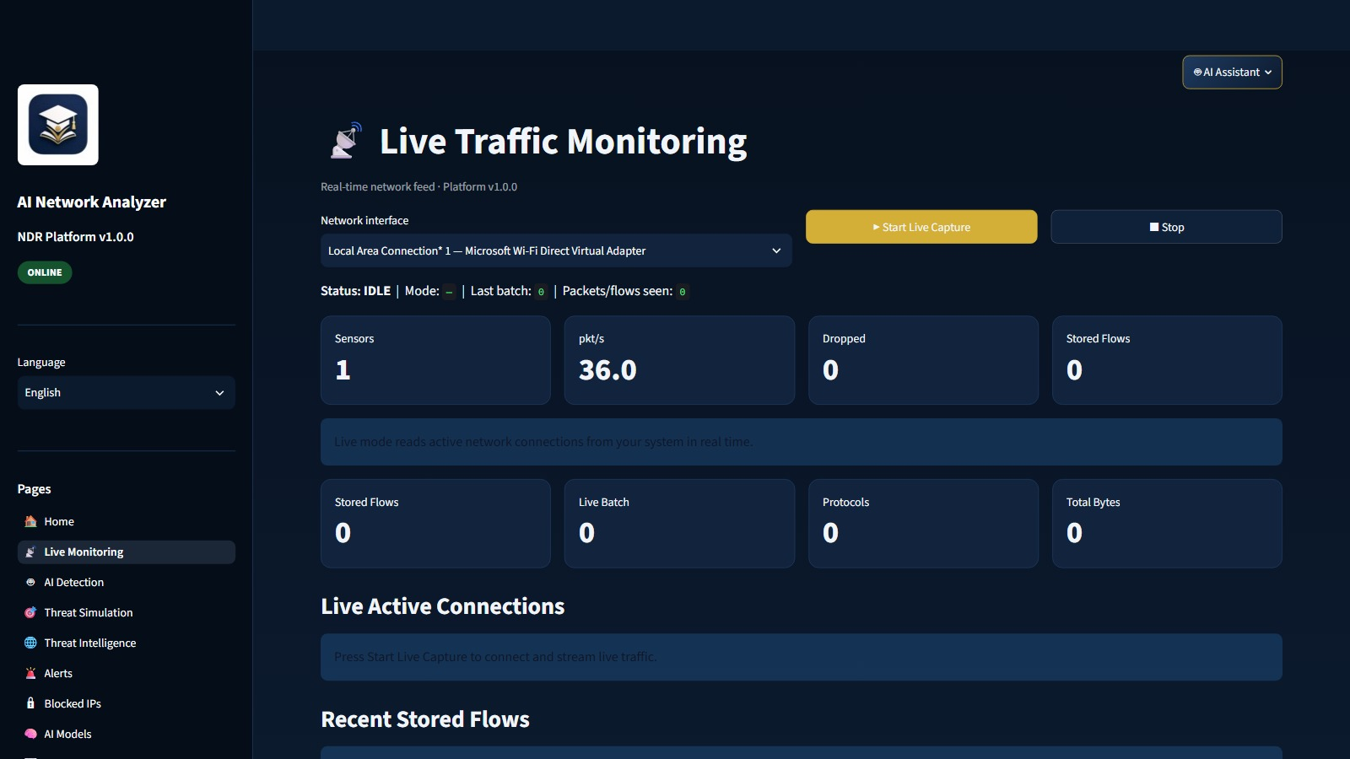
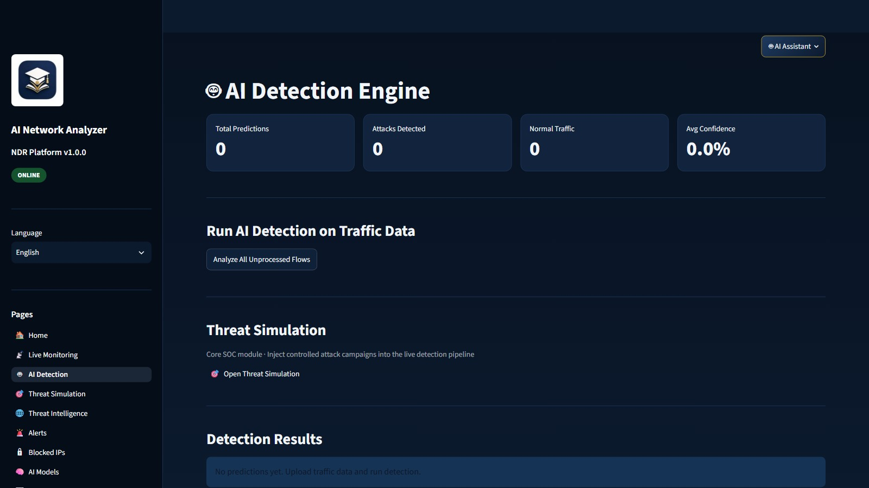
CH. 4 · PAGES 02–03
Traffic in. Verdicts out.
02 Live Monitoring · interface and flows
03 AI Detection · hybrid inference
AI Network Analyzer · Capture & AI · AUCE 2026 · v1.0.0
16 / 32
Notes:
Live NIC capture feeds hybrid detection.

Slide 17
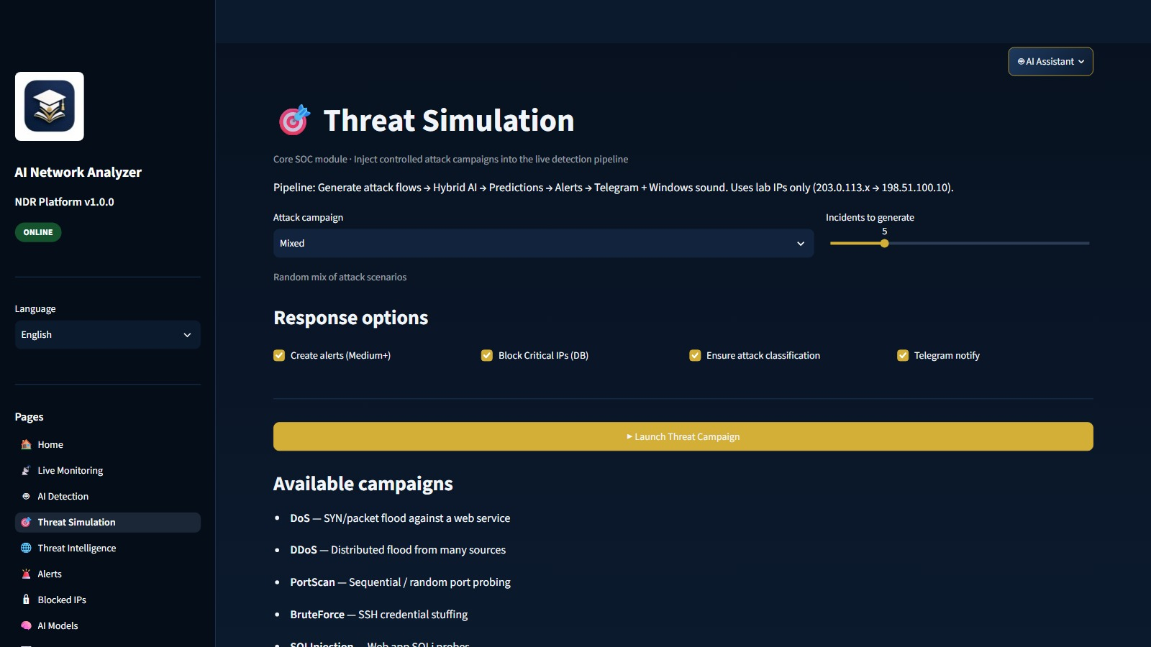
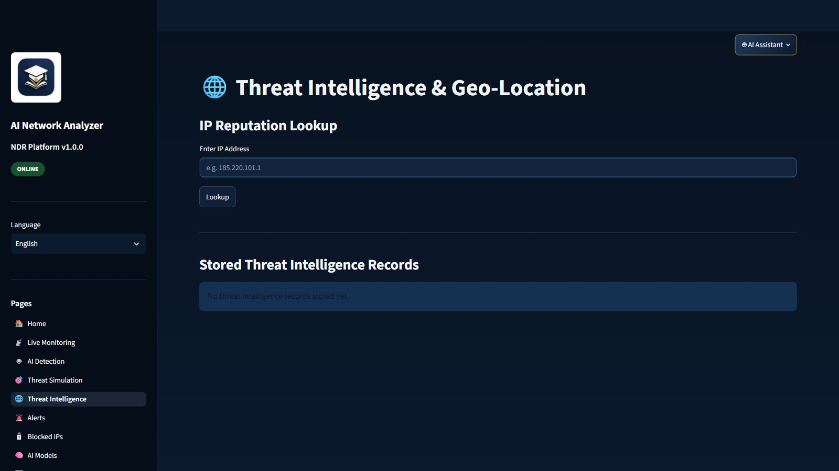
CH. 4 · PAGES 04–05
Inject a campaign. Enrich the IP.
04 Threat Simulation · lab campaigns
05 Threat Intelligence · reputation + geo
AI Network Analyzer · Simulation · AUCE 2026 · v1.0.0
17 / 32
Notes:
Simulation uses the real pipeline. TI is reputation plus geo.

Slide 18
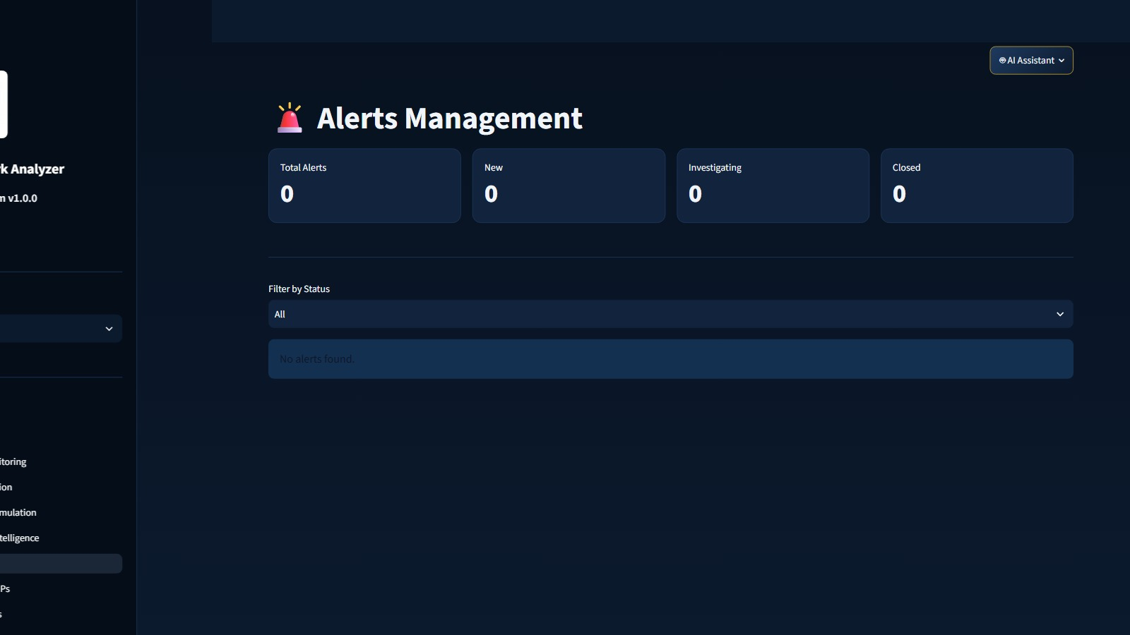
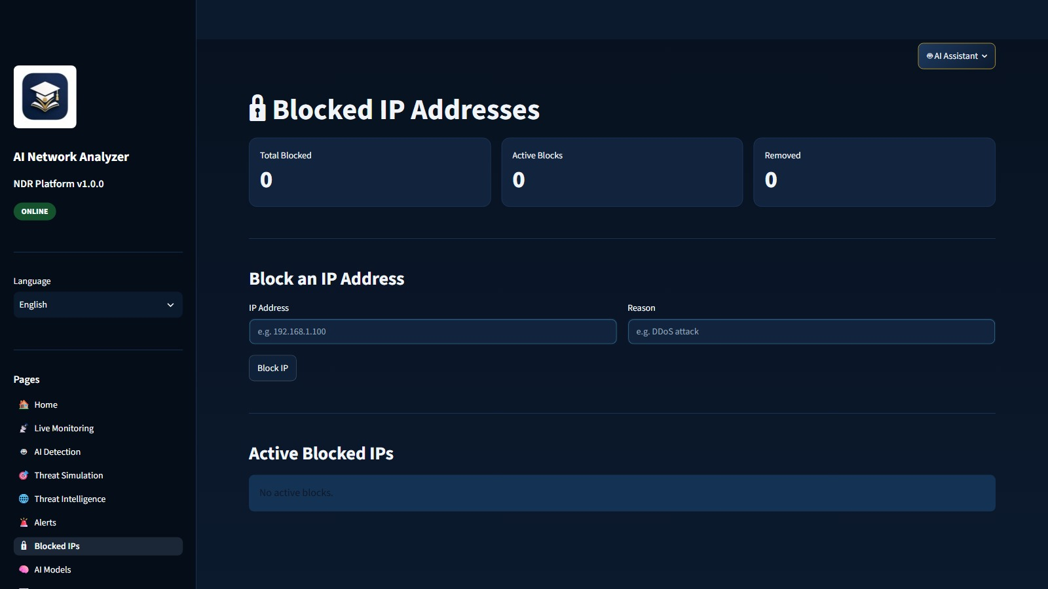
CH. 4 · PAGES 06–07
The inbox and the block list.
06 Alerts · status, MITRE, analyst notes
07 Blocked IPs · block and unblock
AI Network Analyzer · Alerts & blocks · AUCE 2026 · v1.0.0
18 / 32
Notes:
Alerts are the analyst queue. Blocked IPs are the control list.

Slide 19
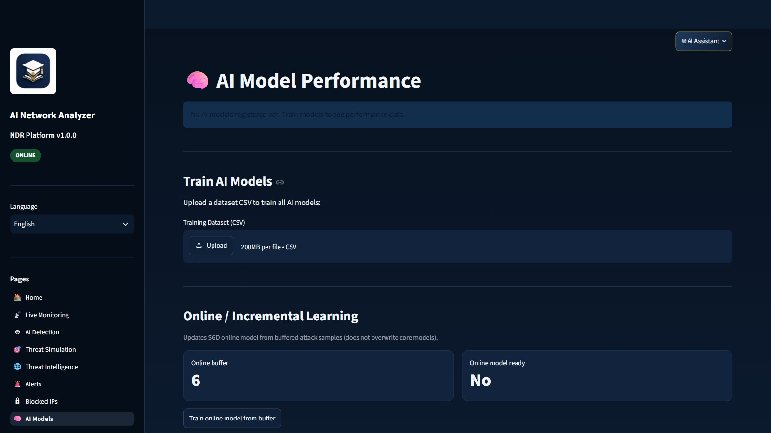
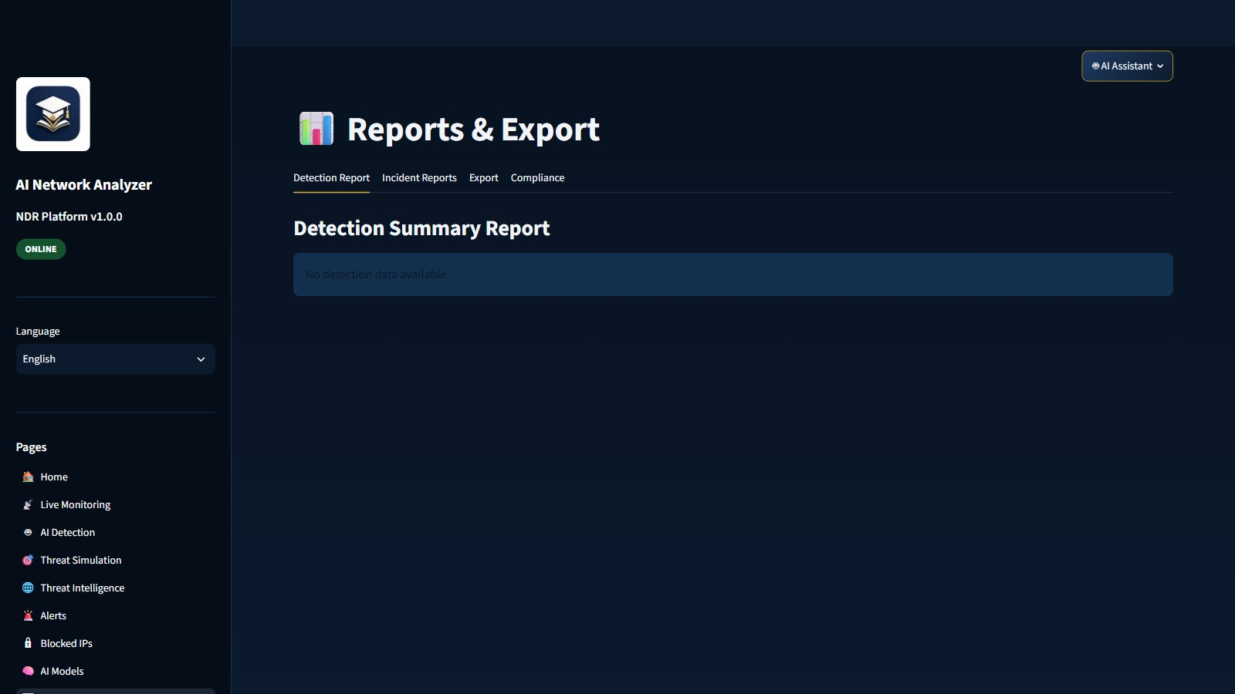
CH. 4 · PAGES 08–09
Measure the models. Export the proof.
08 AI Models · accuracy, precision, F1
09 Reports · CSV, Live Evidence, compliance
AI Network Analyzer · Models & reports · AUCE 2026 · v1.0.0
19 / 32
Notes:
AI Models holds metrics and retrain. Reports: Detection, Incidents, Export, Compliance, Live Evidence.

Slide 20
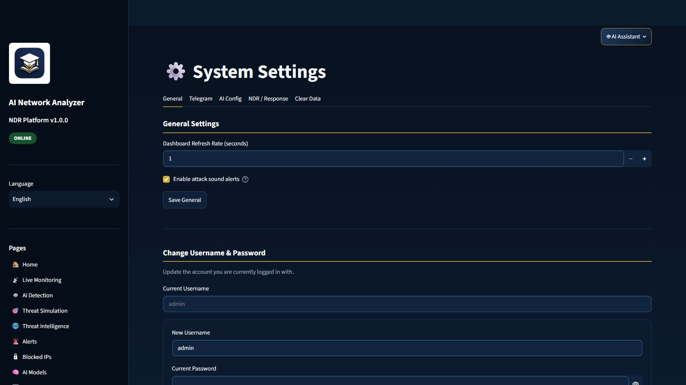
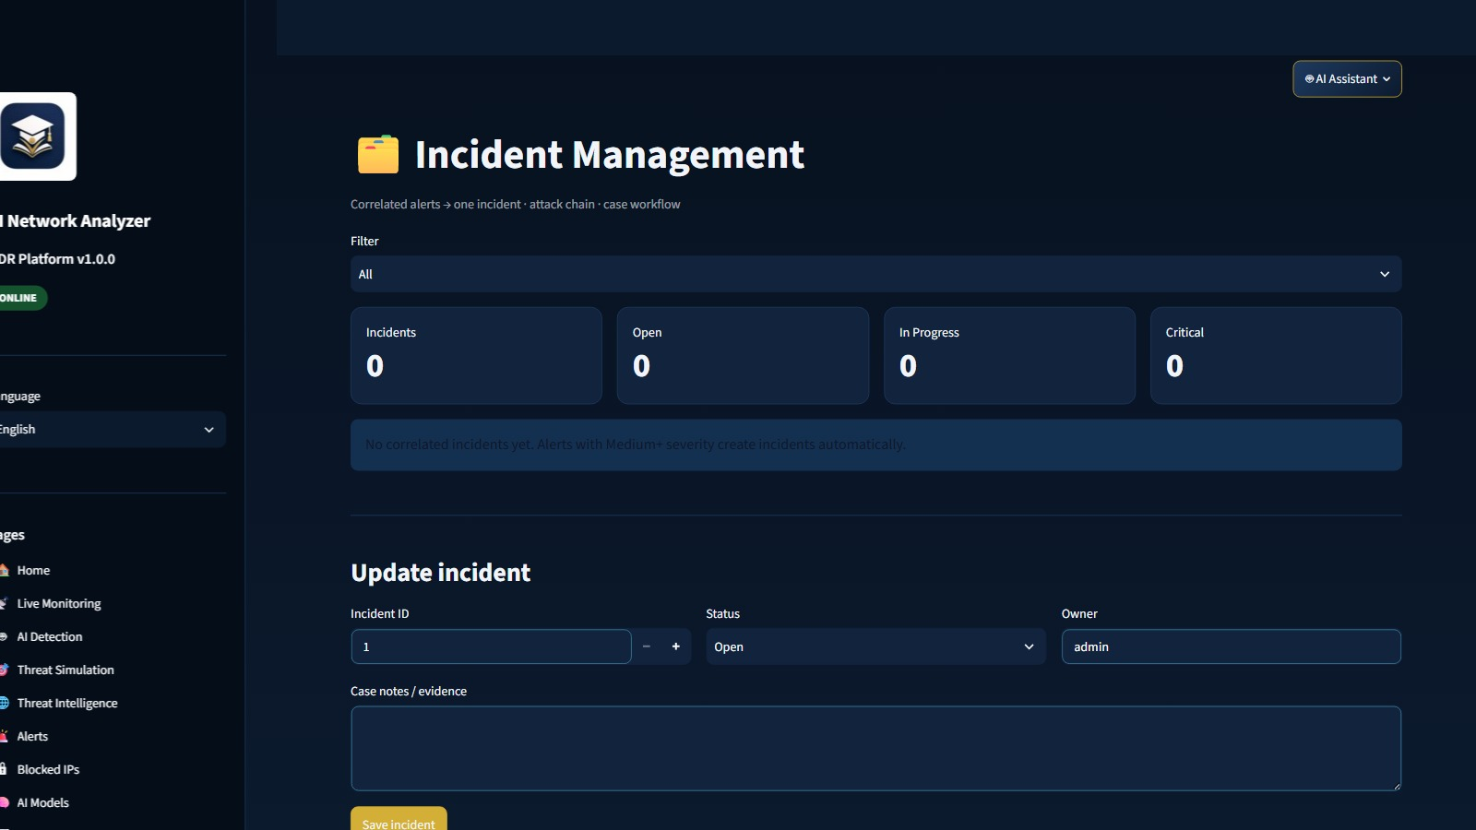
CH. 4 · PAGES 10 AND 12
Configure the platform. Case the alerts.
10 Settings · General, Telegram, AI, NDR, Clear, Company
12 Incidents · cases, owner, status
AI Network Analyzer · Settings & incidents · AUCE 2026 · v1.0.0
20 / 32
Notes:
Settings tabs: General, Telegram, AI, NDR, Clear, Company. Incidents group alerts into cases.

Slide 21
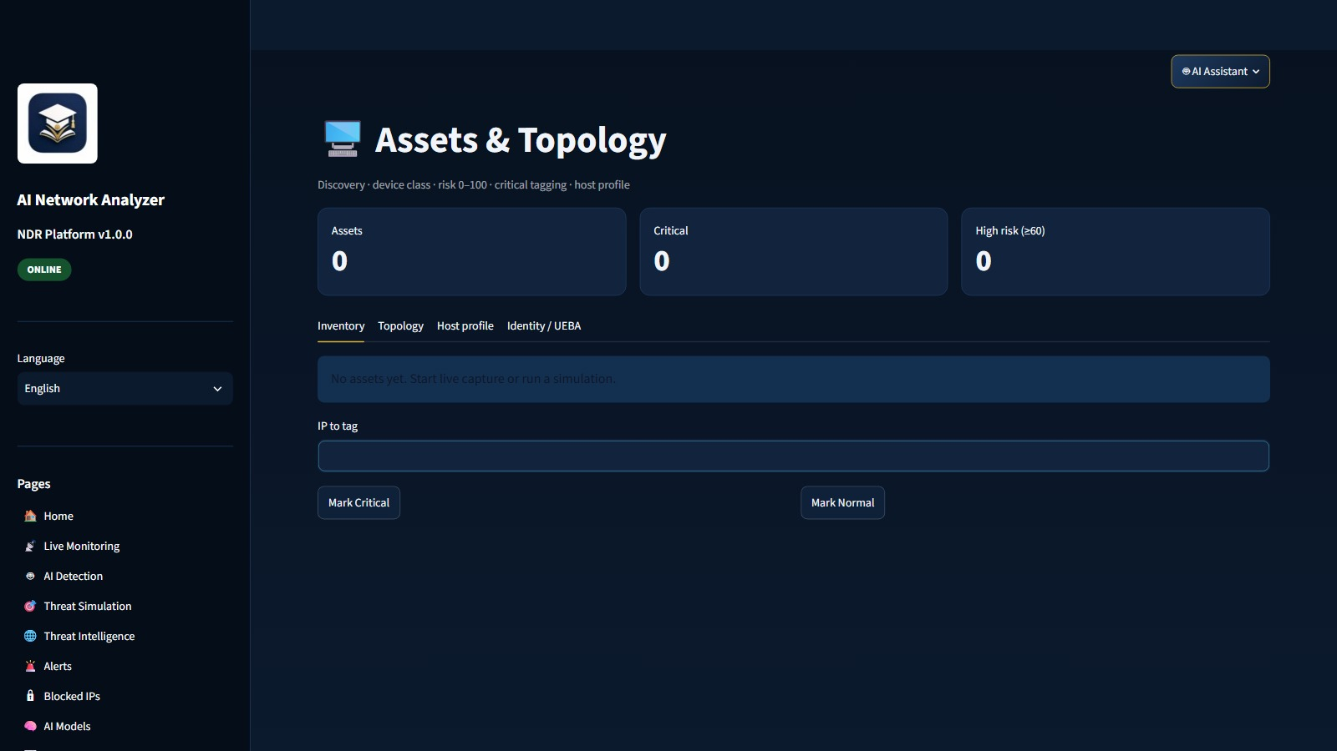
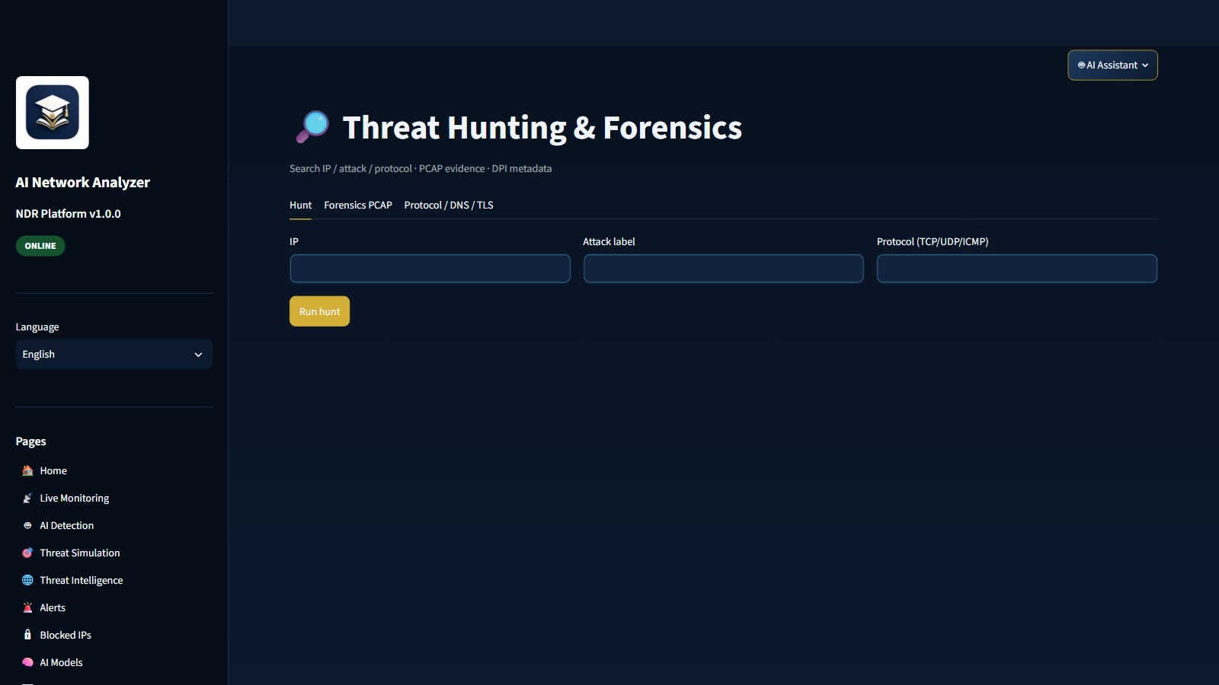
CH. 4 · PAGES 13–14
Know the host. Hunt the trail.
13 Assets · inventory, topology, host profile
14 Hunting · hunt, PCAP, DNS/TLS
AI Network Analyzer · Assets & hunting · AUCE 2026 · v1.0.0
21 / 32
Notes:
Assets: inventory, topology, UEBA. Hunting: query, PCAP, protocol.

Slide 22
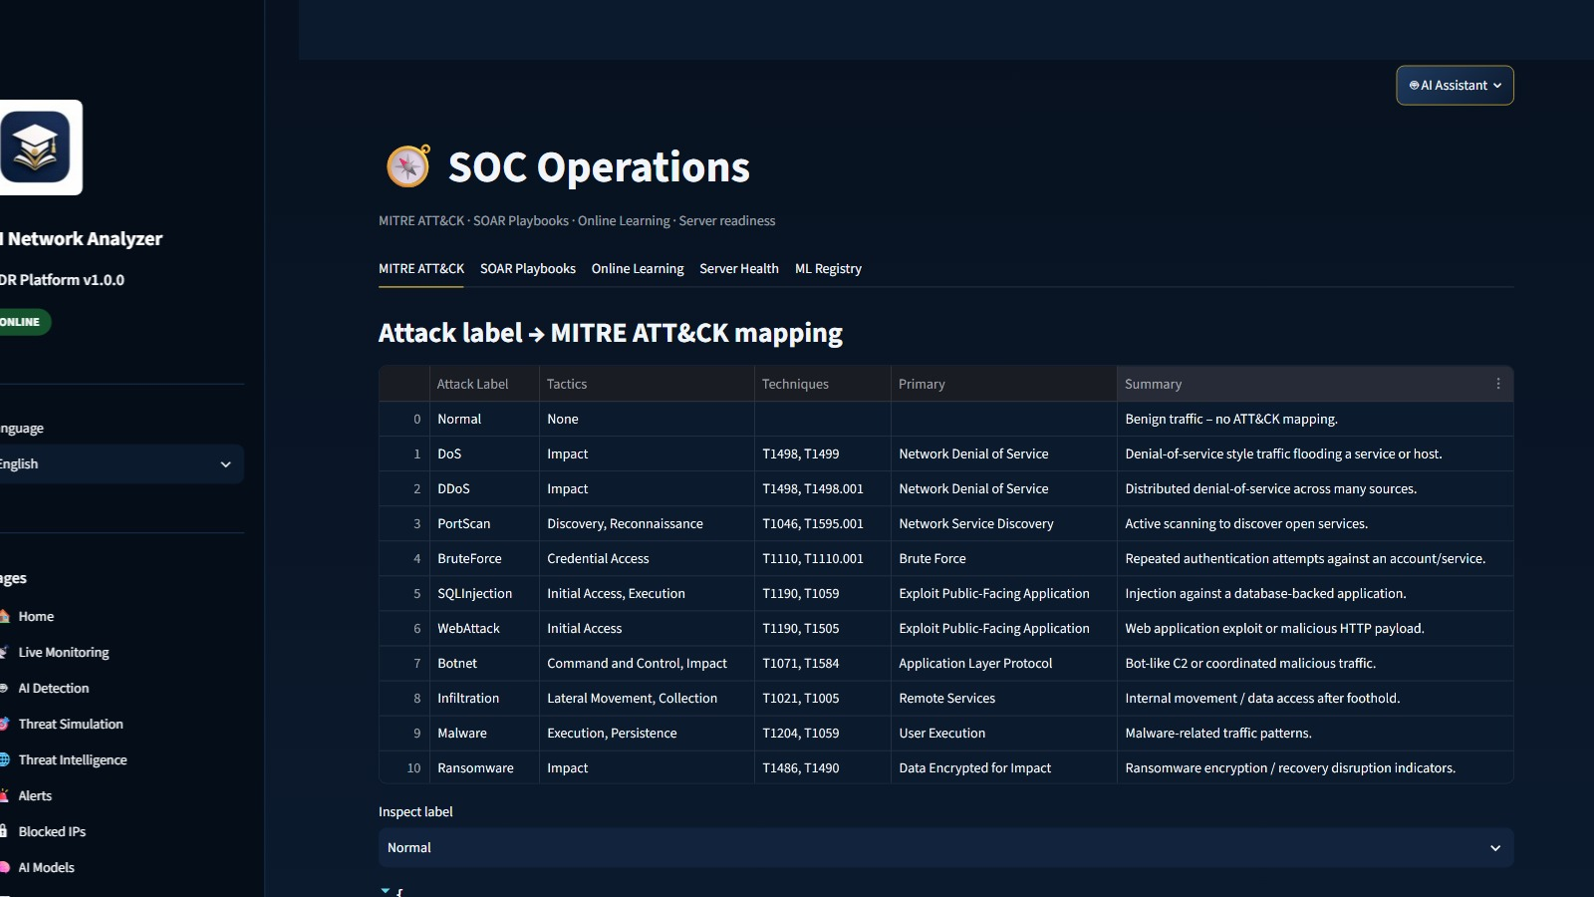
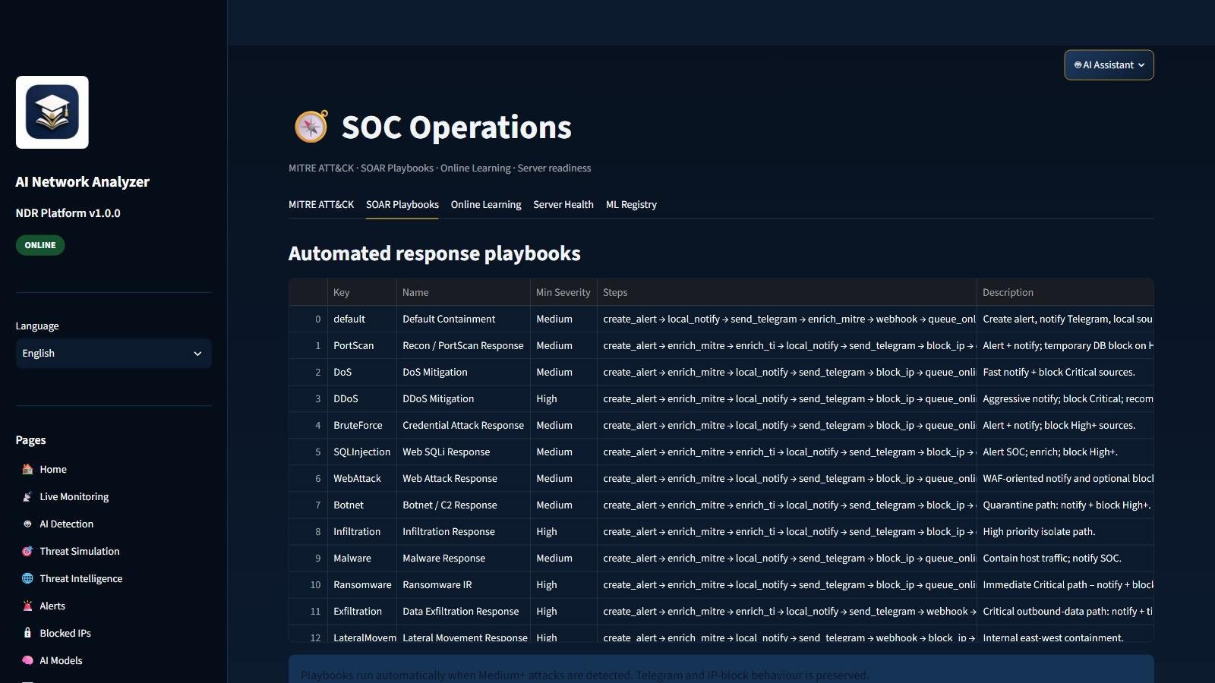
CH. 4 · PAGE 11
Map the technique. Run the playbook.
11 SOC Ops · MITRE ATT&CK
11 SOC Ops · SOAR playbooks
AI Network Analyzer · SOC Ops · AUCE 2026 · v1.0.0
22 / 32
Notes:
SOC Ops tabs: MITRE, SOAR, online learning, server health, ML registry.

Slide 23
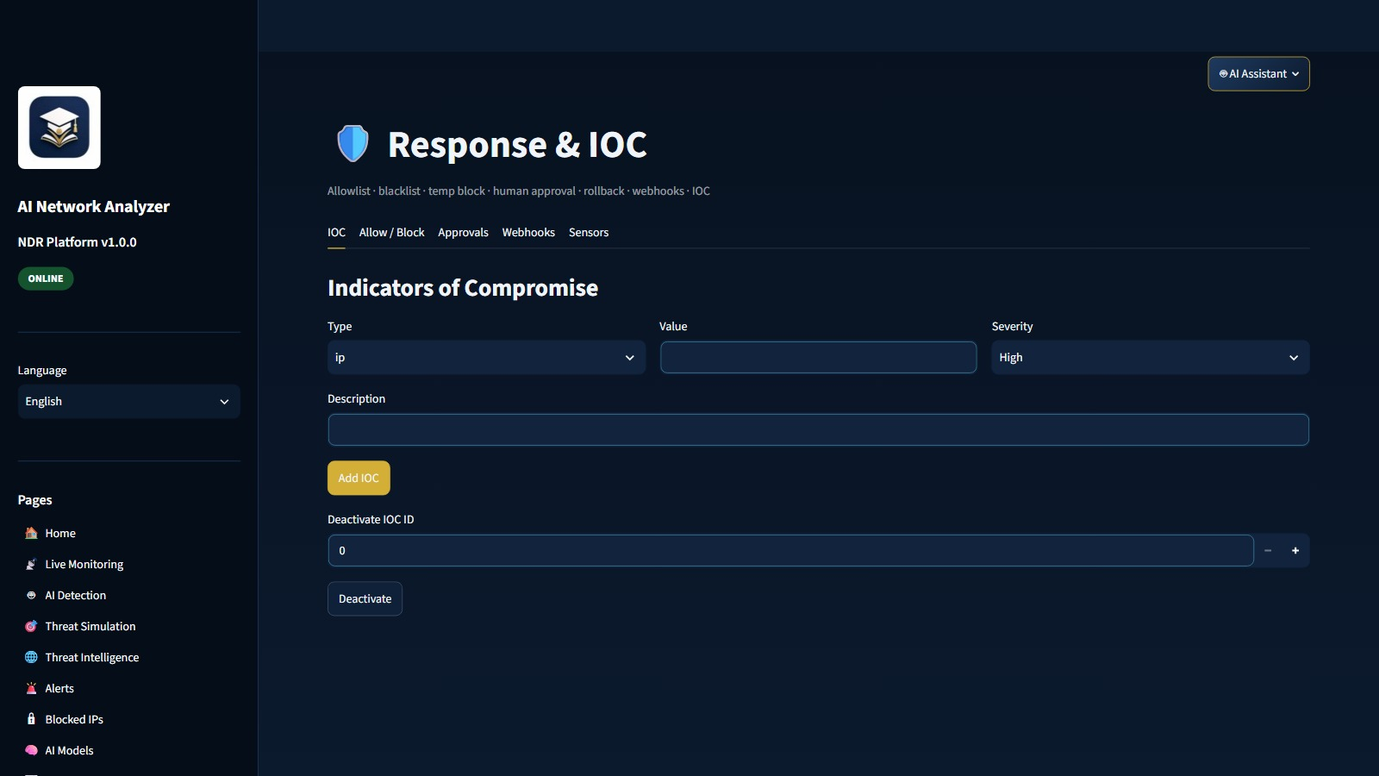
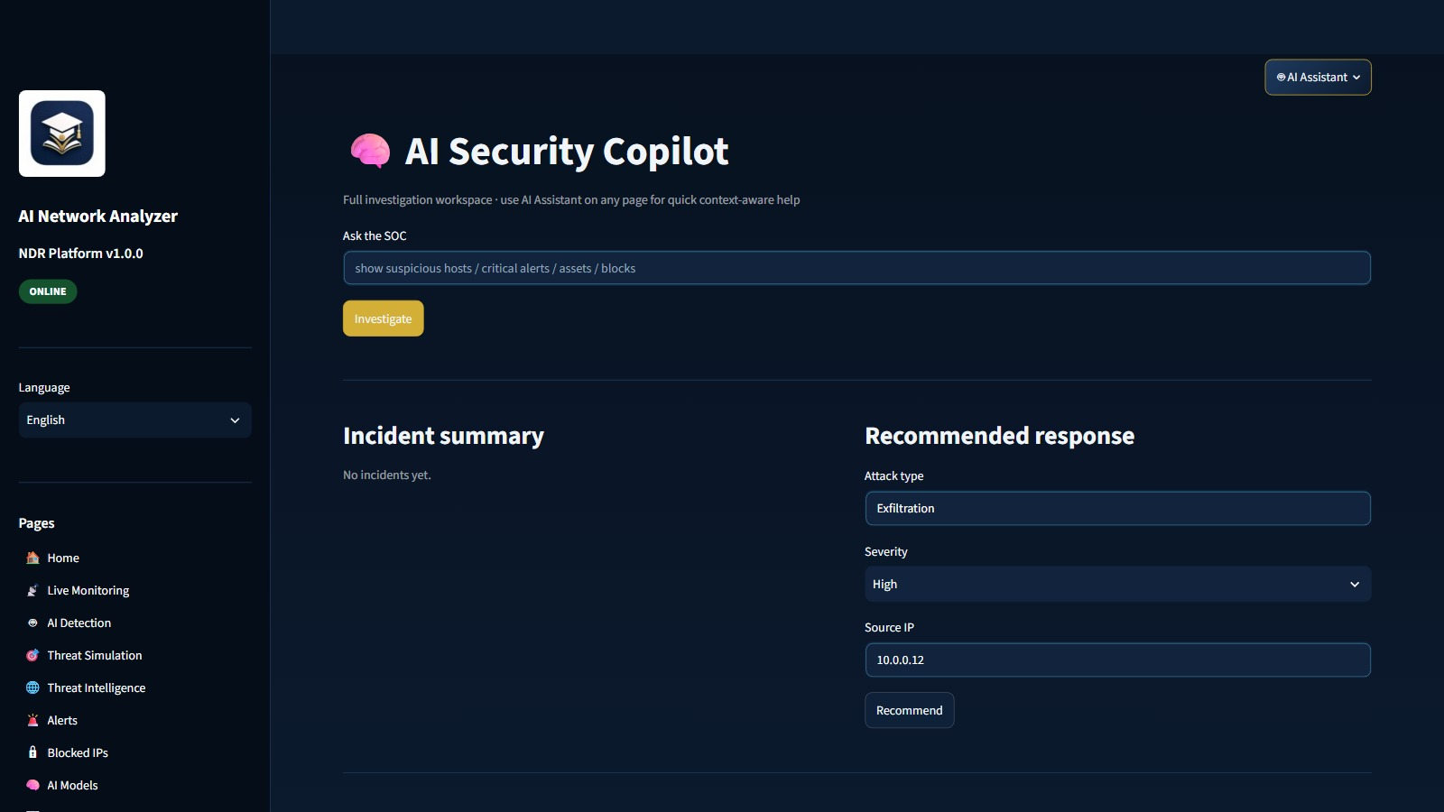
CH. 4 · PAGES 15–16
Ask why. Then allow, block, or wait.
15 Response · IOC, allow, block, sensors
16 Copilot · natural-language assist
AI Network Analyzer · Explain & act · AUCE 2026 · v1.0.0
23 / 32
Notes:
Response: IOC, allow/block, approvals, webhooks, sensors. Copilot explains with stored XAI.

Slide 24
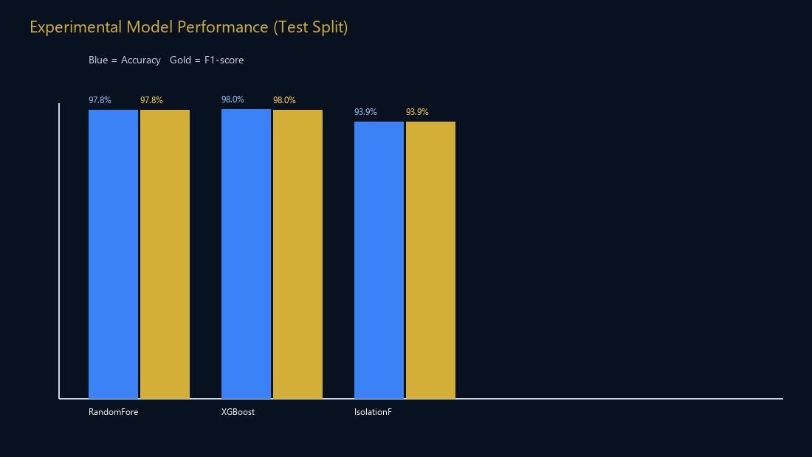
CH. 5 · TESTING AND EVALUATION
Table 9 and Table 11. Same measured holdout.
RANDOM FOREST
XGBOOST
ISOLATION FOREST
EVAL SET
97.8%
98.0%
93.9%
12k
Accuracy & weighted F1
Accuracy & weighted F1
Normal vs Attack proxy
rows · 39 features · 6 classes
ACADEMIC SCOPE
Same numbers as the paper Table 9 / Table 11. 12,000-row CICIDS-style holdout, 39 features, six classes, 75/25 split, random_state=42. Not an official CICIDS2017 leaderboard. AE/LSTM/Hybrid run in the engine.
AI Network Analyzer · Results · AUCE 2026 · v1.0.0
24 / 32
Notes:
Say the numbers, then the disclaimer in the same breath. Honesty is a grade.

Slide 25
CH. 6 · STRENGTHS
What this work already does well.
End-to-end SOC
Hybrid AI
Same pipeline
16 real pages from capture to Copilot — not a mock dashboard.
RF, XGBoost, Isolation Forest, Autoencoder, LSTM, plus online SGD.
Live traffic and simulated campaigns share detect → alert → respond.
Operations
Honest science
Defendable stack
MITRE, SOAR, Telegram, stored XAI, Company trial, human-approval mode.
97.8% RF / 98.0% XGB on a 12k CICIDS-style holdout, with an explicit academic-scope disclaimer.
Local FastAPI, Streamlit, SQLite (Postgres optional) — launchable from the desktop.
AI Network Analyzer · Strengths · AUCE 2026 · v1.0.0
25 / 32
Notes:
Own the strengths. Then the weaknesses. The jury respects both.

Slide 26
CONCLUSION · CONTRIBUTIONS
What this project adds.
01
02
03
04
Working NDR 2.0
Hybrid AI loop
Operations layer
Honest evaluation
A local, versioned SOC product — not a single notebook.
Five detectors plus online learning that preserves core models.
MITRE, SOAR, incidents, hunting, Copilot, Telegram, and response control.
12k CICIDS-style holdout, stored XAI, and live-versus-simulation evidence.
AI Network Analyzer · Contributions · AUCE 2026 · v1.0.0
26 / 32
Notes:
Four bullets only. This is what you added beyond a model file.

Slide 27
CH. 6 · LIMITATIONS
Scope we state on purpose.
Evaluation uses a 12,000-row CICIDS-style set — not an official CICIDS2017 leaderboard.
Prototype is local (SQLite default, optional Postgres). It is not a clustered enterprise NDR.
Live capture needs OS permissions and a selected NIC; results depend on that room.
Company trial (roles, backup, SIEM hooks) is a laboratory/office pilot, not Active Directory SSO.
Headline numbers focus on RF / XGBoost / Isolation Forest; AE and LSTM are in the engine.
AI Network Analyzer · Limitations · AUCE 2026 · v1.0.0
27 / 32
Notes:
State scope before they ask. It signals academic maturity, not a weak product.

Slide 28
CH. 6 · FUTURE WORK
Where this NDR should go next.
Public benchmarks
Explain every hit
Retrain and report on full CICIDS2017 and UNSW-NB15 with published splits.
Keep stored per-alert XAI; add SHAP plots for high-severity alerts.
Sensor fleet
Hardening
SPAN/TAP or multi-host sensors beyond the local NIC and 24/7 capture daemon.
Active Directory SSO and a full container stack — roles, backup, and SIEM hooks already started.
AI Network Analyzer · Vision · AUCE 2026 · v1.0.0
28 / 32
Notes:
Vision is future work with a direction. Keep it credible.

Slide 29
CH. 7–8 · DEMONSTRATION
Seven clicks the jury should see.
01
02
03
04
Launch run.bat / desktop shortcut
Sign in as administrator
Start live capture
Launch a mixed campaign
05
06
07
Run hybrid detection
Open alert + stored XAI
Block + Telegram + Copilot
AI Network Analyzer · Demo path · AUCE 2026 · v1.0.0
29 / 32
Notes:
If live demo fails, this slide is the backup story. Memorize the seven steps.

Slide 30
CONCLUSION
A working academic NDR. Measured. Scoped.
1
The problem was detecting known and unknown attacks without a full capture–detect–respond loop.
2
The solution is the implemented local NDR: hybrid AI, 16 SOC pages, stored XAI, Telegram, and optional company-trial hardening.
3
The evidence is the running system plus Table 11: RF 97.8%, XGB 98.0%, IF 93.9% on a 12,000-row CICIDS-style holdout — not a CICIDS2017 leaderboard.
AI Network Analyzer · Conclusion · AUCE 2026 · v1.0.0
30 / 32
Notes:
Three sentences. Then stop. Invite questions.

Slide 31
SELECTED REFERENCES
Sources the jury will recognise.
• Breiman, L. (2001) Random forests. Machine Learning.
• Chen, T. and Guestrin, C. (2016) XGBoost. KDD.
• Liu, F.T., Ting, K.M. and Zhou, Z.-H. (2008) Isolation Forest. ICDM.
• Sharafaldin et al. CICIDS2017 — Canadian Institute for Cybersecurity.
• MITRE ATT&CK® framework. MITRE Corporation.
• Scikit-learn, XGBoost, PyTorch, Streamlit, FastAPI documentation.
• Full Harvard-style list: AUCE research paper (desktop / appendix).
AI Network Analyzer · References · AUCE 2026 · v1.0.0
31 / 32
Notes:
Do not read all. Point to the paper. Mention MITRE, CICIDS, XGBoost, RF.

Slide 32
Thank you.
Questions, challenges, and live walkthroughs are welcome.
Mahmoud Talal Kanaan · AUCE 2026 · AI Network Analyzer v1.0.0
Desktop launcher · Dashboard :8501 · API :8000
AI Network Analyzer · Q&A · AUCE 2026 · v1.0.0
32 / 32
Notes:
Smile. Repeat the question. Answer in 30–40 seconds. Offer a live page if relevant.

