Slide 1
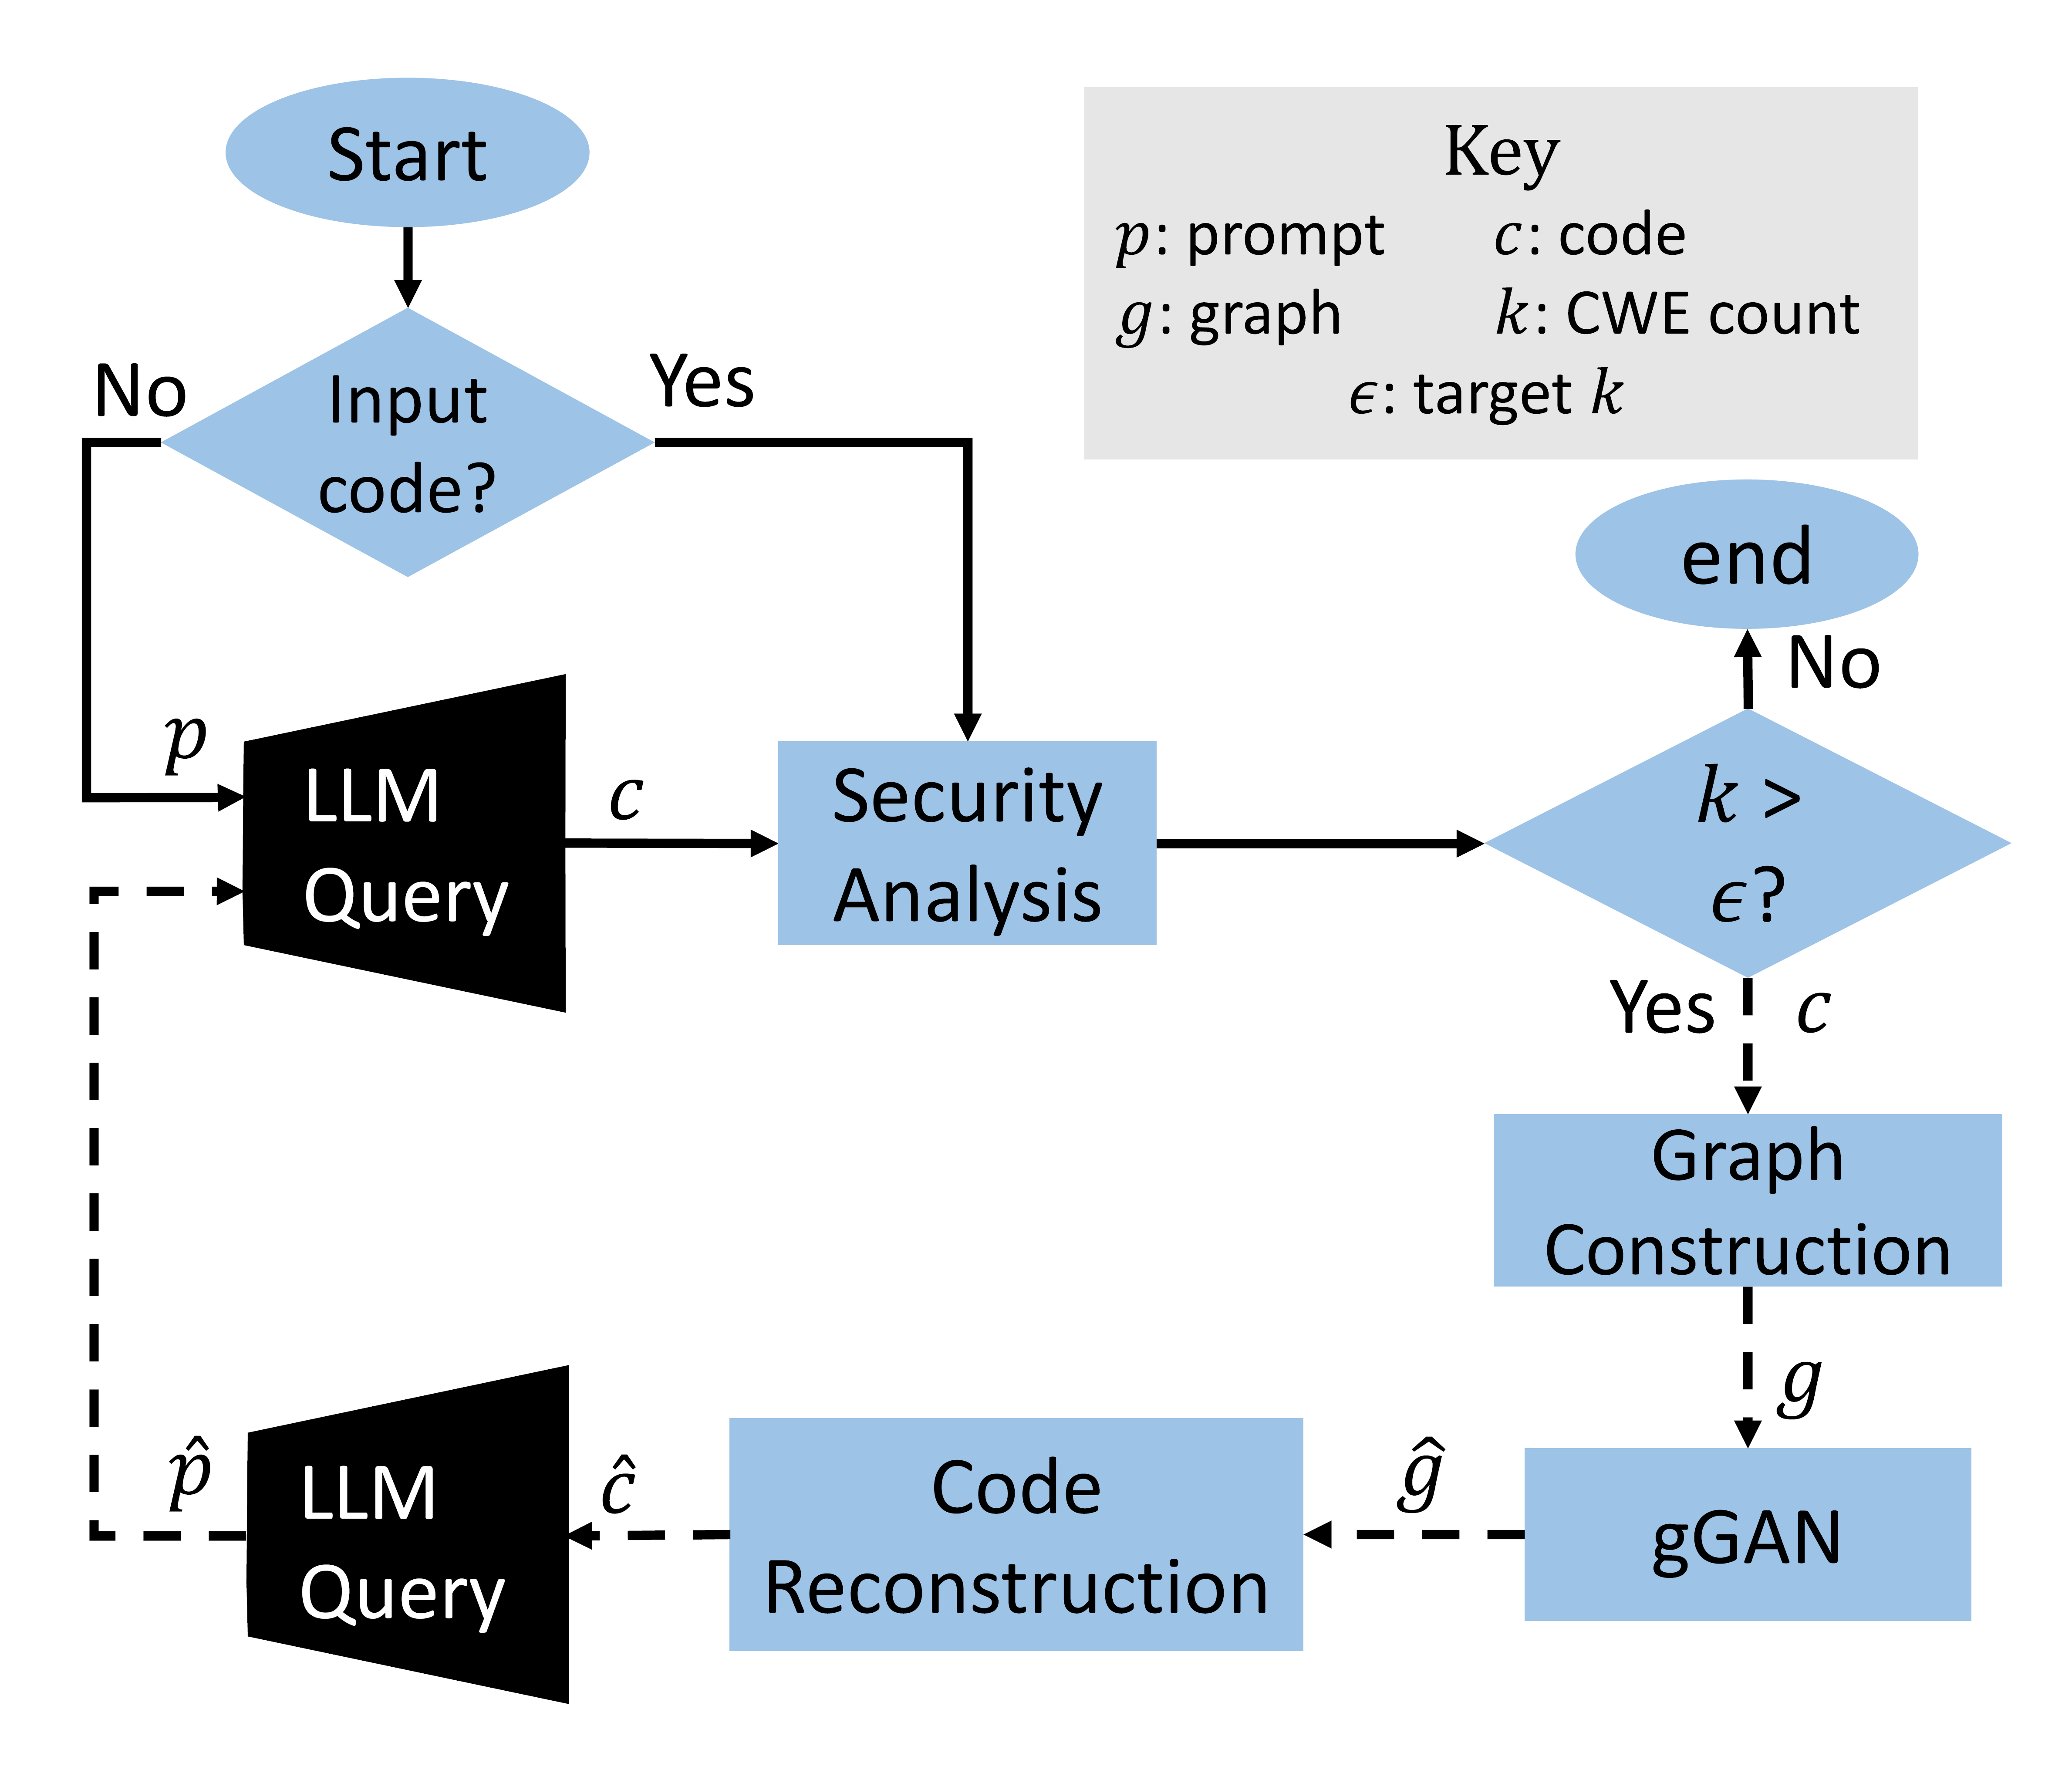
Security
Secure non-functional
Secure functional
LLM
Prompt
optimization
Functionality
Insecure non-functional
Insecure
Functional
LLM
Initial prompt

