Slide 1

Heart disease

Slide 2
Why is heart disease analysis important?
Heart disease analysis is important for several vital reasons related to public health, prevention and treatment. Here are some of the main reasons:
1. High mortality from heart disease
Heart disease is one of the leading causes of death worldwide.
According to the World Health Organization, millions of people die each year from cardiovascular disease.
2. Prediction and prevention
Data analysis helps identify key risk factors, such as:
High blood pressure.
High cholesterol levels.
Age, gender, and daily habits such as smoking.
With this knowledge, prevention and risk reduction strategies (such as awareness programs or lifestyle changes) can be developed

Slide 3
info about Data used in the analysis
Data was obtained from Kaggle.
Link : https://www.kaggle.com/datasets/oktayrdeki/heart-disease/data
Age: The individual's age.
Gender: The individual's gender (Male or Female).
Blood Pressure: The individual's blood pressure (systolic).
Cholesterol Level: The individual's total cholesterol level.
Exercise Habits: The individual's exercise habits (Low, Medium, High).
Smoking: Whether the individual smokes or not (Yes or No).
Family Heart Disease: Whether there is a family history of heart disease (Yes or No).
Diabetes: Whether the individual has diabetes (Yes or No).
BMI: The individual's body mass index.
High Blood Pressure: Whether the individual has high blood pressure (Yes or No).
Low HDL Cholesterol: Whether the individual has low HDL cholesterol (Yes or No).
High LDL Cholesterol: Whether the individual has high LDL cholesterol (Yes or No).
Alcohol Consumption: The individual's alcohol consumption level (None, Low, Medium, High).
Stress Level: The individual's stress level (Low, Medium, High).
Sleep Hours: The number of hours the individual sleeps.
Sugar Consumption: The individual's sugar consumption level (Low, Medium, High).
Triglyceride Level: The individual's triglyceride level.
Fasting Blood Sugar: The individual's fasting blood sugar level.
CRP Level: The C-reactive protein level (a marker of inflammation).
Homocysteine Level: The individual's homocysteine level (an amino acid that affects blood vessel health).
Heart Disease Status: The individual's heart disease status (Yes or No).

Slide 4
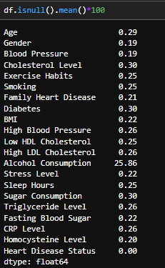
Problems found in the data
Missing Data:

Slide 5
Problems found in the data
Missing Data:

Slide 6
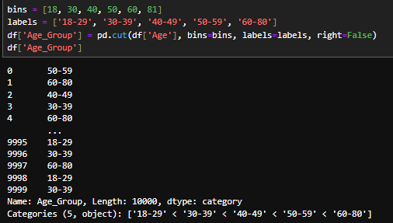
Problems found in the data
New column Age Group:

Slide 7
Exploratory Data Analysis - EDA

Slide 8
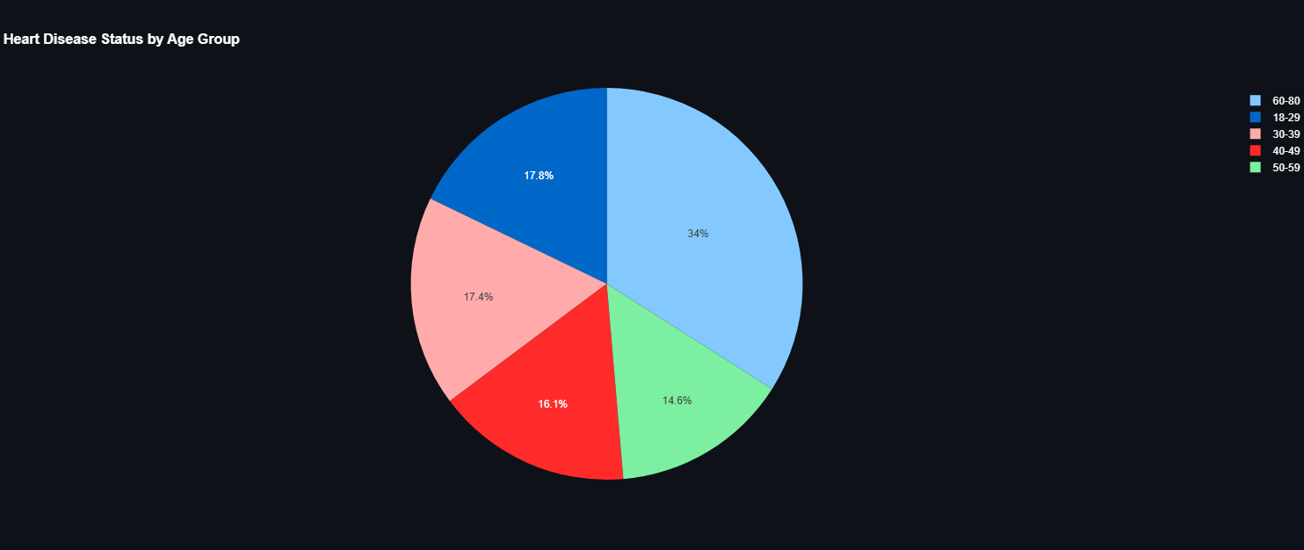
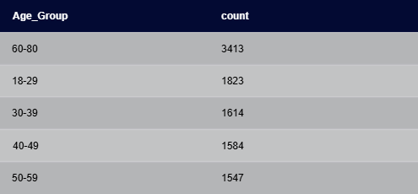
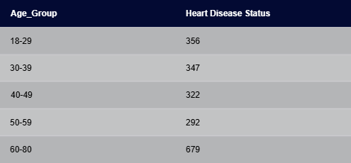

Exploratory Data Analysis - EDA

Slide 9
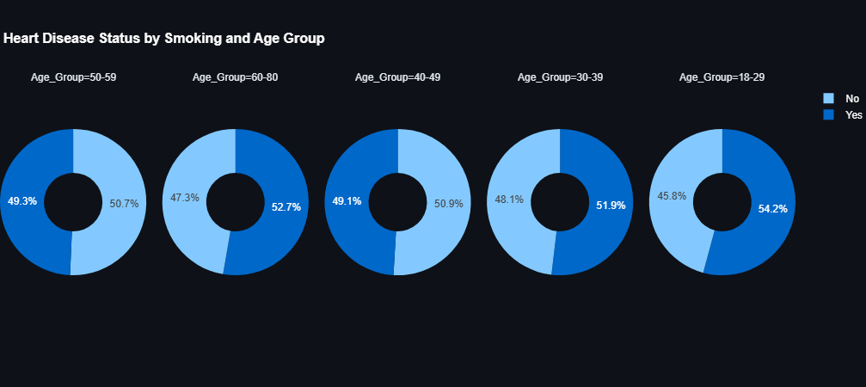


Exploratory Data Analysis - EDA

Slide 10
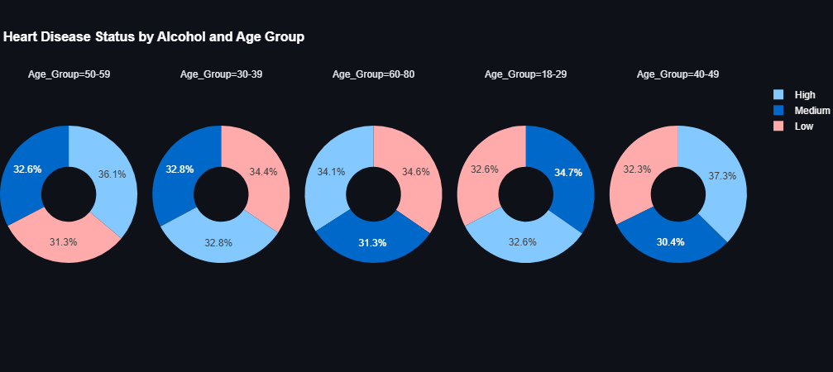
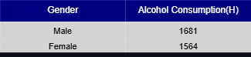
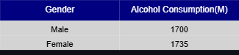

Exploratory Data Analysis - EDA

Slide 11
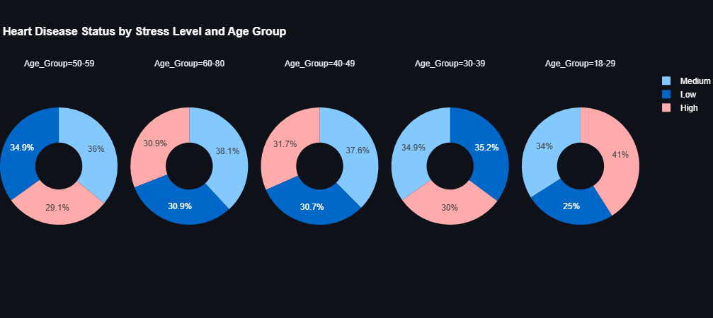
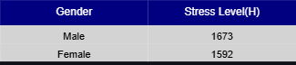
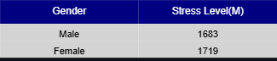
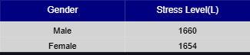
Exploratory Data Analysis - EDA

Slide 12
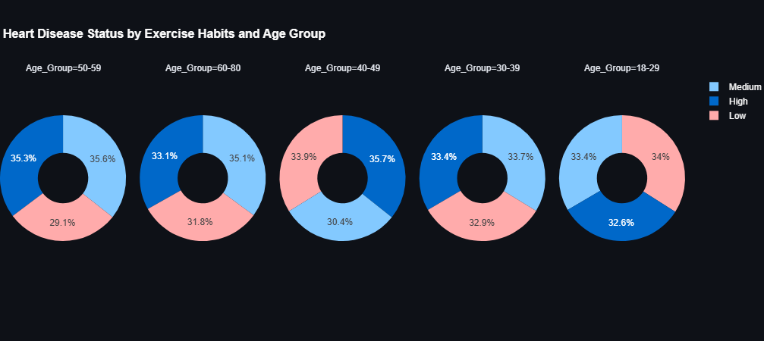
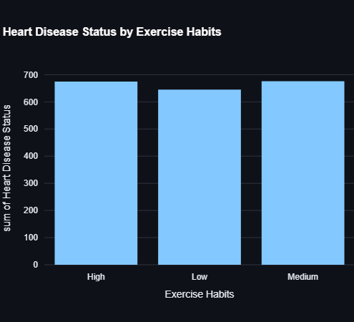
Exploratory Data Analysis - EDA

Slide 13
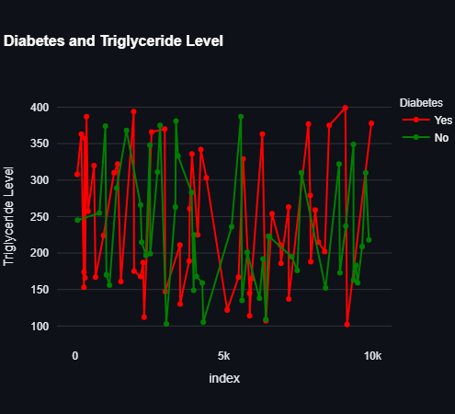
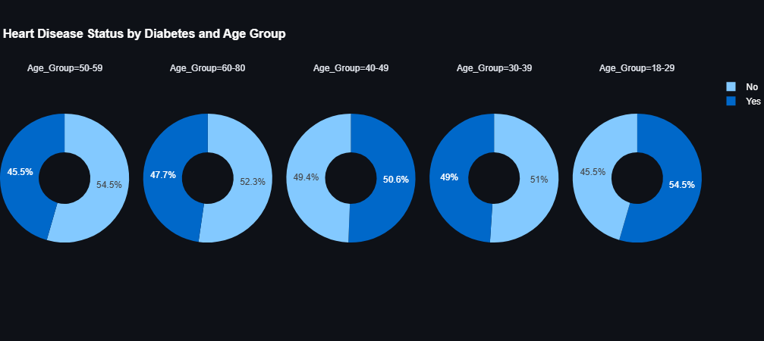

Exploratory Data Analysis - EDA

Slide 14
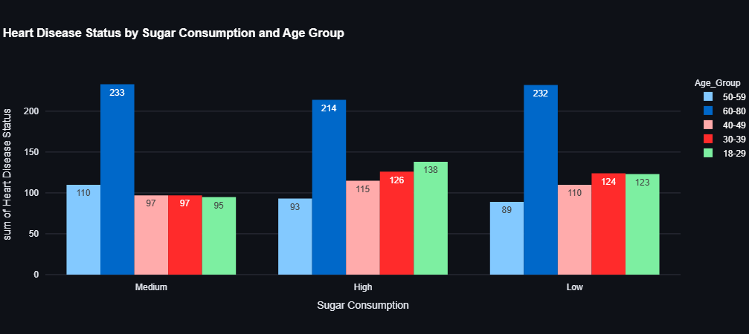
Exploratory Data Analysis - EDA

Slide 15
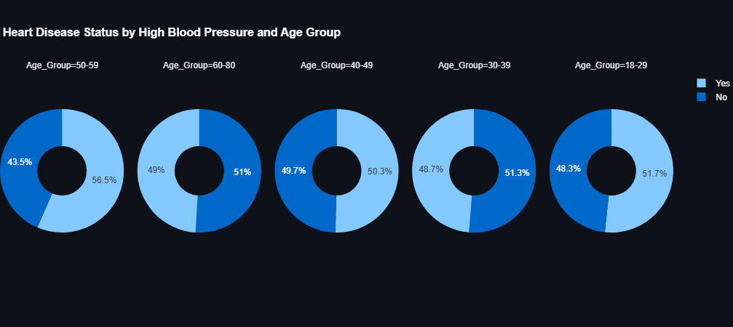
Exploratory Data Analysis - EDA

Slide 16
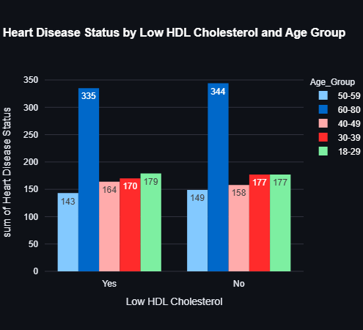
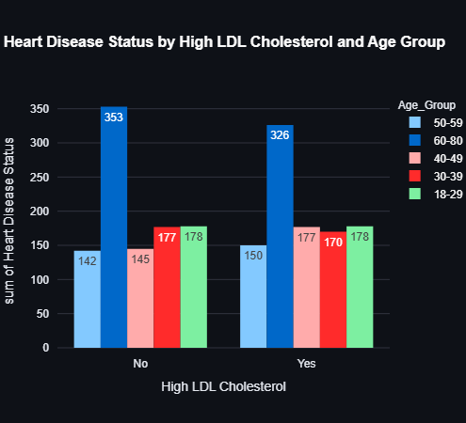
Exploratory Data Analysis - EDA

Slide 17
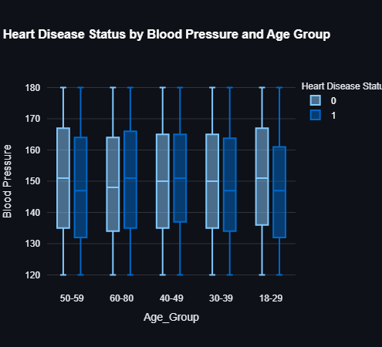
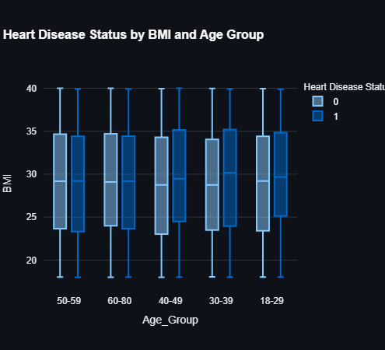
Exploratory Data Analysis - EDA

Slide 18
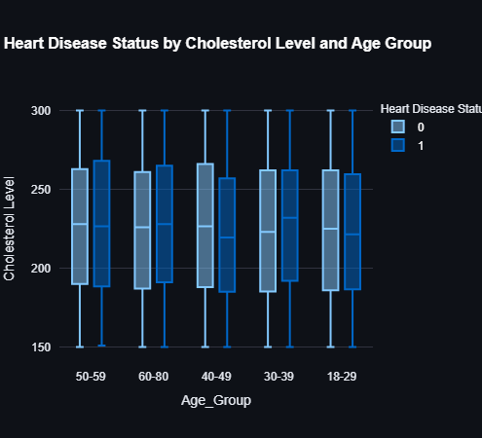
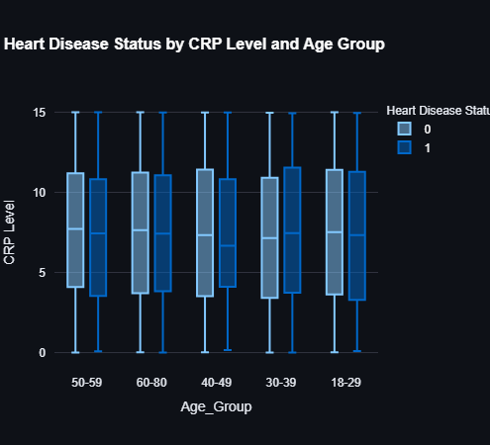
Exploratory Data Analysis - EDA

Slide 19
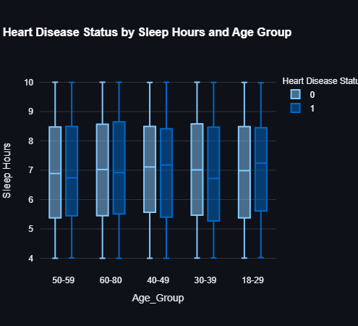

Exploratory Data Analysis - EDA

Slide 20
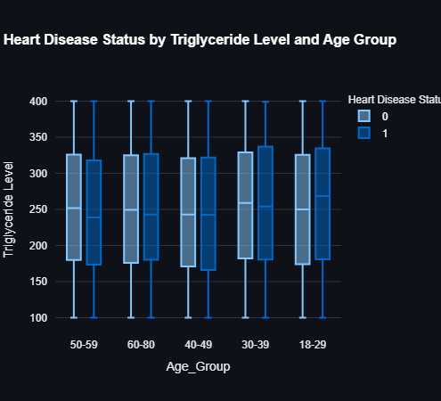
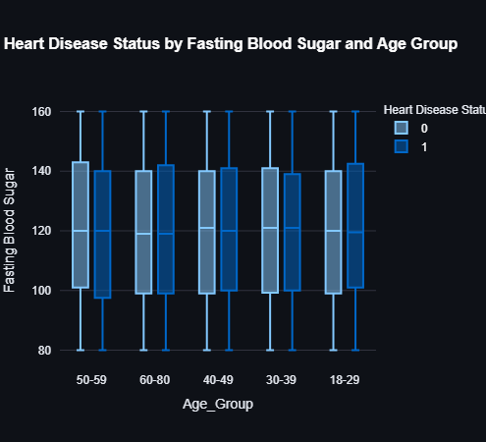
Exploratory Data Analysis - EDA

Slide 21
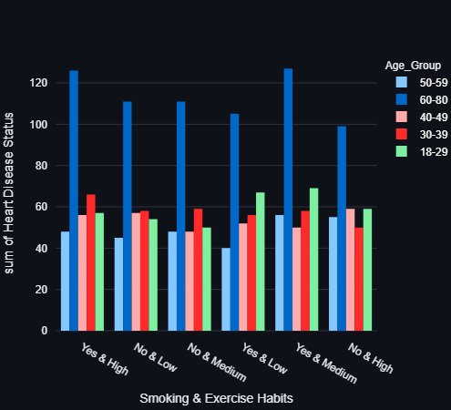
Exploratory Data Analysis - EDA
There is also the ability to merge more than one column to see more analysis in Tap dynamic.

Slide 22
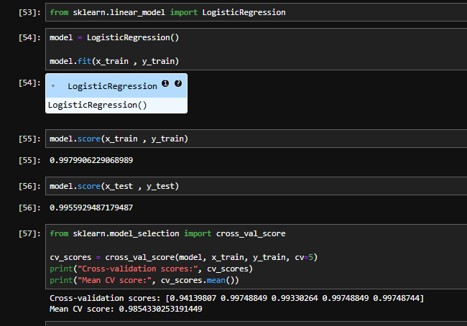
AI Model
Model in train : 99
And in test : 99

