Slide 1
Data Structure
</
/>
Tasneem Bahaa

Slide 2
</Agenda
Arrays
Pointers
String
List (vector)

Slide 3
</steps
{01}
{02}
{03}
Implementation
STLs + Functions
Interview
questions

Slide 4
</ Pointers

Slide 5
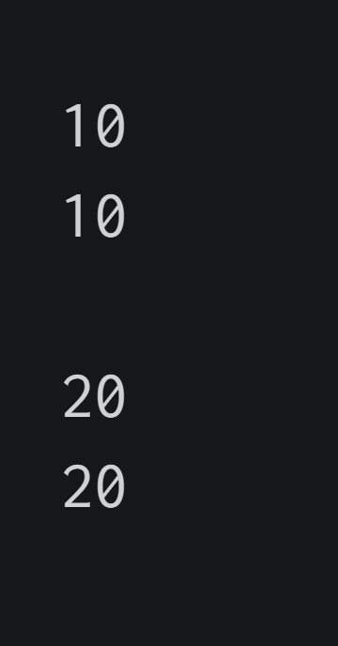
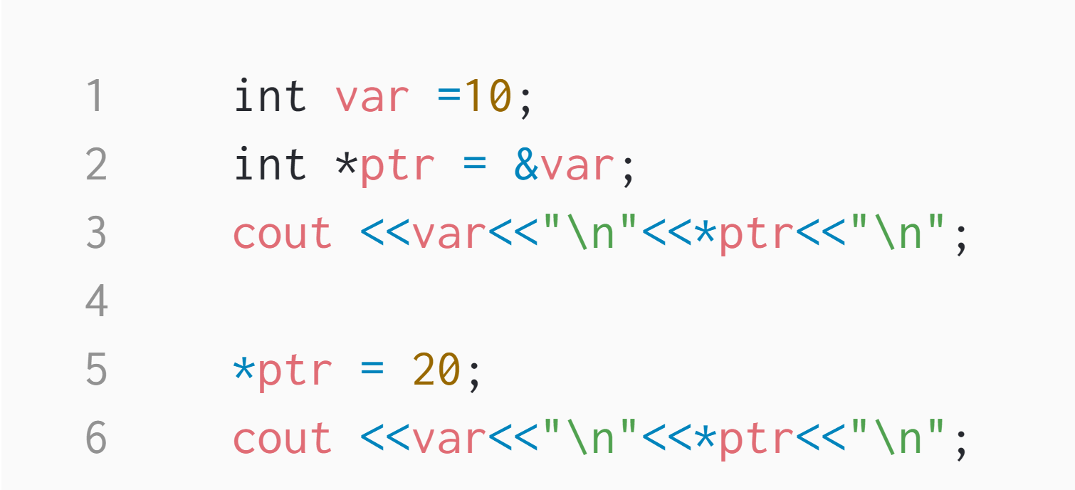

Slide 6
</ Pass by value

Slide 7
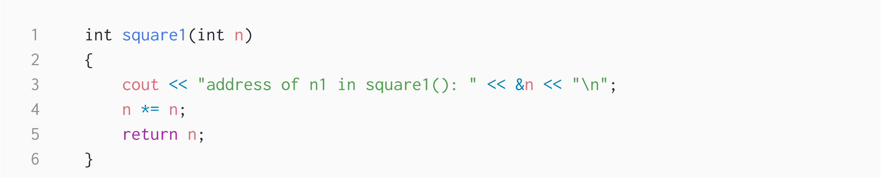
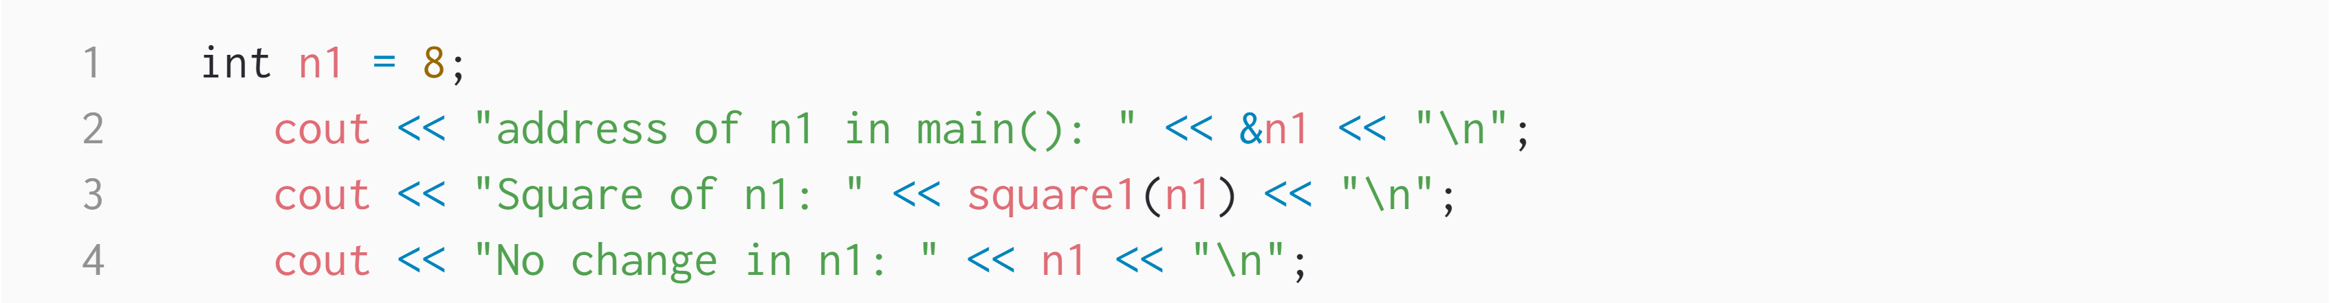
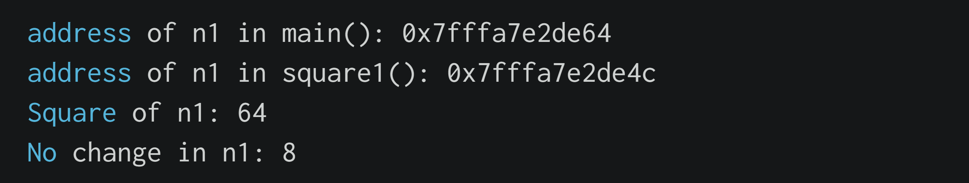

Slide 8
</ Pass by refrence with pointer argument

Slide 9
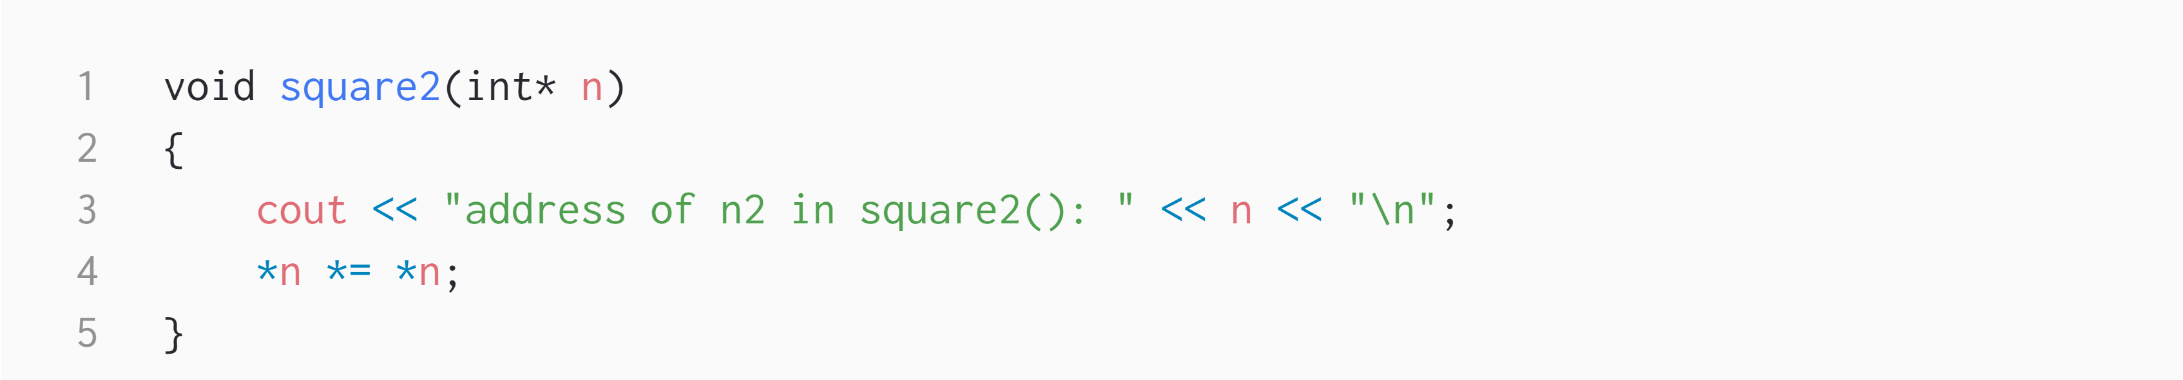
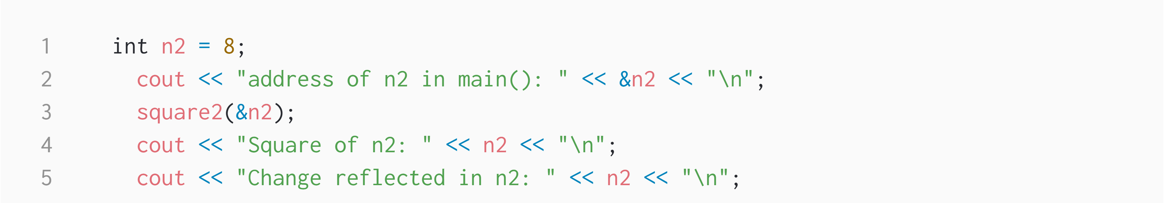
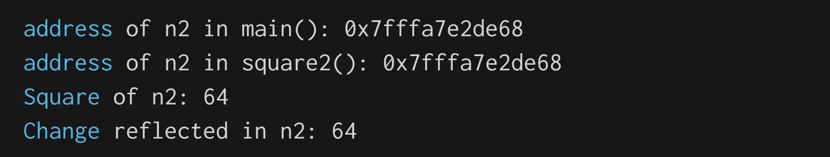

Slide 10
</ Pass by reference with reference argument

Slide 11
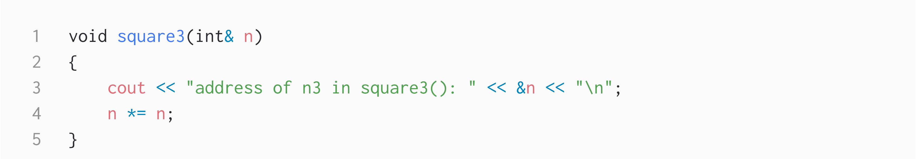
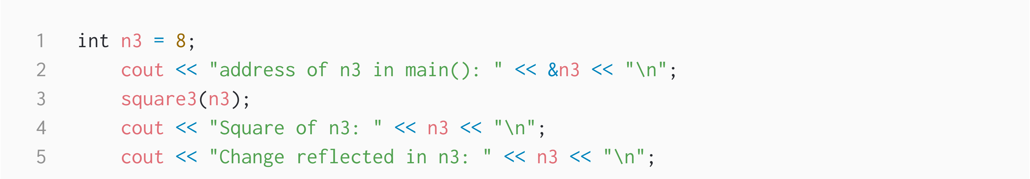
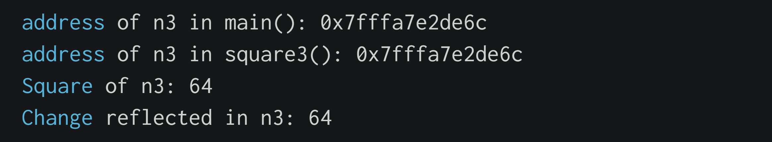

Slide 12
</ Pointer Expressions and Pointer Arithmetic
incremented ( ++ )
decremented ( — )
an integer may be added to a pointer ( + or += )
an integer may be subtracted from a pointer ( – or -= )
difference between two pointers (p1-p2)

Slide 13
</ Arrays

Slide 14
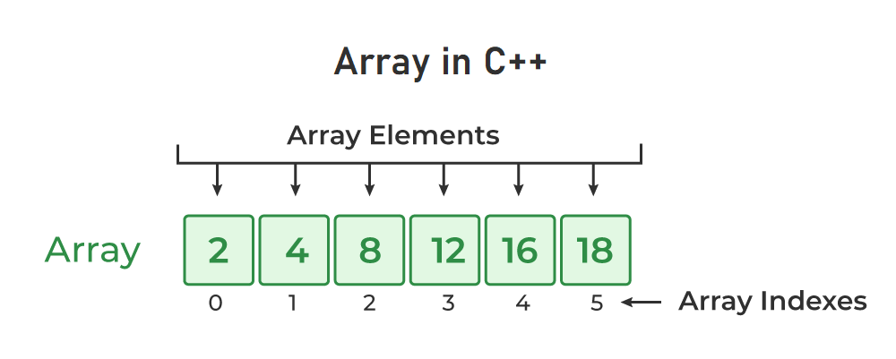
In C++, an array is a data structure that is used to store multiple values of similar data types in a contiguous memory location.

Slide 15
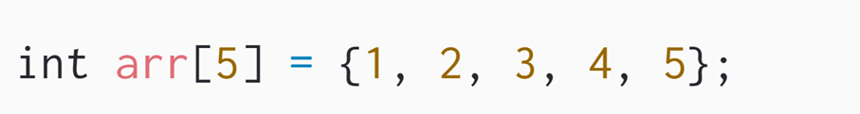
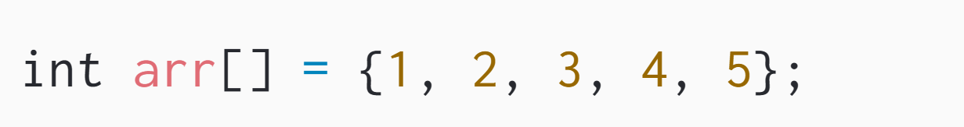
</ Initialization of Array in C++
1. Initialize Array with Values in C++
2. Initialize Array with Values and without
Size in C++

Slide 16
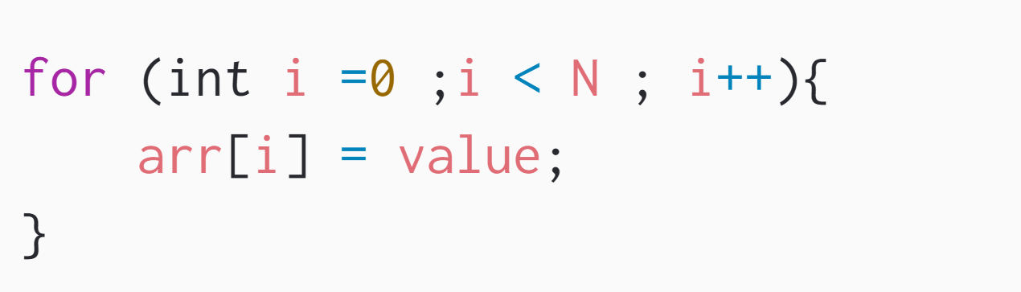
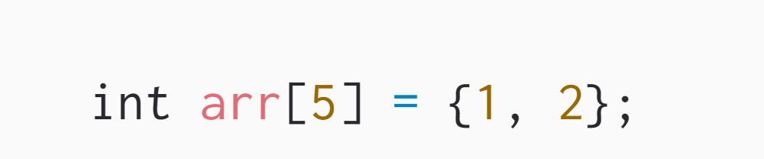
3. Initialize Array after Declaration (Using Loops)
4. Initialize an array partially in C++

Slide 17
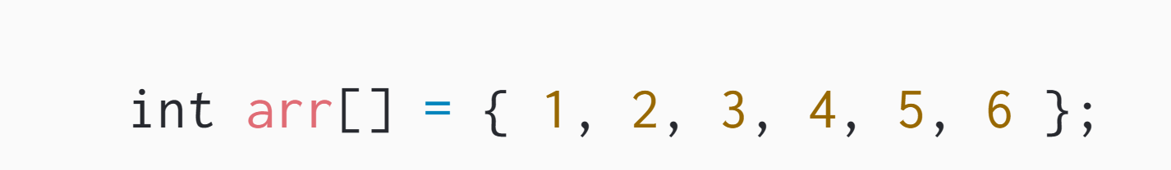
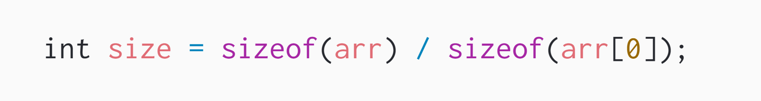
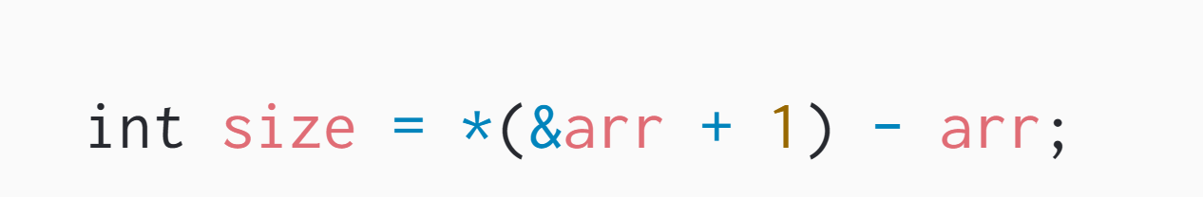
</ Size of an Array in C++

Slide 18
</ Multidimensional Arrays

Slide 19
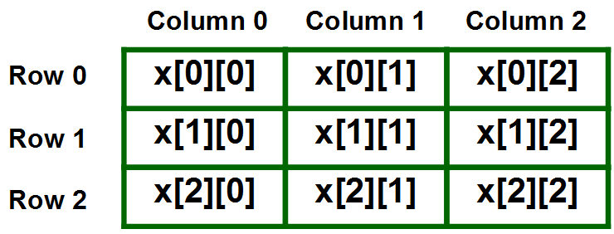
</ Two Dimensional Array in C++

Slide 20
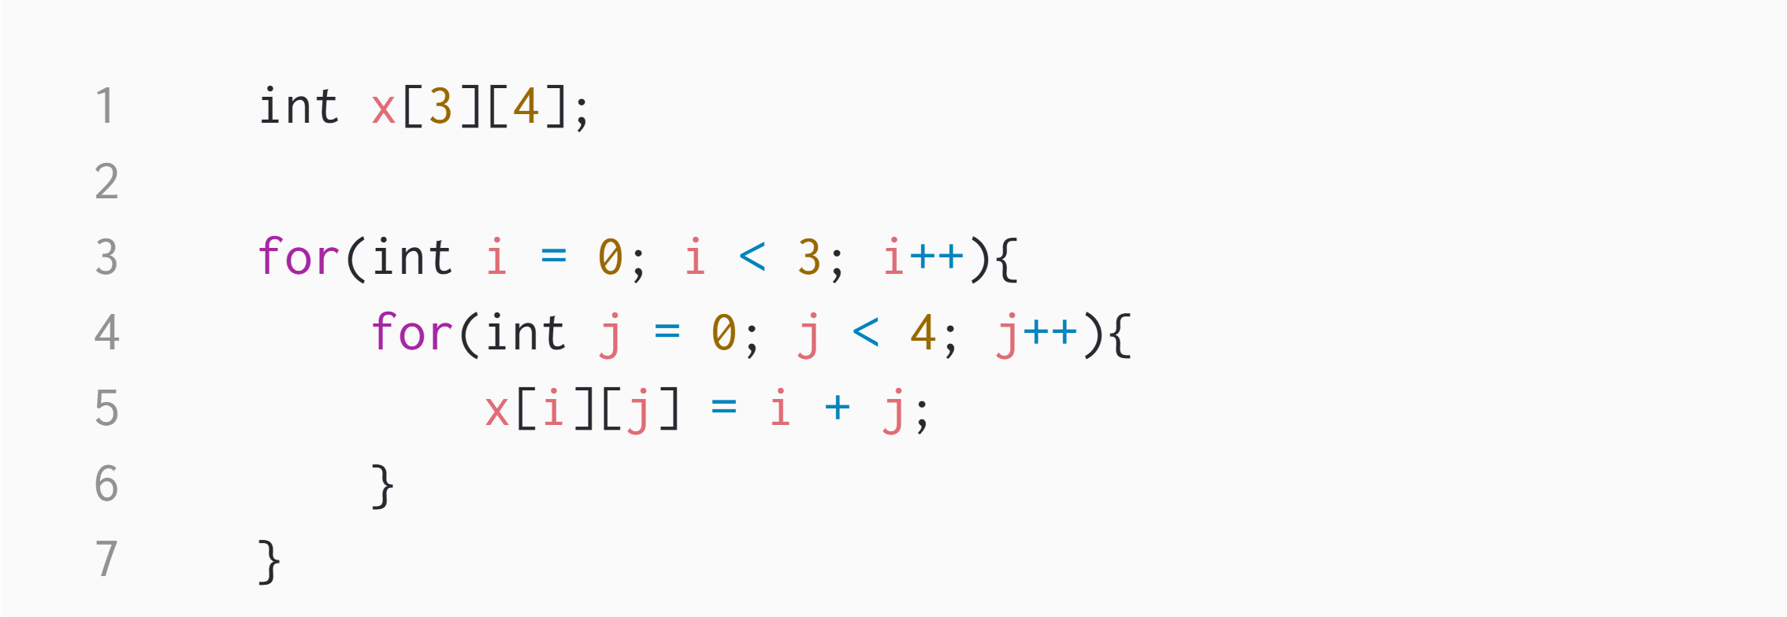
</ Initialize 2d array

Slide 21
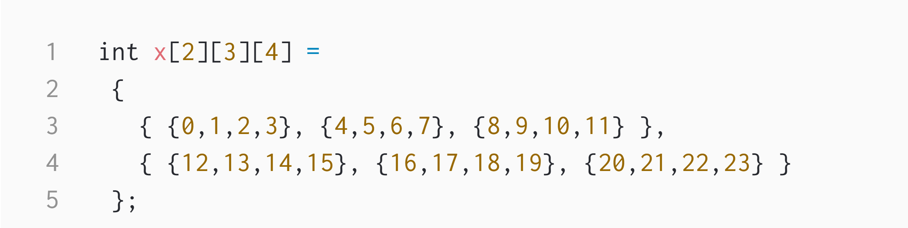
</ What about 3d arrays ???

Slide 22
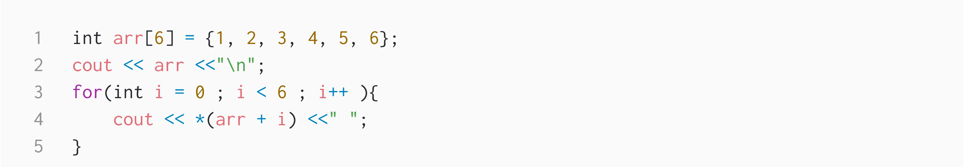
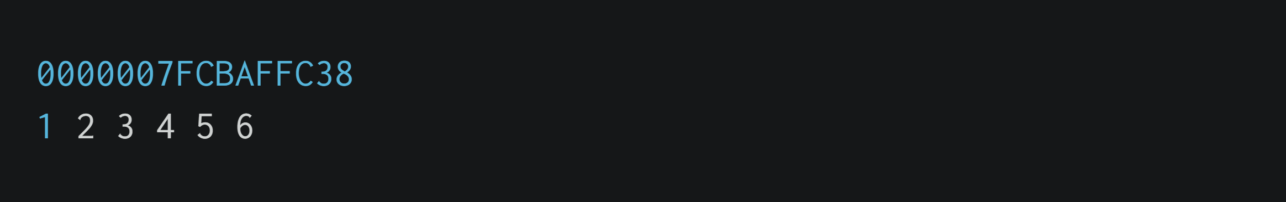
</ Arrays name as pointers

Slide 23
</ What about 2d arrays ???
int nums[2][3] = { { 16, 18, 20 }, { 25, 26, 27 } };
*(*(nums+i)+j)

Slide 24
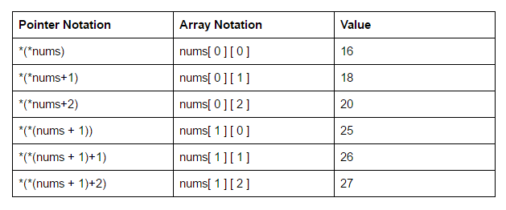

Slide 25
Kadane's Algorithm | Practice | GeeksforGeeks

Slide 26
</ Vector
Vectors are the same as dynamic arrays with the ability to resize itself automatically when an element is inserted or deleted.

Slide 27
</ Built-in Functions
length()
push_back()
size()
insert()
compare()
pop_back()
erase()
find()
empty()
clear()
end()
begin()
back()
front()
Notes:
CODING TIME !

Slide 28
</ Implementation Time !
Notes:
CODING TIME !

Slide 29
</ String
which is a one-dimensional character array terminated by a null character (‘\0'). Instead

Slide 30
</ Built-in Functions
length()
insert()
size()
stoi()
compare()
stod()
to_string()
substr()
erase()
find()
empty()
clear()
end()
begin()
back()
front()
Notes:
CODING TIME !

