Slide 1
Data Structure
</
/>
Tasneem Bahaa

Slide 2
</Agenda
Arrays
Pointers
String
List (vector)
Linked list
Stack
Queue
Circular queue
Priority queue
Deque

Slide 3
</steps
{01}
{02}
{03}
Implementation
STLs + Functions
Interview
questions

Slide 4
</ Pointers

Slide 5
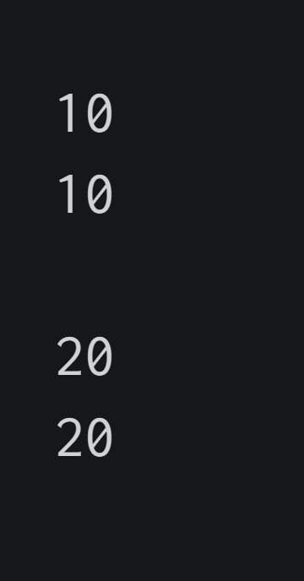
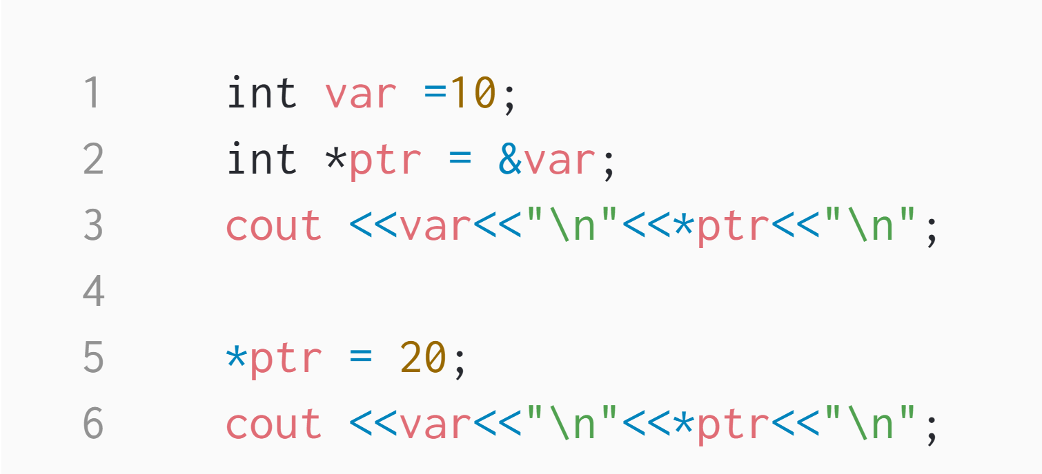

Slide 6
</ Pass by value

Slide 7
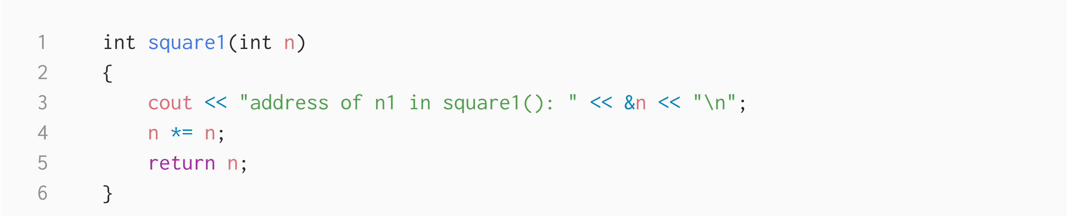
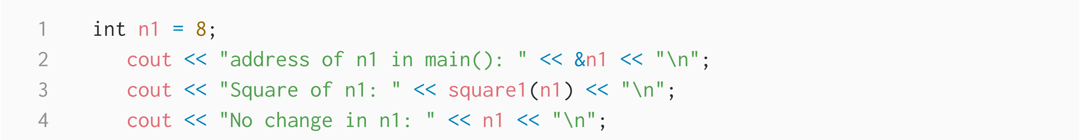
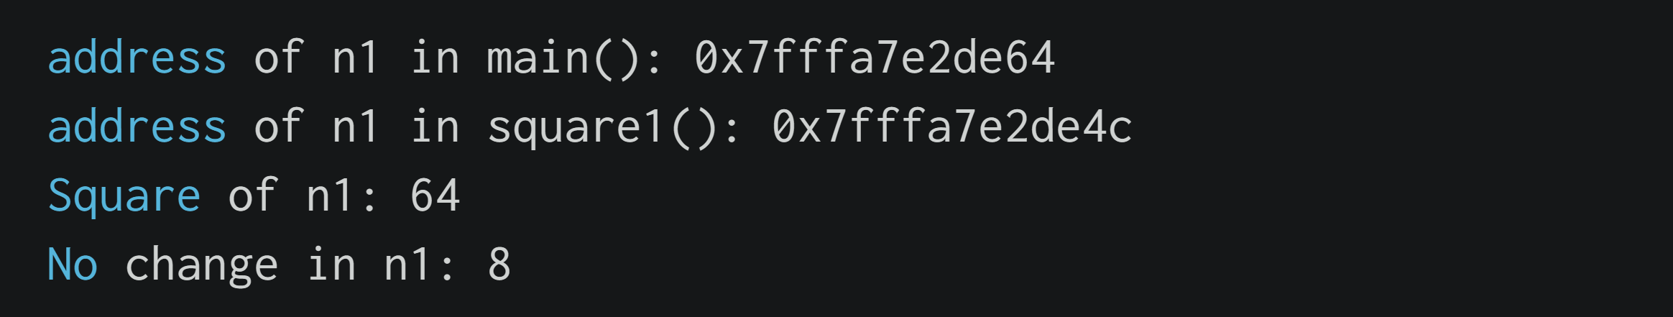

Slide 8
</ Pass by refrence with pointer argument

Slide 9
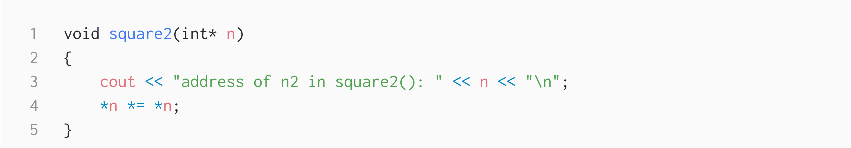
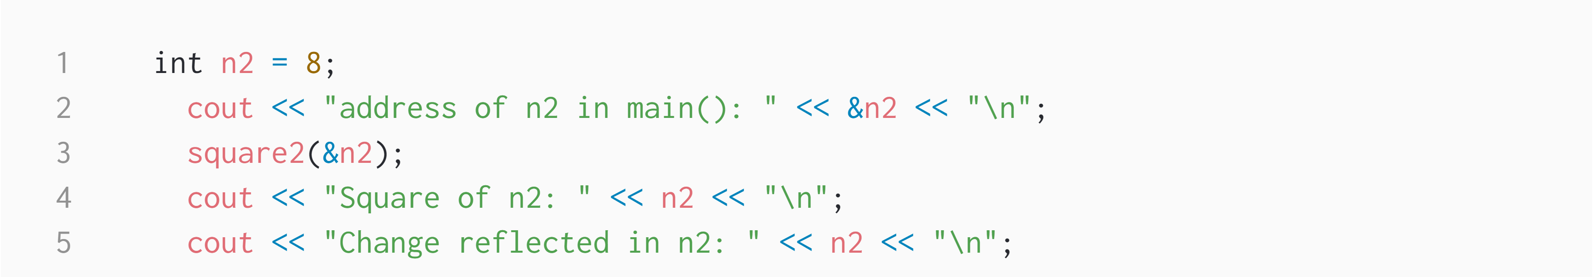
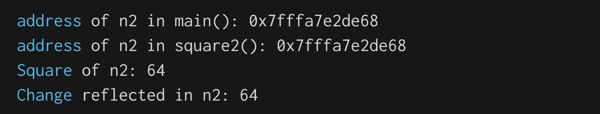

Slide 10
</ Pass by reference with reference argument

Slide 11
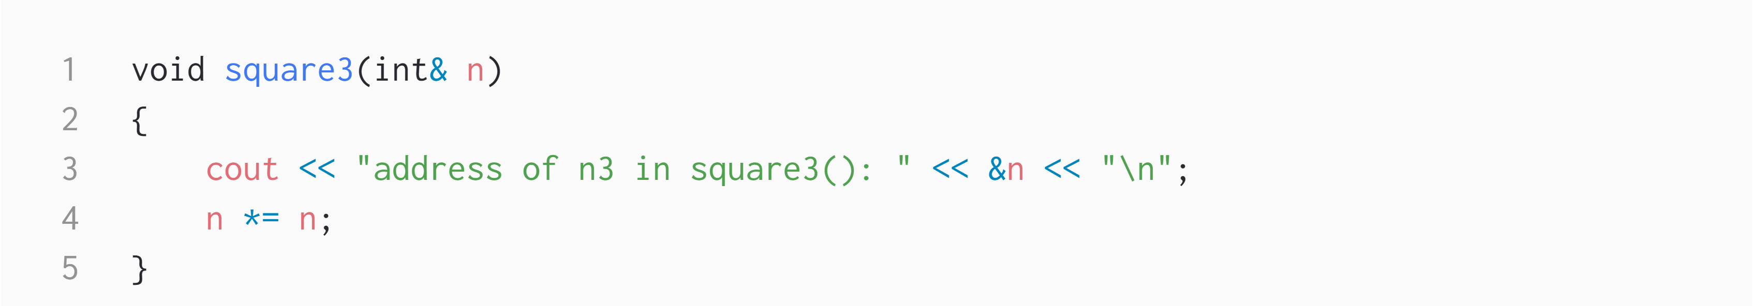
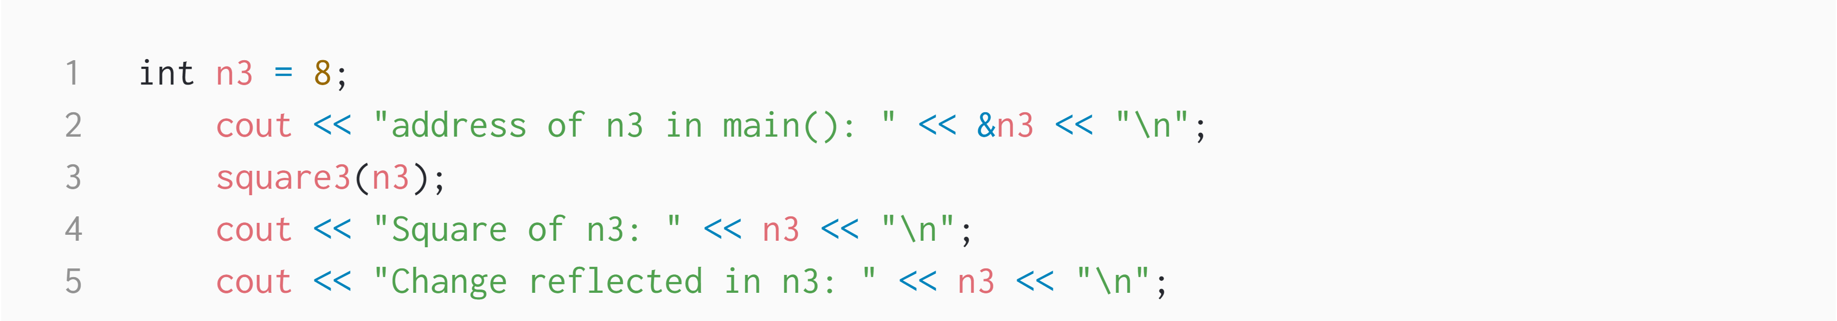
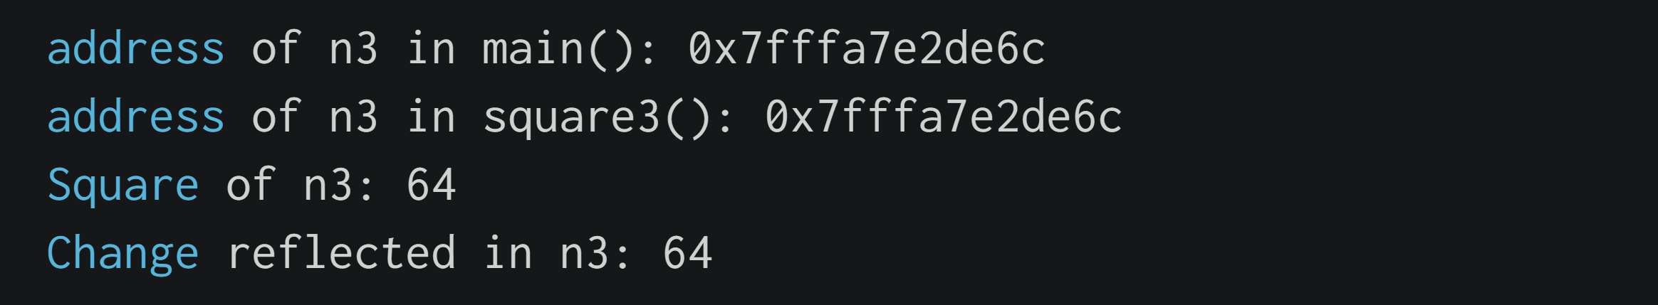

Slide 12
</ Pointer Expressions and Pointer Arithmetic
incremented ( ++ )
decremented ( — )
an integer may be added to a pointer ( + or += )
an integer may be subtracted from a pointer ( – or -= )
difference between two pointers (p1-p2)

Slide 13
</ Arrays

Slide 14
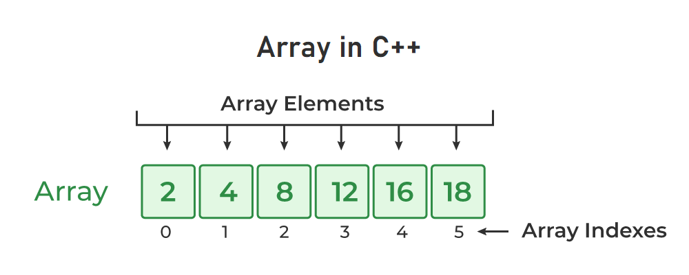
In C++, an array is a data structure that is used to store multiple values of similar data types in a contiguous memory location.

Slide 15
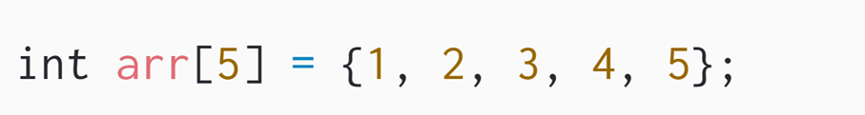
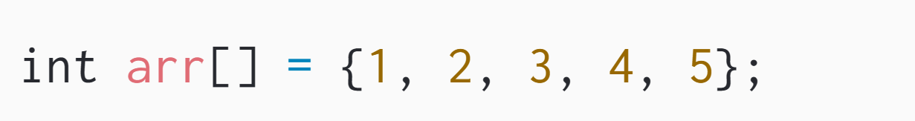
</ Initialization of Array in C++
1. Initialize Array with Values in C++
2. Initialize Array with Values and without
Size in C++

Slide 16
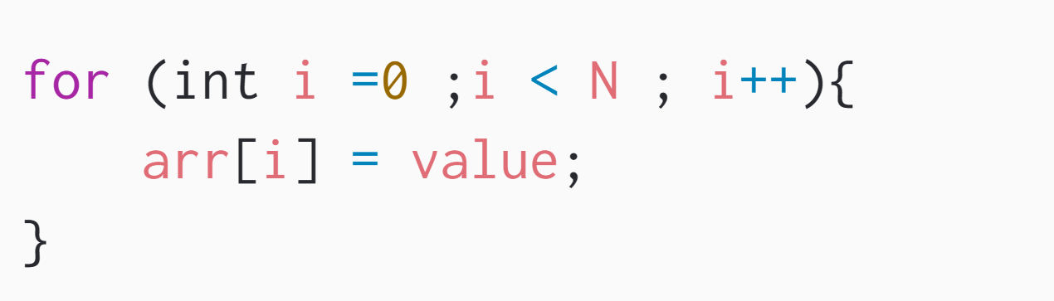
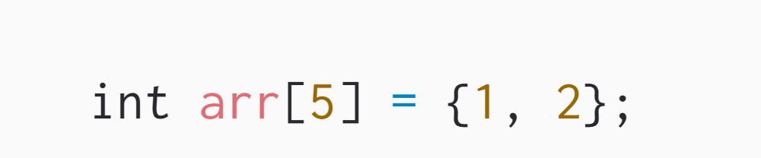
3. Initialize Array after Declaration (Using Loops)
4. Initialize an array partially in C++

Slide 17
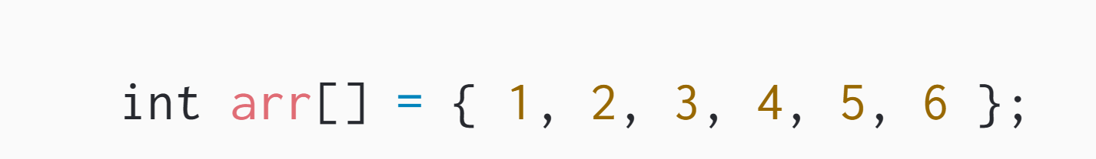
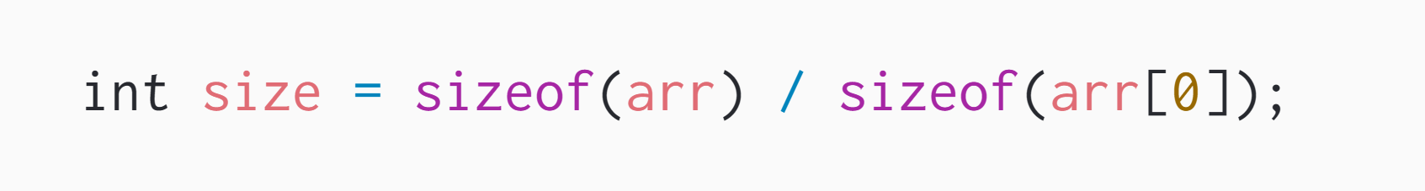
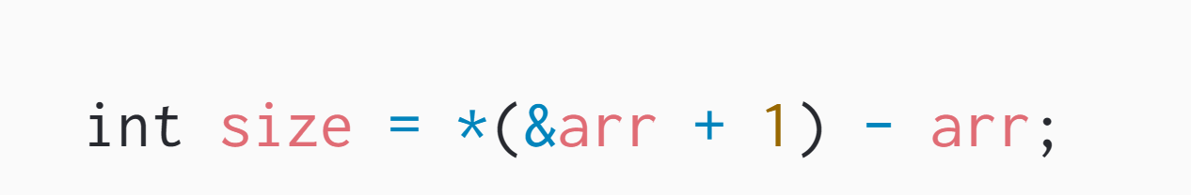
</ Size of an Array in C++

Slide 18
</ Multidimensional Arrays

Slide 19
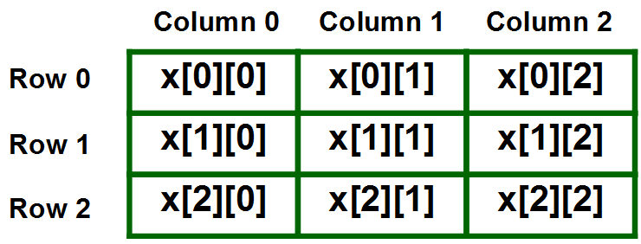
</ Two Dimensional Array in C++

Slide 20
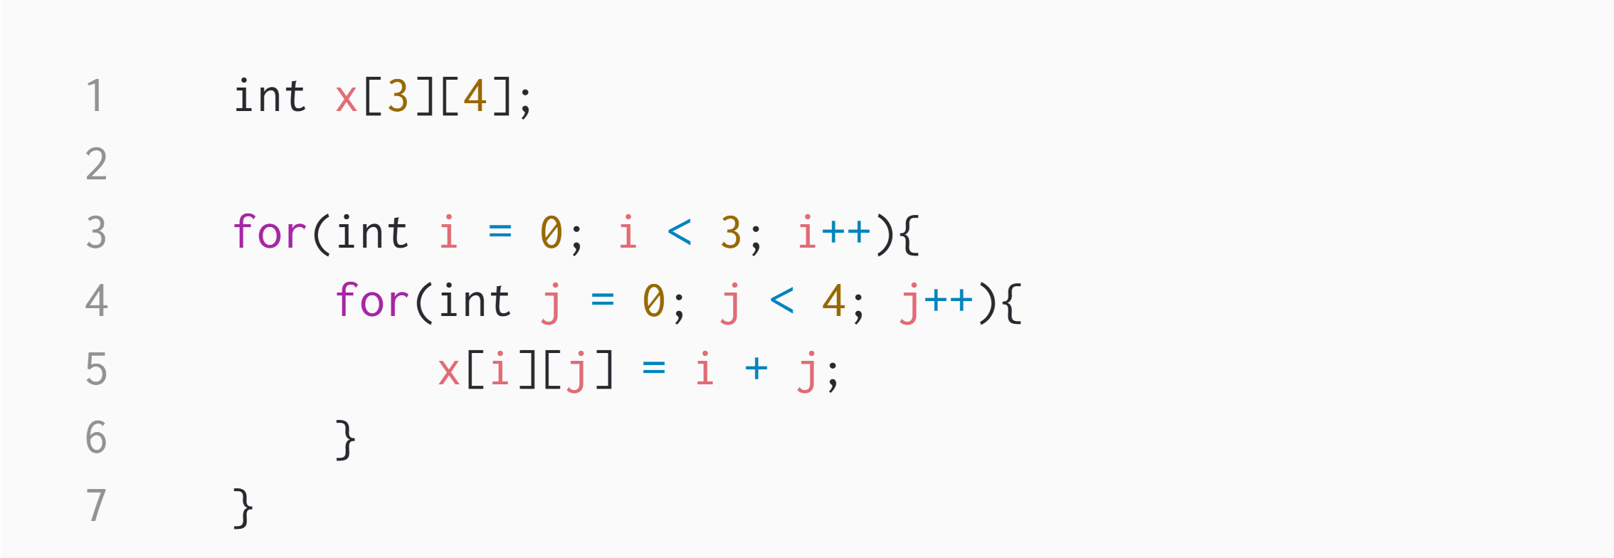
</ Initialize 2d array

Slide 21
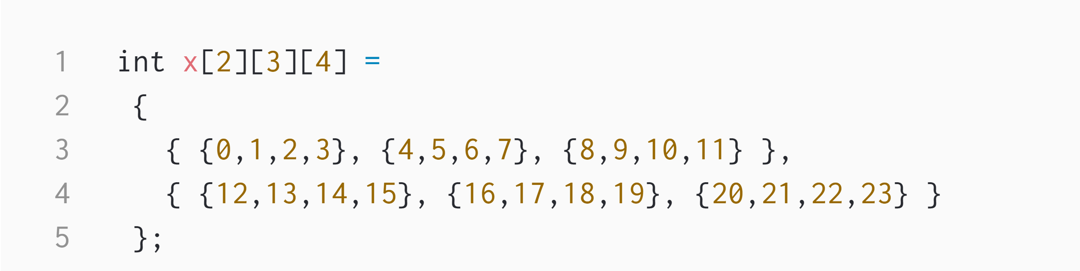
</ What about 3d arrays ???

Slide 22
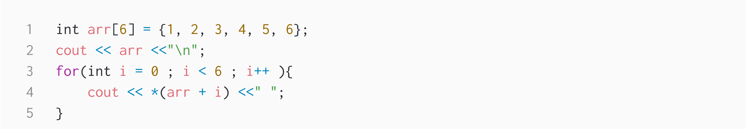
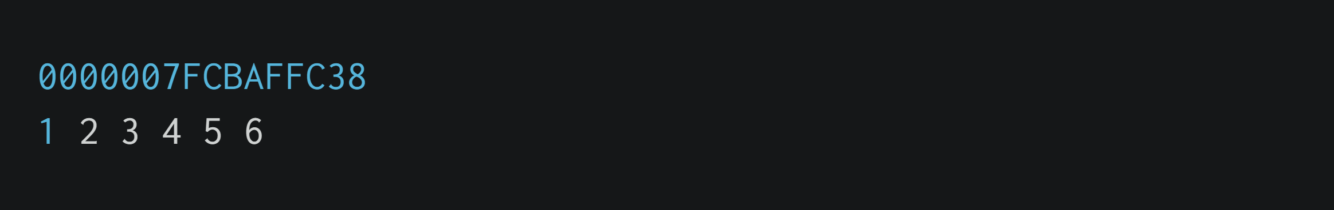
</ Arrays name as pointers

Slide 23
</ What about 2d arrays ???
int nums[2][3] = { { 16, 18, 20 }, { 25, 26, 27 } };
*(*(nums+i)+j)

Slide 24
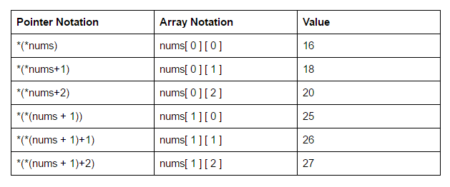

Slide 25
Kadane's Algorithm | Practice | GeeksforGeeks

Slide 26
</ Vector
Vectors are the same as dynamic arrays with the ability to resize itself automatically when an element is inserted or deleted.

Slide 27
</ Built-in Functions
length()
push_back()
size()
insert()
compare()
pop_back()
erase()
find()
empty()
clear()
end()
begin()
back()
front()
Notes:
CODING TIME !

Slide 28
</ Implementation Time !
Notes:
CODING TIME !

Slide 29
</ String
which is a one-dimensional character array terminated by a null character (‘\0'). Instead

Slide 30
</ Built-in Functions
length()
insert()
size()
stoi()
compare()
stod()
to_string()
substr()
erase()
find()
empty()
clear()
end()
begin()
back()
front()
Notes:
CODING TIME !

Slide 31
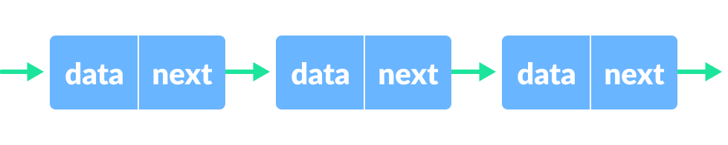
</ Linked list
A linked list is a linear data structure, in which the elements are not stored at contiguous memory locations. The elements in a linked list are linked using pointers
Head
Null

Slide 32
</ Linked list types
Singly Linked List
Doubly Linked List
Circular Linked List
Circular Doubly Linked List
Header Linked List
Notes:
CODING TIME !

Slide 33
</ Implementation Time !
Notes:
CODING TIME !

Slide 34
</ Linked List Traversal
Notes:
CODING TIME !

Slide 35
</ Linked list insertion
At the front of the linked list.
After a given node.
At the end of the linked list.

Slide 36
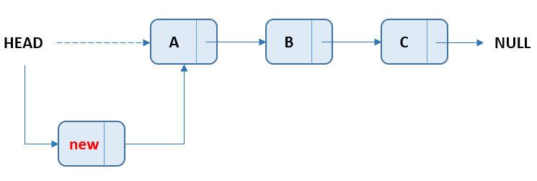
</ At the front of the linked list
Notes:
CODING TIME !

Slide 37
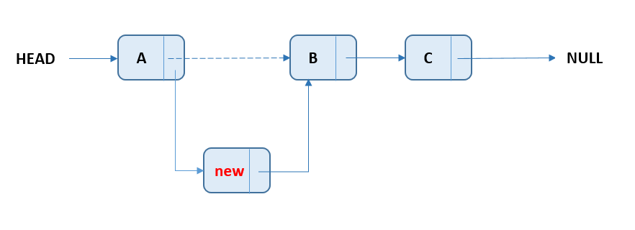
</ After a given node
Notes:
CODING TIME !

Slide 38
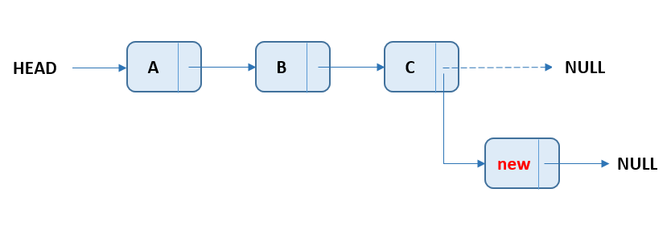
</ At the end of the linked list
Notes:
CODING TIME !

Slide 39
</ Linked list deletion
At the front of the linked list.
After a given node.
At the end of the linked list.

Slide 40
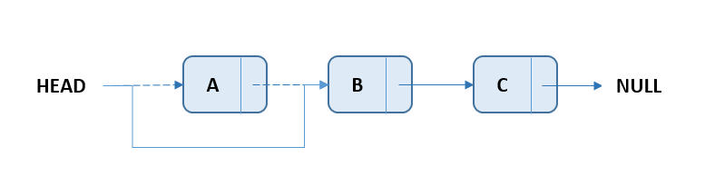
</ At the front of the linked list
Notes:
CODING TIME !

Slide 41
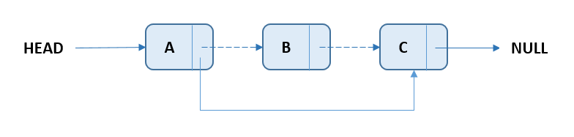
</ After a given node
Notes:
CODING TIME !

Slide 42
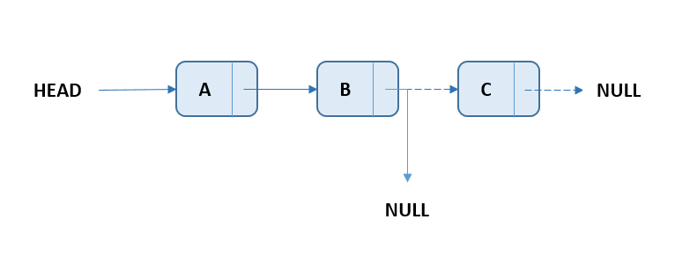
</ At the end of the linked list
Notes:
CODING TIME !

Slide 43
</ queue
Simple Queue
Circular Queue
Priority Queue
Double Ended Queue

Slide 44
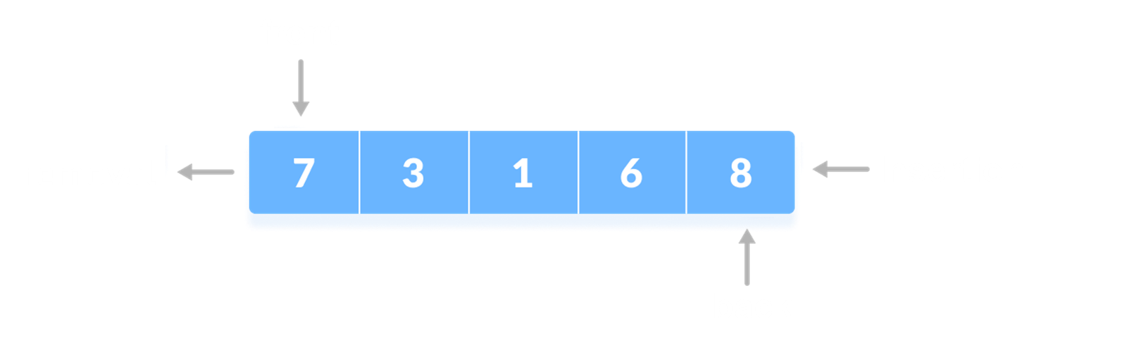
</ simple queue
Queues are a type of container adaptors that operate in a first in first out (FIFO) type of arrangement. Elements are inserted at the back (end) and are deleted from the front.

Slide 45
</ Built-in Functions
push()
size()
pop ()
emplace()
empty()
back()
front()
swap()
Notes:
CODING TIME !

Slide 46
</ queue Initialization + Traversal
Notes:
CODING TIME !

Slide 47
</ Implementation Time !
Notes:
CODING TIME !

Slide 48
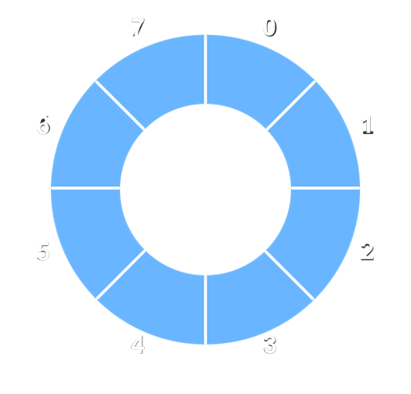
</ Circular queue
A circular queue is the extended version of a regular queue where the last element is connected to the first element. Thus forming a circle-like structure.

Slide 49
Enqueue Operation
check if the queue is full
for the first element, set value of FRONT to 0
circularly increase the REAR index by 1 (i.e. if the rear reaches the end, next it would be at the start of the queue)
add the new element in the position pointed to by REAR
Dequeue Operation
check if the queue is empty
return the value pointed by FRONT
circularly increase the FRONT index by 1
for the last element, reset the values of FRONT and REAR to -1

Slide 50
</ Implementation Time !
Notes:
CODING TIME !

Slide 51
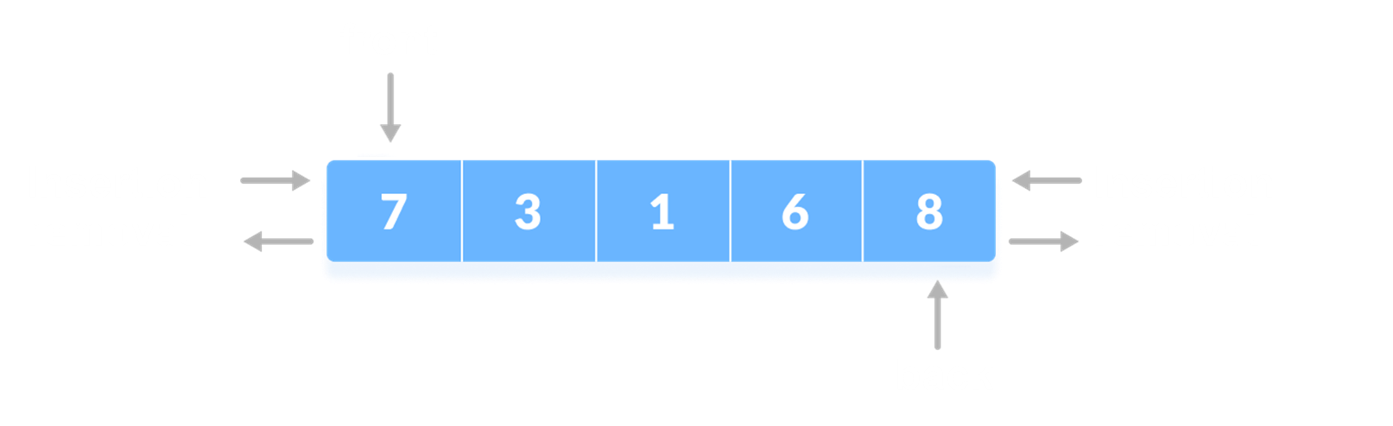
</ deque
Double-ended queues are a special case of queues where insertion and deletion operations are possible at both the ends.

Slide 52
</ Built-in Functions
push_back()
push_front()
size()
insert()
pop_back()
pop_front()
erase()
empty()
clear()
end()
begin()
back()
front()
Notes:
CODING TIME !

Slide 53
</ deque Initialization + Traversal
Notes:
CODING TIME !

Slide 54
</ priority queue
A priority queue is a special type of queue in which each element is associated with a priority value. And, elements are served on the basis of their priority. That is, higher priority elements are served first.

Slide 55
</ Built-in Functions
size()
top()
push()
pop()
swap()
empty()
emplace()
Notes:
CODING TIME !

Slide 56
</ priority queue Initialization + Traversal
Notes:
CODING TIME !

Slide 57
</ Binary Heap
A Binary Heap is a complete Binary Tree which is used to store data efficiently to get the max or min element based on its structure.
Notes:
CODING TIME !

Slide 58
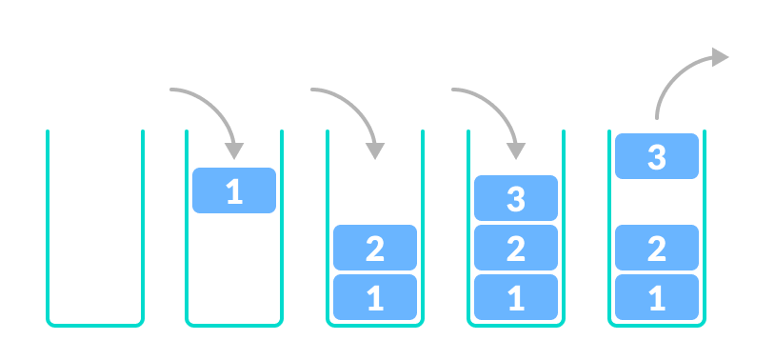
</ stack
A stack is a linear data structure that follows the principle of Last In First Out (LIFO). This means the last element inserted inside the stack is removed first.

Slide 59
</ Built-in Functions
size()
top()
push()
pop()
empty()
Notes:
CODING TIME !

Slide 60
</ stack Initialization + Traversal
Notes:
CODING TIME !

Slide 61
</ Implementation Time !
Notes:
CODING TIME !

Slide 62
Thank you !
</
/>
Any Questions?

