Slide 1
Data Structure
</
/>
Tasneem Bahaa

Slide 2
</Agenda
Linked list
Stack
Queue
Circular queue
Priority queue
Deque

Slide 3
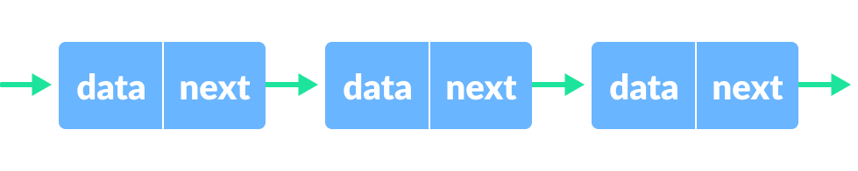
</ Linked list
A linked list is a linear data structure, in which the elements are not stored at contiguous memory locations. The elements in a linked list are linked using pointers
Head
Null

Slide 4
</ Linked list types
Singly Linked List
Doubly Linked List
Circular Linked List
Circular Doubly Linked List
Header Linked List
Notes:
CODING TIME !

Slide 5
</ Implementation Time !
Notes:
CODING TIME !

Slide 6
</ Linked List Traversal
Notes:
CODING TIME !

Slide 7
</ Linked list insertion
At the front of the linked list.
After a given node.
At the end of the linked list.

Slide 8
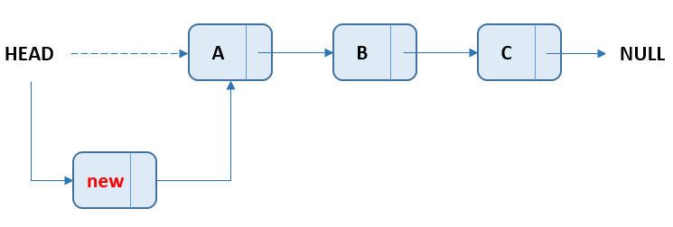
</ At the front of the linked list
Notes:
CODING TIME !

Slide 9
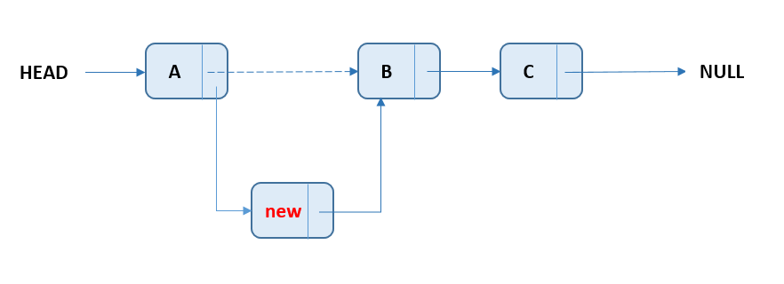
</ After a given node
Notes:
CODING TIME !

Slide 10
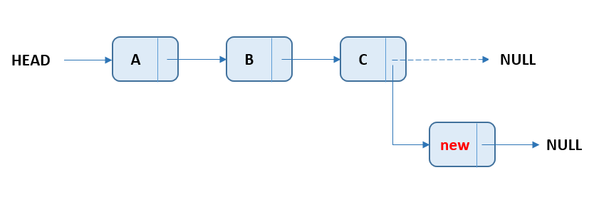
</ At the end of the linked list
Notes:
CODING TIME !

Slide 11
</ Linked list deletion
At the front of the linked list.
After a given node.
At the end of the linked list.

Slide 12
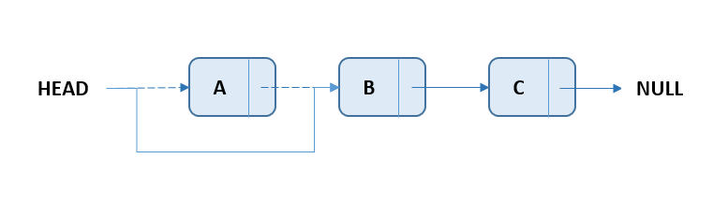
</ At the front of the linked list
Notes:
CODING TIME !

Slide 13
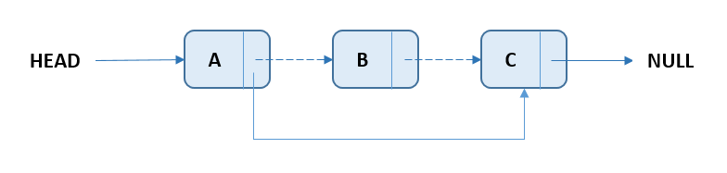
</ After a given node
Notes:
CODING TIME !

Slide 14
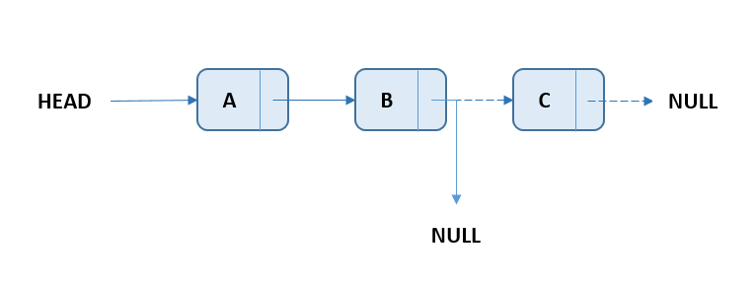
</ At the end of the linked list
Notes:
CODING TIME !

Slide 15
</ queue
Simple Queue
Circular Queue
Priority Queue
Double Ended Queue

Slide 16
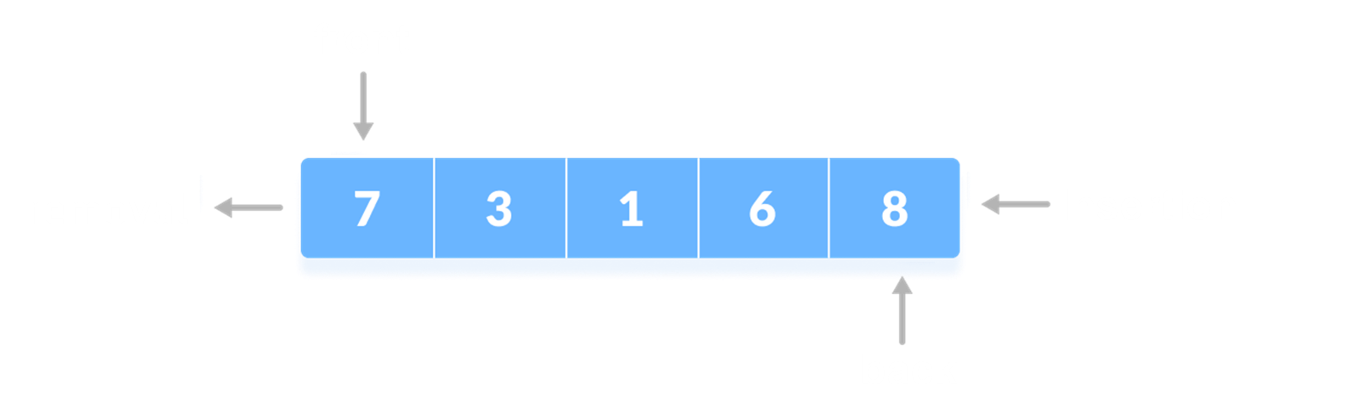
</ simple queue
Queues are a type of container adaptors that operate in a first in first out (FIFO) type of arrangement. Elements are inserted at the back (end) and are deleted from the front.

Slide 17
</ Built-in Functions
push()
size()
pop ()
emplace()
empty()
back()
front()
swap()
Notes:
CODING TIME !

Slide 18
</ queue Initialization + Traversal
Notes:
CODING TIME !

Slide 19
</ Implementation Time !
Notes:
CODING TIME !

Slide 20
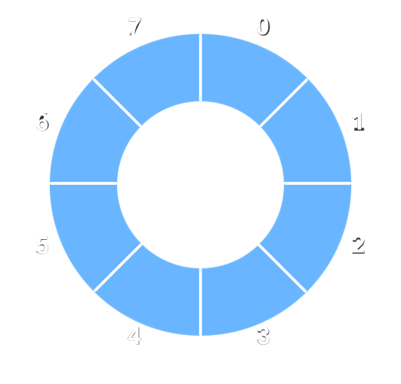
</ Circular queue
A circular queue is the extended version of a regular queue where the last element is connected to the first element. Thus forming a circle-like structure.

Slide 21
Enqueue Operation
check if the queue is full
for the first element, set value of FRONT to 0
circularly increase the REAR index by 1 (i.e. if the rear reaches the end, next it would be at the start of the queue)
add the new element in the position pointed to by REAR
Dequeue Operation
check if the queue is empty
return the value pointed by FRONT
circularly increase the FRONT index by 1
for the last element, reset the values of FRONT and REAR to -1

Slide 22
</ Implementation Time !
Notes:
CODING TIME !

Slide 23
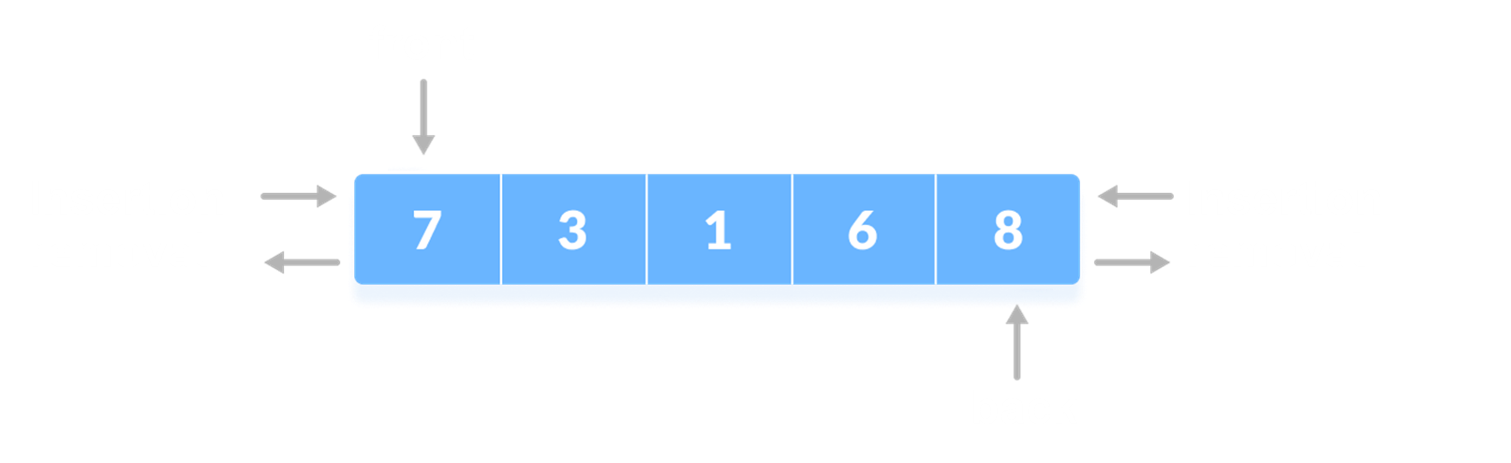
</ deque
Double-ended queues are a special case of queues where insertion and deletion operations are possible at both the ends.

Slide 24
</ Built-in Functions
push_back()
push_front()
size()
insert()
pop_back()
pop_front()
erase()
empty()
clear()
end()
begin()
back()
front()
Notes:
CODING TIME !

Slide 25
</ deque Initialization + Traversal
Notes:
CODING TIME !

Slide 26
</ priority queue
A priority queue is a special type of queue in which each element is associated with a priority value. And, elements are served on the basis of their priority. That is, higher priority elements are served first.

Slide 27
</ Built-in Functions
size()
top()
push()
pop()
swap()
empty()
emplace()
Notes:
CODING TIME !

Slide 28
</ priority queue Initialization + Traversal
Notes:
CODING TIME !

Slide 29
</ Binary Heap
A Binary Heap is a complete Binary Tree which is used to store data efficiently to get the max or min element based on its structure.
Notes:
CODING TIME !

Slide 30
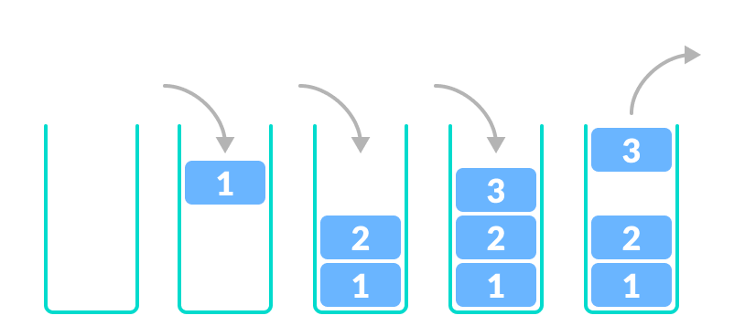
</ stack
A stack is a linear data structure that follows the principle of Last In First Out (LIFO). This means the last element inserted inside the stack is removed first.

Slide 31
</ Built-in Functions
size()
top()
push()
pop()
empty()
Notes:
CODING TIME !

Slide 32
</ stack Initialization + Traversal
Notes:
CODING TIME !

Slide 33
</ Implementation Time !
Notes:
CODING TIME !

Slide 34
Thank you !
</
/>
Any Questions?

