Slide 1

Stress Level Prediction
Mahmoud Mokhiamar

Slide 2



Agenda
Data Preprocessing
Feature Reduction
Model Implementation
Results and metrics

Slide 3

Data Preprocessing, Visualization and Analysis

Slide 4
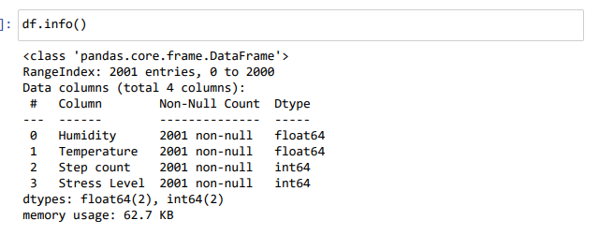
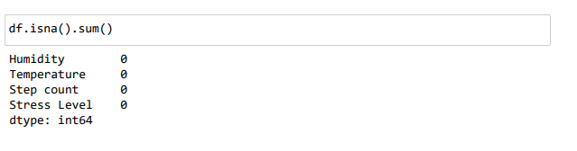
Missing Values

Slide 5
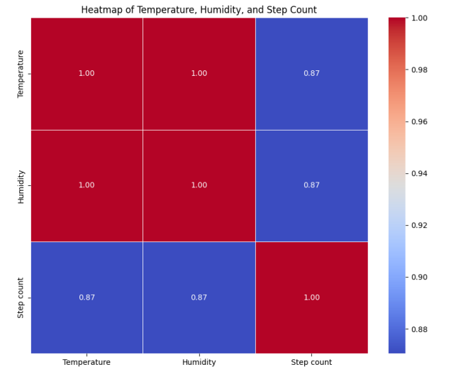
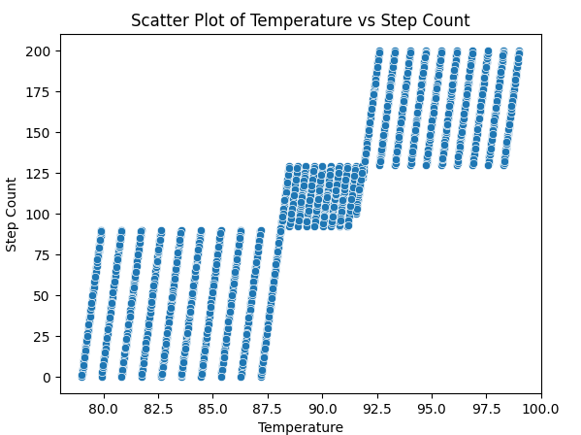
Data Analysis and Visualization

Slide 6
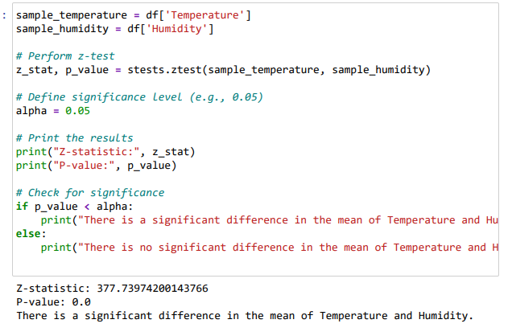
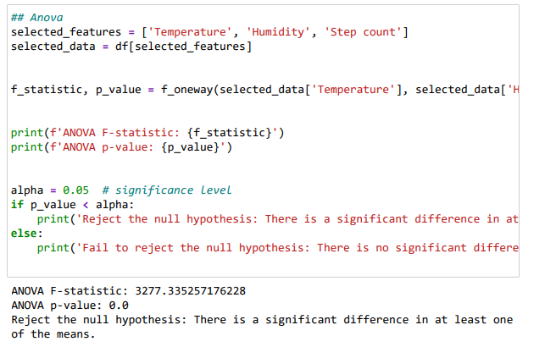
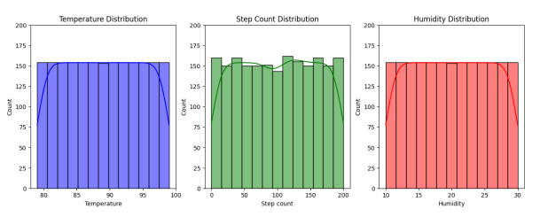
Data Analysis and Visualization

Slide 7
Feature Reduction

Slide 8
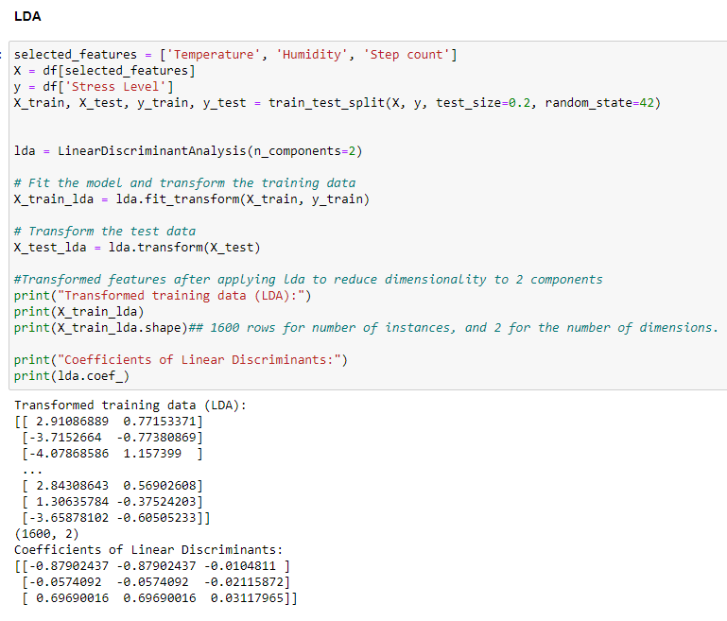
Feature Reduction Using LDA

Slide 9
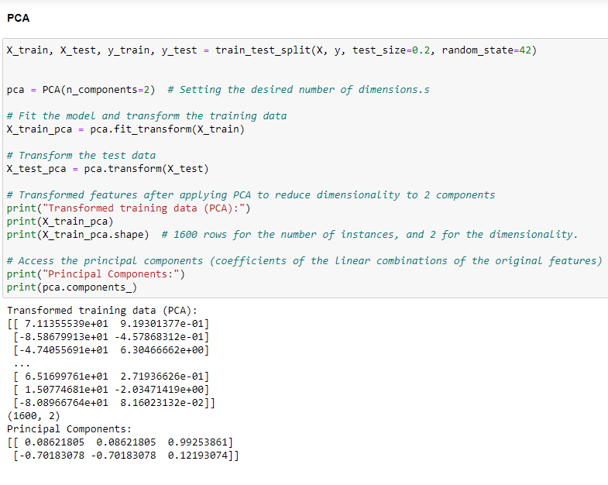
Feature Reduction Using PCA

Slide 10
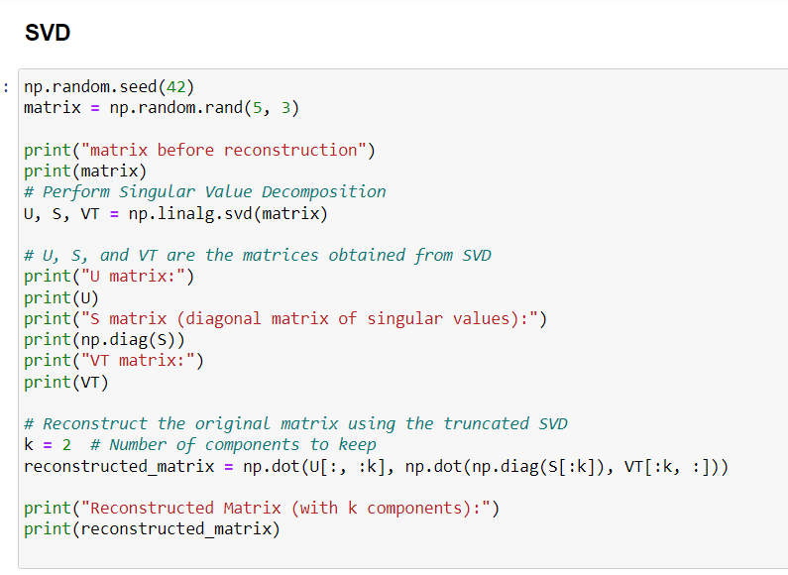
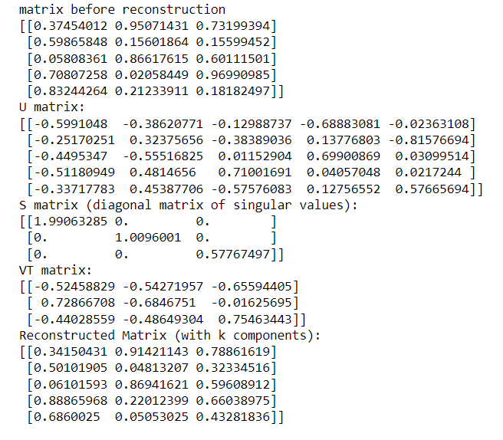
Feature Reduction Using SVD

Slide 11
Model Implementation

Slide 12
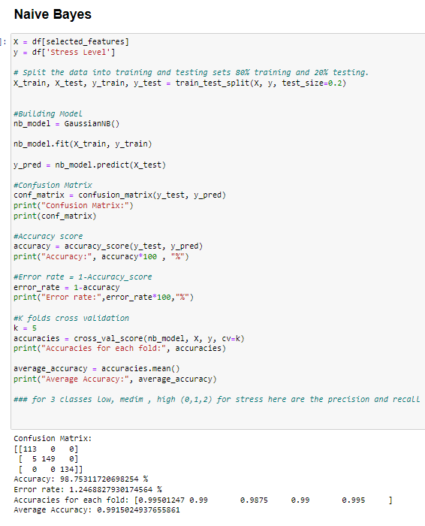
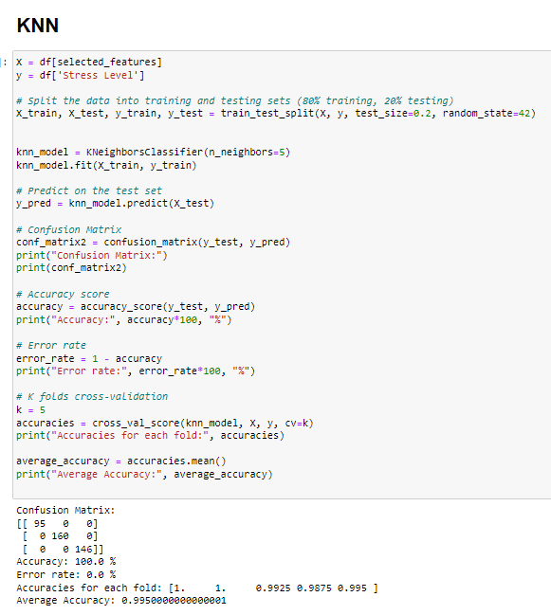
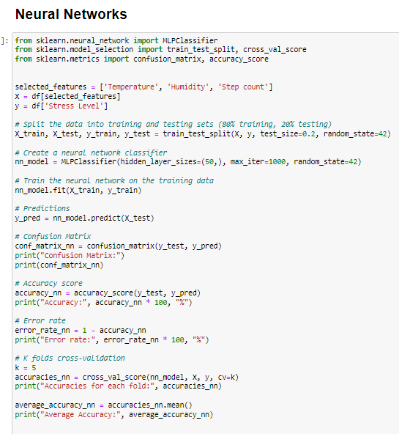
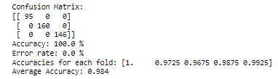
Implemented Models (NB, KNN, Neural Networks

Slide 13
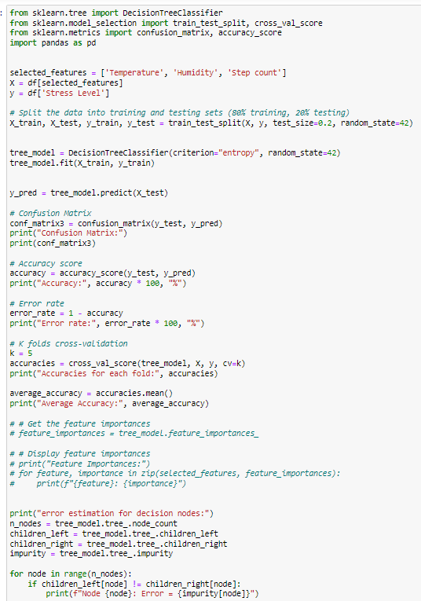
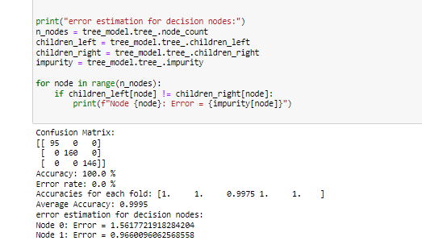
Decision Tree (with error estimation)

Slide 14
Evaluation Metrics

Slide 15
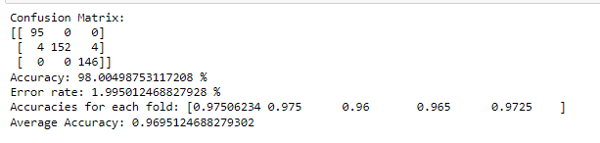
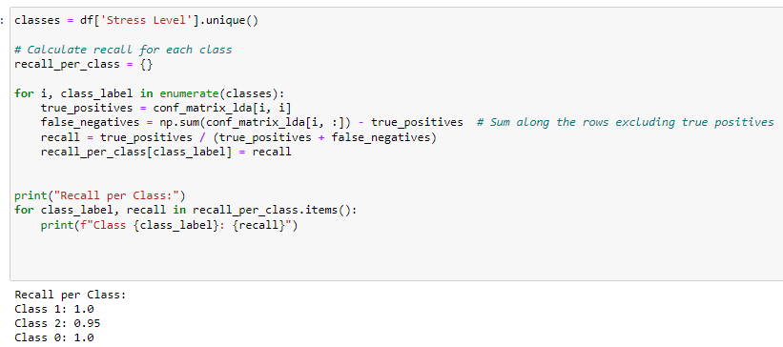
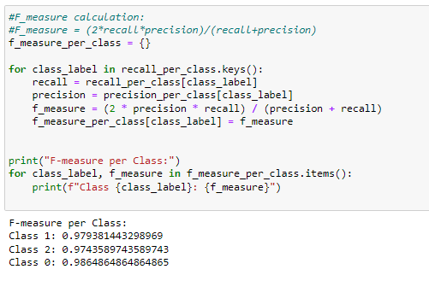
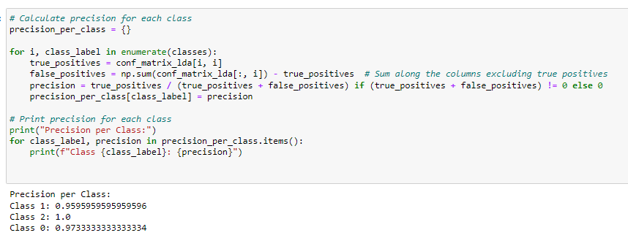
K-folds Accuracy , confusion matrix, precision , recall, f measure

Slide 16
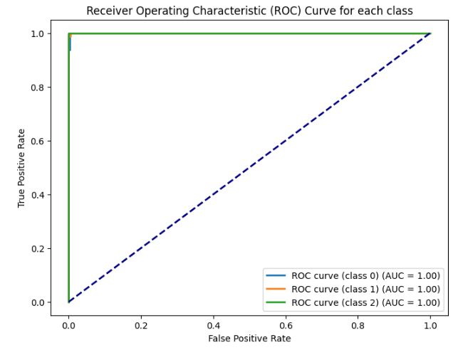
ROC Curve

Slide 17
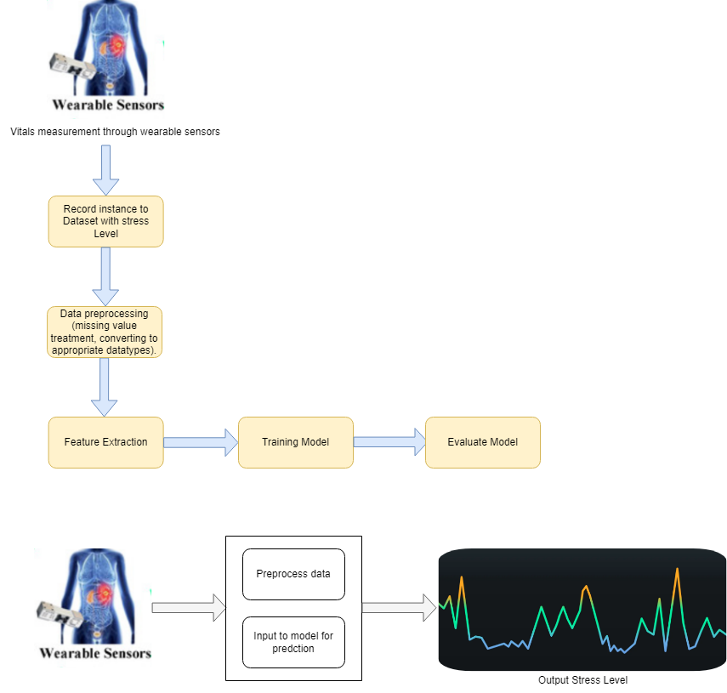
Stress Prediction Process Diagram

Slide 18


Thank You

