Slide 1
Team members: Mahmoud Taha Mostafa Elsayed Mohamed Osman Mohamed Adel Karim Nabil
Big Data Project

Slide 2
Agenda
Discovery
Data Preparation
Model Planning
Model Building

Slide 3
Project Life Cycle
Discovery
This classic dataset contains data, for 1997-2002, from police-reported car crashes in which there is a harmful event (people or property), and from which at least one vehicle was towed
Get All Available Resources and Technologies: R Language.
Determine Problem: Predict if the person would rather live or die.

Slide 4
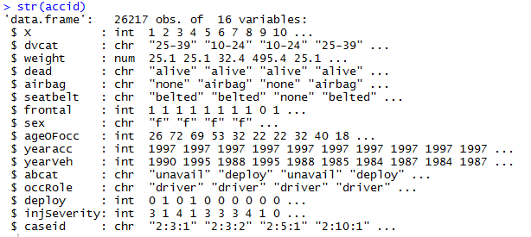
Discovery Cont.
Details of Data

Slide 5
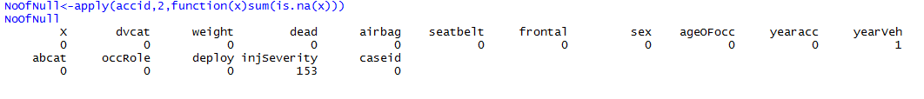
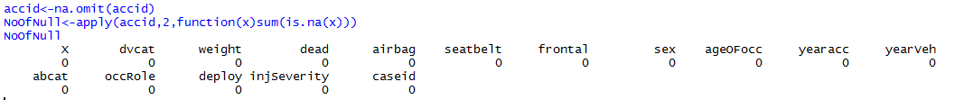
Data preparation
Data Prep
Get Dataset to Apply Visualization and Analytics Methods on it.
Detect Missing Values.
3. Remove all missing values

Slide 6

Data preparation,cont
3. Remove all Unusual values of Weight

Slide 7
Model Planning
Visualize to understand the data.
2. Classify dataset with 2 methods

Slide 8
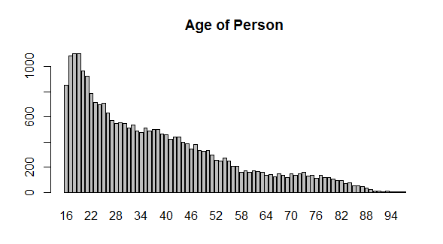
Visualization of Data
Age is skewed to the right ,Most of the ages of the injured are between 17-21 and this indicates the recklessness of young people

Slide 9
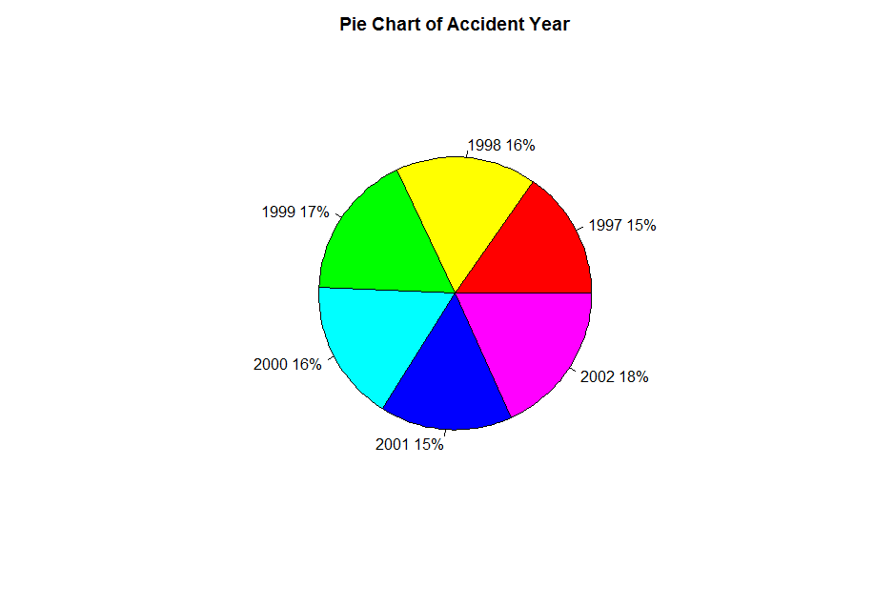
Visualization of Data
A Pie chart showing the distribution of accidents over 6 years and most year is 2002.

Slide 10
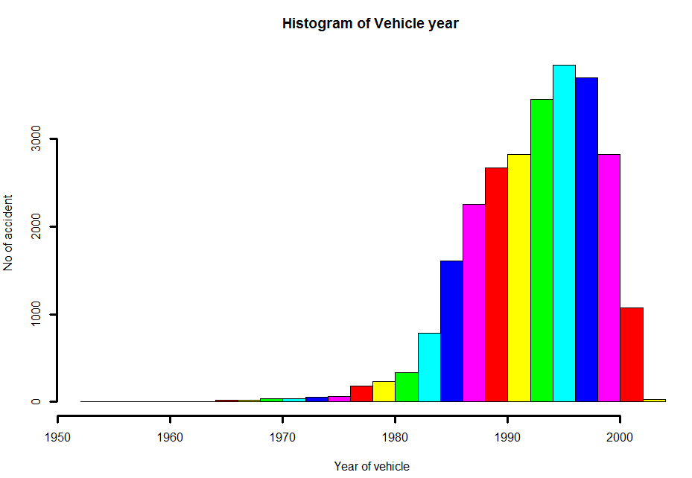
Visualization of Data
A Histogram showing the year of the model of the car that was involved in an accident and most year is 1995 and 1996

Slide 11
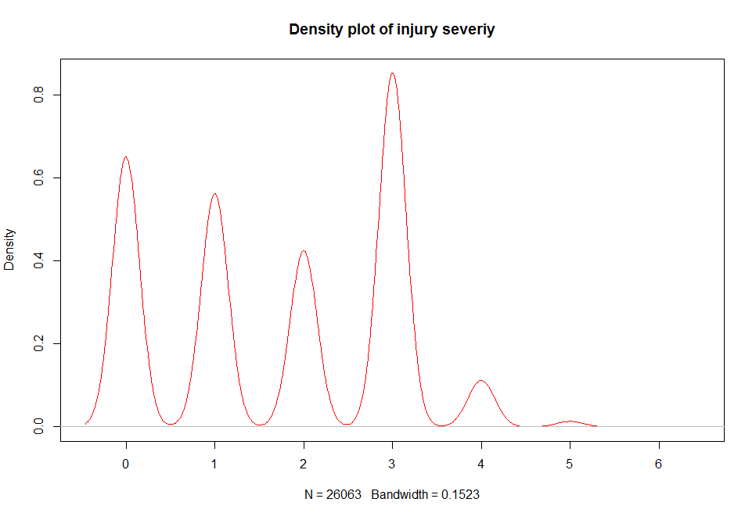
Visualization of Data
A Density Plot showing the degree of injury from 0 to 6 and most one is 3 that means incapacity
Notes:
a numeric vector; 0:none, 1:possible injury, 2:no incapacity, 3:incapacity, 4:killed; 5:unknown, 6:prior death

Slide 12
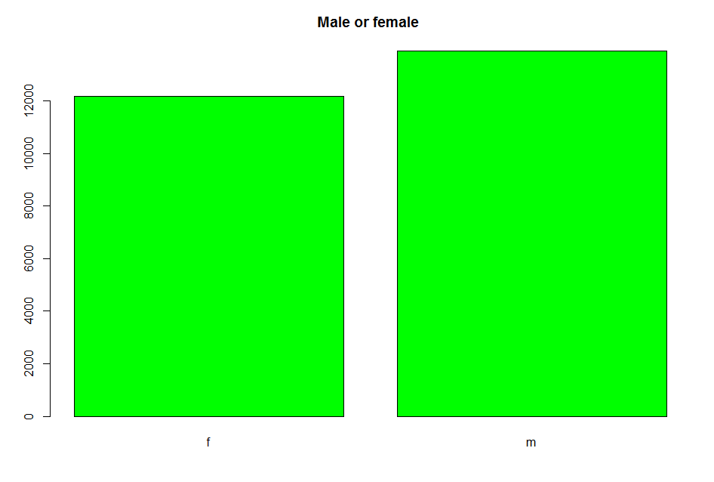
Visualization of Data
A Bar Plot showing the number of male and female from accidents and male is much greater than female

Slide 13
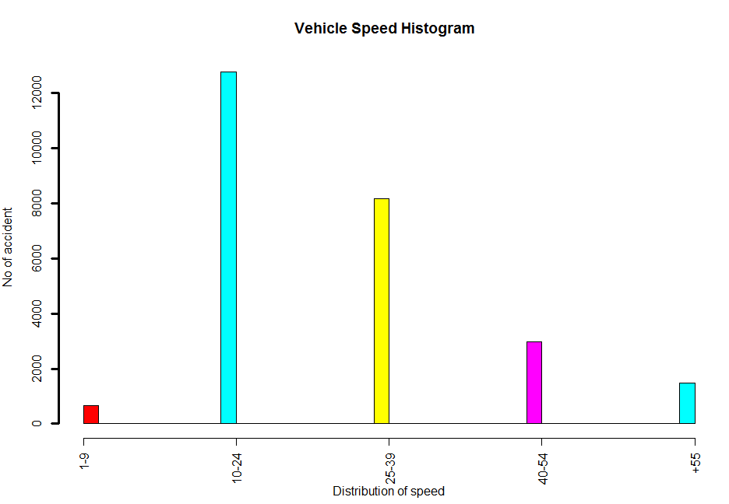
Visualization of Data
A Histogram showing the distribution of vehicle speed during accident

Slide 14

Visualization of Data
Min age:16
Max age: 97

Slide 15
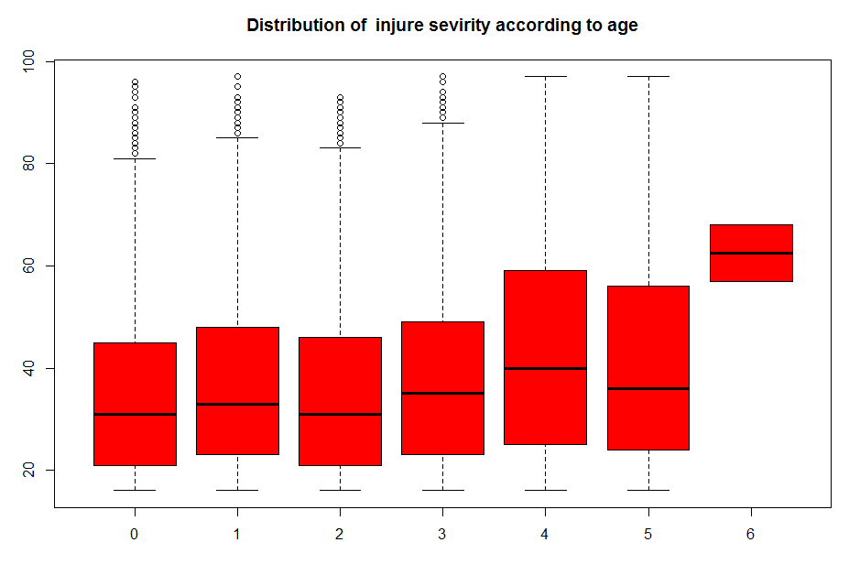
Visualization of Data
injury 6 (prior death) has the greatest age

Slide 16
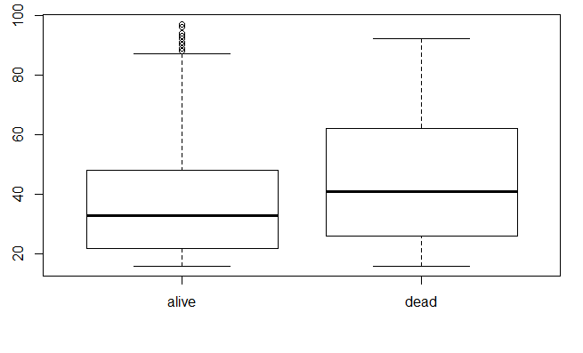

Visualization of Data
Determine distribution of dead and alive based on their age

Slide 17
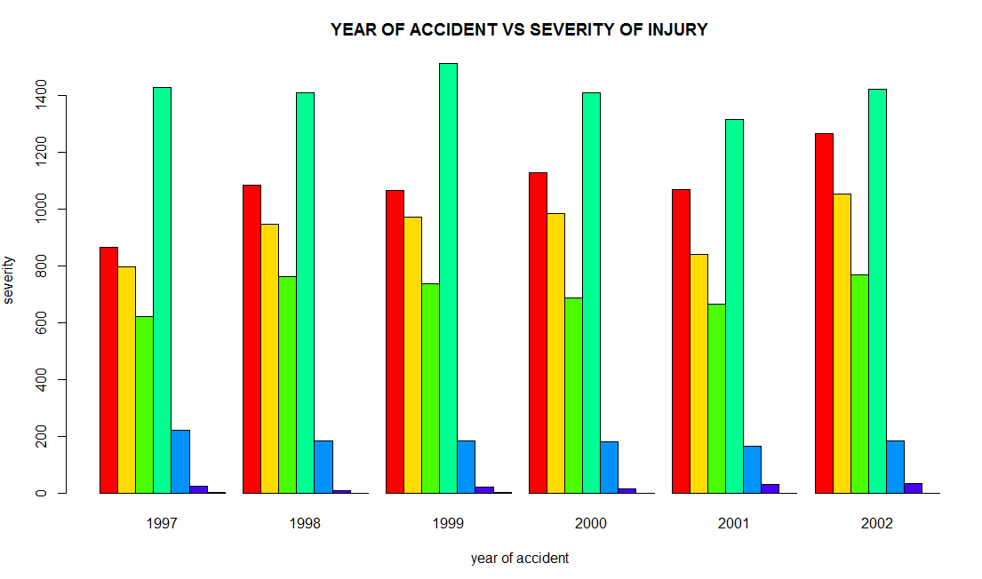
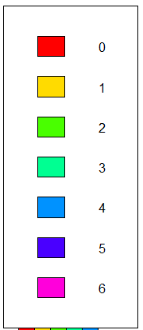
Visualization of Data
Distribution of injury severity based on year of accident

Slide 18
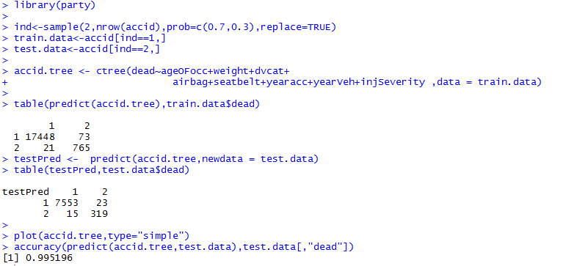
Model Building
Classification by decision tree(id3)

Slide 19
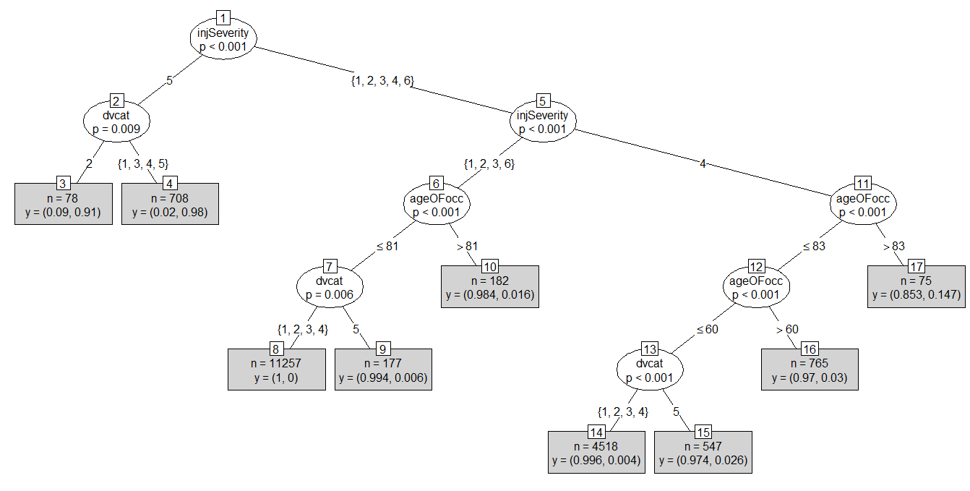

Slide 20
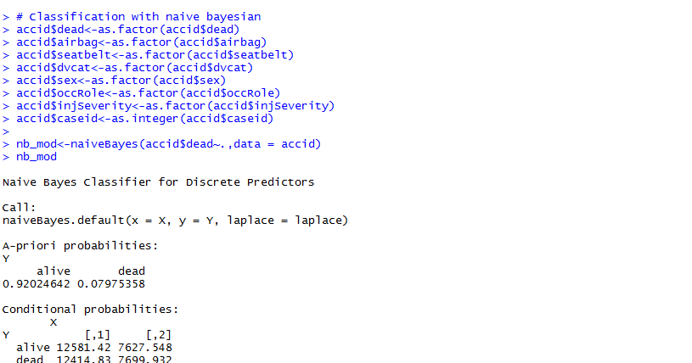
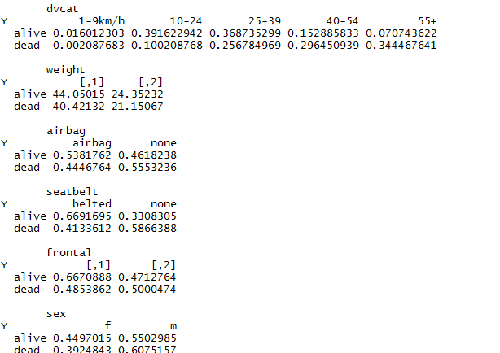
Model Building
Classification by naive Bayesian

Slide 21
