Slide 1
DS1 MINI PROJECT · SPRING BOOT
CourseHub
Online course platform — REST API
Spring Boot 3 · Spring Data JPA · MySQL 8 · Postman
Mahmoud Najar
5-minute presentation · November 2026
Notes:
Good morning. I'm Mahmoud, and this is CourseHub — the backend of an online course platform, built for DS1 with Spring Boot, Spring Data JPA and MySQL. In five minutes I'll show the data model, the layered design, the business rules, the custom queries, and the tests. (0:00–0:15)

Slide 2
01 · OVERVIEW
A complete backend for an online course platform
Instructors publish courses. Students enroll, track their progress and review them. Everything is exposed as a JSON REST API — there is no frontend, Postman is the client.
7
40+
76
linked JPA entities
REST endpoints, full CRUD
Postman checks, all passing
Category
Instructor
Tag
Course
Student
Enrollment
Review
One project, the whole DS1 checklist: entities, relationships, CRUD, custom queries, validation, error handling and Postman tests.
Spring Boot 3 · Spring Data JPA / Hibernate · MySQL 8 · H2 for tests · JUnit 5 · Postman
CourseHub · DS1 Mini Project
2 / 10
Notes:
CourseHub lets instructors publish courses, and students enroll, track progress and review them. There are seven linked entities, more than forty REST endpoints with full CRUD, and a Postman collection of seventy-six requests. There is no frontend — Postman is the client. (0:15–0:45)

Slide 3
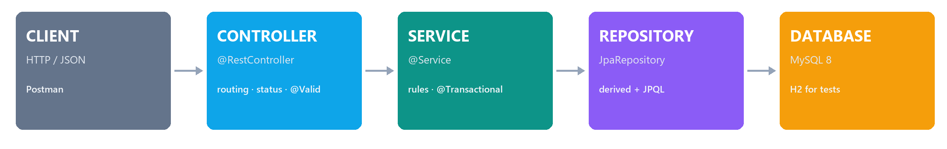
02 · ARCHITECTURE
One request, four layers
Controller
Service
Repository
Model
HTTP only: routing, status codes and @Valid. It contains no business logic.
Owns the rules and the 404 / 409 / 422 decisions. @Transactional keeps each operation atomic.
Spring Data JPA interfaces. Derived queries and five custom JPQL queries; Hibernate writes the SQL.
Seven entities mapped to tables, with their relationships, constraints and validation.
CourseHub · DS1 Mini Project
3 / 10
Notes:
Every request crosses four layers. The controller only handles HTTP: routing, status codes and validation. The service owns the rules and the transaction. The repository is a Spring Data interface — I write no SQL for CRUD. The model maps seven entities to tables. Keeping these separate is what makes the project easy to test. (0:45–1:25)

Slide 4
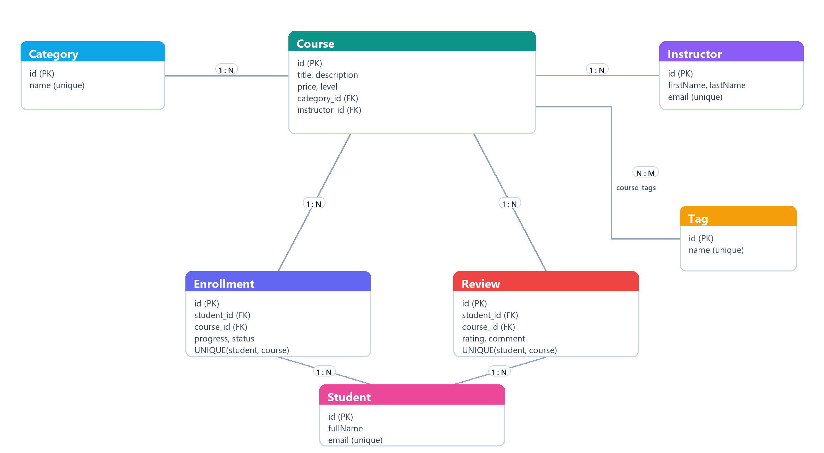
03 · DATA MODEL
Seven entities, three relationship styles
● One-to-many: Category → Course and Instructor → Course. Each course has exactly one of each.
● Many-to-many: Course ↔ Tag, stored in the course_tags join table.
● Enrollment and Review are association entities: they carry progress, status, rating and dates — data a plain join table cannot hold.
● A UNIQUE(student, course) constraint blocks double enrollment and double review.
● Deleting a referenced row is refused with 409 instead of a database error.
7 entities · 2 association entities · 1 join table
CourseHub · DS1 Mini Project
4 / 10
Notes:
The data model uses all three relationship styles. Category and Instructor are one-to-many to Course. Course and Tag are many-to-many through course_tags. Enrollment and Review are association entities: they carry their own columns — progress and status, or rating and comment — plus a unique constraint on student and course, which is what blocks double enrollment and double review. (1:25–2:05)

Slide 5
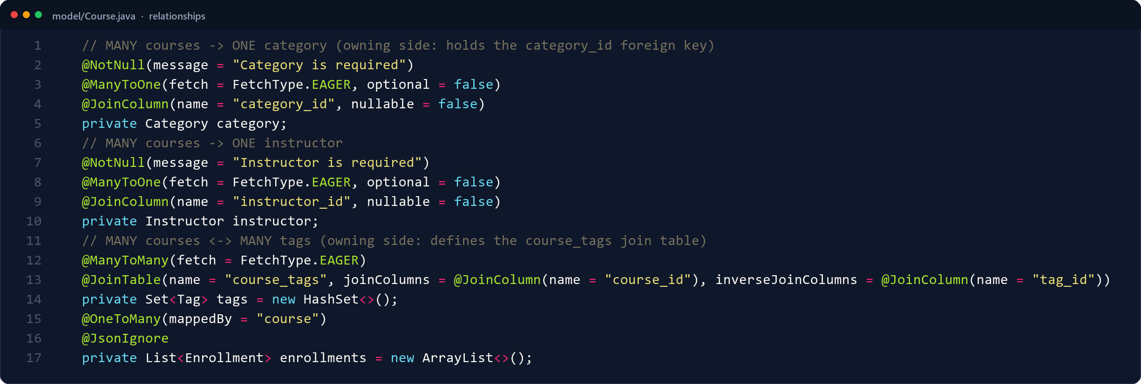
04 · JPA MAPPING
Relationships are declared once, in the entity
● @ManyToOne + @JoinColumn create category_id and instructor_id in the courses table.
● @ManyToMany + @JoinTable create course_tags(course_id, tag_id).
● mappedBy marks the inverse side; @JsonIgnore stops infinite JSON recursion.
● EAGER is used for the small reference objects that appear in every response.
src/main/java/com/mahmoud/coursehub/model/Course.java · lines 61–77
TAKEAWAY
Hibernate turns these declarations into joins — the API keeps returning real objects, not ids.
CourseHub · DS1 Mini Project
5 / 10
Notes:
In JPA the relationships are declared once, in the entity. @ManyToOne with @JoinColumn creates the foreign key. @ManyToMany with @JoinTable creates the join table. mappedBy marks the inverse side, and @JsonIgnore stops infinite recursion when the entity is serialized. After that, Hibernate handles the joins. (2:05–2:40)

Slide 6
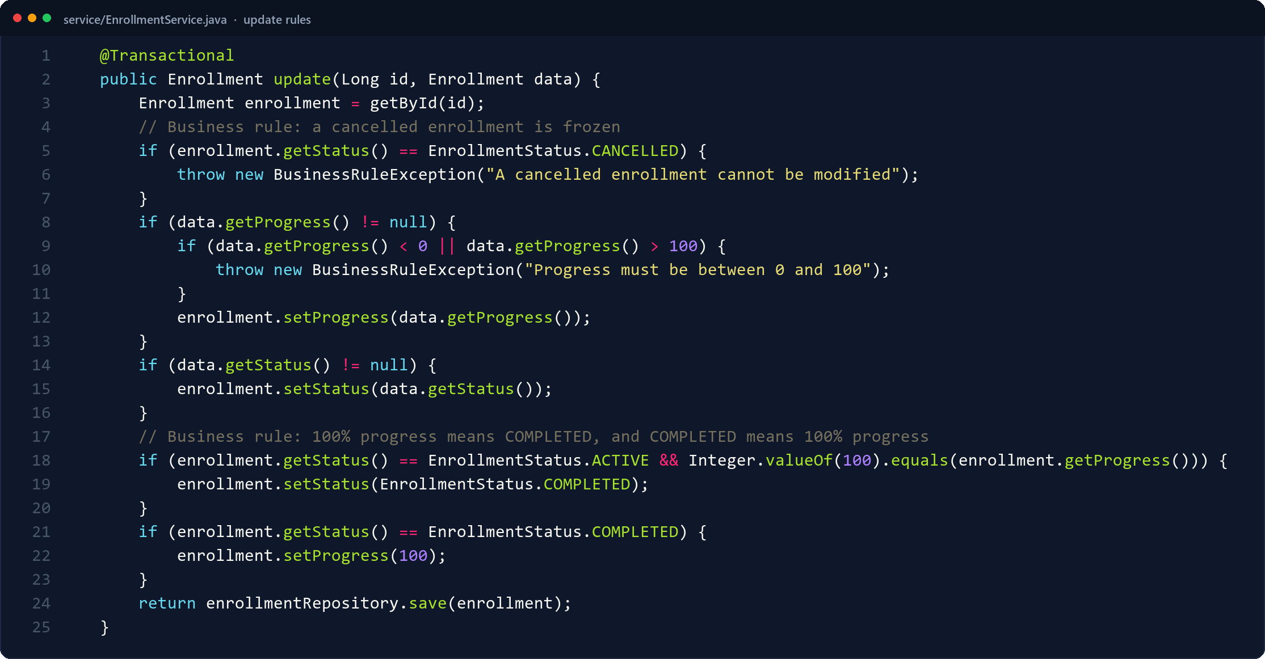
05 · BUSINESS RULES
The service layer is where the rules live
● One enrollment per student per course → 409 Conflict.
● A cancelled enrollment cannot be modified → 422 Unprocessable Entity.
● progress = 100 sets COMPLETED; COMPLETED forces progress = 100.
● The controller stays thin; @Transactional rolls back the whole operation on failure.
src/main/java/com/mahmoud/coursehub/service/EnrollmentService.java · lines 65–89
TAKEAWAY
The same rule protects every client: Postman today, a future frontend tomorrow, or a script.
CourseHub · DS1 Mini Project
6 / 10
Notes:
Business rules stay in the service. A student cannot enroll twice — 409. A cancelled enrollment is frozen — 422. Reaching one hundred percent progress automatically completes the enrollment, and a completed enrollment is forced to one hundred percent. The controller never decides any of this. (2:40–3:20)

Slide 7
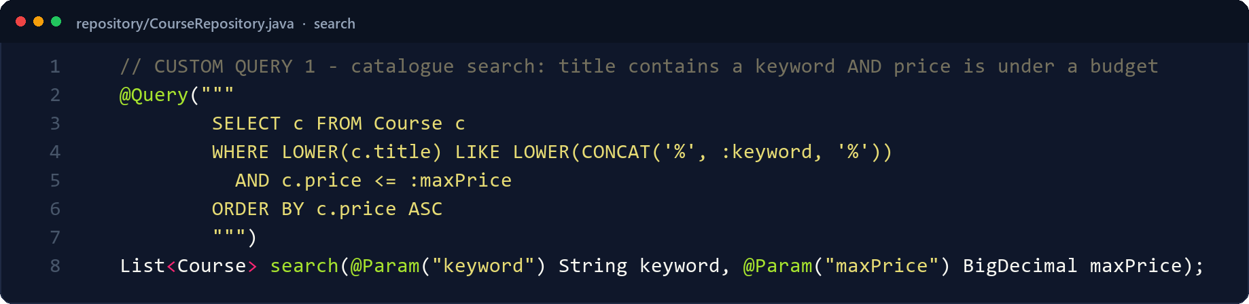
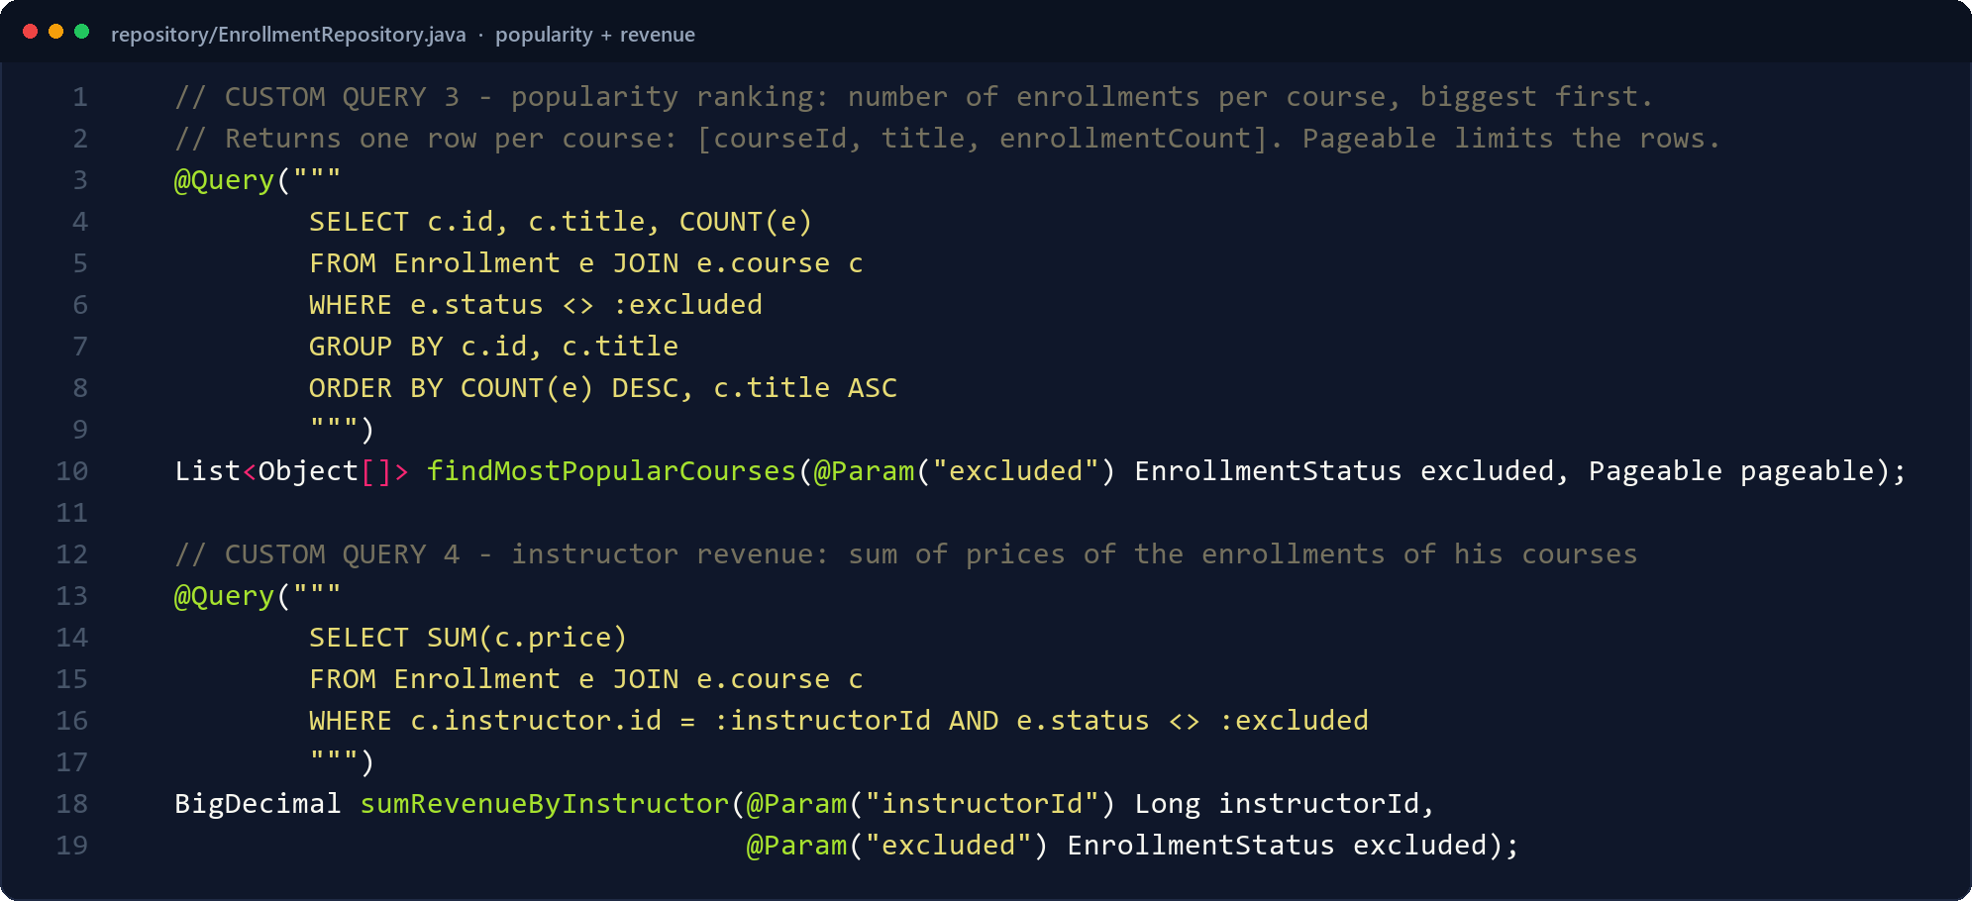
06 · CUSTOM JPQL
Five queries that answer real business questions
CourseRepository · search by title + budget
1 Search — title LIKE + max price
2 Roster — JOIN enrollments, cancelled excluded
3 Popularity — GROUP BY + COUNT + Pageable
4 Revenue — SUM of course prices
5 Rating — AVG of reviews
EnrollmentRepository · popularity ranking + instructor revenue
● JPQL uses entity names and fields; Hibernate translates it to the database dialect.
● Pageable limits the ranking to the top N rows.
● Popularity is returned as JSON: courseId, title, enrollments.
CourseHub · DS1 Mini Project
7 / 10
Notes:
DS1 asks for three custom queries; I wrote five. Search filters by title and budget. The roster joins enrollments and excludes cancelled ones. Popularity groups by course, counts enrollments and limits the result with Pageable. Revenue sums course prices, and rating averages the reviews. All of them are JPQL, so they use entity names and fields, not table names. (3:20–4:00)

Slide 8
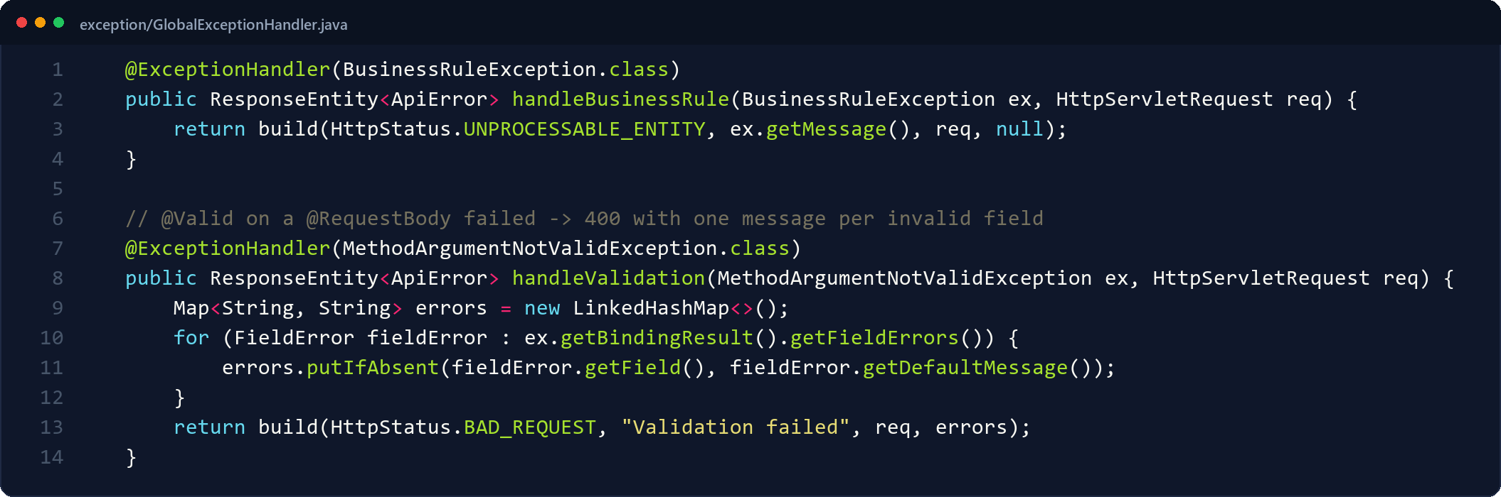
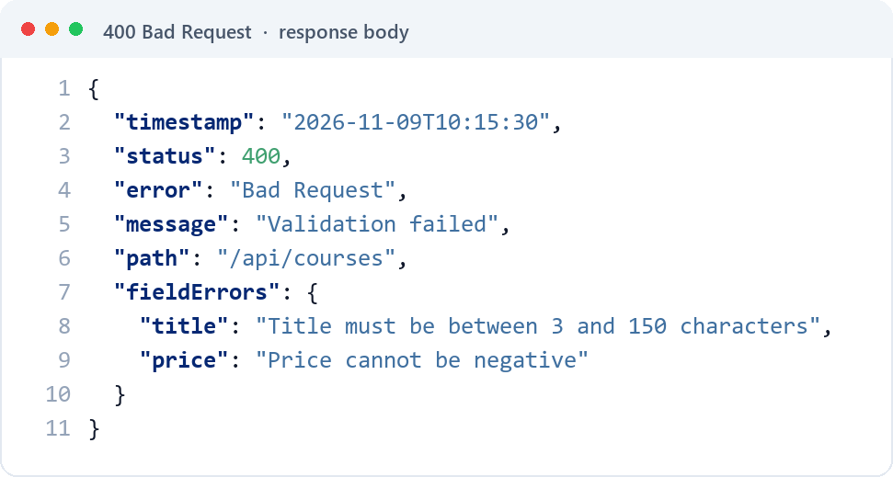
07 · VALIDATION & ERRORS
Bad input never reaches the database
GlobalExceptionHandler · one advice for the whole API
● Rules live on the entities: @NotBlank, @Size, @Email, @Min / @Max, @Past, @NotNull.
● @Valid on the controller parameter triggers them before the service runs.
● One ApiError shape for every failure.
● 400 validation / malformed · 404 unknown id · 409 duplicate · 422 business rule.
TAKEAWAY
The messages come from the annotations; the handler only chooses the status code and the JSON shape.
CourseHub · DS1 Mini Project
8 / 10
Notes:
Validation is declared on the entities — NotBlank, Size, Email, Min, Max, Past, NotNull — and triggered by @Valid on the controller. When something fails, one RestControllerAdvice converts it into the same JSON shape with the right status: 400 for validation or broken JSON, 404 for an unknown id, 409 for a duplicate, and 422 for a broken business rule. (4:00–4:30)

Slide 9
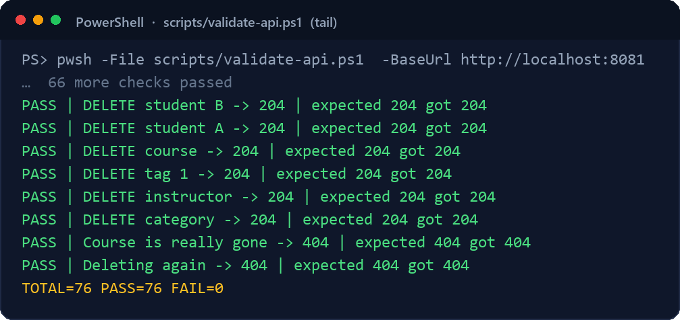
08 · TESTING
Verified end to end, not just compiled
76
76/76
5
Postman requests
checks passed
JUnit tests on H2
● CRUD, the five custom queries and 25 error cases — each with status and body assertions.
● The same API runs on MySQL (default) or H2 (demo / test) by changing the profile only.
● Reproducible from the terminal: scripts/validate-api.ps1.
Real run on the demo profile (H2) · no failures
CourseHub · DS1 Mini Project
9 / 10
Notes:
Finally, testing. The Postman collection has seventy-six requests: full CRUD, the five custom queries, and twenty-five error cases, each asserting the status and the body. All seventy-six pass. There are also five JUnit tests on H2. The same API runs on MySQL or H2 by changing the profile only. (4:30–4:50)

Slide 10
09 · WRAP-UP
Demo, then questions
Live demo path
What it demonstrates
Thank you
— Create category and instructor
— 7 linked entities, 3 relationship styles
Questions?
— Create two tags and a course
— Full CRUD on every entity
— Create a student and enroll
— 5 custom JPQL queries
github.com/mahmoudnajar548-hash/ds
— Update progress to 100%
— Validation + one error shape
— Post a review
— 76 passing Postman checks
— Show popular, rating, revenue
DS1 mini project · Spring Boot 3 · Spring Data JPA · MySQL 8 · Postman
Notes:
In the demo I create a category, an instructor, two tags and a course, then a student, enroll them, review the course and show the three statistics endpoints. The project covers the whole DS1 checklist. Thank you — I'm happy to take questions. (4:50–5:00)

