Slide 1
Marketing Analytics
Pullman MBA
Strategize. Analyze. Lead
Mauricio Featherman, Ph.D.

Slide 2



Marketing Analytics:
Transforming Data into Decisions
$$
We go thru the process of retrieving, integrating and copying data into a data warehouse.
Next we use Visual Statistics and analytics programs to analyze the datasets
Next recommend management action.

Slide 3
What will MKTG 555 cover?
Overview of Business Intelligence processes, technologies, job descriptions, etc.
Sense-making of BI industry: Coverage of MSFT’s BI Semantic Model – stack of technologies that manage, clean, harmonize, and store data, that is used for analysis & visualization
Coverage of key performance indicators – design, creation, usage of KPI’s
Coverage and implementation of statistics that perform descriptive, inferential and predictive analytics that turn data into insights and better decision-making

Slide 4
Will I receive hands-on exposure to relevant technologies which I can put on my resume?
Stating with a Corporate BI perspective - we use SQL Server to prepare the dataset (there is a chance we will use SAS in a similar fashion).
Next semester we replicate the process using a self-service BI perspective and Excel’s Power BI tools.
A module using SQL Server Reporting Services (SSRS) is also provided as it fits very well with SQL Server and is still very popular with recruiters

Slide 5
Will I receive hands-on exposure to relevant technologies which I can put on my resume?
We perform statistics and data mining using SAS
We perform data visualization with SAS or Tableau.

Slide 6


Connection to Data
Internet connection to
on-prem data assets or Cloud assets
.NET
SQL Server Management Studio
Stored procedures
Visual Studio
using VB language
And stored procedures

Slide 7


Connection to Data
Internet connection to on-premises data assets or Cloud assets
SQL Server Management Studio
Stored procedures
Stored procedures
Reports, dashboards, story boards

Slide 8

Connection to Data
Internet connection to
on-prem data assets or Cloud assets
SQL Server Management Studio
Stored procedures
SAS Visual Statistics
and Visual Analytics

Slide 9

Connection to Data
Internet connection to
on-prem data assets or Cloud assets
SQL Server Management Studio
Stored procedures
Stored procedures

Slide 10

Connection to Data
Internet connection to
on-prem data assets or Cloud assets
SQL Server Management Studio
Stored procedures
Stored procedures
Excel Pivot tables and Pivot Charts

Slide 11
Why so many IT approaches?
The more technologies you are familiar with the more you understand the overall BI Architecture picture and can lead a project
A mastery over technical tools fuels your ability to be a competent analyst
The more tools you have under your belt, the more likely you will NOT get an entry-level BI or analyst position (rather rise in stature)

Slide 12

Will I receive hands-on exposure to relevant technologies which I can put on my resume?
blogs.lessthandot.com

Slide 13
What activities will the class consist of?
Class time – discussions, Q&A, demo’s, student presentations
Lab time – work with faculty and TA’s to gain hands-on experience with BI and BA technologies… and statistics
Video time – as individual assignments - review BI-related videos, take notes, answer questions, upload a summary to the CMS
Hands-on learning time @ Daily Grind– working in groups – work with hands-on technologies to deliver task requirements
Reading time – read, interpret, reflect on and summarize BI – related content – sometimes upload a review
Group time – work with group members on presentations & final project
Reflect time – consider BI/MBA issues in a free-form self-reflection

Slide 14
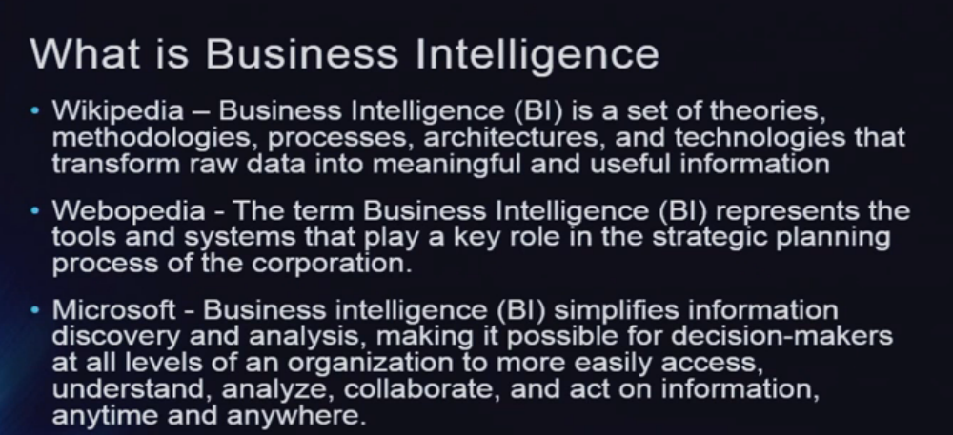

Slide 15
BI Systems are not magic (GIGO)
BI systems aggregate data from many sources
The data needs to be cleaned and harmonized
Some of this can be automated but human eyeballs are still needed to verify data
A million dollar BI system can give you incorrect data…which drives incorrect decisions, business srtategies, actions, etc.
When creating a BI system all the idiosyncrasies of developers, knowledge workers and managers will see the light of day.

Slide 16
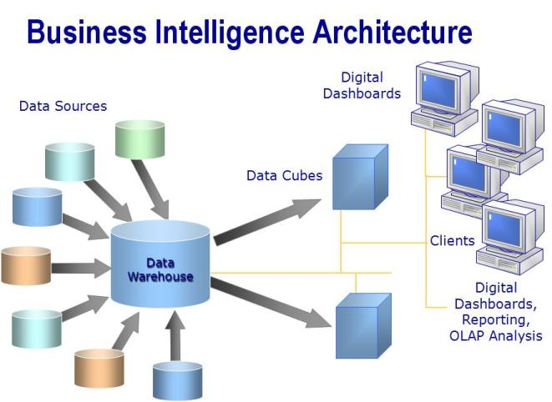
www.ksi.ca

Slide 17
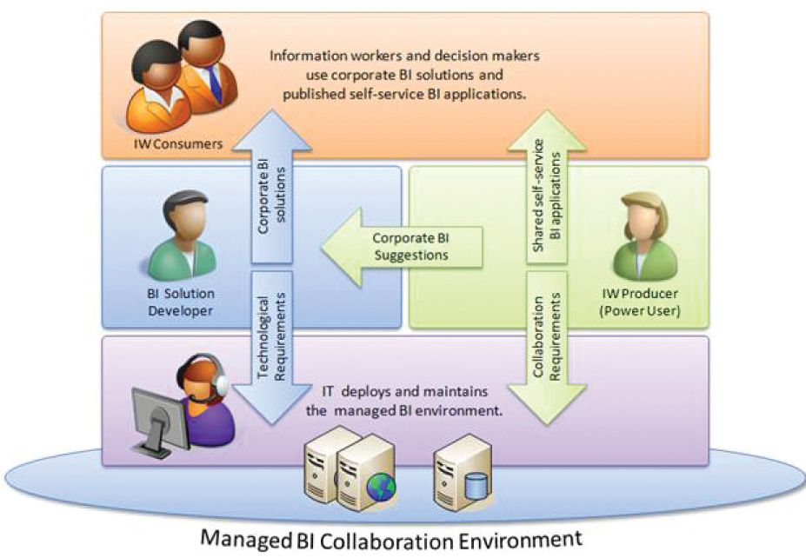

Slide 18
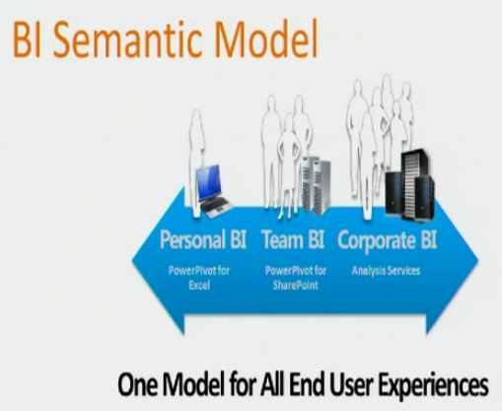

Slide 19
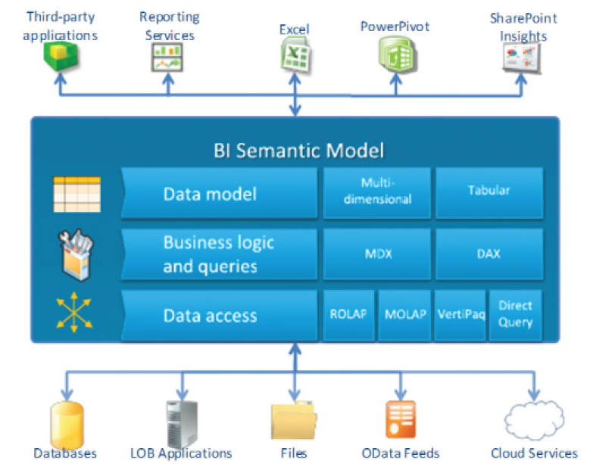

Slide 20
Who uses what MSFT BI tool?
Upper level managers use dashboards and scorecards with stoplights and gauges that are alerting systems to make phones and portals beep.
Business analysts/managers use Excel (with Powerpivot) to pull in external data and use pivot tables, pivot charts
IT staff (DBA’s) use SQLServer database tools to store transaction data (SSMS)
IT staff (DBA’s) also use SQLServer Integration services to copy transaction data to a data warehouse (ECTL process)
Business Analysts use reporting services (SSAS or ??) to create on-demand or on-schedule drill-down, filtered reports with charts, maps, etc.

Slide 21
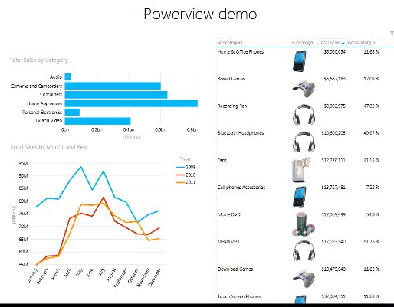
SSRS or Powerview Report

Slide 22
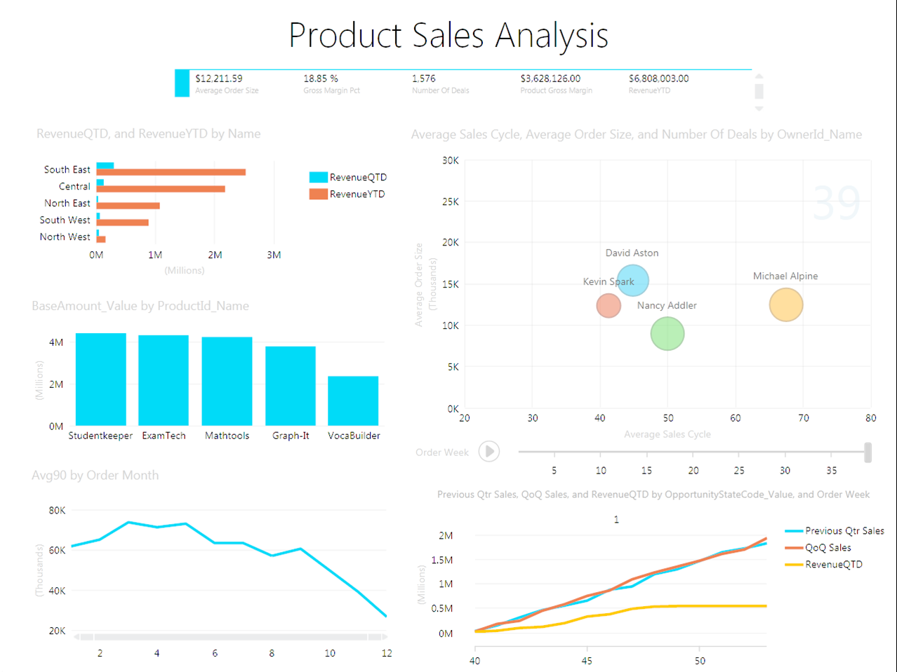
SSRS or Powerview Report
blogs.msdn.com

Slide 23
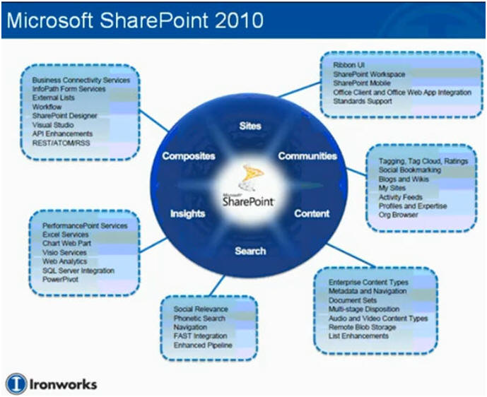

Slide 24
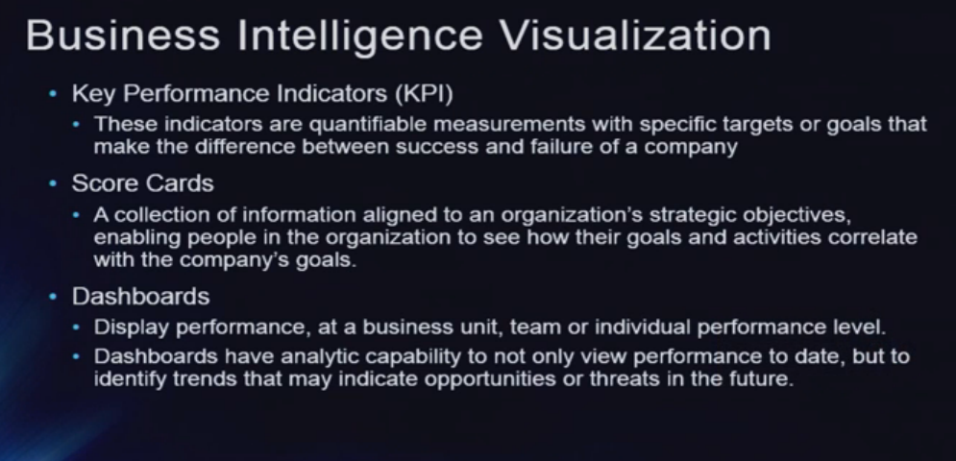

Slide 25
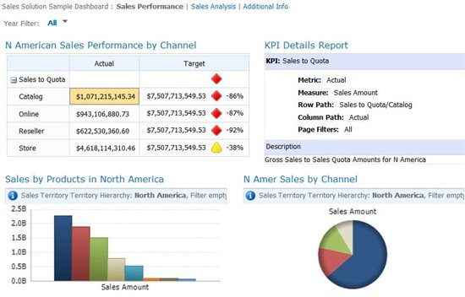
PerformancePoint Dashboard in Sharepoint. Why use sharepoint?
blogs.technet.com

Slide 26
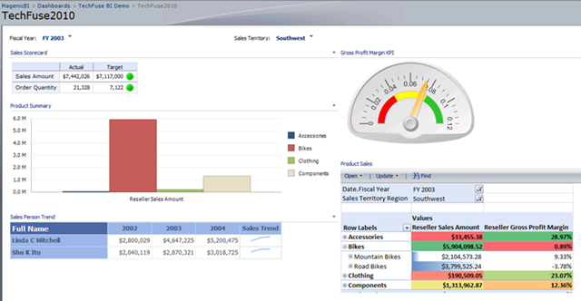
PerformancePoint Dashboard in Sharepoint. Why use sharepoint?
blogs.technet.com

Slide 27
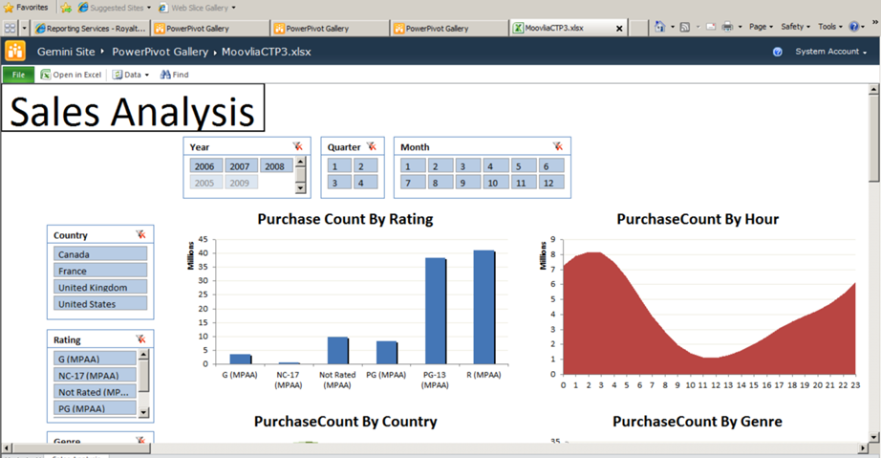
Example Powerpivot report hosted in Sharepoint
blogs.technet.com

Slide 28

You must merge with the machine

Slide 29
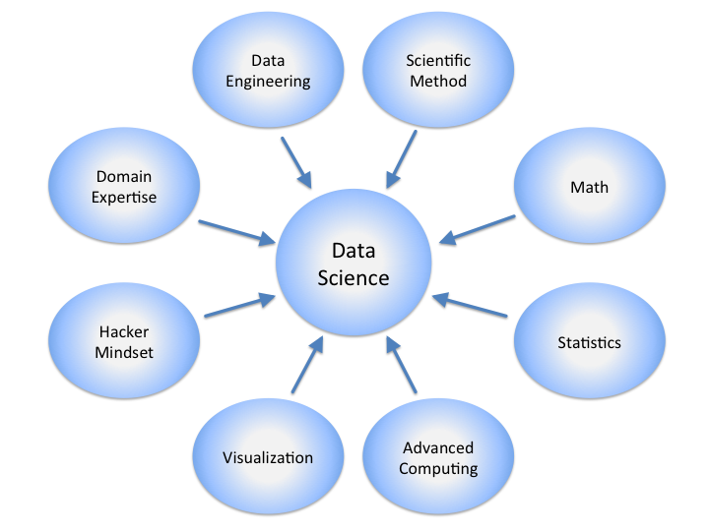
Will I become a data scientist? I heard that’s a good thing.
The class will further you down the road to this journey
Wikipedia.com

Slide 30
Likely Projects - Excel
Excel opening an external datasource a datacube from SSAS. Create a pivot table and pivot chart.
Excel opening a data table from SSMS. Create a data table
Excel opening a tabular data model. Create a pivot chart

Slide 31
OK can you simplify that? What forces are fueling the BI/BA phenomenon.
Statistics, Data Mining, Operations Research
Stats wonks
Part 3 of the class
Management Analysts, MBA’s
Functional Analyst
Dashboard people
Part 4 of the class
Database, Data Warehouse,
BI Architects
Technology experts
Technology wonks
Part 1 of the class
Part 2 of the class

Slide 32

OK can you simplify that? What forces are fueling the BI/BA phenomenon.
Management Analysts, and Business managers. Need to stay competitive.
Statistics,
Data Mining
Data Management Technologies and
Best practices

Slide 33

OK what technologies are we using again?
Statistics,
Data Mining
Excel, SSAS
Excel, Tableau,
IBM Cognos (maybe),
Sharepoint,
PerformancePoint, SSRS
Data Management Technologies and
Best practices
SQL Server MGMT
Studio

Slide 34
Likely Projects - Excel\Sharepoint
Excel opening an external datasource a datacube from SSAS. Create a pivot table and pivot chart. Upload workbook to Sharepoint Excel services.
Excel opening a data table from SSMS. Create a data table – upload workbook to Sharepoint
Excel opening a tabular data model. Create a pivot chart. Add 2 slicers on 2 dimensions. Upload named pivot chart to excel

Slide 35
Likely Projects - PowerPivot
Use powerpivot to connect to external datasource – related tables
Use powerpivot to create tabular model
Add KPI’s to tabular model.

Slide 36
Likely Projects – Excel/PowerPivot
Use powerpivot to connect to external datasource – dataviews
Use powerpivot to create tabular model
You will have to create all the FK relationships
Add KPI’s to tabular model
Use tabular model in Performance point – using KPI’s in scorecard

