Slide 1
Introduction to HDFS:
Hadoop Distributed File System
Mahmoud (Max) Parsian
Ph.D. in Computer Science
Notes:
Introduce myself: 8 years data engineering, data analytics (make sense)

Slide 2
What’s Hadoop
Hadoop is an open-source framework that is used to
efficiently store large datasets ranging in size from gigabytes to petabytes of data.
efficiently process large datasets
HDFS - Hadoop DFS is a distributed file system that handles large data sets running on commodity hardware.
Hadoop implements MapReduce paradigm

Slide 3
What’s Hadoop Functionality
Hadoop implements MapReduce paradigm:
map(): extract some useful information from each record
reduce(): aggregates values for a given key
combine(): mini-reducer on local data nodes

Slide 4
MapReduce Cluster
One (or more) master node
can have more than one master
Set of worker nodes (10’s, 100’s, 1000’s)
Example: cluster of 102 nodes
One master node (another one: standby)
100 worker nodes
Question: What if master node crashes
Question: What if some worker node crashes

Slide 5
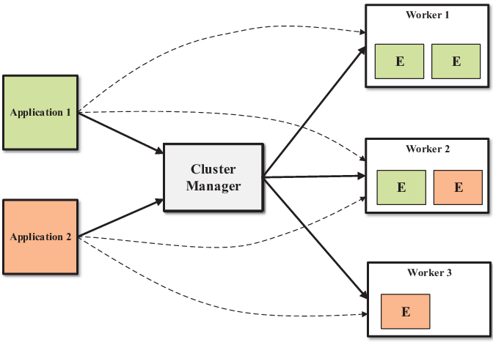
MapReduce Cluster E = Executor service

Slide 6
MapReduce Motivation
Process lots of data
Google processed about 24 petabytes of data per day in 2009.
Facebook processed 60 petabytes of data per day in 2020
A single machine cannot serve all the data
You need a distributed system to store and process in parallel
Parallel programming?
Threading is hard!
How do you facilitate communication between nodes?
How do you scale to more machines?
How do you handle machine failures?

Slide 7
What’s HDFS
HDFS is a distributed file system that is
Fault tolerant
Scalable
Easy to expand
Used in MapReduce
HDFS is the primary distributed storage for Hadoop applications.
HDFS provides interfaces for applications to move themselves closer to data.

Slide 8
Data Size HDFS: Example
Cluster: 15 Nodes
One Master (does not store actual data, stores metadata)
14 worker nodes
Each worker node can store: 100TB
Total size = 14 x 100TB = 1400TB
HDFS can utilize 1400 TB of disk space

Slide 9
Components of HDFS
There are 2 types of nodes/machines in a HDFS cluster
NameNode (master node):
Is the heart of an HDFS filesystem,
It maintains and manages the file system metadata:
What blocks make up a file
Which data nodes those blocks are stored (manages metadata)
DataNode :- (worker node)
Where HDFS stores the actual data,
Runs mappers and reducers

Slide 10
Failure in MapReduce
Failures are norm in commodity hardware
Worker failure
Detect failure via periodic heartbeats
Re-execute in-progress map/reduce tasks
Master failure
Single point of failure; Resume from Execution Log
Robust
Google’s experience: lost 1600 of 1800 machines once!, but finished fine

Slide 11
Fault tolerance: Handled via re-execution
On worker failure:
Detect failure via periodic heartbeats
Re-execute completed and in-progress map tasks
Task completion committed through master

Slide 12
Fault tolerance
Replication
High availability for reads
User controllable, default 3 (non-RAID)
Provides read/seek bandwidth
Master is responsible for directing re-replication if a data node dies
Online check-summing in data nodes
Verified on reads

Slide 13
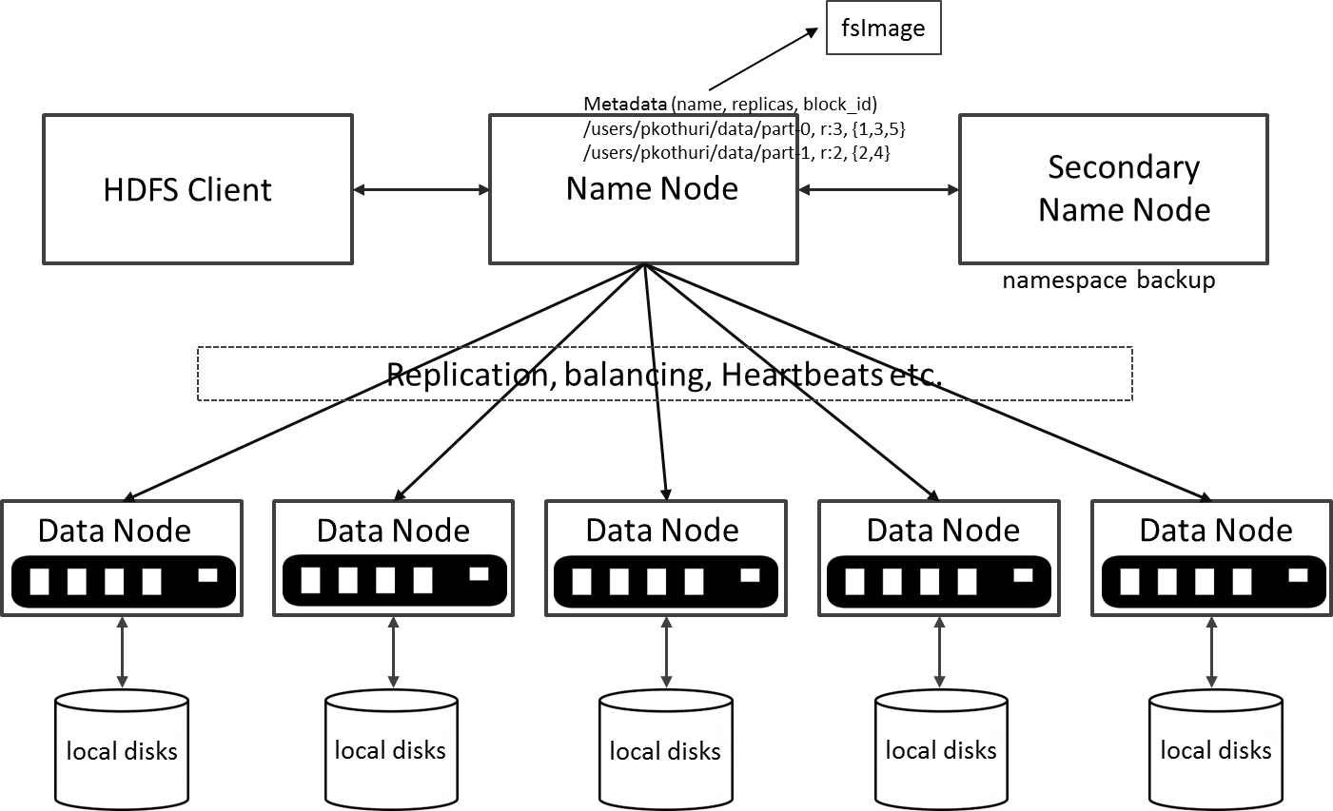
HDFS Architecture

Slide 14
Features of HDFS
HDFS also has a set of features that make it ideal for distributed systems:
Fault tolerant - data is duplicated across multiple DataNodes to protect against machine failures. The default is a replication factor of 3 (every block is stored on three machines).
Scalability - data transfers happen directly with the DataNodes so your read/write capacity scales fairly well with the number of DataNodes
Space - need more disk space? Just add more DataNodes and re-balance
Industry standard - Other distributed applications are built on top of HDFS
Hbase (Hadoop Database)
MapReduce (distributed and parallel computing)
HDFS is designed to process large data sets with write-once-read-many semantics

Slide 15
Features of HDFS: Read/Write
HDFS also has a set of features that make it ideal for distributed systems
HDFS is designed to process large data sets:
with write-once-read-many semantics
Can not update/edit files
Can delete files
Can add files

Slide 16
HDFS – Data Organization
Each file written into HDFS is split into data blocks
Each block is stored on one or more data nodes
Each copy of the block is called replica
Block placement policy
First replica is placed on the local node
Second replica is placed in a different rack
Third replica is placed in the same rack as the second replica
Notes:
NameNode and DataNode each run an internal web server in order to display basic information about the current status of the cluster

Slide 17
HDFS – Example: Single File
Let data block size = 128 MB
Let a file (sample.txt) = 400 MB
Therefore, we need 4 data blocks to store file in HDFS:
400 = 128 + 128 + 128 + 16
B1 = Block1 = 128 MB
B2 = Block2 = 128 MB
B3 = Block3 = 128 MB
B4 = Block3 = 16 MB
NOTE: the whole data block of 128 MB is used for 16 MB
Notes:
NameNode and DataNode each run an internal web server in order to display basic information about the current status of the cluster

Slide 18
HDFS – Example
Consider a cluster of 6 nodes: {M, N1, N2, N3, N4, N5}
1 master + 5 data nodes – and master does not store any data at all (master node just stores metadata)
M: Master = stores metadata only
N1 = data node 1
N2 = data node 2
N3 = data node 3
N4 = data node 4
N5 = data node 5
Notes:
NameNode and DataNode each run an internal web server in order to display basic information about the current status of the cluster

Slide 19
HDFS – Replication of 1
File sample.txt has 4 blocks: B1, B2, B3, B4
Each block is replicated ONCE
N1 = {B2}
N2 = {B3}
N3 = {B1}
N4 = {B4}
N5 = {}
QUESTION: what happens if any of data nodes fail?
Notes:
NameNode and DataNode each run an internal web server in order to display basic information about the current status of the cluster

Slide 20
HDFS – Replication of 2
File sample.txt has 4 blocks: { B1, B2, B3, B4 }
Each block is replicated 2 times
N1 = {B1}
N2 = {B3, B4}
N3 = {B1, B2}
N4 = {B4, B3}
N5 = {B2}
QUESTION: what happens if any of data nodes fail?
Notes:
NameNode and DataNode each run an internal web server in order to display basic information about the current status of the cluster

Slide 21
HDFS – Replication of 3
File sample.txt has 4 blocks: B1, B2, B3, B4
Each block is replicated 3 times
N1 = {B1, B2}
N2 = {B1, B3, B4}
N3 = {B1, B2, B3}
N4 = {B4, B3}
N5 = {B2, B4}
QUESTION: what happens if any of data nodes fail?
Notes:
NameNode and DataNode each run an internal web server in order to display basic information about the current status of the cluster

Slide 22
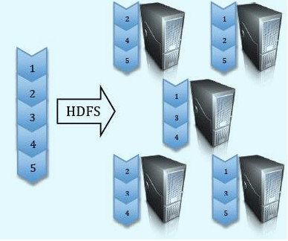
Data Replication Factor = 3

Slide 23
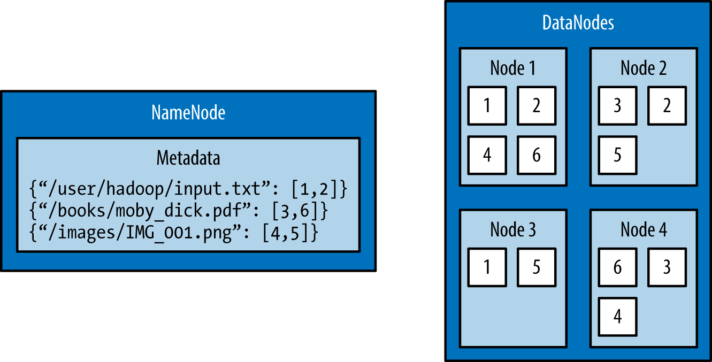
HDFS – Example: Multiple Files : 3 files Replication Factor = 2
Notes:
NameNode and DataNode each run an internal web server in order to display basic information about the current status of the cluster

Slide 24
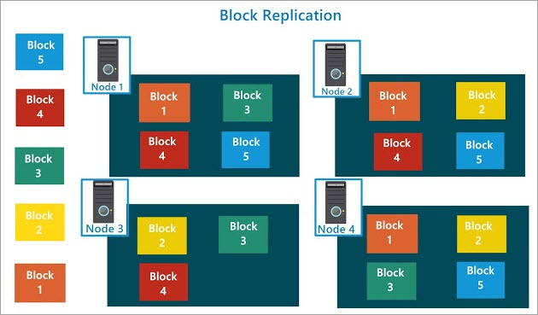
HDFS – Example: 5 blocks, 4 DataNodes Replication Factor = 3
Notes:
NameNode and DataNode each run an internal web server in order to display basic information about the current status of the cluster

Slide 25
Data and Block Size
Data Block Size = 128 MB
File SAMPLE.TXT = 400 MB
We need 5 blocks to store file SAMPLE.TXT:
A: Block1 = 128 MB
B: Block2 = 128 MB
C: Block3 = 128 MB
D: Block4 = 16 MB (128 MB will be allocated for this last block)

Slide 26
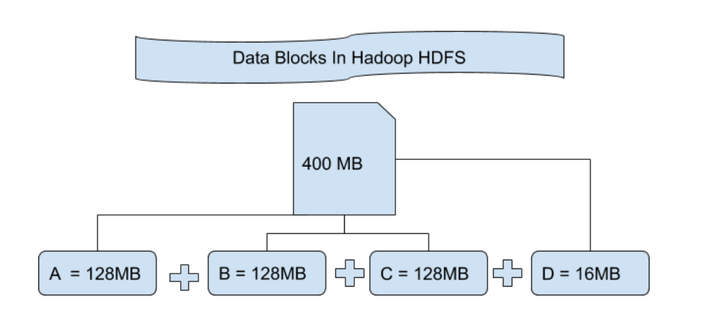
Data and Block Size

Slide 27
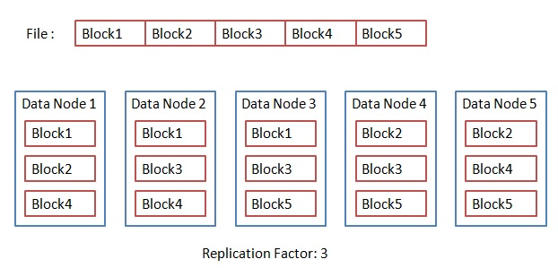
Data Replication Factor = 3

Slide 28
Higher Replication means Less Usable Storage Higher Replication means More Cost
Consider a cluster of 5 nodes: Master + 4 DataNodes
Assume master does not store any data other than metadata
Assume each DataNode can store 50 TB
With replication of 1: usable storage = 4 * 50 = 200 TB
With replication of 2: usable storage = 200 / 2 = 100 TB
With replication of 4: usable storage = 200 / 4 = 50 TB
With replication of 5: usable storage = 200 / 5 = 40 TB
Notes:
NameNode and DataNode each run an internal web server in order to display basic information about the current status of the cluster

Slide 29
Cost of Replication?
Consider a cluster of 5 nodes: Master + 4 DataNodes
Assume each DataNode can store 50 TB
With replication of 1: usable storage = 4 * 50 = 200 TB
With replication of 5: usable storage = 200 / 5 = 40 TB
With replication of 5, only 40 TB is useable → More Cost
So the cost is 160 TB of disk space (which can not be used)
Notes:
NameNode and DataNode each run an internal web server in order to display basic information about the current status of the cluster

Slide 30
HDFS – Fault Tolerance
How many nodes can safely fail in a cluster?
With replication Factor of N,
N-1 nodes can safely fail
Example:
So if replication factor is 3,
then only 2 nodes can safely fail
Notes:
NameNode and DataNode each run an internal web server in order to display basic information about the current status of the cluster

Slide 31
Fault Tolerance: N data nodes, Replication of N
Let’s have a cluster of N+1 nodes
Master with no data
N data nodes
With replication Factor of N,
How many nodes can safely fail
Answer: (N-1) nodes can safely fail: BUT VERY EXPENSIVE
Notes:
NameNode and DataNode each run an internal web server in order to display basic information about the current status of the cluster

Slide 32
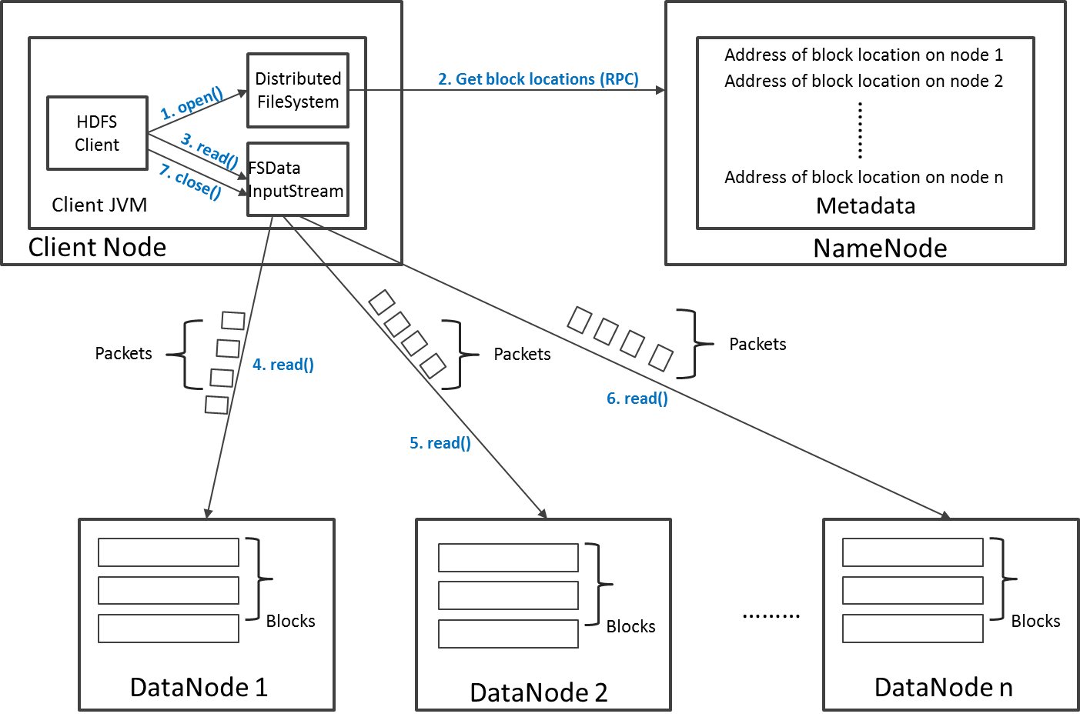
Read Operation in HDFS

Slide 33
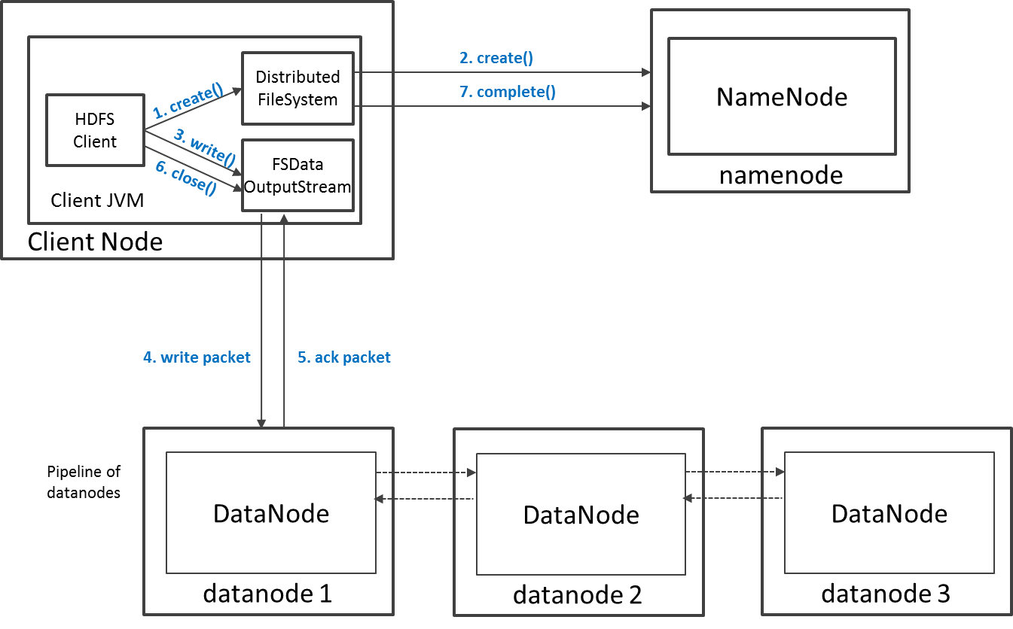
Write Operation in HDFS

Slide 34
HDFS Security
Authentication to Hadoop
Simple – insecure way of using OS username to determine hadoop identity
Kerberos – authentication using kerberos ticket
Set by hadoop.security.authentication=simple|kerberos
File and Directory permissions are same like in POSIX
read (r), write (w), and execute (x) permissions
also has an owner, group and mode
enabled by default (dfs.permissions.enabled=true)
ACLs are used for implemention permissions that differ from natural hierarchy of users and groups
enabled by dfs.namenode.acls.enabled=true
Notes:
NameNode and DataNode each run an internal web server in order to display basic information about the current status of the cluster

Slide 35
HDFS Configuration
HDFS Defaults
Block Size – 256 MB = 268435456 bytes
Replication Factor : 3
Web UI Port : 50070
HDFS conf file - /etc/hadoop/conf/hdfs-site.xml
<property>
<name>dfs.namenode.name.dir</name>
<value>file:///data1/cloudera/dfs/nn,file:///data2/cloudera/dfs/nn</value>
</property>
<property>
<name>dfs.blocksize</name><value>268435456</value>
</property>
<property>
<name>dfs.replication</name><value>3</value>
</property>
<property>
<name>dfs.namenode.http-address</name><value>itracXXX.cern.ch:50070</value>
</property>
Notes:
NameNode and DataNode each run an internal web server in order to display basic information about the current status of the cluster

Slide 36
Interfaces to HDFS
Java API (DistributedFileSystem)
C wrapper (libhdfs)
HTTP protocol
WebDAV protocol
Shell Commands
However, the command line is one of the simplest and most familiar

Slide 37
HDFS – Shell Commands
There are two types of shell commands
User Commands
hdfs dfs – runs filesystem commands on the HDFS
hdfs fsck – runs a HDFS filesystem checking command
Administration Commands
hdfs dfsadmin – runs HDFS administration commands
Notes:
NameNode and DataNode each run an internal web server in order to display basic information about the current status of the cluster

Slide 38
HDFS – User Commands (dfs)
List directory contents
Display the disk space used by files
hdfs dfs –ls
hdfs dfs -ls /
hdfs dfs -ls -R /var
hdfs dfs -du -h /
hdfs dfs -du /hbase/data/hbase/namespace/
hdfs dfs -du -h /hbase/data/hbase/namespace/
hdfs dfs -du -s /hbase/data/hbase/namespace/
Notes:
NameNode and DataNode each run an internal web server in order to display basic information about the current status of the cluster

Slide 39
HDFS – User Commands (dfs)
Copy data to HDFS
Copy the file back to local filesystem
hdfs dfs -mkdir tdata
hdfs dfs -ls
hdfs dfs -copyFromLocal /tmp/test.csv /data/
hdfs dfs -ls –R
cd tutorials/data/
hdfs dfs –copyToLocal /data/test.csv test.csv.hdfs

Slide 40
HDFS – User Commands (acls)
List acl for a file
List the file statistics – (%r – replication factor)
Write to hdfs reading from stdin
hdfs dfs -getfacl /data/test.csv
hdfs dfs -stat "%r" /data/test.csv
echo "blah blah" | hdfs dfs -put - /data/myfile.txt
hdfs dfs -ls –R
hdfs dfs -cat /data/myfile.txt

Slide 41
HDFS – User Commands (fsck)
Removing a file
List the blocks of a file and their locations
Print missing blocks and the files they belong to
hdfs dfs -rm /dir3/tfile.txt
hdfs dfs -ls –R
hdfs fsck /dir5/geneva.csv -files -blocks –locations
hdfs fsck / -list-corruptfileblocks

Slide 42
HDFS – Adminstration Commands
Comprehensive status report of HDFS cluster
Prints a tree of racks and their nodes
Get the information for a given datanode (like ping)
hdfs dfsadmin –report
hdfs dfsadmin –printTopology
hdfs dfsadmin -getDatanodeInfo localhost:50020
Notes:
NameNode and DataNode each run an internal web server in order to display basic information about the current status of the cluster

Slide 43
HDFS – Advanced Commands
Get a list of namenodes in the Hadoop cluster
The general command line syntax is
hdfs command [genericOptions] [commandOptions]
hdfs getconf –namenodes
Notes:
NameNode and DataNode each run an internal web server in order to display basic information about the current status of the cluster

Slide 44
Summary: HDFS
HDFS provides a fault-tolerant storage layer for Hadoop and its other components
Spark, Tez, … can use HDFS
HDFS Replication of data helps us to attain fault-tolerant feature.
HDFS stores data reliably, even in the case of hardware failure.
HDFS provides high throughput access to application data by providing the data access in parallel.
HDFS is write-once-read-many-times

