Slide 1
MapReduce Example: World Temperature (with combiners)
Mahmoud Parsian
Ph.D. in Computer Science

Slide 2
Find Average Temperature per City
Input record
<country><,><city><,><temperature>
Example records:
USA,Cupertino,73
USA,Cupertino,73
CANADA,Toronto,29
CANADA,Tooronto,48
INDIA,Mumbai,68
…

Slide 3
MapReduce job components
Input path
Output path
map() function
reduce() function
combine() function [OPTIONAL]

Slide 4
MapReduce job: Input path
Input path: s3://my_bucket/data/
s3://my_bucket/data/usa.txt
s3://my_bucket/data/canada.txt
s3://my_bucket/data/india.txt
…

Slide 5
MapReduce job: Output path
Output path: s3://my_bucket/output/
s3://my_bucket/output/_SUCCESS
s3://my_bucket/output/part1
s3://my_bucket/output/part2
s3://my_bucket/output/part3
…

Slide 6
Input to mappers
# input to mappers as (key, value)
# key: is a record number, to be ignored by mappers
# value: entire record as: “USA,Cupertino,73”
map(key, value) {
<mapper logic>
}

Slide 7
Mapper function
# key: is a record number, to be ignored by mappers
# value: entire record as: “USA,Cupertino,73”
map(key, value) {
# tokenize input record
tokens = value.split(“,”)
country = tokens[0]
city = tokens[1]
temperature = tokens[2]
# create a new key
new_key = country + “,” + city
emit(new_key, temperature)
}
This will create the following (K,V) pair:
(“USA,Cupertino”, 73)

Slide 8
What if we want to exclude temperatures less than 0: Filtering
# key: is a record number, to be ignored by mappers
# value: entire record as: “CANADA,Toronto,-28”
map(key, value) {
tokens = value.split(“,”)
country = tokens[0]
city = tokens[1]
temperature = tokens[2]
new_key = country + “,” + city
# apply filter
if (temperature >= 0) {
emit(new_key, temperature)
}
}
This will NOT create any (K,V) pair (since temperature is negative)

Slide 9
What if we want to find average temperatures by country as well
# key: is a record number, to be ignored by mappers
# value: entire record as: “CANADA,Toronto,38”
map(key, value) {
tokens = value.split(“,”)
country = tokens[0]
city = tokens[1]
temperature = tokens[2]
new_key = country + “,” + city
if (temperature >= 0) {
# create two (key, value) pairs
emit(new_key, temperature)
emit(country, temperature)
}
}
This will create the following (K,V) pairs:
(“CANADA,Toronto”, 38)
(“CANADA, 38)

Slide 10
After ALL mappers are done: Sort & Shuffle will take place automagically
Sort & Shuffle will create the following output: which will be fed to reducers):
(“USA,Cupertino”, [45, 44, 90,…, 87])
(“USA”, [20, 40, 80, 77, 33, 25, …, 38]
…
Sort & Shuffle’s output is:
(“key-as-string”, [V1, V2, V3, …])
Where V1, V2, V3, … are temperatures

Slide 11
Reducer function (longer version)
# key: is a string, like “USA,Cupertino”
# values: [V1, V2, V3, …]
reduce(key, values) {
total = 0.0
count = 0
for v in values {
total += v
count += 1
}
average = total / count
emit(key, average)
}
Output:
(“USA,Cupertino”, 67.80)

Slide 12
Reducer function (shorter version)
# key: is a string, like “USA,Cupertino”
# values: [V1, V2, V3, …]
reduce(key, values) {
total = sum(values)
count = len(values)
average = total / count
emit(key, average)
}
Output:
(“USA,Cupertino”, 67.80)

Slide 13
Reducer function: (longer version) what if we want to exclude averages less than 25
# key: is a string, like “USA,Cupertino”
# values: [V1, V2, V3, …]
reduce(key, values) {
total = 0.0
count = 0
for v in values {
total += v
count += 1
}
average = total / count
# apply a filter
if (average >= 25) {
emit(key, average)
}
}
Output:
(“USA,Cupertino”, 67.80)

Slide 14
Reducer function: (shorter version) what if we want to exclude averages less than 25
# key: is a string, like “USA,Cupertino”
# values: [V1, V2, V3, …]
reduce(key, values) {
total = sum(values)
count = len(values)
average = total / count
# apply a filter
if (average >= 25) {
emit(key, average)
}
}
Output:
(“USA,Cupertino”, 67.80)

Slide 15
What about Combiners?
Combiner is also known as “Mini-Reducer” that summarizes the mapper output record with the same Key before passing to the Reducer.

Slide 16
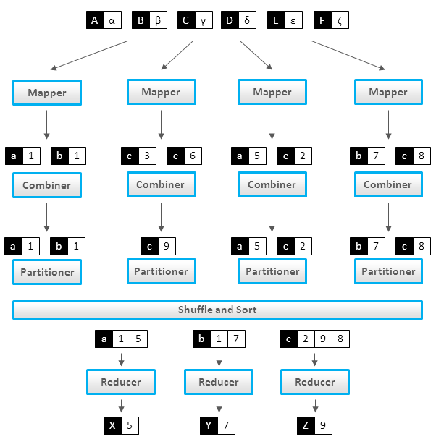
What about Combiners? (c, 3), (c, 6) is combined to (c, 9)

Slide 17
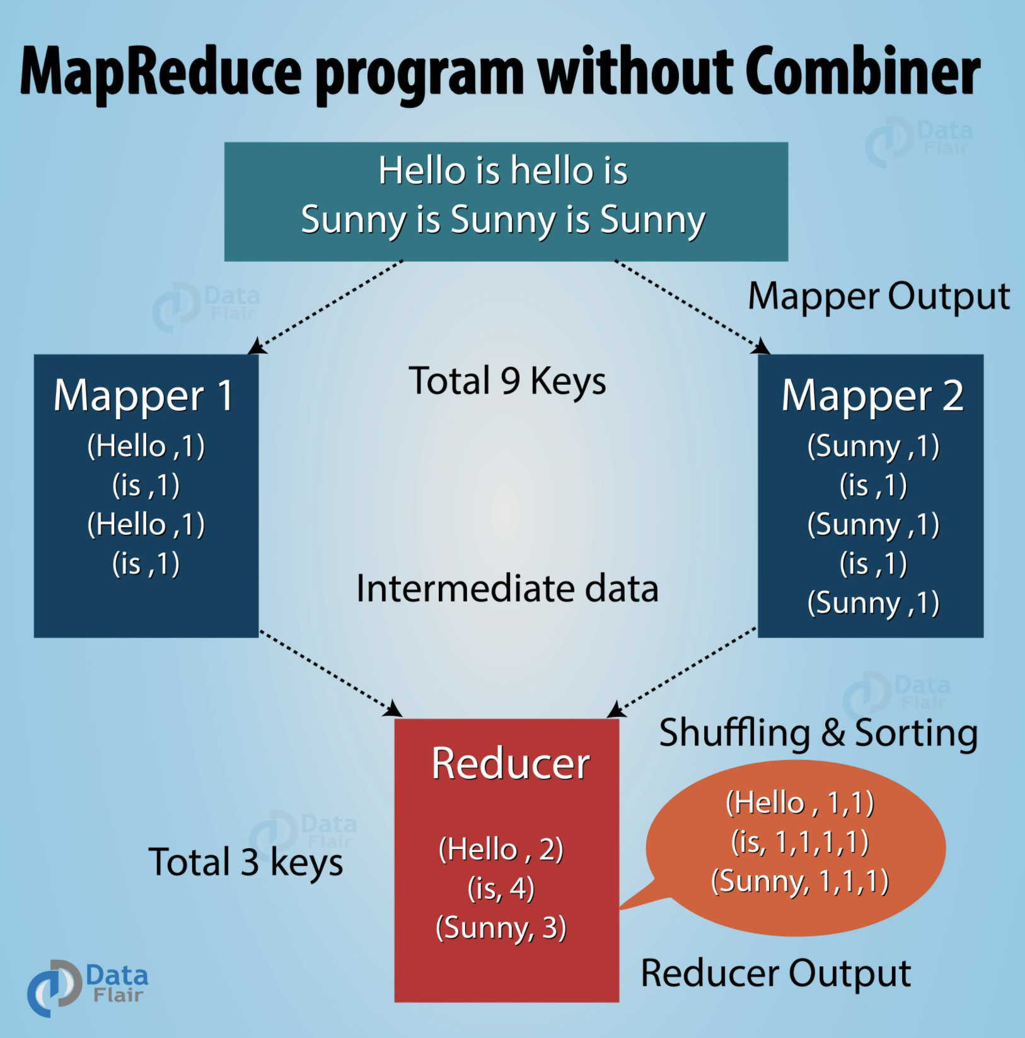
MapReduce without Combiners

Slide 18

MapReduce with Combiners

Slide 19
How do we write Combiners? For Averages?
We need to write 3 functions:
map()
combine()
reduce()
BUT note that average of an average is not an average
What does this mean?

Slide 20
Average of an Average is not an Average
Let say we have 2 partitions
Partition-1: (K, 6), (K, 7)
Average of Partition-1: (6+7)/2 = 6.5
Partition-2: (K, 8)
Average of Partition-2: (8)/1 = 8.0
Average of Partition-1 and Partition-2:
(6.5 + 8.0)/2 = 7.25
We get a wrong result since AVG function is not an associative function
Average(6, 7, 8) = (6+7+8)/3 = 21/3 = 7.0
Hmmmmmm? How to solve this?

Slide 21
Make average of an average as an average
Let say we have 2 partitions
Partition-1: (K, 6), (K, 7)
Partition-2: (K, 8)
Change map() to create (K, (temp, count))
Which makes AVG function as an associative function
(K, Integer) → (K, (Integer, Integer))
(K, 6) --> (K, (6, 1))
(K, 7) --> (K, (7, 1))
(K, 8) --> (K, (8, 1))

Slide 22
Make Average of an Average as an Average
Let say we have 2 partitions:
Partition-1: (K, (6, 1)), (K, (7, 1))
Partition-2: (K, (8, 1))
COMBINE( (K, (sum1, count1)) , (K, (sum2, count2)))
Average of Partition : (K, (sum1+sum2, count1+count2))
Average of Partition-1 : (K, (6+7, 1+1)) = (K, (13, 2))
Average of Partition-2 : (K, (8, 1))
Average(Partition-1, Partition-2) =
(K, (13+8, 2+1)) =
(K, (21, 3)) =
(K, (sum, count))
=> (K, 21/3) = (K, 7)

Slide 23
New Mapper function:
# key: is a record number, to be ignored by mappers
# value: entire record as: “CANADA,Toronto,38”
map(key, value) {
tokens = value.split(“,”)
country = tokens[0]
city = tokens[1]
temperature = tokens[2]
new_key = country + “,” + city
if (temperature >= 0) {
### value is a (sum, count) tuple, which enables associativity
### new_value = (sum, count)
new_value = (temperature, 1)
### emit(new_key, temperature)
emit(new_key, new_value)
### emit(country, temperature)
emit(country, new_value)
}
}
This will create the following (K,V) pairs:
(“CANADA,Toronto”, (38, 1))
(“CANADA, (38, 1))

Slide 24
Sample output of Mappers
Let’s say we have 2 partitions:
Partition-1: (K, (6, 1)), (K, (7, 1))
Partition-2: (K, (8, 1))
Partition-3: (K, (10, 1)), (K, (20, 1)), (K, (30, 1))
Combiner for Partition-1:
(K, (6+7, 1+1)) = (K, (13, 2))
Combiner for Partition-2: (K, (8, 1))
Combiner for Partition-3: (K, (60, 3))

Slide 25
Tuples in Python
>>> a = (78, 3)
>>> a[0]
78
>>> a[1]
3

Slide 26
Combiner function: combine, but delay averaging
# key: is a string, like “USA,Cupertino”
# values: [(V1,1), (V2, 1), (V3, 1), …]
combine(key, values) {
total = 0.0
count = 0
for v in values {
v_temperature = v[0]
v_count = v[1]
total += v_temperature
count += v_count
}
# do NOT calculate average, leave it to reduce() function
new_value = (total, count)
emit(key, new_value)
}

Slide 27
Reducer function: find Average per Key
# key: is a string, like “USA,Cupertino”
# values: [(V1, 3), (V2, 1), (V3, 2), …]
reduce(key, values) {
total = 0.0
count = 0
for v in values {
v_temperature = v[0]
v_count = v[1]
total += v_temperature
count += v_count
}
# calculate average
average = total / count
emit(key, average)
}

Slide 28
How does it work: Consider some input
Input Records:
USA,Cupertino,28
USA,Cupertino,12 Partition-1
USA,Cupertino,50
USA,Cupertino,10
USA,Cupertino,20
USA,Cupertino,30 Partition-2
USA,Cupertino,46
…

Slide 29
How does it work: mappers output
Consider single key : with 2 partitions
Let K = “USA,Cupertino”
Partition-1 (P1): Partition-2 (P2):
(K, (28, 1)) (K, (10, 1))
(K, (12, 1)) (K, (20, 1))
(K, (50, 1)) (K, (30, 1))
(K, (46, 1))

Slide 30
How does it work
Consider 2 partitions for the same key: mappers output
Denote: Partition-1 as P1, Partition-2 as P2
P1: (K, (28, 1)), (K, (12, 1)), (K, (50, 1))
P2: (K, (10, 1)), (K, (20, 1)), (K, (30, 1)), (K, (46, 1))
Combiner(P1): (K, (28+12+50, 1+1+1)) = (K, (90, 3))
Combiner(P2): (K, (10+20+30+46, 1+1+1+1)) = (K, (106, 4))
Reducer’s input: (K, [(90, 3), (106, 4)])
=> (90+106)/(3+4) = 196 / 7 = 28
=> output: (K, 28)

Slide 31
What to consider for combiners & reducers
Make their functions to be associative and commutative:
Let + be a binary function
Commutative Law:
a + b = b + a
Associative Law:
(a + b) + c = a + (b + c)

Slide 32
Addition and Multiplication is Commutative
Addition:
2 + 3 = 3 + 2 = 5
100 + 200 = 200 + 100 = 300
Multiplication:
2 * 5 = 5 * 2 = 10
20 * 30 = 30 * 20 = 600

Slide 33
Subtraction and Division is NOT Commutative
Subtraction:
5 - 3 = 2
3 - 5 = -2
2 NOT EQUAL to -2
Division:
10 / 2 = 5.0
2 / 10 = 0.2
5.0 NOT EQUAL to 0.2

Slide 34
Average function is not Associative
Let Avg(a, b) = (a+b)/2
Then
FACT: Avg (1, 2, 3) = 2.0
Avg(1, Avg(2, 3)) = Avg(1, 2.5) = 1.75
2.0 NOT EQUAL to 1.75

Slide 35
MapReduce Working Example
Consider the following input with 3 partitions:
Partition-1:
USA,Cupertino,58
USA,Cupertino,67
USA,Sunnyvale,88
USA,Sunnyvale,77
USA,Cupertino,78
Partition-2:
INDIA,Mumbai,90
INDIA,Mumbai,96
INDIA,Agra,98
INDIA,Agra,92
Partition-3:
USA,Cupertino,60
USA,Cupertino,80

Slide 36
MapReduce Working Example
Mappers output:
Partition-1:
(“USA,Cupertino”, (58, 1)), (”USA”, (58, 1))
(“USA,Cupertino”, (67, 1)), (“USA”, (67, 1))
(“USA,Sunnyvale”, (88, 1)), (“USA”, (88, 1))
(“USA,Sunnyvale”, (77, 1)), (“USA”, (77, 1))
(“USA,Cupertino”, (78, 1)), (“USA”, (78, 1))
Partition-2:
(“INDIA,Mumbai”, (90, 1)), (“INDIA”, (90, 1))
(“INDIA,Mumbai”, (96, 1)), (“INDIA”, (96, 1))
(“INDIA,Agra”, (98, 1)), (“INDIA”, (98, 1))
(“INDIA,Agra”, (92, 1)), (“INDIA”, (92, 1))
Partition-3:
(“USA,Cupertino”, (60, 1)), (“USA”, (60, 1))
(“USA,Cupertino”, (80, 1)), (“USA”, (80, 1))

Slide 37
MapReduce Working Example
Combiners output:
Partition-1:
(“USA,Cupertino”, (58+67+78, 1+1+1)) → (“USA,Cupertino”, (203, 3))
(”USA”, (58+67+78+88+77, 1+1+1+1+1)) → (”USA”, (368, 5))
(“USA,Sunnyvale”, (88+77, 1+1)) → (“USA,Sunnyvale”, (165, 2))
Partition-2:
(“INDIA,Mumbai”, (90+96, 1+1)) → (“INDIA,Mumbai”, (186, 2))
(“INDIA,Agra”, (98+92, 1+1)) → (“INDIA,Agra”, (190, 2))
(“INDIA”, (90+96+98+92, 1+1+1+1)) → (“INDIA”, (376, 4))
Partition-3:
(“USA,Cupertino”, (60+80, 1+1)) → (“USA,Cupertino”, (140, 2))
(“USA”, (60+80, 1+1)) → (“USA”, (140, 2))

Slide 38
MapReduce Working Example
Combiners output (all partitions):
(“USA,Cupertino”, (203, 3))
(”USA”, (368, 5))
(“USA,Sunnyvale”, (165, 2))
(“INDIA,Mumbai”, (186, 2))
(“INDIA,Agra”, (190, 2))
(“INDIA”, (376, 4))
(“USA,Cupertino”, (140, 2))
(“USA”, (140, 2))
Combiners output ➔ as input to Sort & Shuffle

Slide 39
MapReduce Working Example
Combiners output (all partitions):
(“USA,Cupertino”, (203, 3))
(”USA”, (368, 5))
(“USA,Sunnyvale”, (165, 2))
(“INDIA,Mumbai”, (186, 2))
(“INDIA,Agra”, (190, 2))
(“INDIA”, (376, 4))
(“USA,Cupertino”, (140, 2))
(“USA”, (140, 2))
Combiners output ➔ as input to Sort & Shuffle
(“USA,Cupertino”, [(203, 3), (140, 2)]
(”USA”, [(368, 5), (140, 2)])
(“USA,Sunnyvale”, [(165, 2)])
(“INDIA,Mumbai”, [(186, 2)])
(“INDIA,Agra”, [(190, 2)])
(“INDIA”, [(376, 4)])

Slide 40
MapReduce Working Example
Sort & Shuffle output:
(“USA,Cupertino”, [(203, 3), (140, 2)]
(”USA”, [(368, 5), (140, 2)])
(“USA,Sunnyvale”, [(165, 2)])
(“INDIA,Mumbai”, [(186, 2)])
(“INDIA,Agra”, [(190, 2)])
(“INDIA”, [(376, 4)])
Reducer’s output:
(“USA,Cupertino”, (203+140)/(3+2)) → (“USA,Cupertino”, 68.60)
(”USA”, [(368, 5), (140, 2)]) → (”USA”, 72.57)
(“USA,Sunnyvale”, [(165, 2)]) → (“USA,Sunnyvale”, 82.50)
(“INDIA,Mumbai”, [(186, 2)]) → (“INDIA,Mumbai”, 93.00)
(“INDIA,Agra”, [(190, 2)]) → (“INDIA,Agra”, 95.00)
(“INDIA”, [(376, 4)]) → (“INDIA”, 94.00)

Slide 41
Benefits of Combiners:
Combiners act as mini-reducers
Minimize the number of (key, value) emitted in computing network
Optimize (key, value) per partition and utilize resources
Do not create (key, [V1, V2, …, Vn]) where n is a large number: might create Out of Memory error

Slide 42
References
1. Monoidify! Monoids as a Design Principle for Efficient MapReduce Algorithms (paper) by Jimmy Lin
2. Data Algorithms (book)
by Mahmoud Parsian
3. Data Algorithms with Spark (book)
by Mahmoud Parsian

