Slide 1
Introduction to Amazon Athena
Mahmoud Parsian
Ph.D. in Computer Science

Slide 2
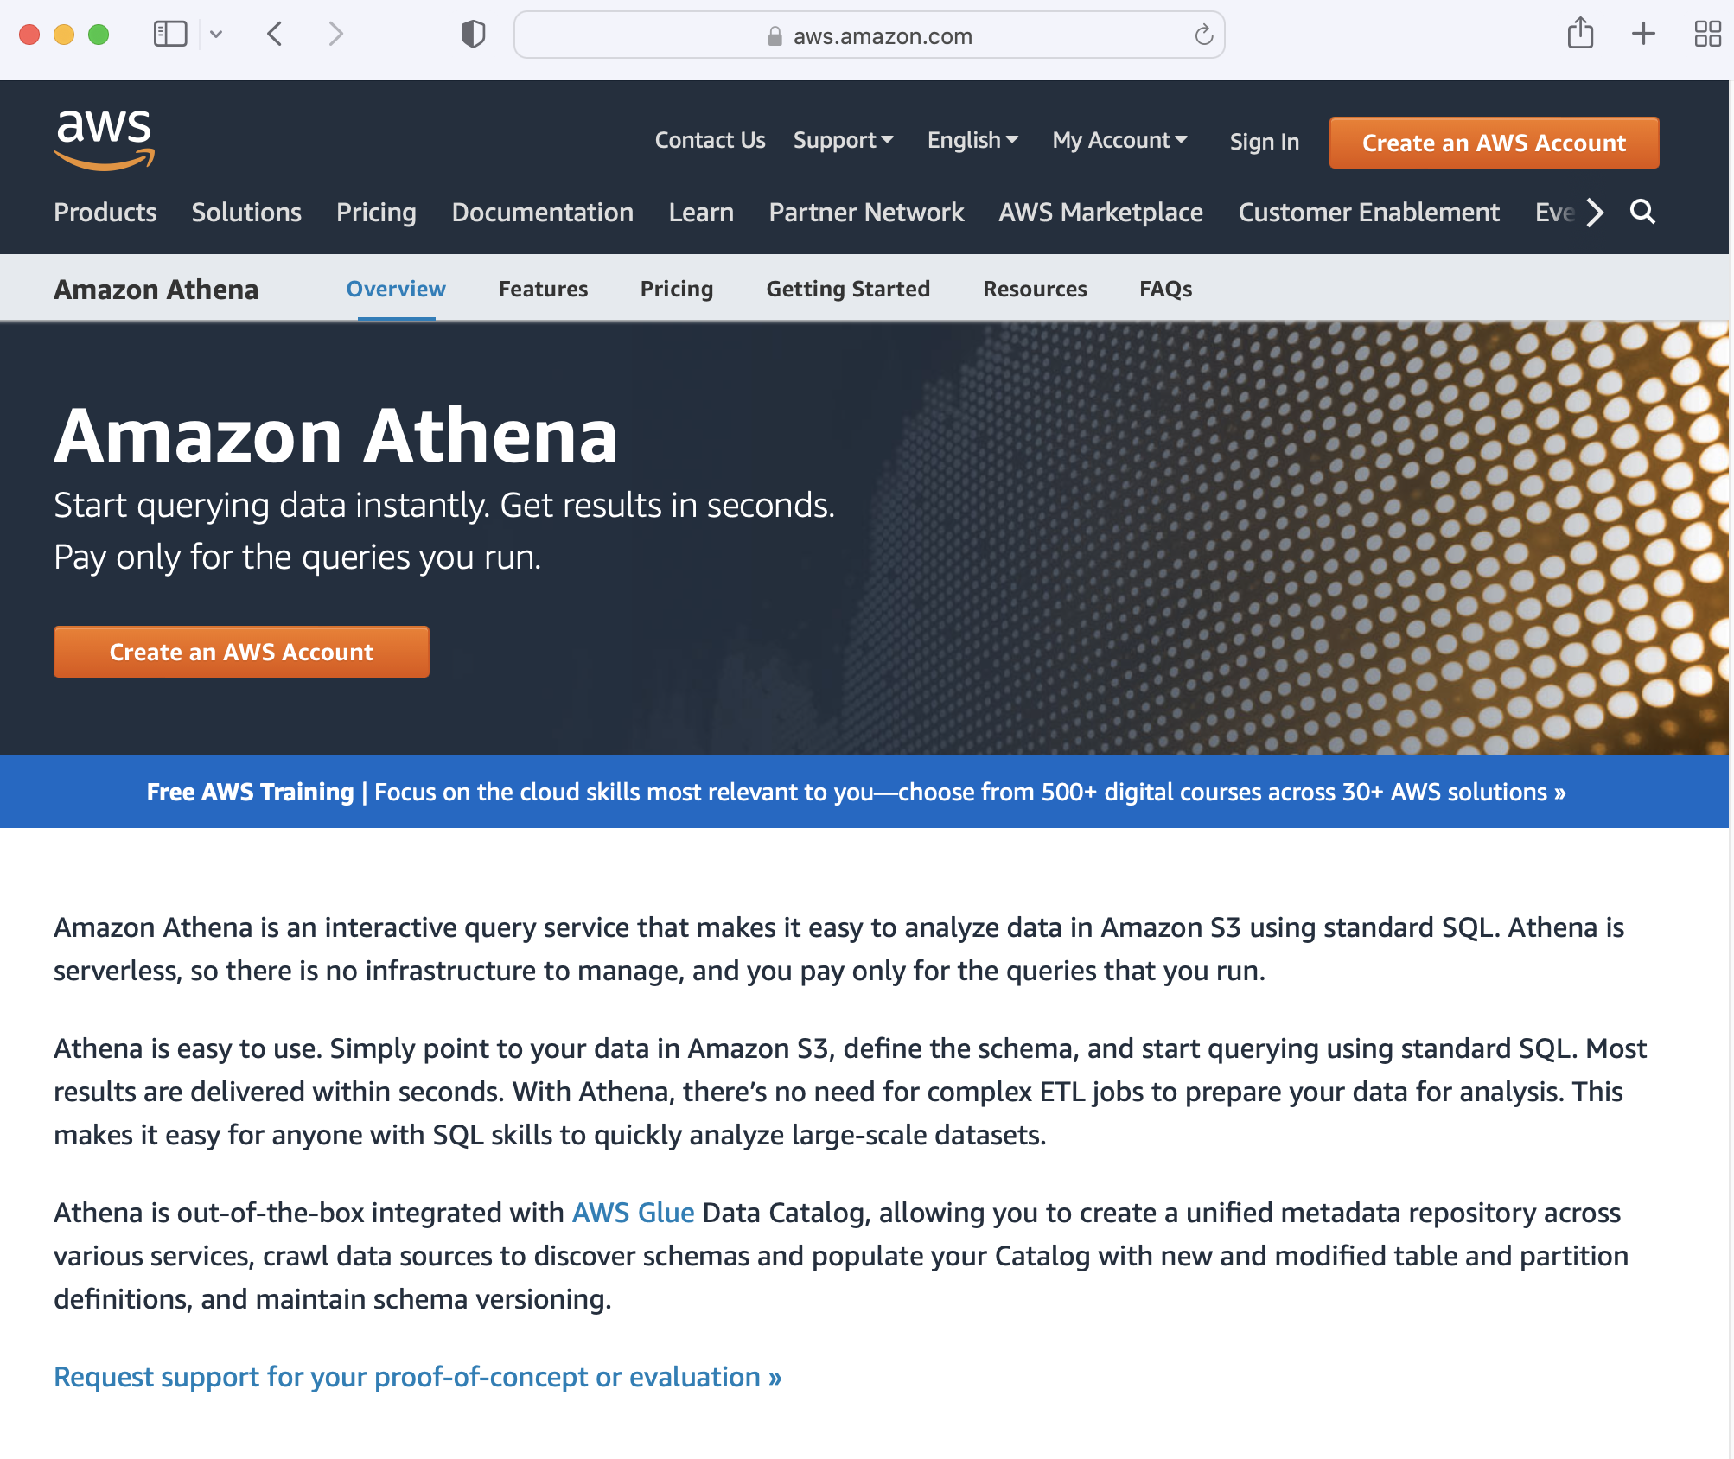
What is Amazon Athena?

Slide 3
What is Amazon Athena?
Amazon Athena is an interactive SQL query service
Analyze data in Amazon S3 using standard SQL
Athena is serverless:
No cluster setup is required
There is no infrastructure to manage, and
You pay only for the SQL queries that you run (Pay-per-Query)
Athena is easy to use:
Simply point to your data in Amazon S3,
Define the schema (create Table), and
Start querying Table by using standard SQL.
Most results are delivered within seconds.

Slide 4
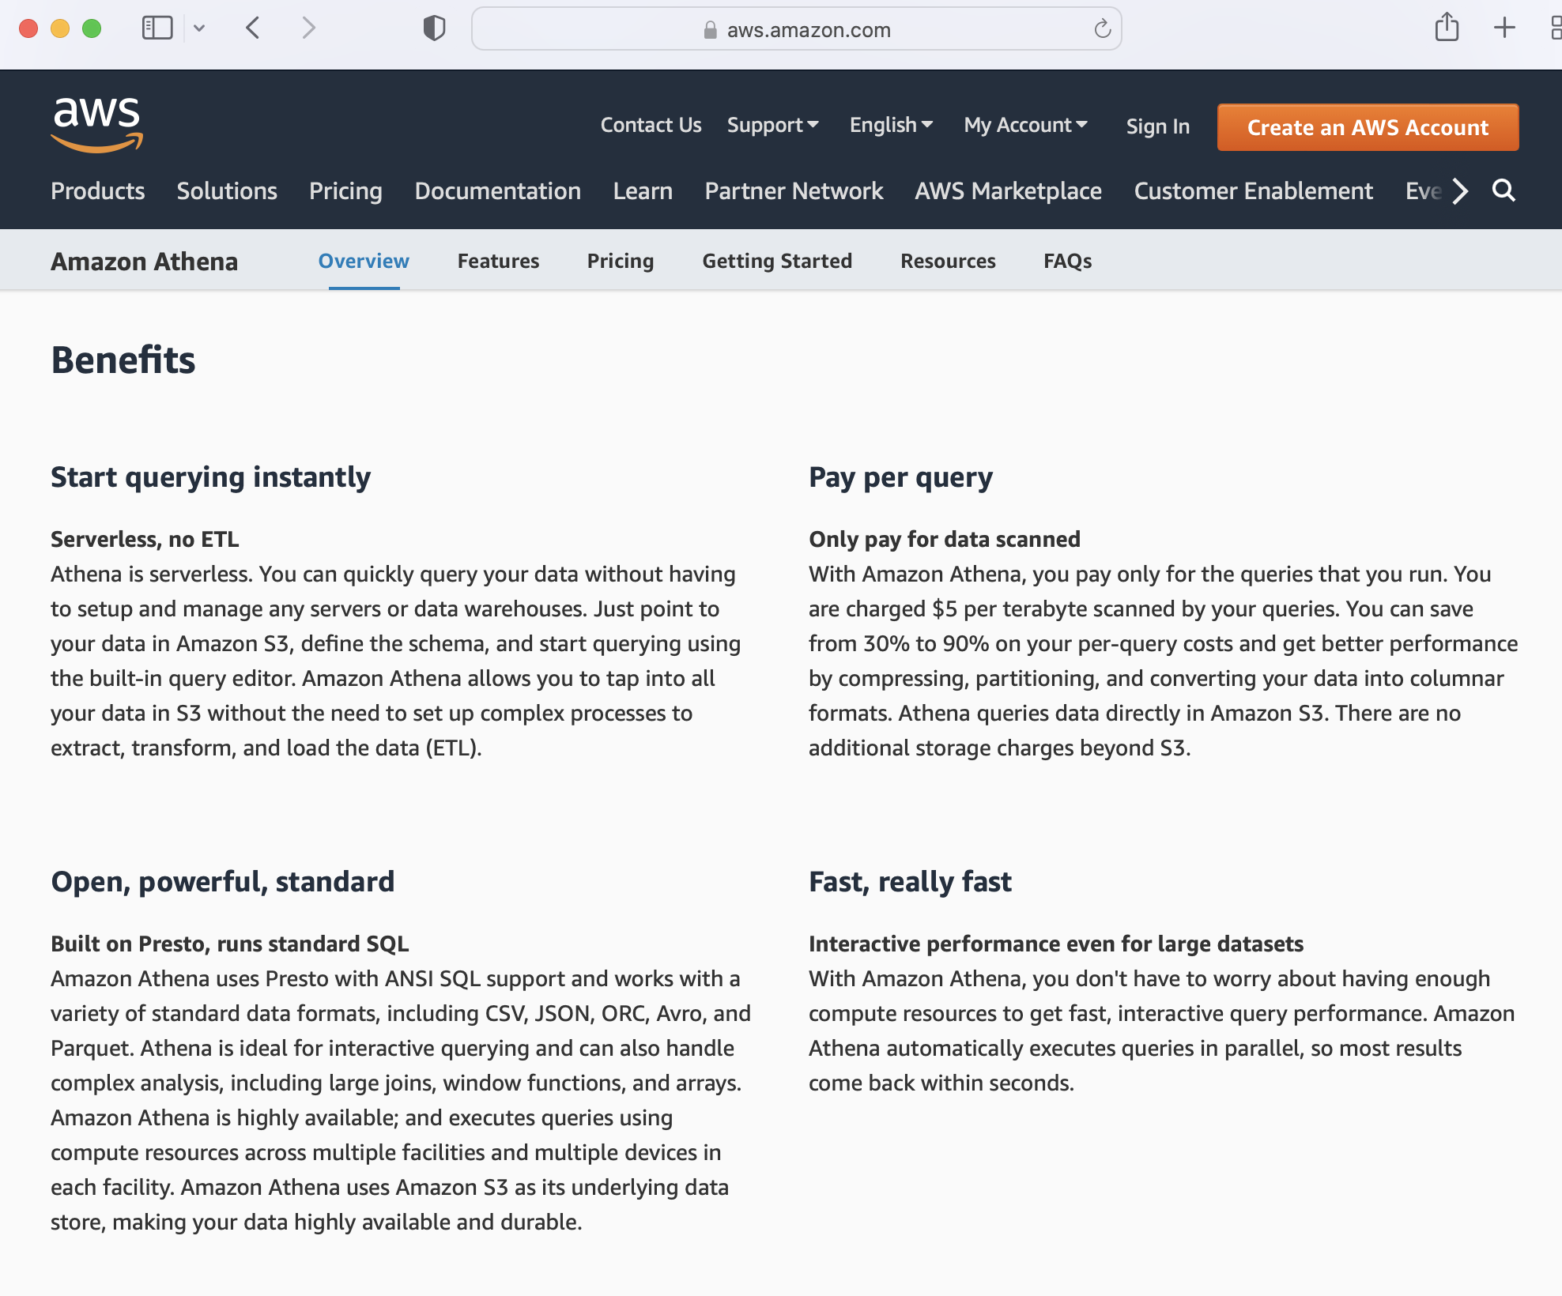
What is Amazon Athena?

Slide 5
Amazon Athena Documentation
Amazon Athena User’s Guide
https://docs.aws.amazon.com/pdfs/athena/latest/ug/athena-ug.pdf
Amazon Athena API Reference
https://docs.aws.amazon.com/pdfs/athena/latest/APIReference/athena-api.pdf

Slide 6
Athena - Basics
Serverless interactive SQL query service
Based on PrestoDB (Facebook) implementation
Works on data stored in S3
But is still quite fast
Using Java, Queries can be done by JDBC

Slide 7
Athena - Basics
Uses Apache Hive Data definition language (DDL)
Supports ANSI SQL
Pay by Query as you go model
Charges based on data scanned by the SQL query
5$ per TB of data scanned
No charge for creating tables
S3 costs are separate

Slide 8
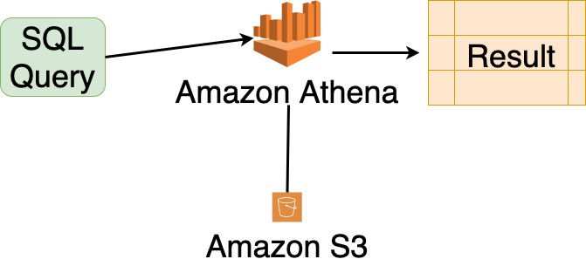
Athena - Basics

Slide 9
Athena – Web-based Query Editor (for testing/debugging)
Amazon Athena Web panel (next slide):
Left side: Database and tables
Top Right side: SQL Query Editor
Bottom Right side: Results of SQL Query

Slide 10
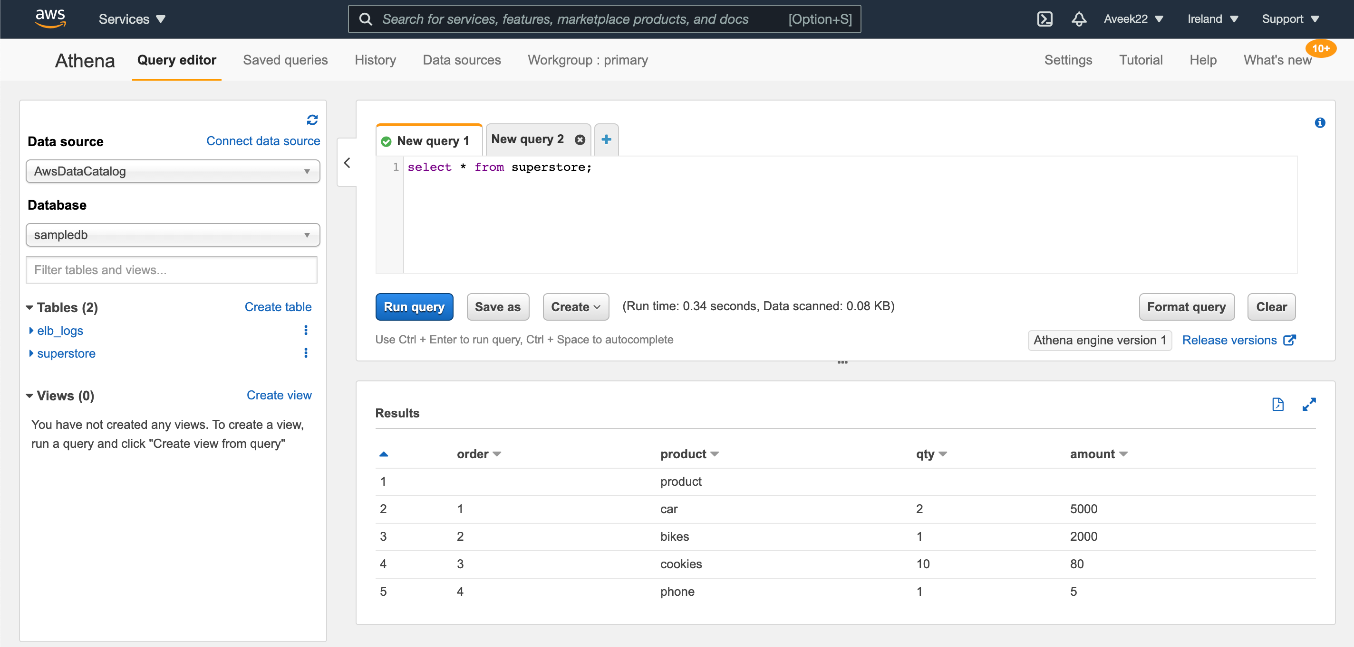
Athena – Web-based Query Editor (for testing/debugging)

Slide 11
Athena Concepts
Database: set of tables
Tables - Metadata that describes your data
Table is a list of rows with named columns
Table’s actual data is in S3
Table is similar to a relational database table
Tables are like views: For example, You can delete table definitions without impacting the underlying S3 data

Slide 12
Athena Concepts
Databases - Logical grouping of tables (catalog)
**SerDe** - Serializer/Deserializer - libraries that tell Hive how to interpret data formats.
Table Data formats:
Apache Web Logs,
Text, CSV, JSON, ORC, Parquet
Optimized for Columnar Data Formats (Parquet, ORC)
Data can also be compressed in GZIP to save costs

Slide 13
Athena API
Web interface for testing/debugging
Native Java API support (amazon proprietary code)
Supports JDBC API (open-source code)

Slide 14
Athena Limitations
No support for transactions. (This includes any transactions found in Hive or Presto)
When you create, update, or delete tables, those operations are guaranteed ACID compliant.

Slide 15
Athena Use Cases
Querying of any data in S3.
If latency is not critical and queries can be run in the background
For example,
analyzing log data in S3
analyzing genomics/DNA data
analyzing Facebook data

Slide 16
Athena Use Cases
Go serverless across the stack (you do not want to manage a cluster of servers)
API gateway can be used to accept requests which are handled by Lambda which in turn can leverage Athena for queries.
The only persistent service used will be S3.

Slide 17
Athena Use Cases
Mix and match AWS services.
Use an on demand EMR cluster to process data and dump results to S3.
Then use Athena (using SQL queries) to create ad-hoc tables and run reports.

Slide 18
Athena Use Cases
Athena is PrestoDB based
Facebook uses PrestoDB for interactive queries against several internal data stores, including their 300PB data warehouse.
Over 1,000 Facebook employees use Presto daily to run more than 30,000 queries that in total scan over a petabyte each per day

Slide 19
Optimization Techniques for Athena
Physical Partitioning of your data in S3
Enables to Analyze slice of a data rather than the whole data
Using data compression techniques
Optimize JOIN conditions in queries
Use selected/partitioned columns in your SQL query:
SELECT …
FROM Table-Name
WHERE <partitioned-column-name> = ‘some-value’

Slide 20
1. Partition data 2. Then Analyze slice of a data rather than the whole data
Partitioning your data in S3 using PySpark
Then, Analyze slice of a data rather than the whole data
For example, you might partition data by
state (AZ, CA, MI, NY, IA, OH, …)
age-group (0-9, 10-19, 20-29, …)
by genomic chromosome (chr1, chr2, chr3, …)
continent (North_America, South_America, Asia, …)
country (USA, CANADA, INDIA, …)
country and state
Year (2000, 2001, 2002, …)

Slide 21
Partition data Then Analyze slice of a data: Steps?
1. Create DF(col-1, col-2, col-3, …)
2. Understand your SQL queries where you will use the SQL’s
WHERE col-2 = ‘some-value`
3. Then col-2 becomes a candidate for partitioning
4. Save Partitioned DF into S3 (partitioned by col-2)
5. Create your Table (as Table-Name) pointing to S3
6. Load Partitions (MSCK REPAIR Table-Name)
only adds partitions to metadata
7. Query your data by SQL:
SELECT … FROM Table-Name
WHERE col-2 = ‘some-value’

Slide 22
Analyze slice of a data rather than the whole data
Let DF be a Spark DataFrame representing your data
Partitioning your data (DF) in S3
Analyze slice of a data rather than the whole data
Let’s consider some data in 7 continents:
DF = (continent, country, city, temperature)
Two obvious data partitioning can be done by:
<continent>, and
<country>

Slide 23
Analyze slice of data: sample data
Sample data:
NorthAmerica,USA,Cupertino,74
NorthAmerica,USA,Cupertino,72
NorthAmerica,CANADA,Toronto,74
NorthAmerica,CANADA,Toronto,72
Oceania,Australia,Melbourne,95
Oceania,Australia,Melbourne,90
…

Slide 24
Analyze slice of data: Partition by <continent>
<data-root-dir>
<NorthAmerica>
USA,Cupertino,74
USA,Cupertino,72
CANADA,Toronto,74
CANADA,Toronto,72
<Oceania>
Australia,Melbourne,95
Australia,Melbourne,90
…

Slide 25
Analyze slice of data: Partition by <continent>: PySpark
Let df (as a Spark DataFrame) denote:
(continent, country, city, temperature)
We assume that our SQL queries will be like:
SELECT … from Table-Name
WHERE continent = ‘some-continent-name`;
Then partition df and save to S3:
output_path = 's3://mybucket/data/continents/’
Df.partitionBy(‘continent`).save(output_path)

Slide 26
Analyze slice of data: Create Table
Let <data-root-dir> denote the S3 directory:
's3://mybucket/data/continents/’
CREATE EXTERNAL TABLE continents (
`country` string,
`city` string,
`temperature` integer
)
PARTITIONED BY ( `continent` string )
STORED AS PARQUET
LOCATION 's3://mybucket/data/continents/’

Slide 27
Analyze slice of data: Partition by <continent>
SELECT …
FROM continents
WHERE continent = ‘NorthAmerica’
NOTE: Only the following folder will be scanned for SQL analysis
<data-root-dir>/<continent=NorthAmerica>
The whole data will NOT be scanned.

Slide 28
Partition by <continent> and <country>
<data-root-dir>
<NorthAmerica>
<country=USA>
Cupertino,74
Cupertino,72
<country=CANADA>
Toronto,74
Toronto,72
<Oceania>
<country=Australia>
Melbourne,95
Melbourne,90
…

Slide 29
Partition by <continent> and <country> : PySpark
Let df (as a Spark DataFrame) denote:
(continent, country, city, temperature)
Then partition df:
output_path = 's3://mybucket/data/continents2/'
df.partitionBy(`continent`, `country`)
.save(output_path)

Slide 30
Analyze slice of data: Create Table
Let <data-root-dir> denote the S3 directory:
's3://mybucket/data/continents2/’
CREATE EXTERNAL TABLE continents2 (
`city` string,
`temperature` integer
)
PARTITIONED BY (
`continent` string,
`country` string
)
STORED AS PARQUET
LOCATION 's3://mybucket/data/continents2/’

Slide 31
Partition by <continent> and <country>
SELECT …
FROM continents2
WHERE continent = ‘NorthAmerica’ AND
country = ‘USA’
NOTE: Only the following folder will be scanned for SQL analysis
<data-root-dir>/<continent=NorthAmerica>/<country=USA>
The whole data will NOT be scanned.

Slide 32
Whole Data Analysis: all folders will be scanned
SELECT …
FROM continents2
NOTE: All the data folders will be scanned for SQL query/analysis since partitioning columns are not used by the WHERE clause
When there is no SQL’s WHERE caluse in a query, the entire data set will be scanned.

Slide 33
Live Demo: Amazon Athena

