Slide 1
Understanding Parallelism & Concurrency (informal introduction)
Mahmoud (Max) Parsian
Ph.D. in Computer Science

Slide 2
Why Parallelism?
Parallelism and Partitioning are foundations of big data solutions.
MapReduce is based on parallelism and partitioning data
Hadoop is based on parallelism and partitioning data
Spark is based on parallelism and partitioning data
Snowflake is based on parallelism and partitioning data
The concept of parallel computing is based on
dividing a large problem into smaller ones, and
each of them is carried out by one single processor individually.

Slide 3
Parallelism Example: array addition
// a: a[0], a[1], …, a[n-1] c[0] = a[0] + b[0]
// b: b[0], b[1], …, b[n-1] c[1] = a[1] + b[1]
for (i = 0; i < n; i++) { c[2] = a[2] + b[2]
c[i] = a[i] + b[i]; …
} c[n-1] = a[n-1] + b[n-1]
Sequential: Parallel:
n steps one step
one processor n processors

Slide 4
Concurrency & Parallelism (informal definition):
Some definitions:
The fact of two or more events or circumstances happening or existing at the same time.
The ability to execute more than one program or task simultaneously.
Example: "a high level of concurrency is crucial to good performance in a multiuser database system”
Multiple reads at a time
Multiple writes at a time

Slide 5
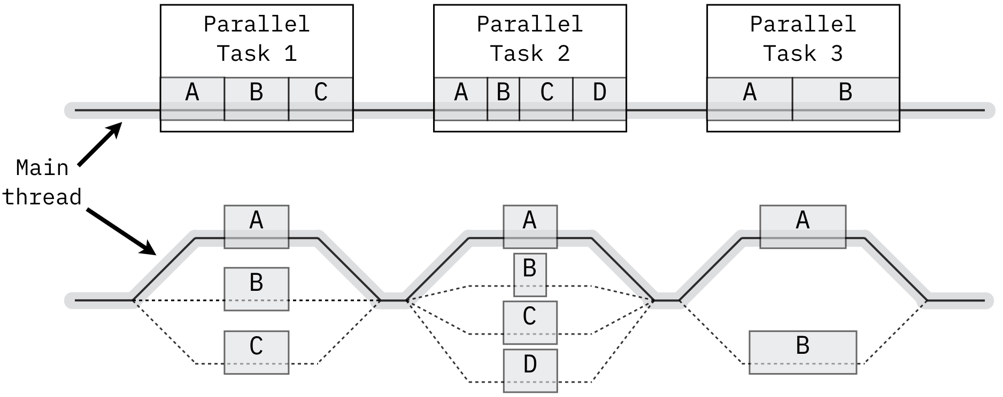
Concurrency & Parallelism (informal definition):

Slide 6
Concurrency & Parallelism
Task A = { A1, A2, A3, A4}, Task B = {B1, B2, B3}, Task C = {C1, C2}
Execute Tasks A and B and C (in sequential order):
1. A1
2. A2
3. A3
4. A4
5. B1
6. B2
7. B3
8. C1
9. C2

Slide 7
Concurrency & Parallelism
Task A = { A1, A2, A3, A4} Task B = {B1, B2, B3}, Task C = {C1, C2}
Assume that Tasks (A, B, and C) are independent of each other
Execute Tasks A, B, C: (concurrently)
1. A1 B1 C1 (3 tasks running concurrently)
2. A2 B2 C2 (3 tasks running concurrently)
A3 B3 (2 tasks running concurrently)
A4 (1 task running)

Slide 8
Concurrency & Parallelism: Maximum Parallelism
Task A = { A1, A2, A3, A4}
Task B = {B1, B2, B3},
Task C = {C1, C2}
If there is NO dependency between any tasks:
Then run all of these 9 tasks concurrently:
A1, A2, A3, A4, B1, B2, B3, C1, C2

Slide 9
Parallelism
Parallelism is basically a type of computation in which
many tasks/computations/operations are carried out in parallel.
Sequential Tasks: Parallel Tasks:
Task-1: 20 minutes Task-1, Task-2, Task-3, Task-4
Task-2: 20 minutes
Task-3: 25 minutes
Task-4: 25 minutes
=============== ==================
Total Elapsed time: 90 minutes Total Elapsed time: 25 minutes
(assuming that there is no dependencies between tasks)
→ Therefore, Parallelism improves execution time.

Slide 10
Parallelism
What if {Task-3 and Task-4} depends on output of {Task-1 and Task-2}
4 Sequential Tasks: 4 Parallel Tasks:
Iteration-1: Task-1 : 20 minutes Iteration-1: Task-1, Task-2 (duration: 20 mins)
Iteration-2: Task-2 : 20 minutes Iteration-2: Task-3, Task-4 (duration: 25 mins)
Iteration-3: Task-3: 25 minutes
Iteration-4: Task-4 : 25 minutes
====================== ======================
Total Elapsed time: 90 minutes Total Elapsed time: 45 minutes
(assuming that there is no dependencies between tasks)
Dependencies can be bottlenecks!!!

Slide 11
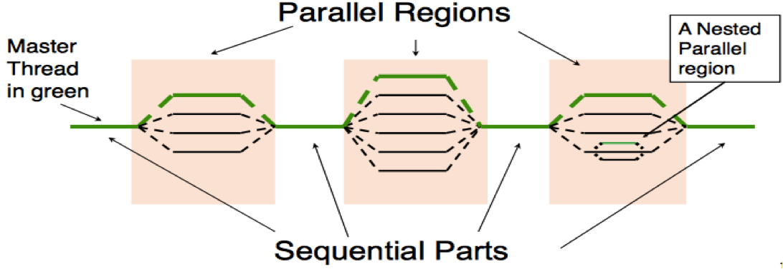
Parallelism

Slide 12
Birthday Example
Alex wants to throw a big birthday party.
He has a list of 1000 items to buy from a Safeway (grocery store).
Items to buy:
item-1: ice-cream
item-2: chips
item-3: oranges
item-4: cup cakes
…
item-1000: grapes
How long will it take for Alex to buy all these 1000 items
assuming that he is the only person in grocery store?

Slide 13
What is our Data?
ID | Item to buy
1 | ice-cream
2 | chips
3 | oranges
4 | Cup-cakes
… | …
1000 | grapes

Slide 14
Birthday Example …
How long will it take for Alex to buy all these 1000 items?
assuming that he is the only person in grocery store
It is estimated that on average he needs 14 seconds to find the item and put in the shopping cart.
Therefore, he will spend
1000 x 14 = 14,000 seconds = 234 minutes
BUT, Alex is busy and can not spend 234 minutes for shopping.
What to do?

Slide 15
Processing Data? One Executor: Alex Buy item-1, then item-2, …, then item-1000, … All is done in sequence: No Parallelism yet.
ID | Item to buy
1 | ice-cream
2 | chips
3 | oranges
4 | Cup-cakes
… | …
1000 | grapes

Slide 16
Birthday Example …
But, Alex is busy and can not spend 234 minutes for shopping.
What to do?
Alex calls 10 of his friends (F1, F2, …, F10):
they will do shopping and deliver to Alex.
Therefore, Each friend will buy 100 items
Total time elapsed to buy all items:
100 x 14 = 1400 seconds = 24 minutes
THIS IS a BIG IMPROVEMENT: 234 minutes reduced to 24 minutes
Alex is still not satisfied with this plan.

Slide 17
Processing Data? 10 parallel executors Each executor operates in parallel & independently
Executor-1: F1
…
Executor-1: F2
Executor-10: F-10
ID | Item to buy
1 | ice-cream
2 | chips
3 | oranges
4 | Cup-cakes
… | …
100 | grapes
ID | Item to buy
101 | …
102 | …
103 | …
104 | …
… | …
200 | grapes
ID | Item to buy
901 | …
902 | …
903 | …
904 | …
… | …
1000 | grapes

Slide 18
Birthday Example …
But, Alex is busy and can not spend 24 minutes for shopping.
What to do?
Alex calls 100 of his friends (F1, F2, …, F100):
they will do shopping and deliver to Alex.
Therefore, Each friend will buy 10 items
Total time elapsed to buy all items:
10 x 14 = 140 seconds = about 3 minutes
THIS IS a BIG IMPROVEMENT: 234 minutes reduced to 3 minutes
Alex is still not satisfied with this plan.

Slide 19
Processing Data? 100 parallel executors Each executor operates in parallel & independently
…
Executor-1: F1
Executor-2: F2
Executor-100: F-100
ID | Item to buy
1 | ice-cream
2 | chips
3 | oranges
4 | Cup-cakes
… | …
10 | …
ID | Item to buy
11 | …
12 | …
13 | …
14 | …
… | …
20 | …
ID | Item to buy
991 | …
992 | …
993 | …
994 | …
… | …
1000 | grapes

Slide 20
Birthday Example …
But, Alex is busy and can not even spend 3 minutes for shopping.
What to do?
Alex calls 1000 of his friends (F1, F2, …, F1000):
they will do shopping and deliver to Alex.
Therefore, Each friend will buy 1 single item
Total time elapsed to buy all items:
1 x 14 = 14 seconds
THIS IS a HUGE IMPROVEMENT:
234 minutes reduced to 14 seconds
Alex is satisfied with this plan.

Slide 21
Processing Data? 1000 parallel executors Each executor operates in parallel & independently
Executor-1: F1
Executor-2: F2
Executor-1000: F-1000
ID | Item to buy
1 | ice-cream
ID | Item to buy
2 | chips
…
ID | Item to buy
1000 | grapes

Slide 22
How do we write parallel programs?
Task parallelism
Partition various tasks carried out solving the problem among the cores.
Data parallelism
Partition the data used in solving the problem among the cores.
Each core carries out similar operations on it’s part of the data.

Slide 23
Data parallelism
Let your data has 200,000,000,000 data points
Partition your data into 100,000 chunks:
Number of partitions: 100,000
Number of records per partition: 2000,000
100,000 x 2000,000 = 200,000,000,000
Assume you want to execute map(function) on (a transformation function) each record and create a new record
With these partitioning in place, The fastest way to execute map(function) will be to have 100,000 mappers (mappers are transformations, which execute in parallel)
What happens if we have only 1000 mappers?

Slide 24
Data parallelism
What happens if we have only 1000 mappers?
First, we assign 1000 of these partitions to 1000 mappers (each mapper gets a single partition, which has 2,000,000 records)
Once a mapper completes its task, we assign another partition to that mapper
This iteration continues until we exhaust all 100,000 partitions
At most 1000 mappers are executing at a single point of time.
The more mappers we have:
The more we execute faster

Slide 25
Parallelism requires Coordination
Executors usually need to coordinate their work.
Communication – one or more Executors send their current partial results to another core.
Load balancing – share the work evenly among the Executors so that one is not heavily loaded.
Synchronization – because each Executors works at its own pace, make sure Executors do not get too far ahead of the rest.
NOTE: If you use Spark or MapReduce, then all
of these are done automagically for you!!!

Slide 26
Partitioner: partition data into chunks
A partitioner partitions the input into chunks.
If input has 200,000,000,000 records and we partition this input into 200,000 chunks, then we have:
Number of partitions: 200,000
Size of each partition: 1000,000 records
200,000,000,000 = 200,000 x 1000,000
Typically, a chunk (1000,000 records) becomes a unit of parallelism.
Chunk = Partition

Slide 27
Benefits of Parallel Computing
Parallel computing models the real world. The world around us isn't serial and sequential: many things happen at the same time
Saves time. Serial/sequential computing forces fast processors to do things inefficiently.
Saves money. By saving time, parallel computing makes things cheaper and faster
Solve more complex or larger problems be partitioning them into smaller problems
Solve Larger Problems in a short point of time.

Slide 28
References
Introduction to Parallel Computing
https://www.geeksforgeeks.org/introduction-to-parallel-computing/
Introduction: Parallelism = Opportunities + Challenges
https://courses.cs.washington.edu/courses/csep524/07sp/poppChaper1.pdf

