Slide 1
Lecture 10
Clustering

Slide 2
Preview
Introduction
Partitioning methods
Hierarchical methods
Model-based methods
Density-based methods

Slide 3
What is Clustering?
Cluster: a collection of data objects
  Similar to one another within the same cluster
  Dissimilar to the objects in other clusters
Cluster analysis
  Grouping a set of data objects into clusters
Clustering is unsupervised classification: no predefined classes
Typical applications
  As a stand-alone tool to get insight into data distribution
  As a preprocessing step for other algorithms

Slide 4
Examples of Clustering Applications
Marketing: Help marketers discover distinct groups in their customer bases, and then use this knowledge to develop targeted marketing programs
Land use: Identification of areas of similar land use in an earth observation database
Insurance: Identifying groups of motor insurance policy holders with a high average claim cost
Urban planning: Identifying groups of houses according to their house type, value, and geographical location
Seismology: Observed earth quake epicenters should be clustered along continent faults

Slide 5
What Is a Good Clustering?
A good clustering method will produce clusters with
  High intra-class similarity
  Low inter-class similarity
Precise definition of clustering quality is difficult
  Application-dependent
  Ultimately subjective

Slide 6
Requirements for Clustering in Data Mining
Scalability
Ability to deal with different types of attributes
Discovery of clusters with arbitrary shape
Minimal domain knowledge required to determine input parameters
Ability to deal with noise and outliers
Insensitivity to order of input records
Robustness wrt high dimensionality
Incorporation of user-specified constraints
Interpretability and usability

Slide 7

Similarity and Dissimilarity Between Objects
Same we used for IBL (e.g, Lp norm)
Euclidean distance (p = 2):
Properties of a metric d(i,j):
  d(i,j) ≥ 0
  d(i,i) = 0
  d(i,j) = d(j,i)
  d(i,j) ≤ d(i,k) + d(k,j)

Slide 8
Major Clustering Approaches
Partitioning: Construct various partitions and then evaluate them by some criterion
Hierarchical: Create a hierarchical decomposition of the set of objects using some criterion
Model-based: Hypothesize a model for each cluster and find best fit of models to data
Density-based: Guided by connectivity and density functions

Slide 9
Partitioning Algorithms
Partitioning method: Construct a partition of a database D of n objects into a set of k clusters
Given a k, find a partition of k clusters that optimizes the chosen partitioning criterion
  Global optimal: exhaustively enumerate all partitions
  Heuristic methods: k-means and k-medoids algorithms
  k-means (MacQueen, 1967): Each cluster is represented by the center of the cluster
  k-medoids or PAM (Partition around medoids) (Kaufman & Rousseeuw, 1987): Each cluster is represented by one of the objects in the cluster

Slide 10
K-Means Clustering
Given k, the k-means algorithm consists of four steps:
  Select initial centroids at random.
  Assign each object to the cluster with the nearest centroid.
  Compute each centroid as the mean of the objects assigned to it.
  Repeat previous 2 steps until no change.

Slide 11

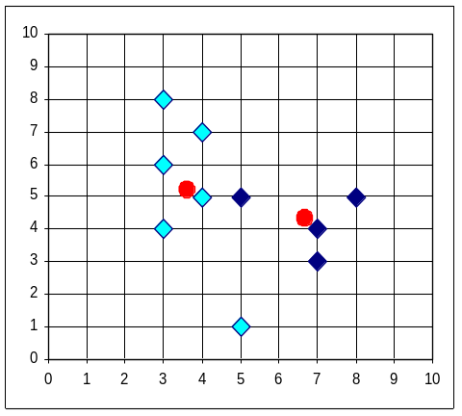


K-Means Clustering (contd.)
Example

Slide 12
Comments on the K-Means Method
Strengths
  Relatively efficient: O(tkn), where n is # objects, k is # clusters, and t is # iterations. Normally, k, t << n.
  Often terminates at a local optimum. The global optimum may be found using techniques such as simulated annealing and genetic algorithms
Weaknesses
  Applicable only when mean is defined (what about categorical data?)
  Need to specify k, the number of clusters, in advance
  Trouble with noisy data and outliers
  Not suitable to discover clusters with non-convex shapes

Slide 13
Hierarchical Clustering
Use distance matrix as clustering criteria. This method does not require the number of clusters k as an input, but needs a termination condition
Step 0
Step 1
Step 2
Step 3
Step 4
agglomerative
(AGNES)
a
a b
b
a b c d e
c
c d e
d
d e
e
divisive
(DIANA)
Step 4
Step 3
Step 2
Step 1
Step 0

Slide 14

AGNES (Agglomerative Nesting)
Produces tree of clusters (nodes)
Initially: each object is a cluster (leaf)
Recursively merges nodes that have the least dissimilarity
Criteria: min distance, max distance, avg distance, center distance
Eventually all nodes belong to the same cluster (root)

Slide 15
A Dendrogram Shows How the Clusters are Merged Hierarchically
  Decompose data objects into several levels of nested partitioning (tree of clusters), called a dendrogram.
  A clustering of the data objects is obtained by cutting the dendrogram at the desired level. Then each connected component forms a cluster.

Slide 16
DIANA (Divisive Analysis)
Inverse order of AGNES
Start with root cluster containing all objects
Recursively divide into subclusters
Eventually each cluster contains a single object

Slide 17
Other Hierarchical Clustering Methods
Major weakness of agglomerative clustering methods
  Do not scale well: time complexity of at least O(n²), where n is the number of total objects
  Can never undo what was done previously
Integration of hierarchical with distance-based clustering
  BIRCH: uses CF-tree and incrementally adjusts the quality of sub-clusters
  CURE: selects well-scattered points from the cluster and then shrinks them towards the center of the cluster by a specified fraction

Slide 18
BIRCH
BIRCH: Balanced Iterative Reducing and Clustering using Hierarchies (Zhang, Ramakrishnan & Livny, 1996)
Incrementally construct a CF (Clustering Feature) tree
  Parameters: max diameter, max children
  Phase 1: scan DB to build an initial in-memory CF tree (each node: #points, sum, sum of squares)
  Phase 2: use an arbitrary clustering algorithm to cluster the leaf nodes of the CF-tree
Scales linearly: finds a good clustering with a single scan and improves the quality with a few additional scans
Weaknesses: handles only numeric data, sensitive to order of data records.

Slide 19
Clustering Feature Vector
Clustering Feature: CF = (N, LS, SS)
N: Number of data points
LS: ∑^{N}_{i=1} X_{i}
SS: ∑^{N}_{i=1} X_{i}²
CF = (5, (16,30),(54,190))
(3,4)
(2,6)
(4,5)
(4,7)
(3,8)

Slide 20
CF Tree
Root
B = 7
L = 6
CF₁
CF₂
CF₃
CF₆
child₁
child₂
child₃
child₆
Non-leaf node
CF₁
CF₂
CF₃
CF₅
child₁
child₂
child₃
child₅
Leaf node
Leaf node
prev
CF₁
CF₂
CF₆
next
prev
CF₁
CF₂
CF₄
next

Slide 21
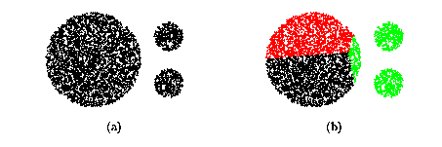
CURE (Clustering Using REpresentatives)
CURE: non-spherical clusters, robust wrt outliers
  Uses multiple representative points to evaluate the distance between clusters
  Stops the creation of a cluster hierarchy if a level consists of k clusters

Slide 22
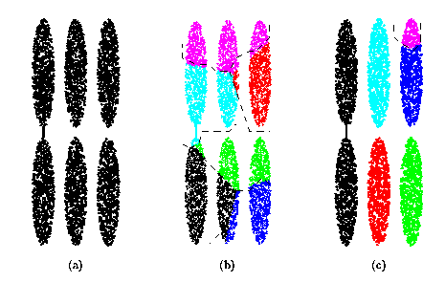
Drawbacks of Distance-Based Method
Drawbacks of square-error-based clustering method
  Consider only one point as representative of a cluster
  Good only for convex clusters, of similar size and density, and if k can be reasonably estimated

Slide 23
Cure: The Algorithm
  Draw random sample s
  Partition sample to p partitions with size s/p
  Partially cluster partitions into s/pq clusters
  Cluster partial clusters, shrinking representatives towards centroid
  Label data on disk

Slide 24
Data Partitioning and Clustering
  s = 50
  p = 2
  s/p = 25
  s/pq = 5
y
y
y
x
y
y
x
x
x
x

Slide 25
Cure: Shrinking Representative Points
y
y
x
x
Shrink the multiple representative points towards the gravity center by a fraction of α.
Multiple representatives capture the shape of the cluster

Slide 26
Model-Based Clustering
Basic idea: Clustering as probability estimation
One model for each cluster
Generative model:
  Probability of selecting a cluster
  Probability of generating an object in cluster
Find max. likelihood or MAP model
Missing information: Cluster membership
Use EM algorithm
Quality of clustering: Likelihood of test objects

Slide 27
Mixtures of Gaussians
Cluster model: Normal distribution (mean, covariance)
Assume: diagonal covariance, known variance, same for all clusters
Max. likelihood: mean = avg. of samples
But what points are samples of a given cluster?
Estimate prob. that point belongs to cluster
Mean = weighted avg. of points, weight = prob.
But to estimate probs. we need model
“Chicken and egg” problem: use EM algorithm

Slide 28
EM Algorithm for Mixtures
Initialization: Choose means at random
E step:
  For all points and means, compute Prob(point|mean)
  Prob(mean|point) = Prob(mean) Prob(point|mean) / Prob(point)
M step:
  Each mean = Weighted avg. of points
  Weight = Prob(mean|point)
Repeat until convergence

Slide 29
EM Algorithm (contd.)
Guaranteed to converge to local optimum
K-means is special case

Slide 30
AutoClass
Developed at NASA (Cheeseman & Stutz, 1988)
Mixture of Naïve Bayes models
Variety of possible models for Prob(attribute|class)
Missing information: Class of each example
Apply EM algorithm as before
Special case of learning Bayes net with missing values
Widely used in practice

Slide 31
COBWEB
Grows tree of clusters (Fisher, 1987)
Each node contains: P(cluster), P(attribute|cluster) for each attribute
Objects presented sequentially
Options: Add to node, new node; merge, split
Quality measure: Category utility: Increase in predictability of attributes/#Clusters

Slide 32

A COBWEB Tree

Slide 33
Neural Network Approaches
Neuron = Cluster = Centroid in instance space
Layer = Level of hierarchy
Several competing sets of clusters in each layer
Objects sequentially presented to network
Within each set, neurons compete to win object
Winning neuron is moved towards object
Can be viewed as mapping from low-level features to high-level ones

Slide 34
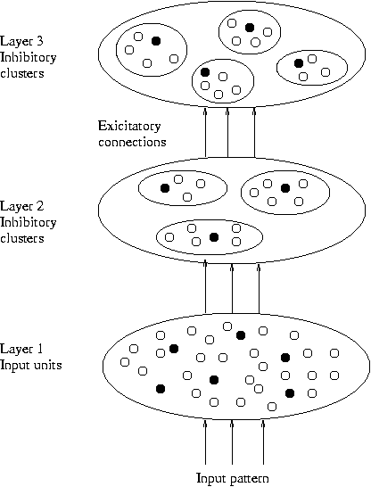
Competitive Learning

Slide 35
Self-Organizing Feature Maps
Clustering is also performed by having several units competing for the current object
The unit whose weight vector is closest to the current object wins
The winner and its neighbors learn by having their weights adjusted
SOMs are believed to resemble processing that can occur in the brain
Useful for visualizing high-dimensional data in 2- or 3-D space

Slide 36
Density-Based Clustering
Clustering based on density (local cluster criterion), such as density-connected points
Major features:
  Discover clusters of arbitrary shape
  Handle noise
  One scan
  Need density parameters as termination condition
Representative algorithms:
  DBSCAN (Ester et al., 1996)
  DENCLUE (Hinneburg & Keim, 1998)

Slide 37
Definitions (I)
Two parameters:
  Eps: Maximum radius of neighborhood
  MinPts: Minimum number of points in an Eps-neighborhood of a point
N_{Eps}(p) ={q Є D | dist(p,q) <= Eps}
Directly density-reachable: A point p is directly density-reachable from a point q wrt. Eps, MinPts iff
  1) p belongs to N_{Eps}(q)
  2) q is a core point:
  |N_{Eps} (q)| >= MinPts
p
MinPts = 5
Eps = 1 cm
q

Slide 38
Definitions (II)
Density-reachable:
  A point p is density-reachable from a point q wrt. Eps, MinPts if there is a chain of points p₁, …, p_{n}, p₁ = q, p_{n} = p such that p_{i+1} is directly density-reachable from p_{i}
Density-connected
  A point p is density-connected to a point q wrt. Eps, MinPts if there is a point o such that both, p and q are density-reachable from o wrt. Eps and MinPts.
p
p₁
q
p
q
o

Slide 39
DBSCAN: Density Based Spatial Clustering of Applications with Noise
Relies on a density-based notion of cluster: A cluster is defined as a maximal set of density-connected points
Discovers clusters of arbitrary shape in spatial databases with noise
Outlier
Border
Eps = 1cm
MinPts = 5
Core

Slide 40
DBSCAN: The Algorithm
  Arbitrarily select a point p
  Retrieve all points density-reachable from p wrt Eps and MinPts.
  If p is a core point, a cluster is formed.
  If p is a border point, no points are density-reachable from p and DBSCAN visits the next point of the database.
  Continue the process until all of the points have been processed.

Slide 41
DENCLUE: Using Density Functions
DENsity-based CLUstEring (Hinneburg & Keim, 1998)
Major features
  Good for data sets with large amounts of noise
  Allows a compact mathematical description of arbitrarily shaped clusters in high-dimensional data sets
  Significantly faster than other algorithms (faster than DBSCAN by a factor of up to 45)
  But needs a large number of parameters

Slide 42
DENCLUE
Uses grid cells but only keeps information about grid cells that do actually contain data points and manages these cells in a tree-based access structure.
Influence function: describes the impact of a data point within its neighborhood.
Overall density of the data space can be calculated as the sum of the influence function of all data points.
Clusters can be determined mathematically by identifying density attractors.
Density attractors are local maxima of the overall density function.

Slide 43
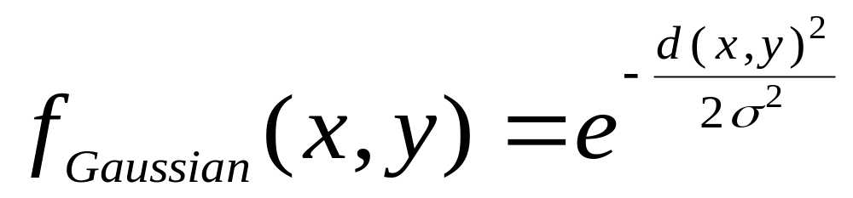
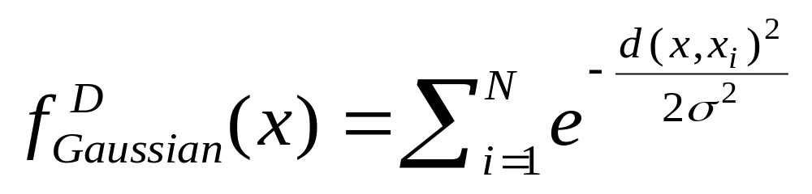

Influence Functions
Example

Slide 44



Density Attractors

Slide 45

Center-Defined & Arbitrary Clusters

Slide 46
Clustering: Summary
Introduction
Partitioning methods
Hierarchical methods
Model-based methods
Density-based methods

