Slide 1
K-means algorithm
Pick a number (k) of cluster centers
Assign every gene to its nearest cluster center
Move each cluster center to the mean of its assigned genes
Repeat 2-3 until convergence
Slides from Wash Univ. BIO5488 lecture, 2004

Slide 2
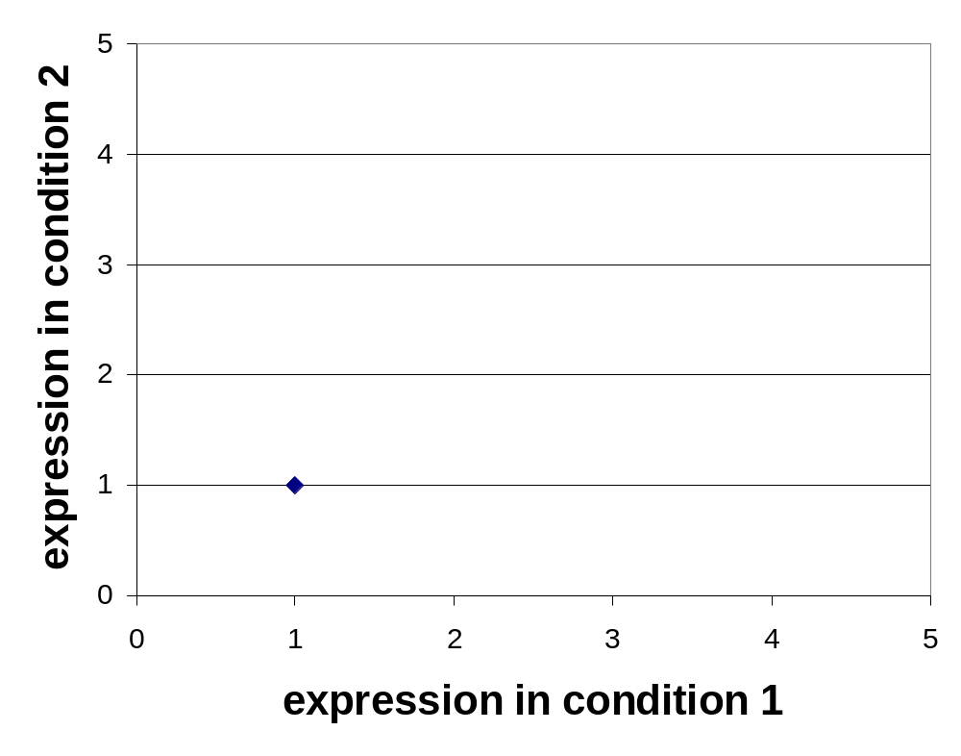
Clustering: Example 2, Step 1
Algorithm: k-means, Distance Metric: Euclidean Distance
k₁
k₂
k₃

Slide 3
Clustering: Example 2, Step 2
Algorithm: k-means, Distance Metric: Euclidean Distance
k₁
k₂
k₃

Slide 4
Clustering: Example 2, Step 3
Algorithm: k-means, Distance Metric: Euclidean Distance
k₁
k₃
k₂

Slide 5
Clustering: Example 2, Step 4
Algorithm: k-means, Distance Metric: Euclidean Distance
k₁
k₃
k₂

Slide 6

Clustering: Example 2, Step 5
Algorithm: k-means, Distance Metric: Euclidean Distance
k₁
k₂
k₃

