Slide 1
Amazon Athena: Data Partitioning
Mahmoud Parsian
Ph.D. in Computer Science

Slide 2
Athena - Basics
Serverless interactive SQL query service
No need to set up a cluster
No Need to admin a cluster
Just use the serverless service
Based on PrestoDB (Facebook) implementation
Works on data stored in S3
It is still quite fast

Slide 3
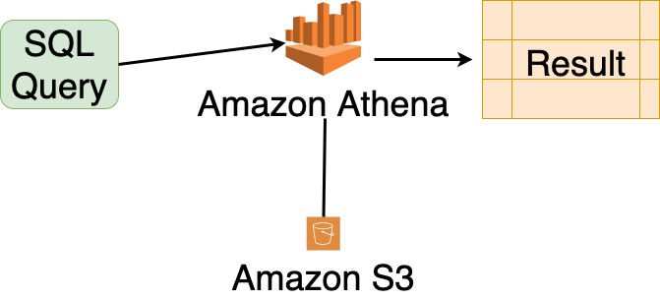
Athena - Basics

Slide 4
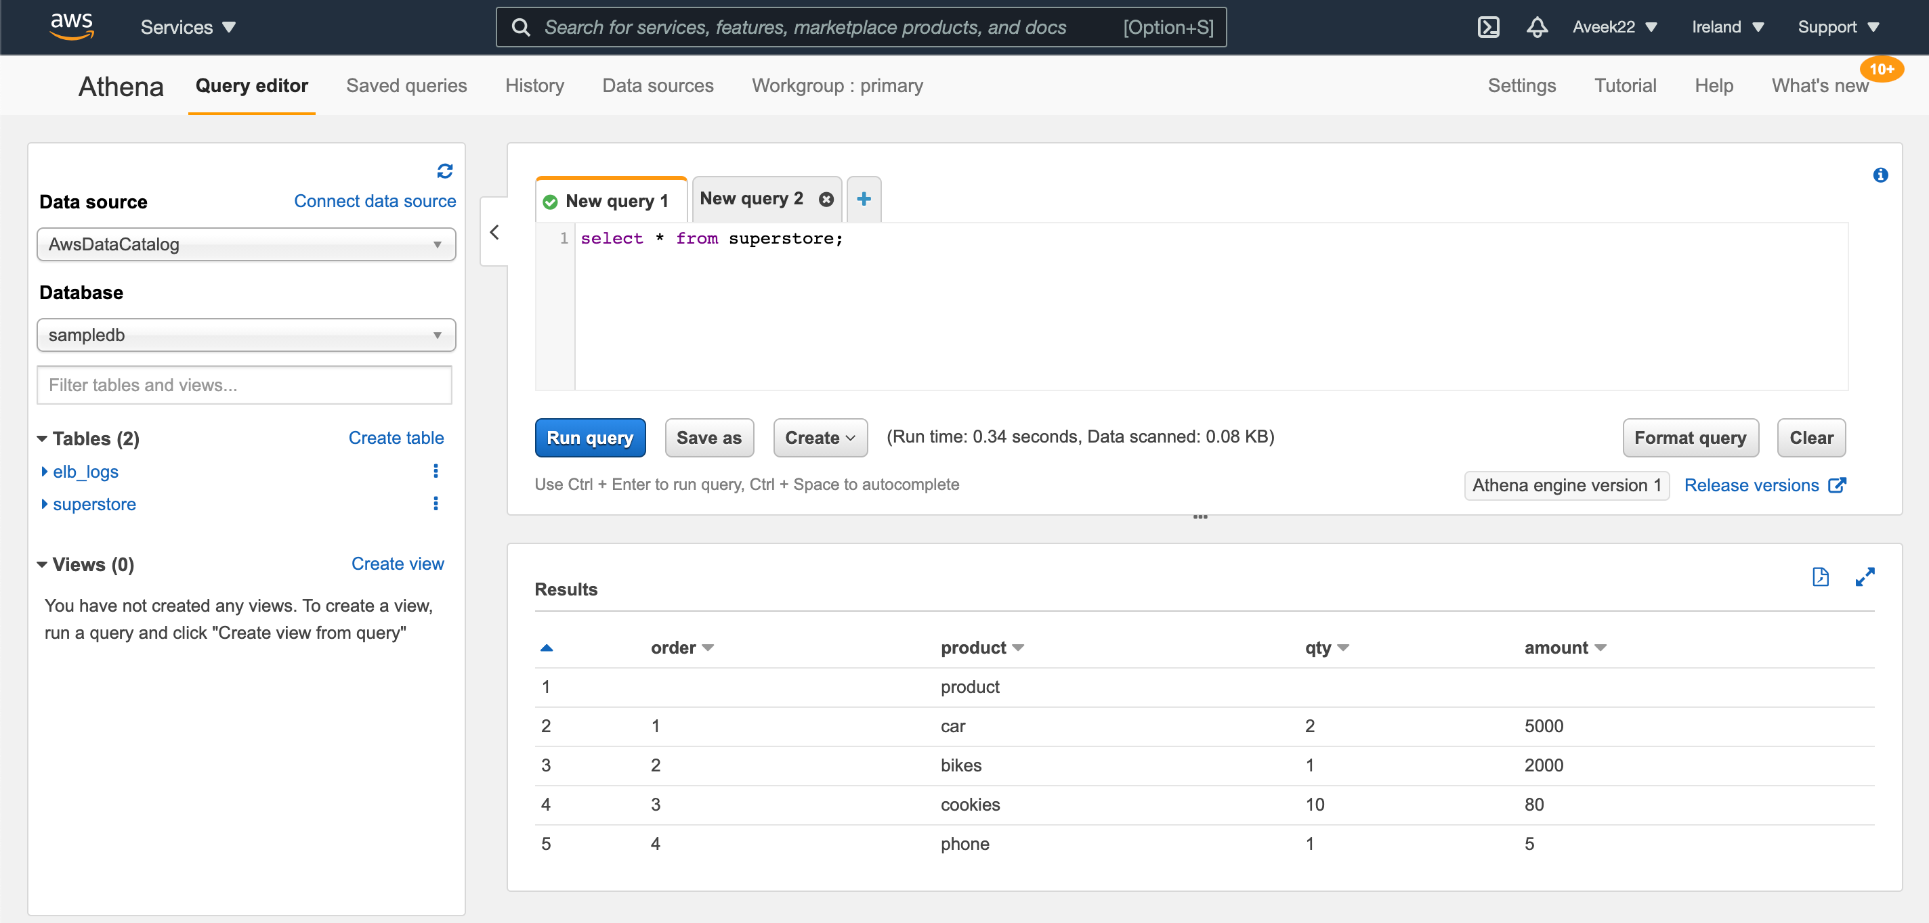
Athena – Query Editor

Slide 5
Athena Concepts
Database: set of tables
Tables - Metadata that describes your data
Similar to traditional database tables.
Tables are like views: For example, You can delete table definitions without impacting the underlying S3 data
Table deletion: does not delete actual data in S3

Slide 6
Optimization Techniques for Athena: Partitioning
Physical Partitioning your data in S3
Analyze slice of a data rather than the whole data
Using data compression techniques
Optimize JOIN conditions in queries
Use partitioned columns in your SQL query:
SELECT …
FROM Table-name
WHERE partitioned-column-name = ‘some-value’

Slide 7
1. Physically Partition data based on column(s) 2. Then Analyze slice of a data rather than the whole data
Partitioning your data in S3 using PySpark
Then, Analyze slice of a data rather than the whole data
For example, you might partition data by a columns as:
state (AZ, CA, MI, NY, IA, OH, …)
age-group (0-9, 10-19, 20-29, …)
genomic-chromosome (chr1, chr2, chr3, …)
continent (North_America, South_America, Asia, …)
country (USA, CANADA, INDIA, …)
country and state
Year (2000, 2001, 2002, …)
Customer_ID

Slide 8
Complete Example: from Beginning to an End
1. Data:
Data in Table Format (URL)
Data in Text format (URL)
2. Create DF(continent, country, city, temperature)
3. Understand your SQL queries where you will use the SQL’s
WHERE continent = ‘Asis`
4. Then continent becomes a candidate for partitioning
5. Using PySpark, Partition DF by the continent column
6. Using PySpark, Save Partitioned DF into S3 (partitioned by continent)
7. Create your Table (as continents) pointing to S3
8. Load Partitions (MSCK REPAIR continents)
only adds partitions to metadata
9. Query your data by SQL:
SELECT … FROM continents
WHERE continent = ‘Asia’

Slide 9
Complete Example: 1. Data
1. Data:
Data in Table Format (continents_countries_temp.csv)
Data in Text format (continents_countries_temp.csv)
Download Data in Text Format and save it as file continents_countries_temp.csv
2. Sample records:
$ cat continents_countries_temp.csv
continent,country,city,temperature
Africa,Algeria,Oran,71
Africa,Algeria,Oran,74
Africa,Algeria,Oran,64
Africa,Algeria,Banta,81
Africa,Algeria,Banta,64
…

Slide 10
Complete Example: 2. Create DF (using PySpark)
# create an instance of a SparkSession object
from pyspark.sql import SparkSession
spark = SparkSession.builder.getOrCreate()
# define your input in S3
s3_input_path= 's3://mybucket/INPUT/continents_countries_temp.csv’
# create a DataFrame from S3
df = spark.read.format("csv")\
.option("header","true")\
.option("inferSchema", "true")\
.load(s3_input_path)

Slide 11
Complete Example: 2. Create DF and examine it
>>> df
DataFrame[continent: string, country: string, city: string, temperature: int]
>>> df.show(5)
+---------+-------+-----+-----------+
|continent|country| city|temperature|
+---------+-------+-----+-----------+
| Africa|Algeria| Oran| 71|
| Africa|Algeria| Oran| 74|
| Africa|Algeria| Oran| 64|
| Africa|Algeria|Banta| 81|
| Africa|Algeria|Banta| 64|
+---------+-------+-----+-----------+
only showing top 5 rows

Slide 12
Complete Example: 2. Create DF and examine it
>>> df
DataFrame[continent: string, country: string, city: string, temperature: int]
>>> df.printSchema()
root
|-- continent: string (nullable = true)
|-- country: string (nullable = true)
|-- city: string (nullable = true)
|-- temperature: integer (nullable = true)
>>> df.count()
74
>>>

Slide 13
Complete Example: 3. Understand your SQL queries
The goal is to optimize queries such as
SELECT avg(temperature)
FROM continents
WHERE continent = ‘Asia`
Therefore, the continent column becomes a candidate for partitioning

Slide 14
Complete Example: 4. Identify Partitioned Columns
DataFrame[continent: string, country: string, city: string, temperature: int]
Based on desired SQL queries, therefore, the continent column becomes a candidate for partitioning

Slide 15
Complete Example: 5. Using PySpark, Partition DF by the continent column 6. Using PySpark, Save Partitioned DF into S3 (partitioned by continent)
# define output path in S3
output_path = "s3://mybucket/OUTPUT/continents/"
# partition by continent and save into S3
df.repartition("continent")\
.write.mode("append")\
.partitionBy("continent")\
.parquet(output_path)
# NOTE: There will be a separate folder under <output_path> per continent

Slide 16
Complete Example: 7. Create your Table (as continents) pointing to S3
First, examine your S3 data:
$ aws s3 ls s3://mybucket/OUTPUT/continents/ --recursive
s3://mybucket/OUTPUT/continents/continent=Asia/…
s3://mybucket/OUTPUT/continents/continent=NorthAmerica/…
s3://mybucket/OUTPUT/continents/continent=SouthAmerica/…
…

Slide 17
Complete Example: 7. Create your Table (as continents) pointing to S3, examine output directories
CREATE EXTERNAL TABLE `continents`(
`country` string,
`city` string,
`temperature` integer
)
PARTITIONED BY (
`continent` string
)
STORED AS PARQUET
LOCATION ‘s3://mybucket/OUTPUT/continents/’
tblproperties ("parquet.compress"="SNAPPY");

Slide 18
Complete Example: 7.1 Created Output Directories
There will be one folder per continent:
$# Examine S3 folders:
$ aws s3 ls s3://mybucket/OUTPUT/continents/ --recursive
s3://mybucket/OUTPUT/continents/continent=Asia/part1.parquet
s3://mybucket/OUTPUT/continents/continent=NorthAmerica/part1.parquet
s3://mybucket/OUTPUT/continents/continent=Africa/part1.parquet
s3://mybucket/OUTPUT/continents/continent=Europe/part1.parquet
s3://mybucket/OUTPUT/continents/continent=Oceania/part1.parquet
s3://mybucket/OUTPUT/continents/continent=SouthAmerica/part1.parquet

Slide 19
Complete Example: 8. Load Partitions (MSCK REPAIR continents)
General Format:
MSCK REPAIR <table-name>
Example:
MSCK REPAIR continents
This command will load all partitions for the continents table.
MSCK = metastore consistency check

Slide 20
Complete Example: 9. Query your data by SQL
Query your data by SQL:
SELECT avg(temprature)
FROM continents
WHERE continent = ‘Asia’
This SQL query will analyze data in only one folder (since “continent” is a partitioned column):
s3://mybucket/OUTPUT/continents/continent=Asia/

Slide 21
Complete Example: 9. Query your data by SQL
Query your data by SQL:
SELECT avg(temprature)
FROM continents
WHERE country = ‘USA’
This SQL query will analyze ALL of data in ALL folders (no optimization is applied): since “country” is NOT a partitioned column.

Slide 22
Multiple Columns in Partitioning Data
Let’s partition our data by 2 columns:
Continent, and
Country
What has to happen to accomplish this partitioning?

Slide 23
Multiple Columns in Partitioning Data
Let’s partition our data by 2 columns:
Continent, and
Country
What has to happen to accomplish this partitioning by 2 columns?

Slide 24
Partition by 2 columns: continent and country
# define output path in S3
output_path = "s3://mybucket/OUTPUT/continentsNEW/"
# partition by 2 columns and save into S3
df.repartition("continent”, “country”)\
.write.mode("append")\
.partitionBy("continent”, “country”)\
.parquet(output_path)

Slide 25
Partition by 2 columns: continent and country
Output directories:
There will be a separate folders per country under each continent
s3://mybucket/OUTPUT/continentsNEW/continent=Asia/
s3://mybucket/OUTPUT/continentsNEW/continent=Asia/country=China/part1.parquet
s3://mybucket/OUTPUT/continentsNEW/continent=Asia/country=India/part1.parquet
…

Slide 26
Create your Table with 2 partitions: continents and country
CREATE EXTERNAL TABLE `continents22`(
`city` string,
`temperature` integer
)
PARTITIONED BY (
`continent` string,
`country` string
)
STORED AS PARQUET
LOCATION ‘s3://mybucket/OUTPUT/continentsNEW/’
tblproperties ("parquet.compress"="SNAPPY");

Slide 27
Load Partitions (MSCK REPAIR continents)
General Format:
MSCK REPAIR <table-name>
Example:
MSCK REPAIR continents22
This command will load all partitions for the continents table.
MSCK = metastore consistency check

Slide 28
Optimized Query by SQL: use 2 partitioned columns
Query your data by SQL:
SELECT avg(temprature)
FROM continents22
WHERE continent = ‘Asia’ AND
country = ‘India’
This SQL query will analyze data in only one folder (since “continent” and “country” are partitioned columns):
s3://mybucket/OUTPUT/continentsNEW/ continent=Asia/country=India/part1.parquet

Slide 29
Summary
You need to understand your data
Make sure the columns are atomic and not composed of atomic attributes
Date (as MM-DD-YYYY) data type is not a good candidate: break this into 3 atomic columns: Year (YYYY), Month: MM, and Day (DD)
List and understand your SQL queries before partitioning by desired columns
Make sure partitioning columns satisfies 80+% of your queries
For other 20% of queries, you may define other tables
By Studying your SQL query requirements, you should identify partitioned columns (which columns are used in the SQL’s WHERE clause?)
Make sure that partitioned columns are atomic
Avoid composite data types for partitioned columns

Slide 30
Summary, continued
4. Using PySpark, physically partition your data (as a DataFrame) for identified/selected partitioned columns
5. Proper partitioning help you to analyze slice (fraction) of data rather than the whole data: this makes your SQL queries to run faster
6. Avoid scanning the whole table if your table is too big

