Slide 1
Creating Spark DataFrames
Mahmoud Parsian
Ph.D. in Computer Science

Slide 2
Challenges and Solutions
Challenges
Solutions
Perform ETL to and from various (semi- or unstructured) data sources
Perform advanced analytics
machine learning
graph processing
that are hard to express in relational systems.
ETL = Extract Transfer Load
A DataFrame API that can perform relational operations on both external data sources and Spark’s built-in RDDs.
A highly extensible optimizer, Catalyst, that uses features of Scala to add composable rule, control code gen., and define extensions.

Slide 3
DataFrame
A distributed collection of billions of rows organized into named columns.
An abstraction for selecting, filtering, aggregating and plotting structured data
Partitioned: for parallelism
SQL can be used for data transformation

Slide 4
Spark DataFrame
A distributed collection of billions of rows organized into named columns. It is similar to a relational database table:
Can have billions of rows
Each row has a fixed set of columns
Each column has a name and a type
SQL can be used to perform queries

Slide 5
DataFrame (pyspark.sql.DataFrame)
SQL can be used for data transformation
# df : DataFrame(name, age, salary)
# register DataFrame as a Table
df.createOrReplaceTempView("people")
# Use SQL Query
sql_query = "select * from people where age < 20"
# df_teens is a new target DataFrame
df_teens = spark.sql(sql_query)

Slide 6
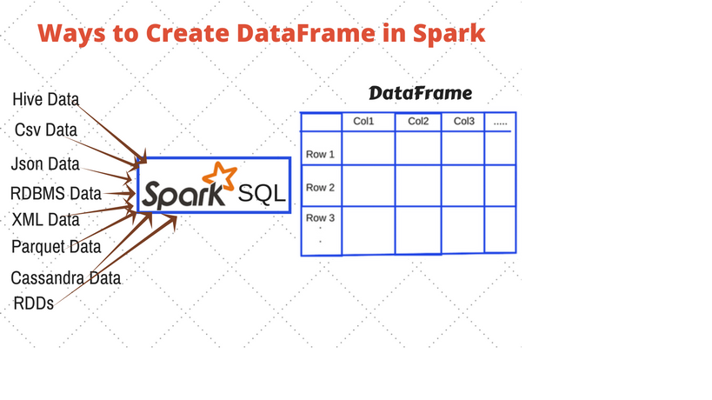
Spark DataFrame: Example

Slide 7
Spark DataFrame: Features
A DataFrame: a Table of rows with named columns
Easy to Use
A DataFrame may have billions of rows
Scalable
A DataFrame is immutable (READ-ONLY)
No Synchronization
A DataFrame is PARTITIONED
Parallelism

Slide 8
Spark DataFrame: Features
A DataFrame: a Table of rows with named columns Easy to Use
A DataFrame may have billions of rows Scalable
A DataFrame is immutable (READ-ONLY) No Synchronization
A DataFrame is PARTITIONED:
Number of rows = 800,000,000,000
Number of Partitions = 20,000 Parallelism
Number of rows per partition = 40,000,000
800,000,000,000 = 20,000 x 40,000,000
Any Transformation of this DataFrame can be parallelized by up to 20,000 executors/processes
Can register your DataFrame as a table and then fire SQL queries on the table/DataFrame. Simple Transformations and Usage

Slide 9
DataFrame
A distributed collection of rows with the same schema
DataFrame(name : STRING, age: INTEGER, salary: INTEGER)
Can be constructed from external data sources or RDDs into essentially an RDD of Row objects
Supports relational operators (e.g. where, groupby) as well as Spark operations.
Evaluated lazily → un-materialized logical plan

Slide 10
DataFrame: Example
# df : a DataFrame(name, age, salary)
# spark : SparkSession
# register df as a table named “people”
df.createOrReplaceTempView("people")
Sql_query_1 = "select * from people where age < 20"
df_teens = spark.sql(sql_query_1)
sql_query_2 = "select * from people where salary > 200000"
high_salaries = spark.sql(sql_query_2)

Slide 11
Creating DataFrame: from Collection
>>> # SparkSession available as 'spark'.
>>> tuples = [('alex', 20, 78000), ('jane', 30, 68000), ('rafa', 34, 98000)]
>>> df = spark.createDataFrame(tuples)
>>> df.show()
+----+---+------+
|_1 |_2 |_3 |
+----+---+------+
|alex| 20| 78000|
|jane| 30| 68000|
|rafa| 34| 98000|
+----+---+------+

Slide 12
Creating DataFrame: from Collection: Rename Columns
>>> df.show()
+----+---+------+
|_1 |_2 |_3 |
+----+---+------+
|alex| 20| 78000|
|jane| 30| 68000|
|rafa| 34| 98000|
+----+---+------+
# rename columns
df2 = df.selectExpr("_1 as name", "_2 as age”, "_3 as salary”)
df2.show()
+-----+----+--------+
|name | age| salary |
+-----+----+--------+
| alex| 20| 78000 |
| jane| 30| 68000 |
| rafa| 34| 98000 |
+-----+----+--------+

Slide 13
Creating DataFrame: from Collection
>>> # SparkSession available as 'spark'.
>>> tuples = [('alex', 20, 78000), ('jane', 30, 68000), ('rafa', 34, 98000)]
column_names = ["name", "age", "salary"]
>>> df = spark.createDataFrame(tuples, column_names)
>>> df.show()
+----+---+------+
|name|age|salary|
+----+---+------+
|alex| 20| 78000|
|jane| 30| 68000|
|rafa| 34| 98000|
+----+---+------+

Slide 14
Creating DataFrame: Inspect Schema
1. >>> df
DataFrame[name: string, age: bigint, salary: bigint]
2. >>> df.printSchema()
root
|-- name: string (nullable = true)
|-- age: long (nullable = true)
|-- salary: long (nullable = true)
3. >>> df.count()
3
>>>

Slide 15
Manipulate DataFrame by SQL
# regiter your DataFrame as a Table
# df as a DataFrame
df.createOrReplaceTempView("people")
# create a new DataFrame df2
df2 = spark.sql("select * from people where age > 21")
df2.show()
+----+---+------+
|name|age|salary|
+----+---+------+
|jane| 30| 68000|
|rafa| 34| 98000|
+----+---+------+

Slide 16
Creating DataFrame: from RDD
>>> tuples = [('alex', 20, 78000), ('jane', 30, 68000), ('rafa', 34, 98000)]
>>> rdd = spark.sparkContext.parallelize(tuples)
>>> from pyspark.sql import Row
>>> rdd2 = rdd.map(lambda x: Row(name=x[0], age=x[1], salary=x[2]))
>>> rdd2.collect()
[Row(name='alex', age=20, salary=78000), Row(name='jane', age=30, salary=68000), Row(name='rafa', age=34, salary=98000)]
>>> df2 = rdd2.toDF()
>>> df2.show()
+----+---+------+
|name|age|salary|
+----+---+------+
|alex| 20| 78000|
|jane| 30| 68000|
|rafa| 34| 98000|
+----+---+------+

Slide 17
Convert DataFrame to RDD
>>> df.show()
+----+---+------+
|name|age|salary|
+----+---+------+
|alex| 20| 78000|
|jane| 30| 68000|
|rafa| 34| 98000|
+----+---+------+
>>> rdd4 = df.rdd
>>> rdd4.collect()
[Row(name='alex', age=20, salary=78000),
Row(name='jane', age=30, salary=68000), Row(name='rafa', age=34, salary=98000)]
>>> rdd5 = rdd4.filter(lambda r: r.age > 20)
>>> rdd5.collect()
[Row(name='jane', age=30, salary=68000),
Row(name='rafa', age=34, salary=98000)]

Slide 18
Create DataFrame From CSV File with Header
% cat emps_with_header.txt
id,name,salary,dept
1001,alex,67000,SALES
1002,bob,24000,SALES
…
How to Convert CSV File with Header to a DataFrame?
df.show()
+----+-----+------+--------+
| id| name|salary| dept|
+----+-----+------+--------+
|1001| alex| 67000| SALES|
|1002| bob| 24000| SALES|
…

Slide 19
Create DataFrame From CSV File with Header
Complete Examples (as URLs) are:
dataframe_creation_cvs_with_header.sh
dataframe_creation_cvs_with_header.py
dataframe_creation_cvs_with_header.log

Slide 20
Create DataFrame From CSV File without Header
% cat emps_no_header.txt
1001,alex,67000,SALES
1002,bob,24000,SALES
…
How to Convert CSV File with Header to a DataFrame?
df.show()
+----+-----+------+--------+
| id| name|salary| dept|
+----+-----+------+--------+
|1001| alex| 67000| SALES|
|1002| bob| 24000| SALES|
…

Slide 21
Create DataFrame From CSV File without Header
Complete Examples (as URLs) are:
dataframe_creation_cvs_no_header.sh
dataframe_creation_cvs_no_header.py
dataframe_creation_cvs_no_header.log

Slide 22
Create DataFrame From JSON
{"name":"alex","id":200,"scores":[1,2], …}
{"name":"bob","id":300,"scores":[1,2,4,6], … }
…
How to Convert JSON File to a DataFrame?
df.show()
+---+----+------------+
|id |name|scores |
+---+----+------------+
|200|alex|[1, 2] |
|300|bob |[1, 2, 4, 6]|
|… |… | … |
+---+----+------------+

Slide 23
Create DataFrame From JSON
Complete Examples (as URLs) are:
datasource_json_reader_single_line.sh
datasource_json_reader_single_line.py
datasource_json_reader_single_line.log

Slide 24
Add New Columns to an Spark DataFrame
df.show()
+---+---+----+
| x1| x2| x3|
+---+---+----+
|100| a| 3.0|
|300| b| 5.0|
+---+---+----+
Add a new column: x4 and initialize it to 0
df_with_x4 = df.withColumn("x4", lit(0))
df_with_x4.show()
+---+---+----+---+
| x1| x2| x3| x4|
+---+---+----+---+
|100| a| 3.0| 0|
|300| b| 5.0| 0|
+---+---+----+---+

Slide 25
Add New Columns to an Spark DataFrame
Complete Examples (as URLs) are:
dataframe_creation_add_columns.sh
dataframe_creation_add_columns.py
dataframe_creation_add_columns.log

Slide 26
Create an Spark DataFrame with Schema
Specify the column names
Specify column data types
HOW?
Create the StructType schema first and then
Assign schema while creating a DataFrame

Slide 27
Create a DataFrame with Schema -- Example
Specify the column names
Specify column data types
HOW?
Create the StructType schema first and then
Assign schema while creating a DataFrame

Slide 28
Create a DataFrame with Schema -- Example
from pyspark.sql.types import StructType, StructField
from pyspark.sql.types import StringType, IntegerType
emp_schema = StructType([ \
StructField("firstname",StringType(),True), \
StructField("lastname",StringType(),True), \
StructField("id", IntegerType(), True), \
StructField("gender", StringType(), True), \
StructField("salary", IntegerType(), True) \
])

Slide 29
Create a DataFrame with Schema -- Example
Define some data:
data2 = [
("James", "Smith", 100, "M", 38000),
("Michael", "Rose", 200, "M", 49000),
("Robert", "Williams", 300, "M", 24000),
("Maria", "Jones", 600, "F", 94000),
("Mary", "Brown", 900, "F", 88000)
]

Slide 30
Create a DataFrame with Schema -- Example
df = spark.createDataFrame(data=data2,schema=emp_schema)
df.show(truncate=False)
+-----------+----------+-------+--------+--------+
| firstname | lastname | id | gender | salary |
+-----------+----------+-------+--------+--------+
| James | Smith |100 | M | 38000 |
| Michael | Rose |200 | M | 49000 |
| Robert | Williams |300 | M | 24000 |
| Maria | Jones |600 | F | 94000 |
| Mary | Brown |900 | F | 88000 |
+-----------+----------+-------+--------+--------+

Slide 31
Summary : Creating DataFrames
DataFrames can be created from many data sources:
Python collections
Python dataframe
CSV files
JSON
XML
Parquet
Relational database tables
…

