Slide 1
Spark DataFrames Transformations: Using SQL
Mahmoud Parsian
Ph.D. in Computer Science

Slide 2
DataFrame
A distributed collection of billions of rows organized into named columns.
An abstraction for selecting, filtering, aggregating and plotting structured data
Partitioned: for parallelism
SQL can be used for data transformation

Slide 3
Spark DataFrame: Features
A DataFrame: a Table of rows with named columns
Easy to Use
A DataFrame may have billions of rows
Scalable
A DataFrame is immutable (READ-ONLY)
No Synchronization
A DataFrame is PARTITIONED
Parallelism

Slide 4
Spark DataFrame: Features
A DataFrame: a Table of rows with named columns Easy to Use
A DataFrame may have billions of rows Scalable
A DataFrame is immutable (READ-ONLY) No Synchronization
A DataFrame is PARTITIONED:
Number of rows = 800,000,000,000
Number of Partitions = 20,000 Parallelism
Number of rows per partition = 40,000,000
800,000,000,000 = 20,000 x 40,000,000
Any Transformation of this DataFrame can be parallelized by up to 20,000 executors/processes
Can register your DataFrame as a table and then fire SQL queries on the table/DataFrame. Simple Transformations and Usage

Slide 5
DataFrame Transformation: Manipulating Columns
Preparing Data
Creating a DataFrame
Register a DataFrame as a Table
Use SQL Queries on registered Table

Slide 6
DataFrame Transformation: GROUP BY : 1. Prepare Data
records =
[
("James","Sales","NY",90000,34,10000), ("Michael","Sales","NY",86000,56,20000), ("Robert","Sales","CA",81000,30,23000), ("Maria","Finance","CA",90000,24,23000), ("Raman","Finance","CA",99000,40,24000), ("Scott","Finance","NY",83000,36,19000), ("Jen","Finance","NY",79000,53,15000), ("Jeff","Marketing","CA",80000,25,18000), ("Kumar","Marketing","NY",91000,50,21000)
]

Slide 7
DataFrame Transformation: GROUP BY : 2. Create DataFrame
# spark : SparkSession
column_names = ["name", "dept", "state", "salary", "age", "bonus"]
df = spark.createDataFrame(data=records, schema = column_names)
df.show(truncate=False)
+--------+----------+-----+------+---+-----+
|name |dept |state|salary|age|bonus|
+--------+----------+-----+------+---+-----+
| James | Sales | NY | 90000| 34|10000|
| Michael| Sales | NY | 86000| 56|20000|
| Robert | Sales | CA | 81000| 30|23000|
| Maria | Finance | CA | 90000| 24|23000|
| Raman | Finance | CA | 99000| 40|24000|
| Scott | Finance | NY | 83000| 36|19000|
| Jen | Finance | NY | 79000| 53|15000|
| Jeff | Marketing| CA | 80000| 25|18000|
| Kumar | Marketing| NY | 91000| 50|21000|
+--------+----------+-----+------+---+-----+

Slide 8
DataFrame Transformation: 3. Register DataFrame as a Table
DataFrame.createOrReplaceTempView(name)
Creates or replaces a local temporary view with this DataFrame
>>> # register a DataFrame as a Table
>>> df.createOrReplaceTempView("people")
>>> # define your SQL query and then execute it
>>> sql_query = "select * from people"
>>> # spark.sql(sql_query) → a new DataFrame
>>> new_dataframe = spark.sql(sql_query)

Slide 9
DataFrame Transformation: 3. Register DataFrame as a Table
DataFrame.createOrReplaceTempView(name)
Creates or replaces a local temporary view with this DataFrame
>>> df.createOrReplaceTempView("people")
>>> spark.sql("select * from people")
DataFrame[name: string, dept: string, state: string, salary: bigint, age: bigint, bonus: bigint]
>>> spark.sql("select * from people").show()
+-------+---------+-----+------+---+-----+
| name| dept|state|salary|age|bonus|
+-------+---------+-----+------+---+-----+
| James| Sales| NY| 90000| 34|10000|
…
| Kumar|Marketing| NY| 91000| 50|21000|
+-------+---------+-----+------+---+-----+

Slide 10
DataFrame Transformation: 3. Register DataFrame as a Table
>>> df.createOrReplaceTempView("people")
>>> spark.sql("select * from people")
DataFrame[name: string, dept: string, state: string, salary: bigint, age: bigint, bonus: bigint]
>>> spark.sql("select * from people").show()
+-------+---------+-----+------+---+-----+
| name| dept|state|salary|age|bonus|
+-------+---------+-----+------+---+-----+
| James| Sales| NY| 90000| 34|10000|
|Michael| Sales| NY| 86000| 56|20000|
| Robert| Sales| CA| 81000| 30|23000|
| Maria| Finance| CA| 90000| 24|23000|
| Raman| Finance| CA| 99000| 40|24000|
| Scott| Finance| NY| 83000| 36|19000|
| Jen| Finance| NY| 79000| 53|15000|
| Jeff|Marketing| CA| 80000| 25|18000|
| Kumar|Marketing| NY| 91000| 50|21000|
+-------+---------+-----+------+---+-----+

Slide 11
DataFrame Transformation: 4. Use SQL: GROUP BY
spark.sql("select dept, sum(salary) as total_salary
from people group by dept").show()
+---------+------------+
| dept|total_salary|
+---------+------------+
| Sales| 257000|
| Finance| 351000|
|Marketing| 171000|
+---------+------------+

Slide 12
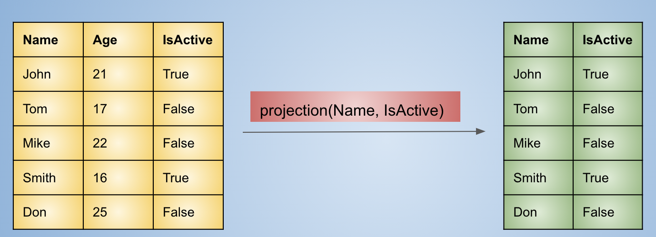
DataFrame Transformation: 4. Use SQL: PROJECTION

Slide 13
DataFrame Transformation: 4. Use SQL: PROJECTION
>>> spark.sql("select dept, salary from people").show()
+---------+------+
| dept|salary|
+---------+------+
| Sales| 90000|
| Sales| 86000|
| Sales| 81000|
| Finance| 90000|
| Finance| 99000|
| Finance| 83000|
| Finance| 79000|
|Marketing| 80000|
|Marketing| 91000|
+---------+------+

Slide 14
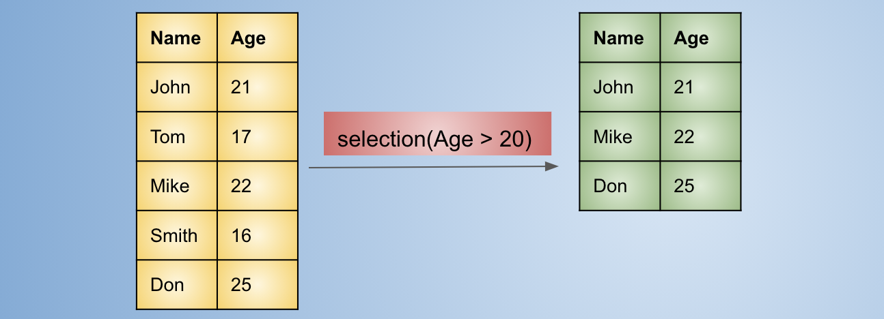
DataFrame Transformation: 4. Use SQL: Selection/FILTER

Slide 15
DataFrame Transformation: 4. Use SQL: Selection/FILTER
>>> spark.sql("select dept, salary from people where salary > 85000").show()
+---------+------+
| dept|salary|
+---------+------+
| Sales| 90000|
| Sales| 86000|
| Finance| 90000|
| Finance| 99000|
|Marketing| 91000|
+---------+------+

Slide 16
DataFrame Transformation: 4. Use SQL: Cartesian Product
Let A have N elements.
Let B have M elements.
CartesianProduct(A, B) will have M x N elements.
Example:
A = { A1, A2 }
B = { B1, B2, B3, B4 }
CartesianProduct(A, B) =
{
(A1, B1), (A1, B2), {(A1, B3), (A1, B4),
(A2, B1), (A2, B2), {(A2, B3), (A2, B4)
}

Slide 17
DataFrame Transformation: 4. Use SQL: Cartesian Product
Prepare some data:
>>> data1 = [('A', 2), ('B', 3), ('B', 4)]
>>> data2 = [('D', 60), ('E', 70), ('E', 80)]
>>> df1 = spark.createDataFrame(data1, ["key1", "value1"])
>>> df1.show()
+----+------+
|key1|value1|
+----+------+
| A| 2|
| B| 3|
| B| 4|
+----+------+
>>> df2 = spark.createDataFrame(data2, ["key2", "value2"])
>>> df2.show()
+----+------+
|key2|value2|
+----+------+
| D| 60|
| E| 70|
| E| 80|
+----+------+

Slide 18
DataFrame Transformation: 4. Use SQL: Cartesian Product
>>> df = df1.join(df2)
>>> df.show()
+----+------+----+------+
|key1|value1|key2|value2|
+----+------+----+------+
| A| 2| D| 60|
| A| 2| E| 70|
| A| 2| E| 80|
| B| 3| D| 60|
| B| 3| E| 70|
| B| 3| E| 80|
| B| 4| D| 60|
| B| 4| E| 70|
| B| 4| E| 80|
+----+------+----+------+
>>> df.count()
9

Slide 19
DataFrame Transformation: 4. Use SQL: Cartesian Product
>>> spark.sql("select p1.dept, p1.salary,
p2.dept, p2.salary from people p1, people p2").count()
81
>>> spark.sql("select p1.dept, p1.salary, p2.dept, p2.salary from people p1, people p2").show(200)
+---------+------+---------+------+
| dept|salary| dept|salary|
+---------+------+---------+------+
| Sales| 90000| Sales| 90000|
| Sales| 90000| Sales| 86000|
| Sales| 90000| Sales| 81000|
…
|Marketing| 91000|Marketing| 80000|
|Marketing| 91000|Marketing| 91000|
+---------+------+---------+------+

Slide 20
DataFrame Transformation: 4. Use SQL: Cartesian Product & Condition
>>> query "select p1.dept, p1.salary, p2.dept, p2.salary from people p1, people p2 where p1.salary < p2.salary").count()
>>> spark.sql("select p1.dept, p1.salary, p2.dept, p2.salary from people p1, people p2 where p1.salary < p2.salary").count()
35
>>> spark.sql("select p1.dept, p1.salary, p2.dept, p2.salary from people p1, people p2 where p1.salary < p2.salary").show()
+-------+------+---------+------+
| dept|salary| dept|salary|
+-------+------+---------+------+
| Sales| 90000| Finance| 99000|
| Sales| 90000|Marketing| 91000|
| Sales| 86000| Sales| 90000|
…
|Finance| 79000| Sales| 90000|
+-------+------+---------+------+

Slide 21
DataFrame Transformation: 4. Use SQL: Distinct
>>> spark.sql("select distinct dept from people").show()
+---------+
| dept|
+---------+
| Sales|
| Finance|
|Marketing|
+---------+

Slide 22
DataFrame Transformation: 4. Use SQL: ORDER BY
>>> spark.sql("select * from people ORDER by age").show()
+-------+---------+-----+------+---+-----+
| name| dept|state|salary|age|bonus|
+-------+---------+-----+------+---+-----+
| Maria| Finance| CA| 90000| 24|23000|
| Jeff|Marketing| CA| 80000| 25|18000|
| Robert| Sales| CA| 81000| 30|23000|
| James| Sales| NY| 90000| 34|10000|
| Scott| Finance| NY| 83000| 36|19000|
| Raman| Finance| CA| 99000| 40|24000|
| Kumar|Marketing| NY| 91000| 50|21000|
| Jen| Finance| NY| 79000| 53|15000|
|Michael| Sales| NY| 86000| 56|20000|
+-------+---------+-----+------+---+-----+

Slide 23
DataFrame Transformation: 4. Use SQL: ORDER BY DESC
>>> spark.sql("select * from people ORDER by age DESC").show()
+-------+---------+-----+------+---+-----+
| name| dept|state|salary|age|bonus|
+-------+---------+-----+------+---+-----+
|Michael| Sales| NY| 86000| 56|20000|
| Jen| Finance| NY| 79000| 53|15000|
| Kumar|Marketing| NY| 91000| 50|21000|
| Raman| Finance| CA| 99000| 40|24000|
| Scott| Finance| NY| 83000| 36|19000|
| James| Sales| NY| 90000| 34|10000|
| Robert| Sales| CA| 81000| 30|23000|
| Jeff|Marketing| CA| 80000| 25|18000|
| Maria| Finance| CA| 90000| 24|23000|
+-------+---------+-----+------+---+-----+

Slide 24
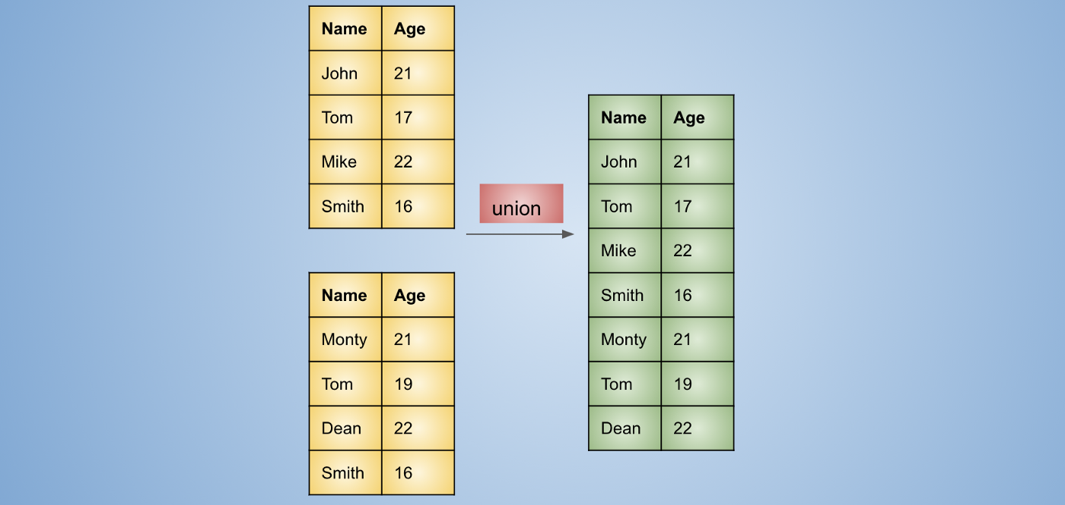
DataFrame Transformation: 4. Use SQL: UNION

Slide 25
DataFrame Transformation: 4. Use SQL: UNION
>>> df.count()
9
>>> df4 = df.union(df)
>>> df4.count()
18
>>> df4.show(truncate=False)
+-------+---------+-----+------+---+-----+
|name |dept |state|salary|age|bonus|
+-------+---------+-----+------+---+-----+
|James |Sales |NY |90000 |34 |10000|
|Michael|Sales |NY |86000 |56 |20000|
…
|James |Sales |NY |90000 |34 |10000|
|Michael|Sales |NY |86000 |56 |20000|
…
+-------+---------+-----+------+---+-----+

Slide 26
DataFrame Transformation: 4. Use SQL: Intersect
>>> data1 = [('A', 2), ('B', 3), ('C', 5)]
>>> data2 = [('A', 2), ('B', 3), ('D', 6), ('E', 7)]
>>> df1 = spark.createDataFrame(data1, ["key1", "value1"])
>>> df2 = spark.createDataFrame(data2, ["key2", "value2"])
>>> df = df1.intersect(df2)
>>> df.show()
+----+------+
|key1|value1|
+----+------+
| A| 2|
| B| 3|
+----+------+

Slide 27
DataFrame Transformation: 4. Use SQL: Distinct
>>> data1 = [('A', 2), ('B', 3), ('C', 5), ('B', 3), ('C', 5)]
>>> df1 = spark.createDataFrame(data1, ["key1", "value1"])
>>> df1.count()
5
>>> df2 = df1.distinct()
>>> df2.show()
+----+------+
|key1|value1|
+----+------+
| A| 2|
| B| 3|
| C| 5|
+----+------+
>>> df2.count()
3
>>>

Slide 28
Spark’s SQL
Seamlessly mix SQL queries with Spark programs.
Spark SQL lets you query structured data inside Spark programs, using either SQL or a powerful and simple DataFrame API.
Spark SQL is a Spark module for structured data processing.
Spark SQL provides a programming abstraction called DataFrames and can also act as a distributed SQL query engine.

