Slide 1
External Data Sources in Spark
Mahmoud Parsian
Ph.D. in Computer Science

Slide 2
Challenges and Solutions
Challenges
Solutions
1. Perform ETL to and from various data sources
Structured data sources (CSV files, Parquet, tables)
Semi-structured data sources (XML, JSON)
Unstructured data sources (text files)
2. Perform advanced analytics
machine learning
graph processing
that are hard to express in relational systems.
ETL = Extract Transfer Load
A DataFrame API that can perform relational operations on both external data sources and Spark’s built-in RDDs.
READ: A DataFrame can be created from many external data sources (files, tables, …)
WRITE: A DataFrame can be saved as an external data sources (files, tables, …)

Slide 3
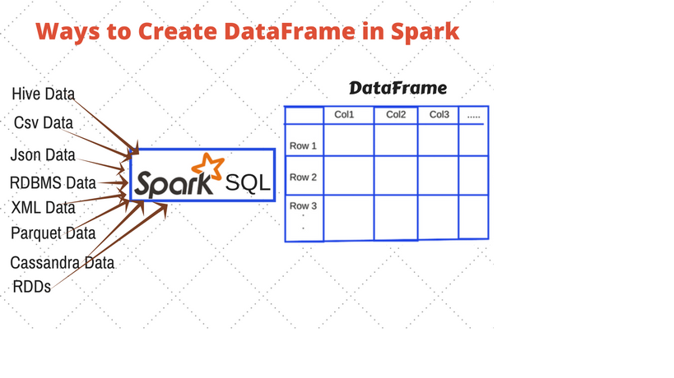
Read: Data Source → DataFrame Write: DataFrame → Data Source

Slide 4
Spark Read/Write Data Sources
Spark can read from many different data sources
READ: <Data Source> → DataFrame
Spark can write to many different data sources
WRITE: DataFrame → <Data Source>
You can create custom readers/writers

Slide 5
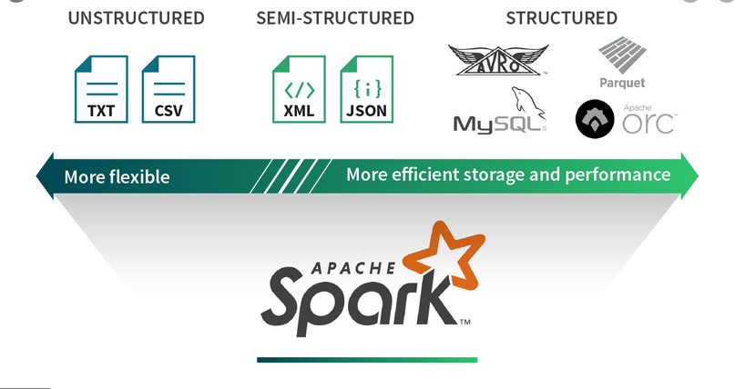
Spark Data Sources

Slide 6
Spark Data Sources API Frame
The Spark Data Source API has two main features:
Generality: Support reading/writing most data management/storage systems.
Flexibility: Customize and optimize the read and write paths for different systems based on their capabilities

Slide 7
Spark Data Engineering 101
Structure of Spark’s Data Source API
Read API Structure
Write API Structure
Spark Data Sources you Should Know About
Python Collections (arrays, lists, …)
CSV
XML
JSON
Parquet (binary, columnar data: rows and columns)
ORC (binary, columnar data: rows and columns)
Text
JDBC/ODBC connections (read/write relational database tables)

Slide 8
Structure of Spark’s Data Sources API
DataFrameReader
Create a DataFrame from an external data source
DataFrameWriter
Write an existing DataFrame to an external data source

Slide 9
Structure of Spark’s Data Sources API
DataFrameReader
Interface used to load a dataset from external storage systems (e.g. file systems, key-value stores, etc).
Creates a new DataFrame
DataFrameWriter
Interface used to write a dataset to an external storage systems (e.g. file systems, key-value stores, etc).
Writes an existing DataFrame to an external data source

Slide 10
DataFrameReader
Interface used to load a dataset from external storage systems (e.g. file systems, key-value stores, etc).
Use SparkSession.read to access this
Creates a new DataFrame
set of rows with named columns
Data Source → DataFrame

Slide 11
DataFrameWriter
Interface used to write a dataset to external storage systems (e.g. file systems, key-value stores, etc).
Use DataFrame.write to access this
Writes an existing DataFrame to an external data source
DataFrame → Data Source

Slide 12
DataFrameReader Example
# spark : SparkSession object
# df : a DataFrame object
df = spark.read
.format("csv")
.option("mode", "FAILFAST")
.option("inferSchema", "true")
.option("path", "path/to/file(s)")
.schema(someSchema)
.load()

Slide 13
DataFrameWriter Example
# df : a DataFrame object
df.write
.format("csv")
.option("mode", "OVERWRITE")
.option("dateFormat", "yyyy-MM-dd")
.option("path", "path/to/file(s)")
.save()

Slide 14
Spark DataFrame: Features
A DataFrame: a Table of rows with named columns
Easy to Use
A DataFrame may have billions of rows
Scalable
A DataFrame is immutable (READ-ONLY)
No Synchronization
A DataFrame is PARTITIONED
Parallelism
Powerful API to manipulate and query DataFrame
Simple to use

Slide 15
Creating DataFrame: Reading Python Collection
Python Collection → DataFrame
What are Python collections?
Lists
sample_list = [1, "Yes", ['a','e’]]
Key_value = [(“A”, 2), (“A”, 3), (“B”, 6), (“B”, 7)]
Arrays
Sample_array = [1, 2, 3, 5, 0, 9, 10]
Dictionaries
my_dictionary = {“key1” : 10, “key2”: “fox jumped”}

Slide 16
Creating DataFrame: Reading Python Collection
>>> # SparkSession available as 'spark'.
>>> tuples = [('alex', 20, 78000), ('jane', 30, 68000), ('rafa', 34, 98000)]
>>> df = spark.createDataFrame(tuples)
>>> df.show()
+----+---+------+
|_1 |_2 |_3 |
+----+---+------+
|alex| 20| 78000|
|jane| 30| 68000|
|rafa| 34| 98000|
+----+---+------+

Slide 17
Creating DataFrame: from Collection: rename columns
>>> df.show()
+----+---+------+
|_1 |_2 |_3 |
+----+---+------+
|alex| 20| 78000|
|jane| 30| 68000|
|rafa| 34| 98000|
+----+---+------+
# rename column names
df2 = df.selectExpr("_1 as name", "_2 as age”, "_3 as salary”)
df2.show()
+-----+----+--------+
|name | age| salary |
+-----+----+--------+
| alex| 20| 78000 |
| jane| 30| 68000 |
| rafa| 34| 98000 |
+-----+----+--------+

Slide 18
Read Python Collection and Create DataFrame with named columns
>>> # SparkSession available as 'spark'.
>>> tuples = [('alex', 20, 78000), ('jane', 30, 68000), ('rafa', 34, 98000)]
column_names = ["name", "age", "salary"]
>>> df = spark.createDataFrame(tuples, column_names)
>>> df.show()
+----+---+------+
|name|age|salary|
+----+---+------+
|alex| 20| 78000|
|jane| 30| 68000|
|rafa| 34| 98000|
+----+---+------+

Slide 19
Creating DataFrame: Inspect Schema
1. >>> df
DataFrame[name: string, age: bigint, salary: bigint]
2. >>> df.printSchema()
root
|-- name: string (nullable = true)
|-- age: long (nullable = true)
|-- salary: long (nullable = true)
3. >>> df.count()
3
>>>

Slide 20
Writing a DataFrame in CSV Format: TAB Separated
# df : a DataFrame
output_path = "/tmp/project/output1/"
df.write
.format("csv")
.mode("overwrite")
.option("sep", "\t")
.save(output_path)

Slide 21
Creating DataFrame: from RDD
>>> tuples = [('alex', 20, 78000), ('jane', 30, 68000), ('rafa', 34, 98000)]
>>> rdd = spark.sparkContext.parallelize(tuples)
>>> from pyspark.sql import Row
>>># Convert every element of rdd to a pyspark.sql.Row object
>>> rdd2 = rdd.map(lambda x: Row(name=x[0], age=x[1], salary=x[2]))
>>> rdd2.collect()
[Row(name='alex', age=20, salary=78000), Row(name='jane', age=30, salary=68000), Row(name='rafa', age=34, salary=98000)]
>>> df2 = rdd2.toDF()
>>> df2.show()
+----+---+------+
|name|age|salary|
+----+---+------+
|alex| 20| 78000|
|jane| 30| 68000|
|rafa| 34| 98000|
+----+---+------+

Slide 22
Convert DataFrame to RDD
>>> df.show()
+----+---+------+
|name|age|salary|
+----+---+------+
|alex| 20| 78000|
|jane| 30| 68000|
|rafa| 34| 98000|
+----+---+------+
>>> rdd4 = df.rdd
>>> rdd4.collect()
[Row(name='alex', age=20, salary=78000),
Row(name='jane', age=30, salary=68000),
Row(name='rafa', age=34, salary=98000)]
12. >>># apply a filter to rdd4
>>> rdd5 = rdd4.filter(lambda r: r.age > 20)
13. >>> rdd5.collect()
[Row(name='jane', age=30, salary=68000),
Row(name='rafa', age=34, salary=98000)]

Slide 23
Create DataFrame From CSV File with Header
% cat emps_with_header.txt
id,name,salary,dept
1001,alex,67000,SALES
1002,bob,24000,SALES
…
How to Convert CSV File with Header to a DataFrame?
df.show()
+----+-----+------+--------+
| id| name|salary| dept|
+----+-----+------+--------+
|1001| alex| 67000| SALES|
|1002| bob| 24000| SALES|
…

Slide 24
Create DataFrame From CSV File with Header
Complete Examples (as URLs) are:
DataFrame_creation_cvs_with_header.sh
A basic shell script
DataFrame_creation_cvs_with_header.py
A PySpark Program
DataFrame_creation_cvs_with_header.log
Sample run of PySpark Program

Slide 25
Create DataFrame From CSV File without Header
% cat emps_no_header.txt
1001,alex,67000,SALES
1002,bob,24000,SALES
…
How to Convert CSV File with Header to a DataFrame?
df.show()
+----+-----+------+--------+
| id| name|salary| dept|
+----+-----+------+--------+
|1001| alex| 67000| SALES|
|1002| bob| 24000| SALES|
…

Slide 26
Create DataFrame From CSV File without Header
Complete Examples (as URLs) are:
DataFrame_creation_cvs_no_header.sh
Shell script to run program
DataFrame_creation_cvs_no_header.py
A PySpark Program
DataFrame_creation_cvs_no_header.log
Sample run of PySpark program

Slide 27
Reading JSON → Create a DataFrame
# spark : a SparkSession object
input_as_json = “/data/movies.json”
df = spark.read
.format("json")
.option("mode", "FAILFAST")
.option("inferSchema", "true")
.load(input_as_json)

Slide 28
Writing a DataFrame as JSON
# df : a DataFrame
output_path = “/tmp/output5/”
#
df.write
.format("json")
.mode("overwrite")
.save(output_path)

Slide 29
Create DataFrame From JSON
{"name":"alex","id":200,"scores":[1,2], …}
{"name":"bob","id":300,"scores":[1,2,4,6], … }
…
How to Convert JSON File to a DataFrame?
df.show()
+---+----+------------+
|id |name|scores |
+---+----+------------+
|200|alex|[1, 2] |
|300|bob |[1, 2, 4, 6]|
|… |… | … |
+---+----+------------+

Slide 30
Create DataFrame From JSON
Complete Examples (as URLs) are:
datasource_json_reader_single_line.sh
datasource_json_reader_single_line.py
datasource_json_reader_single_line.log

Slide 31
Create a DataFrame with Schema
Specify the column names
Specify column data types
HOW?
Create the StructType schema first and then
Assign schema while creating a DataFrame

Slide 32
Create a DataFrame with Schema -- Example
Specify the column names
Specify column data types
HOW?
Create the StructType schema first and then
Assign schema while creating a DataFrame

Slide 33
Create a DataFrame with Schema -- Example
from pyspark.sql.types import StructType, StructField
from pyspark.sql.types import StringType, IntegerType
emp_schema = StructType([ \
StructField("firstname",StringType(),True), \
StructField("lastname",StringType(),True), \
StructField("id", IntegerType(), True), \
StructField("gender", StringType(), True), \
StructField("salary", IntegerType(), True) \
])

Slide 34
Create a DataFrame with Schema -- Example
Define some data:
data2 = [
("James", "Smith", 100, "M", 38000),
("Michael", "Rose", 200, "M", 49000),
("Robert", "Williams", 300, "M", 24000),
("Maria", "Jones", 600, "F", 94000),
("Mary", "Brown", 900, "F", 88000)
]

Slide 35
Create a DataFrame with Schema -- Example
df = spark.createDataFrame(data=data2,schema=emp_schema)
df.show(truncate=False)
+-----------+----------+-------+--------+--------+
| firstname | lastname | id | gender | salary |
+-----------+----------+-------+--------+--------+
| James | Smith |100 | M | 38000 |
| Michael | Rose |200 | M | 49000 |
| Robert | Williams |300 | M | 24000 |
| Maria | Jones |600 | F | 94000 |
| Mary | Brown |900 | F | 88000 |
+-----------+----------+-------+--------+--------+

Slide 36
Reading/Writing Parquet Format
Parquet is an open-source file format
Available to any project in the Hadoop ecosystem.
Apache Parquet is designed for efficiency as well as the performant flat columnar storage format of data compared to row-based files like CSV or TSV files.
https://parquet.apache.org

Slide 37
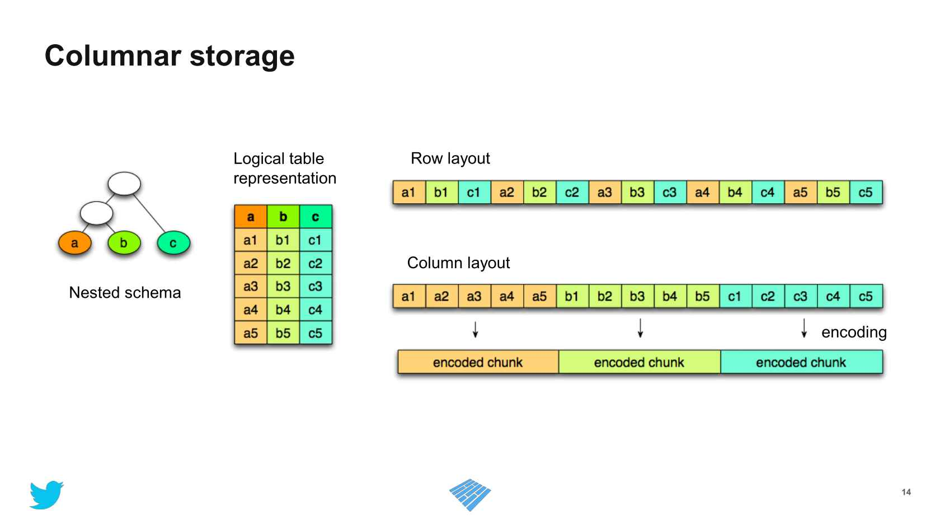
Parquet: Columnar Storage

Slide 38
Reading Parquet → DataFrame
# spark : SparkSession
input_path = "/data/movies/2020-summary.parquet"
df = spark.read
.format("parquet")
.load(input_path)
#
df.show(5)

Slide 39
Writing Dataframe → Parquet
# df : DataFrame
output_path = "/tmp/my-parquet-file.parquet"
#
df.write
.format("parquet")
.mode("overwrite")
.save(output_path)

Slide 40
Reading/Writing Parquet: A Complete Example
Input data:
https://github.com/mahmoudparsian/pyspark-algorithms/blob/master/code/chap07/users4.parquet
Read users4.parquet file → a DataFrame
Inspect created DataFrame
Write a DataFrame as Parquet
Inspect output path

Slide 41
Reading/Writing Parquet: Read Parquet
Data Download URL for users4.parquet
Download users4.parquet file and place it to "/tmp/users4.parquet
>>> input_path = "/tmp/users4.parquet"
>>>
>>> spark.read.format("parquet").load(input_path).show()
+-----+---------+---+
| name| city|age|
+-----+---------+---+
| alex|Sunnyvale| 20|
| jane|Cupertino| 30|
| max|Sunnyvale| 27|
|terry| Stanford| 60|
+-----+---------+---+

Slide 42
Reading/Writing Parquet: Write a DataFrame as Parquet
>>> output_path = "/tmp/parquet/"
# df : a DataFrame
df.write
.format("parquet")
.mode("overwrite")
.save(output_path)

Slide 43
Reading/Writing Parquet: Inspect Output Path
% ls –l /tmp/parquet/
-rw-r--r-- 1 mparsian staff 0 Apr 25 22:41 _SUCCESS
-rw-r--r-- 1 mparsian staff 1056 Apr 25 22:41 part-00000-24773691-4c1c-47e2-ba9f-b18b58eede73-c000.snappy.parquet

Slide 44
Reading Table from a JDBC Data Source
# spark : SparkSession object
df = spark.read
.format("jdbc")
.option("url", "jdbc:postgresql:dbserver")
.option("dbtable", "schema.tablename")
.option("user", "username")
.option("password", "password")
.load()

Slide 45
Writing a DataFrame to a JDBC Table
df.write
.format("jdbc”)
.option("url", "jdbc:postgresql:dbserver")
.option("dbtable", "schema.tablename")
.option("user", "username")
.option("password", "password")
.save()

Slide 46
Reading from Relational Database Tables (as URLs)
Read a Relational Database Table and Create a DataFrame
datasource_jdbc_reader.sh
datasource_jdbc_reader.py
datasource_jdbc_reader.log

Slide 47
Writing a DataFrame to a Relational Database Table (as URLs)
Writing a DataFrame to a Relational Database Table
datasource_jdbc_writer.sh
datasource_jdbc_writer.py
datasource_jdbc_writer.log

Slide 48
Summary: Readers and Writers
Spark can read data (almost any format) from any data source
and create a DataFrame
Spark can write a DataFrame to any data source
Save a DataFrame to a Data Source (such as Amazon S3, File system, …)

Slide 49
Summary: Readers
Spark can read data (almost any format) from any data source
and create a DataFrame
Data Source Formats:
Text files (CSV files)
JSON format
XML format
Parquet format
ORC format
Relational database tables
+ more

Slide 50
Summary, Writers
Spark can write a DataFrame to any data source
Save a DataFrame to a Data Source (such as Amazon S3, File system, …)
Data Source Formats:
Text files (CSV files)
JSON format
XML format
Parquet format
ORC format
Relational database tables
+ more

