Slide 1
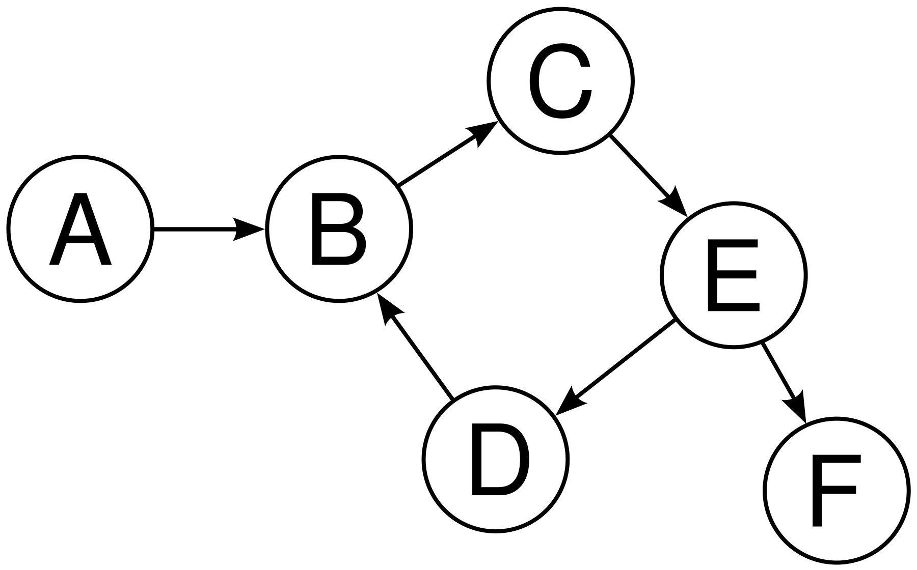
Introduction to Graphs
Mahmoud Parsian
Ph.D. in Computer Science

Slide 2
What is a Graph Data Structure?
Graphs are a generalization of trees
Nodes (or vertices)
Edges (or arcs)
Two kinds of graphs
Directed
Undirected

Slide 3
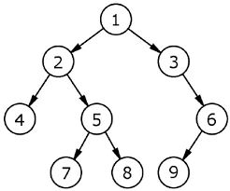
Graphs are a generalization of trees

Slide 4
Formal Definition of Graphs
A graph G = (V, E) consists of
V: a finite set of vertices/nodes, and
E: a finite set of edges
Each edge is a pair (a, b), where
a in V
b in V

Slide 5

Graph Examples: an Undirected Graph with 5 nodes

Slide 6
2 Types of Graphs
A directed graph, or digraph, is a graph in which the edges are ordered pairs
(a, b) ≠ (b, a)
An undirected graph is a graph in which the edges are unordered pairs
(a, b) == (b, a)

Slide 7
Graph Examples: a Directed Graph
Twitter data is a Directed Graph.
Alex follows Jane (but Jane might not follow Alex)
Jane follows Ted (but Ted might not follow Jane)

Slide 8
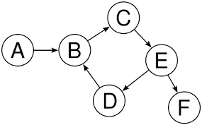
Graph Examples: a Directed Graph

Slide 9
Graph Examples: a Directed Graph
In a directed graph, the edges are arrows.
Directed graphs show the flow from one node to another and not vise versa.

Slide 10
Graph Examples: a Undirected Graph
Facebook data is an Undirected Graph.
Bidirectional relationship
Alex follows Jane (and Jane follows Alex)
Jane follows Ted (and Ted follows Jane)

Slide 11
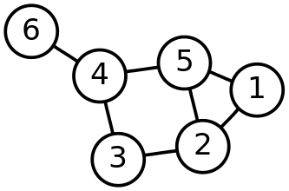
Graph Examples: an Undirected Graph

Slide 12
Graph Examples: an Undirected Graph
In an Undirected graph, the edges are lines.
Undirected graphs show a bi-directional relationship between two nodes.

Slide 13
Graph terminology: Directed
In the directed graph above, b is adjacent to a
because (a, b) in E. Note that a is not adjacent to b.
A is a predecessor of node B
B is a successor of node A
The source of the edge is node a, the target is node b
a
b

Slide 14
Graph terminology: Undirected
In the undirected graph, a and b are adjacent
because (a, b) in E. a and b are called neighbors.
Bidirectional relationship
a
b

Slide 15
Graph terminology: Path
Let E be set of edges for a graph
A path is a sequence of vertices w₁, w₂,…w_{n} such that (w_{i}, w_{i+1}) in E, 1 <= i < n, and each vertex is unique except that the path may start and end on the same vertex
The length of the path is the number of edges along the path

Slide 16
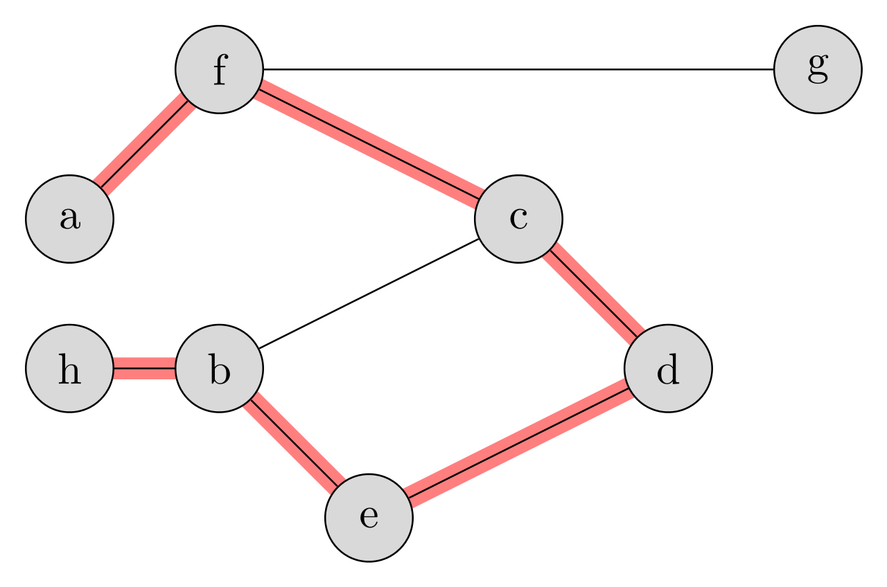
Graph terminology: Path
Sample path (red color):
(a, f), (f, c), (c, d), (d, e), (e, b), (b, h)

Slide 17
Graph terminology: Cyclic Path
A cyclic path in Graph is a path for which the first and the last vertex coincide :
(a, b), (b, c), (c, d), (d, a)

Slide 18
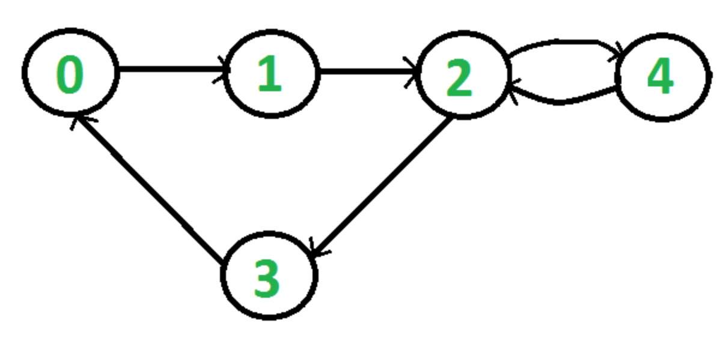
Graph terminology: Cyclic Path
A cyclic path in Graph is a path for which the first and the last vertex coincide :
Cyclic path: (0, 1), (1, 2), (2, 3), (3, 0)

Slide 19
Graph terminology: DAG
A directed graph that has no cyclic paths is called a DAG (a Directed Acyclic Graph).

Slide 20
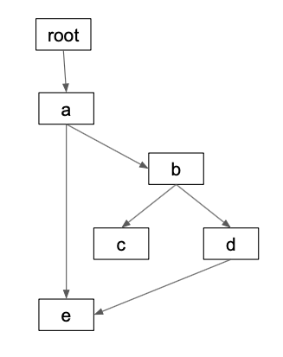
Graph terminology: DAG Example
A directed graph that has no cyclic paths is called a DAG (a Directed Acyclic Graph).

Slide 21
Uses for Graph
Computer networks
Social media:
Twitter
Facebook
Genomics: relationships between genes
Web sites
Airports and planes

Slide 22
Graph Theory Tutorial (as a URL link)
Graph Theory Tutorial by TutorialsPoint

Slide 23
Summary
A graph data structure is a collection of nodes that have data and are connected to other nodes.
A Graph is a non-linear data structure consisting of nodes and edges. The nodes are sometimes also referred to as vertices and the edges are lines or arcs that connect any two nodes in the graph. More formally a Graph can be defined as,
A Graph consists of a finite set of vertices(or nodes) and set of Edges which connect a pair of nodes.
When there are relationships between 2 or entities, graph may be used to represent data
Twitter users (directed graph)
Facebook users (undirected graph)

