Slide 1
Introduction to PySpark PySpark : Python API for Spark PySpark = { Python + Spark }
Mahmoud Parsian
Ph.D. in Computer Science

Slide 2
Outline
Apache Spark
Resilient Distributed Datasets (RDD)
Transformation and Actions in Spark
RDD Partitions
DataFrames

Slide 3
What is Spark?
Spark is a multi-language engine for executing data engineering, data science, and machine learning on single-node machines or clusters.
Simple (uses high-level API)
Fast (uses RAM/memory)
Scalable (runs in cluster environment)
Unified (can run anywhere…)

Slide 4
Spark and PySpark
Spark is written in Scala , but it supports:
Python (PySpark) (code is compact)
Java (code is bulky)
Scala
SQL

Slide 5
PySpark
PySpark is the Python API for Spark, an open source, distributed computing framework and set of libraries for real-time, large-scale data processing.
If you're already familiar with Python and libraries such as Pandas, then PySpark is a good language to learn to create more scalable analyses and pipelines.

Slide 6
PySpark’s Official Documentation and API (as URLs)
1. PySpark is the Python API for Spark
You may search API
2. RDD Programming Guide
Select Python tab for examples

Slide 7
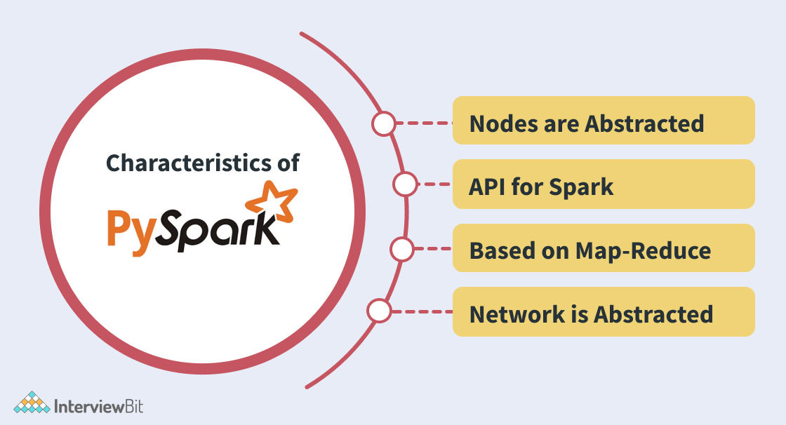
PySpark Characteristics

Slide 8
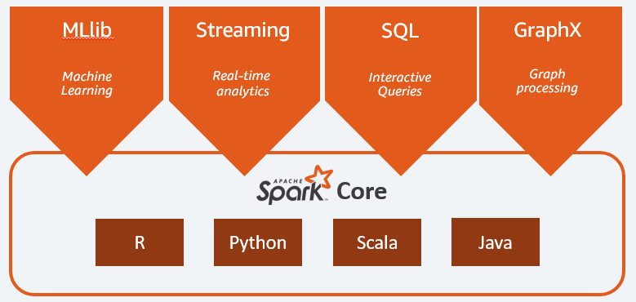
What is Spark? Why Use It?
Spark enables big data processing through parallel processing
Have choice of multiple languages to run Spark applications
We will be conducting this class in PySpark or “Python Spark”
PySpark operates on distributed
RDDs
DataFrames

Slide 9
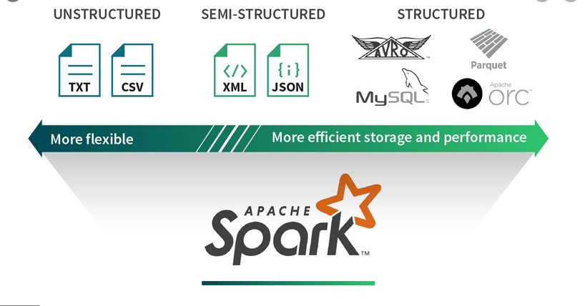
Spark Data Sources

Slide 10
Advantages of PySpark
Simple to use:
Parallelized code can be written in a simpler manner.
Error Handling:
PySpark framework easily handles errors.
Inbuilt Algorithms:
PySpark provides many of the useful algorithms in Machine Learning or Graphs.
Library Support:
Compared to Scala, Python has a huge library collection for working in the field of data science and data visualization.
Easy to Learn:
PySpark is an easy to learn language.

Slide 11
PySpark: can be used in 2 ways
PySpark shell ($SPARK_HOME/bin/pyspark)
Interactive
Testing
Debugging
Batch submit ($SPARK_HOME/bin/spark-submit <prog> <params>)
Production environment
NOTE: SPARK_HOME is an environment variable pointing to Spark’s installed directory
export SPARK_HOME=/home/spark-3.3.1

Slide 12
PySpark’s Interactive Shell How to Invoke (% is operating system prompt)
% export SPARK_HOME=/Users/mparsian/spark-3.3.1
% $SPARK_HOME/bin/pyspark
Python 3.10.5 (v3.10.5:f377153967, Jun 6 2022, 12:36:10) [Clang 13.0.0 (clang-1300.0.29.30)] on darwin
Type "help", "copyright", "credits" or "license" for more information.
Welcome to
____ __
/ __/__ ___ _____/ /__
_\ \/ _ \/ _ `/ __/ '_/
/__ / .__/\_,_/_/ /_/\_\ version 3.3.1
/_/
Using Python version 3.10.5 (v3.10.5:f377153967, Jun 6 2022 12:36:10)
Spark context Web UI available at http://c02fj5kymd6n.hsd1.ca.comcast.net:4040
Spark context available as 'sc' (master = local[*], app id = local-1676876907026).
SparkSession available as 'spark'.
>>>

Slide 13
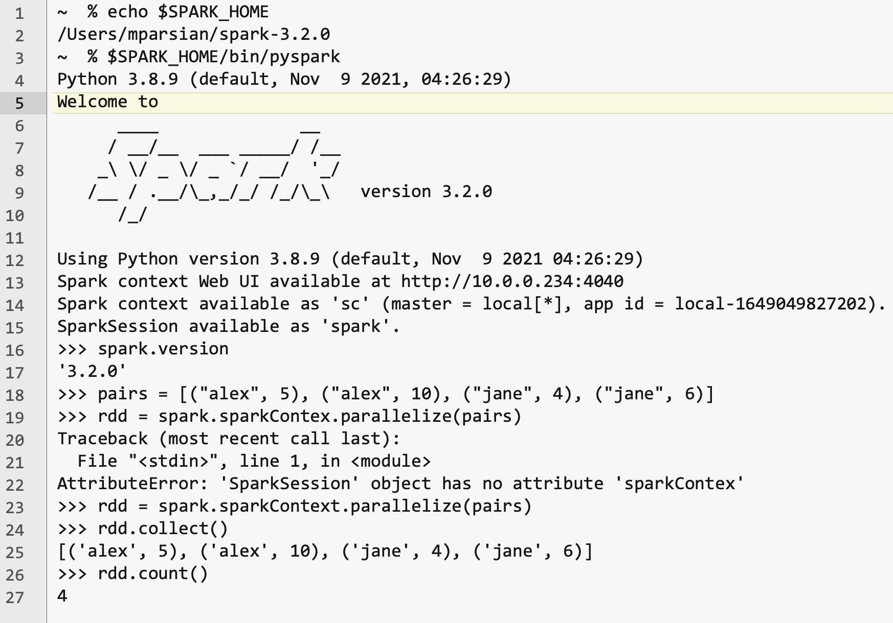
PySpark’s Interactive Shell Create an RDD from a Python Collection

Slide 14
PySpark Interactive Shell Command Usage with Examples
The following links will be useful in understandings of PySpark Interactive Shell:
1. PySpark Shell Command Usage with Examples
2. PySpark Quick Start
select Python tab

Slide 15
$SPARK_HOME/bin/spark-submit Runs PySpark as a Batch
Define environment variable:
export SPARK_HOME=<spark-installed-directory>
2. Submit your PySpark program as a batch
$SPARK_HOME/bin/spark-submit <prog> <parameters>
where,
<prog> is your PySpark program (such as my_prog.py)
<parameters> are program parameters
Example:
INPUT_PATH=“s3://my_bucket/project7/data/”
OUTPUT_PATH=“s3://my_bucket/project7/output/”
$SPARK_HOME/bin/spark-submit --verbose \
my_prog.py \
${INPUT_PATH} \
${OUTPUT_PATH}

Slide 16
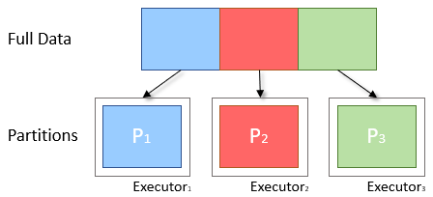
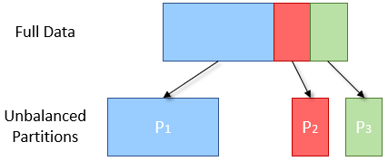
Data Partitioning
Spark breaks data into chunks, or a group of rows
Parallelism: Groups of data (chunks) on multiple cluster nodes simultaneously
Processing data in smaller chunks allows you to process larger data sets more quickly
Can scale from 1 to thousands of executors based on data size
Ideal
Reality

Slide 17
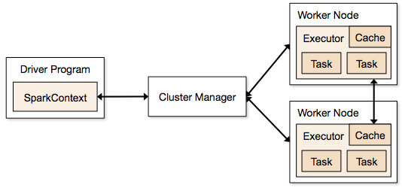
pyspark.SparkContext
SparkContext is the main entry point for Spark functionality.
A SparkContext represents the connection to a Spark cluster, and can be used to create RDD and broadcast variables on that cluster.

Slide 18

Spark Architecture
Spark Driver
Converts user applications to smaller execution “tasks”
Schedules tasks on clusters
Cluster Manager
Manages and allocates resources to cluster nodes
Worker Nodes
Runs application code in the cluster
Spark Executor
Executes tasks on each worker node
Communicates with the driver program
Keeps data in memory or disk storage
Task
A unit of work sent to one executor

Slide 19
Resilient Distributed Datasets (RDD)
An RDD is Spark's representation of a dataset (your data) that is immutable, distributed across the RAM, or memory, of lots of machines.
An RDD object is essentially a collection of elements that you can use to hold lists of records, tuples, dictionaries, lists, etc.
Lazy Evaluation : the ability to lazily evaluate code, postponing running a calculation until absolutely necessary.
# sc : SparkContext
num_partitions = 3
lines = sc.textFile(“example.txt”, num_partitions)
lines.take(5)
Notes:
The core data structure in Spark is an RDD, or a resilient distributed dataset. As the name suggests,
In the code above, Spark didn‘t wait to load the txt file into an RDD until lines.take(5) was run. When lines = sc.textFile(“hw10/tweets_sm.txt”, numPartitions) was called, a pointer to the file was created, but only when lines.take(5) needed the file to run its logic was the text file actually read into lines.
This brings the concept of actions and transformations.

Slide 20
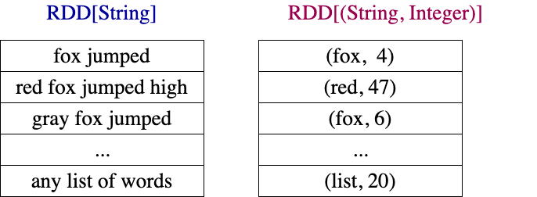
RDDs Examples

Slide 21
Creating RDDs
RDDs can be created from many data sources:
Python collections (lists, arrays, …)
Text files
Amazon S3
HDFS
Relational Database tables
DataFrames
+ many more…
Notes:
take(5) is an action

Slide 22
Creating RDDs: Example
# import library
from pyspark.sql import SparkSession
# CREATE an instance of a SparkSession object
spark = SparkSession.builder.getOrCreate()
# create a collection of pairs in Python
pairs = [(“alex”, 2), (“alex”, 4), (“jane”, 3)]
# Create rdd as RDD[(String, Integer)]
rdd = spark.sparkContext.parallelize(pairs)
# count number of elements
rdd.count()
3
# collect all of the elements
rdd.collect()
[ (“alex”, 2), (“alex”, 4), (“jane”, 3) ]
Notes:
take(5) is an action

Slide 23
Creating RDDs: Example
# Return a list that contains all of the elements in this RDD.
rdd.collect()
[ (“alex”, 2), (“alex”, 4), (“jane”, 3) ]
# filter elements: return a new RDD containing
# only the elements that satisfy a Boolean predicate.
# x denotes a single element of source rdd
# x = (String, Integer) : (x[0], x[1])
rdd2 = rdd.filter(lambda x : x[1] > 2)
rdd2.collect()
[ (“alex”, 4), (“jane”, 3) ]
Notes:
take(5) is an action

Slide 24
Transformation and Actions in Spark
RDDs have
Actions, which return values (non-RDDs), and
Transformations, which return pointers to new RDDs.
RDDs’ value is only updated once that RDD is computed as part of an action
Transformation: source_RDD → target_RDD
# convert all rdd1 elements to lowercase
rdd2 = rdd1.map(lambda x: x.lower())
Action: source_RDD → non-RDD
# count the number of elements for rdd
total = rdd.count()
Notes:
take(5) is an action

Slide 25
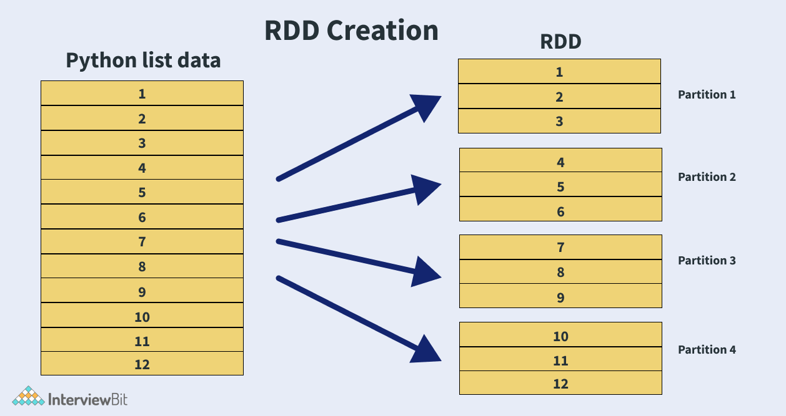
RDD Partitions: units for parallelism

Slide 26
Transformations vs. Actions
Transformations
Actions
Changes a Spark DataFrame into a new DataFrame without altering the original data (i.e. immutable)
Evaluated lazily or not computed immediately
Adds a step into the Spark query plan
Examples: select(), filter()
Triggers a computation
Causes Spark to execute a query plan (a series of transformations)
Returns a result
Example: count(), collect()

Slide 27
Lazy Evaluation
Spark has “lazy” or delayed execution
Spark inspects query and optimizes them by:
Generates multiple plans and chooses the best one with a cost model
Reorders transformations
Breaking them into stages
Optimizes “shuffles” where data is “shuffled” between workers

Slide 28
Transformation and Actions
Spark Transformations
map()
mapValues()
flatMap()
filter()
mapPartitions()
reduceByKey()
groupByKey()
combineByKey()
…
Spark Actions
collect()
count()
take()
takeOrdered()
save()
…

Slide 29
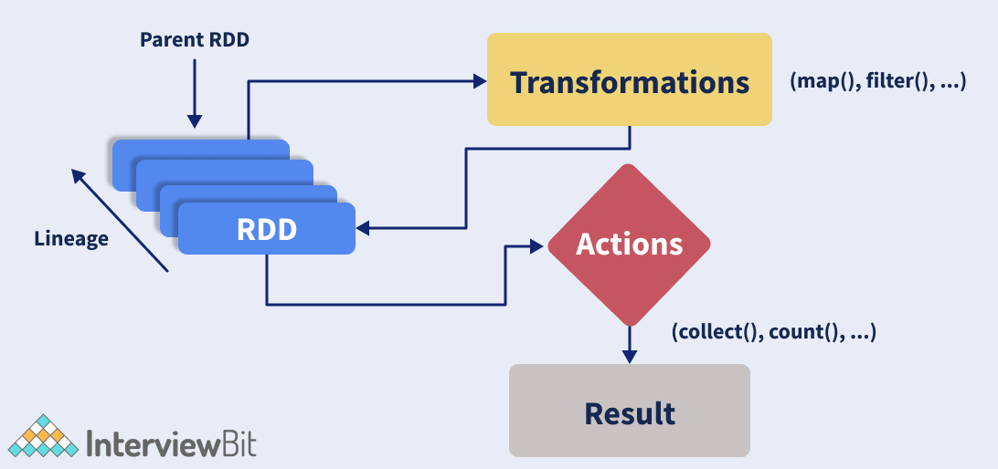
Transformation and Actions

Slide 30
Create an RDD from a Text File (Step-1)
Step-1: create a text file with 3 records:
$ cat /tmp/sample.txt
fox jumped and ran
red fox jumped
blue fox jumped and jumped

Slide 31
Create an RDD from a Text File (Step-2)
Step-2: Invoke PySpark Shell and create an RDD
(NOTE: /home/spark-3.3.1 is Spark’s installed directory)
$ /home/spark-3.3.1/bin/pyspark
Python 3.10.5
Welcome to version 3.3.1
Spark context available as 'sc'
SparkSession available as 'spark'.
>>> rdd = sc.textFile("/tmp/sample.txt")
>>> rdd.collect()
[
'fox jumped and ran’,
'red fox jumped’,
'blue fox jumped and jumped’
]
>>> rdd.count()
3

Slide 32
Create an RDD from a Python Collection
>>> # sc : SparkContext
>>> # create a Python collection
>>> pairs = [("alex", 23), ("alex", 25), ("jane", 30), ("jane", 40)]
>>> # create an RDD from a Python collection
>>> rdd = sc.parallelize(pairs)
>>> rdd.collect()
[('alex', 23), ('alex', 25), ('jane', 30), ('jane', 40)]
>>> rdd.count()
4

Slide 33
RDD Mapper Transformations
map(): 1-to-1 mapping
map() transformation applies the mapper function on each element of the RDD and returns the transformed RDD
flatMap(): 1-to-Many mapping
Return a new RDD by first applying a function to all elements of this RDD, and then flattening the results.
mapPartitions(): Many-to-1 mapping
Return a new RDD by applying a function to each partition of this RDD.

Slide 34
RDD map() Example
# spark : SparkSession
# spark.sparkContext denotes a SparkContext object
strings = [“fox jumped”, “fox not jumped”]
# rdd: RDD[String]
rdd = spark.sparkContext.parallelize(strings)
# apply a map() transformation:
rdd2 = rdd.map(lambda x: (x, len(x))
rdd2.collect()
[
(“fox jumped”, 10),
(“fox not jumped”, 14)
]

Slide 35
RDD flatMap() Example
# spark : SparkSession
lists = [ [4, 5, 6], [7, 8, 9], [], [3], [] ]
# rdd: RDD[[Integer]]
# rdd: each element is a list of integers
rdd = spark.sparkContext.parallelize(lists)
rdd.count()
5
# apply flatMap() transformation
# note that empty lists are dropped
rdd2 = rdd.flatMap(lambda x: x)
rdd2.collect()
[4, 5, 6, 7, 8, 9, 3]
rdd2.count()
7

Slide 36
map() vs. flatMap()
# spark : SparkSession
lists = [ [4, 5, 6, 7], [8, 9], [], [2], [] ]
# create rdd: RDD[[Integer]]
rdd = spark.sparkContext.parallelize(lists)
rdd.count()
5
# apply a flatMap() transformation: flattens
rdd2 = rdd.flatMap(lambda x: x)
rdd2.collect()
[4, 5, 6, 7, 8, 9, 2]
rdd2.count()
7
# apply a map() transformation: NO flattens
rdd3 = rdd.map(lambda x: x)
rdd3.collect()
[ [4, 5, 6, 7], [8, 9], [], [2], [] ]
rdd3.count()
5
Notes:
Confused !!! Ok. Let’s clear this confusion with an example …

Slide 37
filter(f): Return a new RDD containing only the elements that satisfy a Boolean predicate f().
# spark : SparkSession
lists = [ [4, 5, 6], [7, 8], [], [3] ]
# rdd: RDD[[Integer]]
rdd = spark.sparkContext.parallelize(lists)
rdd.count()
4
# apply a filter() transformation
rdd2 = rdd.filter(lambda x: len(x) > 1)
rdd2.collect()
[ [4, 5, 6], [7, 8] ]
rdd2.count()
2

Slide 38
Reduction Transformation: reduceByKey()
Merge the values for each key using an associative and commutative reduce function.
# spark : SparkSession
pairs = [(“A”, 2), (“A”, 3), (“B”, 5), (“B”, 7), (“C”, 1)]
# rdd: RDD[(String, Integer)]
rdd = spark.sparkContext.parallelize(pairs)
rdd.count()
5
# apply a reduction transformation
rdd2 = rdd.reduceByKey(lambda x, y: x+y)
rdd2.collect()
[(“A”, 5), (“B”, 12), (“C”, 1)]]
rdd2.count()
3

Slide 39
RDD Partitions Partitions: units for parallelism
Map and Reduce operations can be effectively applied in parallel in apache spark by dividing the data into multiple partitions.
rdd.getNumPartitions()
returns the number of partitions
A copy of each partition within an RDD is distributed across several workers running on different nodes of a cluster so that in case of failure of a single worker the RDD still remains available.
Notes:
Parallelism is the key feature of any distributed system where operations are done by dividing the data into multiple parallel partitions. The same operation is performed on the partitions simultaneously which helps achieve fast data processing with spark.

Slide 40
RDD Partitions: Example
rdd.count(): 800,000,000,000
rdd.getNumPartitions(): 40,000
Therefore, each partition will have about
20,000,000 elements
Maximum parallelism: 40,000 tasks
800,000,000,000 = 40,000 x 20,000,000
Notes:
Parallelism is the key feature of any distributed system where operations are done by dividing the data into multiple parallel partitions. The same operation is performed on the partitions simultaneously which helps achieve fast data processing with spark.

Slide 41
mapPartitions(func) Transformation
mapPartitions(func) implements design summarization pattern.
mapPartitions(func) transformation is similar to map(), but runs separately on each partition of the RDD, so func() must be of type Iterator<T> => Iterator<U> when running on an RDD of type T.

Slide 42
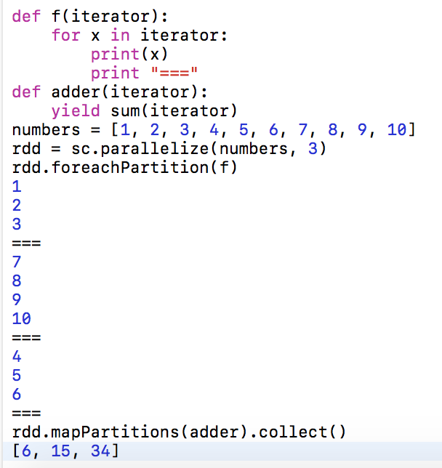
Example-1: Sum Each Partition

Slide 43
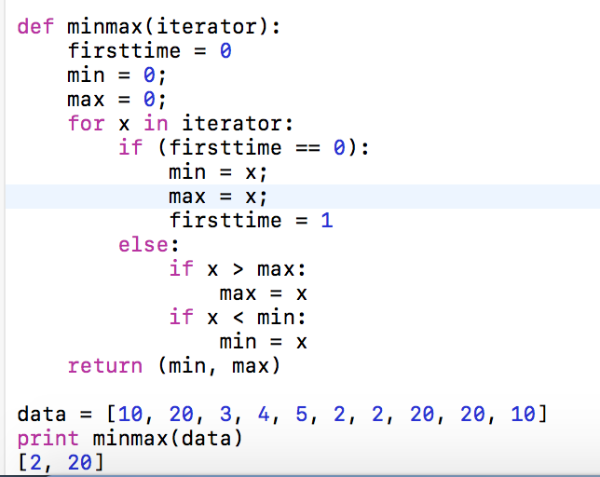
Example-2: Find Minimum and Maximum

Slide 44
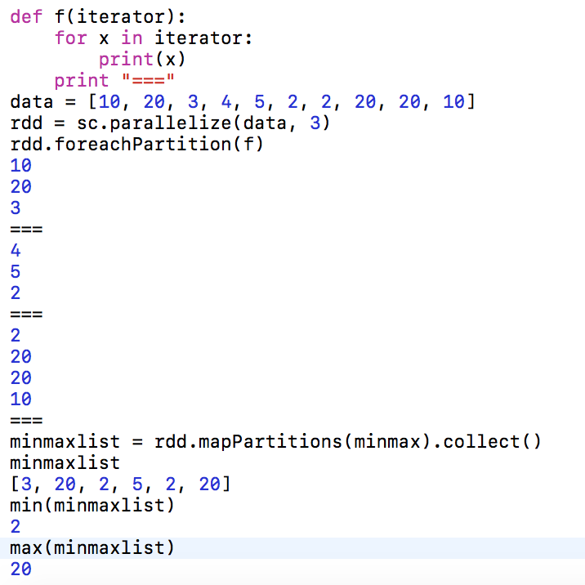

Slide 45
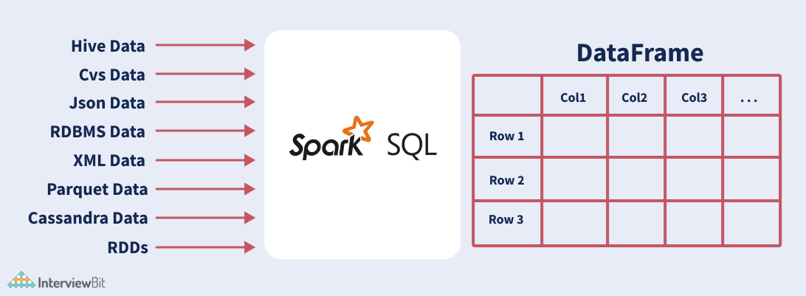
PySpark DataFrames

Slide 46
DataFrame Creation from Collection
>>> # SparkSession available as 'spark'.
>>> triplets = [(100, 'alex', 24), (200, 'jane', 35), (300, 'david', 56)]
>>> column_names = ["id", "name", "age"]
>>> # create a DataFrame
>>> df = spark.createDataFrame(triplets, column_names)
>>> df.show()
+---+-----+---+
| id| name|age|
+---+-----+---+
|100| alex| 24|
|200| jane| 35|
|300|david| 56|
+---+-----+---+

Slide 47
Summary
Spark: an open source, distributed computing framework and set of libraries for real-time, large-scale data processing.
PySpark is the Python API for Spark
If you're already familiar with Python and libraries such as Pandas, then PySpark is a good language to learn to create more scalable analyses and pipelines.

Slide 48
More Reading…
Resilient Distributed Datasets: A Fault-Tolerant Abstraction for In-Memory Cluster Computing
Reference
https://www.dezyre.com/apache-spark-tutorial/pyspark-tutorial
http://www.kdnuggets.com/2015/11/introduction-spark-python.html
https://github.com/mahmoudparsian/pyspark-tutorial/blob/master/tutorial/map-partitions/README.md

