Slide 1
Data Abstractions in Spark
Mahmoud Parsian
Ph.D. in Computer Science

Slide 2
Spark Data Abstraction
The data abstraction in Spark represents a logical data structure to the underlying data distributed on different nodes of the cluster.
Data → Spark → RDD
Data → Spark → DataFrame
Once RDD/DataFrame is created: then we can analyze data by applying PySpark’s transformations (mappers, filters, …) on RDD/DataFrame.

Slide 3
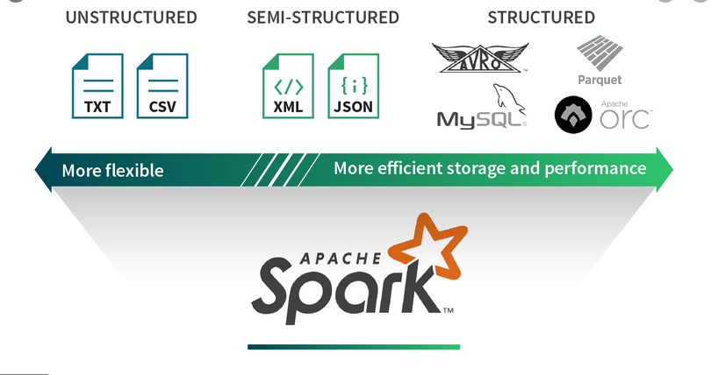
Spark Data Sources

Slide 4
Spark Data Abstraction
The data abstraction in Spark represents a logical data structure to the underlying data distributed on different nodes of the cluster.
Data Abstractions in Spark/PySpark:
Resilient Distributed Datasets (RDD)
can have billions of elements
DataFrames
a table of rows with named columns
can have billions of rows

Slide 5
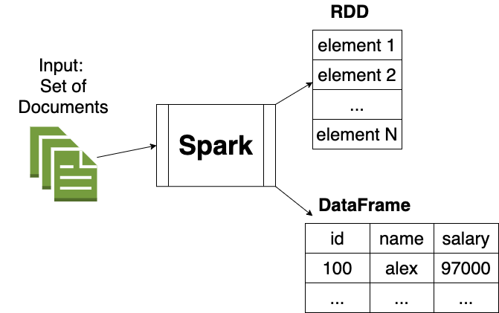
Spark Data Abstraction

Slide 6
Spark Data Abstraction: RDD
RDD : Resilient Distributed Dataset
RDD is the core data abstraction API
It is a lower-level API for manipulating distributed collection of data.
The RDD APIs exposes some extremely useful methods which can be used to get very tight control over underlying physical data structure.
It is an immutable (read only) collection of partitioned data distributed on different machines.
RDD enables in-memory computation on large clusters to speed up big data processing in a fault tolerant manner.
Partitioned: enables parallelism

Slide 7
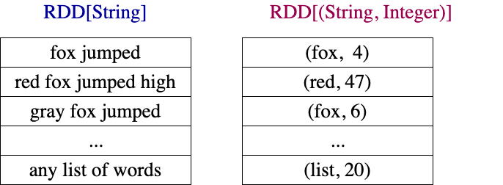
Spark Data Abstraction: RDD

Slide 8
RDD features
Immutable collection: RDD is an immutable partitioned collection distributed on different nodes. A partition is a basic unit of parallelism in Spark. The immutability helps to achieve fault tolerance and consistency.
Distributed data: RDD is a collection of distributed data which helps in big data processing by distributing the workload to different nodes in the cluster.
Lazy evaluation: The defined transformations do not gets evaluated until an action is called. It helps Spark in optimizing the overall transformations in one go.
Fault tolerant: RDD can be recomputed in case of any failure using DAG(Directed acyclic graph) of transformations defined for that RDD.
Multi-language support: RDD APIs supports Python, R, Scala, and Java programming languages.

Slide 9
Spark Data Abstraction: DataFrame
The DataFrame APIs organizes the data into rows with named columns like a table in relational database.
It enables programmers to define schema on a distributed collection of data. Each row in a DataFrame is of object type row.
Like an SQL table, each column must have same number of rows in a DataFrame.
In short, DataFrame is lazily evaluated plan which specifies the operations needs to be performed on the distributed collection of the data.
DataFrame is also an immutable collection.
Partitioned: enables parallelism

Slide 10
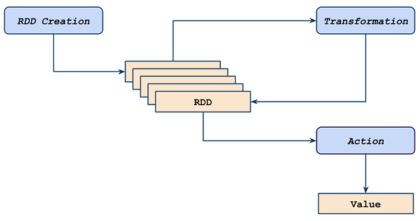
RDD Transformations & Actions

Slide 11
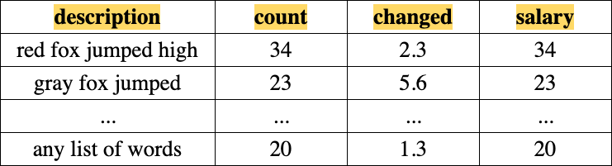
Spark Data Abstraction: DataFrame

Slide 12
Spark DataFrame features
In-built Optimization: DataFrame uses Catalyst engine which has an in-built execution optimization that improves the data processing performance significantly.
Hive compatible: The DataFrame is fully compatible with Hive query language. We can access all hive data, queries, UDFs, etc using Spark SQL from hive MetaStore and can execute queries against these hive databases.
Structured, semi-structured, and highly structured data support: DataFrame APIs supports manipulation of all kind of data from structured data files to semi-structured data files and highly structured parquet files.
Multi-language support: DataFrame APIs are available in Python, R, Scala, and Java.
Schema support: We can define a schema manually or we can read a schema from a data source which defines the column names and their data types.

Slide 13
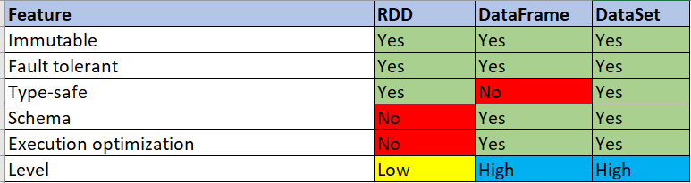
RDD vs. DataFrame

Slide 14
RDD & DataFrame Creation
RDDs and DataFrames can be created from:
Text files
Python Collections: lists, arrays, tuples, …
Relational Database Tables
Amazon S3
Hadoop HDFS
Parquet files (columnar-format)
…

Slide 15
RDD Creation: from Collection
% $SPARK_HOME/bin/pyspark
Python 3.8.9 (default, Nov 9 2021, 04:26:29)
Welcome to Spark version 3.2.0
Spark context available as 'sc'
SparkSession available as 'spark'.
>>> pairs = [("A", 2), ("A", 14), ("B", 3), ("B", 10), ("C", 2)]
>>> rdd = sc.parallelize(pairs)
>>> rdd.count()
5
>>> rdd.collect()
[('A', 2), ('A', 14), ('B', 3), ('B', 10), ('C', 2)]
>>> rdd2 = rdd.reduceByKey(lambda x, y: x+y)
>>> rdd2.count()
3
>>> rdd2.collect()
[('B', 13), ('C', 2), ('A', 16)]
>>>

Slide 16
RDD Creation: from file
% cat sample.txt
fox jumped
fox jumped high
% $SPARK_HOME/bin/pyspark
Welcome to version 3.2.0
Spark context available as 'sc' (master = local[*], app id = local-1649190002489).
SparkSession available as 'spark'.
>>> rdd = sc.textFile("sample.txt")
>>> rdd.count()
2
>>> rdd.collect()
['fox jumped', 'fox jumped high']
>>> triplets = rdd.map(lambda x: (x, len(x), x.upper()))
>>> triplets.collect()
[
('fox jumped', 10, 'FOX JUMPED’),
('fox jumped high', 15, 'FOX JUMPED HIGH’)
]
>>>

Slide 17
DataFrame Creation: from collection
% $SPARK_HOME/bin/pyspark
SparkSession available as 'spark'.
>>> rows = [("alex", 10, 38000), ("jane", 20, 49000), ("ted", 30, 65000)]
>>> column_names = ("name", "id", "salary")
>>> df = spark.createDataFrame(rows, column_names)
>>> df.show()
+----+---+------+
|name| id|salary|
+----+---+------+
|alex| 10| 38000|
|jane| 20| 49000|
| ted| 30| 65000|
+----+---+------+
>>> df.printSchema()
root
|-- name: string (nullable = true)
|-- id: long (nullable = true)
|-- salary: long (nullable = true)

Slide 18
DataFrame Creation: from File
% cat emps.csv
alex,1000,38000
ted,2000,56000
jane,3000,78000
>>> # SparkSession available as 'spark'.
>>> df = spark.read.format("csv").load("emps.csv")
>>> df.show()
+----+----+-----+
| _c0| _c1| _c2|
+----+----+-----+
|alex|1000|38000|
| ted|2000|56000|
|jane|3000|78000|
+----+----+-----+

Slide 19
DataFrame Creation: from File
>>> df.show()
+----+----+-----+
| _c0| _c1| _c2|
+----+----+-----+
|alex|1000|38000|
| ted|2000|56000|
|jane|3000|78000|
+----+----+-----+
>>> df2 = df.withColumnRenamed("_c0", "name")
.withColumnRenamed("_c1", "id")
.withColumnRenamed("_c2", "salary")
>>> df2.show()
+----+----+------+
|name| id|salary|
+----+----+------+
|alex|1000| 38000|
| ted|2000| 56000|
|jane|3000| 78000|
+----+----+------+

Slide 20
DataFrame filter
>>> df2.show()
+----+----+------+
|name| id|salary|
+----+----+------+
|alex|1000| 38000|
| ted|2000| 56000|
|jane|3000| 78000|
+----+----+------+
>>> df3 = df2.filter(df2.salary > 39000)
>>> df3.show()
+----+----+------+
|name| id|salary|
+----+----+------+
| ted|2000| 56000|
|jane|3000| 78000|
+----+----+------+

Slide 21
DataFrame add a new column
>>> df2.show()
+----+----+------+
|name| id|salary|
+----+----+------+
|alex|1000| 38000|
| ted|2000| 56000|
|jane|3000| 78000|
+----+----+------+
>>> df4 = df2.withColumn("new_col", df2.salary *2)
>>> df4.show()
+----+----+------+--------+
|name| id|salary| new_col|
+----+----+------+--------+
|alex|1000| 38000| 76000.0|
| ted|2000| 56000|112000.0|
|jane|3000| 78000|156000.0|
+----+----+------+--------+

Slide 22
Convert DataFrame to RDD
>>> df4.show()
+----+----+------+--------+
|name| id|salary| new_col|
+----+----+------+--------+
|alex|1000| 38000| 76000.0|
| ted|2000| 56000|112000.0|
|jane|3000| 78000|156000.0|
+----+----+------+--------+
>>> rdd4 = df4.rdd
>>> rdd4.collect()
[
Row(name='alex', id='1000', salary='38000', new_col=76000.0),
Row(name='ted', id='2000', salary='56000', new_col=112000.0),
Row(name='jane', id='3000', salary='78000', new_col=156000.0)
]
# NOTE pyspark.sql.Row : A row in DataFrame

Slide 23
Convert RDD to DataFrame
>>> # sc : SparkContext
>>> pairs = [("A", 2), ("A", 14), ("B", 3), ("B", 10), ("C", 2)]
>>> rdd = sc.parallelize(pairs)
>>> rdd.collect()
[('A', 2), ('A', 14), ('B', 3), ('B', 10), ('C', 2)]
>>> from pyspark.sql import Row
>>> rdd2 = rdd.map(lambda x: Row(key=x[0], value=x[1]))
>>> df = rdd2.toDF()
>>> df.show()
+---+-----+
|key|value|
+---+-----+
| A| 2|
| A| 14|
| B| 3|
| B| 10|
| C| 2|
+---+-----+

Slide 24
Spark Data Abstractions: RDD & DataFrame

