Slide 1
What is a Spark RDD? RDD = Resilient Distributed Dataset
Mahmoud Parsian
Ph.D. in Computer Science

Slide 2
Data Abstractions in Spark
RDD
Low-Level
Each element can have a data type T
Used for unstructured and semi-structured data (log files, text files, CSV files, …)
DataFrame
High-Level
Table with named columns
Used for structured data
CSV files
JSON
Parquet
Relational tables

Slide 3
Data Abstractions in Spark
RDD
Low-Level
Partitioned (to enable parallel transformations)
Each element can have a data type T
Used for unstructured and semi-structured data (log files, text files, CSV files, …)
Your-Data → Spark → RDD

Slide 4
RDD = Resilient Distributed Dataset
RDD is the fundamental data structure of Spark.
RDD is an immutable collection of objects which computes on the different node of the cluster.
RDD is Resilient: fault-tolerant with the help of RDD lineage graph (DAG) and so able to recompute missing or damaged partitions due to node failures.
RDD is Distributed, since Data resides on multiple nodes.
RDD is a Dataset
Represents records of the data you work with.
The user can load the data set externally which can be either JSON file, CSV file, text file or database via JDBC with no specific data structure.

Slide 5
RDD = Resilient Distributed Dataset
RDD is the fundamental data structure of Spark.
Your data (files, collections, …) is represented as an RDD
RDDs are immutable (READ-ONLY)
RDDs are distributed/partitioned collections of objects of any type (enable parallel transformations)
As the name suggests is a Resilient (Fault-tolerant) records of data that resides on multiple nodes of a cluster

Slide 6
RDD = Resilient Distributed Dataset
RDD represents your data in Spark
data = Python collection: lists, arrays
data = text files, CSV files
data = parquet files,
data = relational database table, ...
RDD : dataset of elements (huge list of elements)
RDD can handle 100s of billions of elements

Slide 7
RDD Example: represent billions of integer numbers
RDD[Integer]
Each element is an integer
The number of elements can be in billions
Partitioned: enable parallelism
An RDD of 800,000,000,000 can be partitioned to 20,000 chucks, each chunk 40,000,000
READ-ONLY: eliminates synchronization

Slide 8
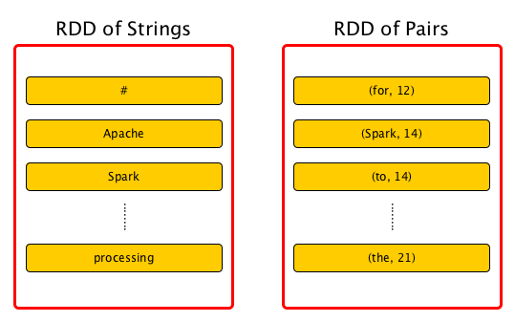
RDD Examples
RDD[String]
RDD[(String, Integer)]

Slide 9
RDD Partitions: Enable Parallel Transformations/Analytics
In the next slide:
There is an RDD[Integer] with 4 partitions:
RDD = { Partition-1, Partition-2, Partition-3, Partition-4 }
Partition-1: {1, 3}
Partition-2: {5, 7}
Partition-3: {9, 11}
Partition-4: {13, 15}
When we apply a transformation to this RDD: partitions can be transformed/analyzed in Parallel.

Slide 10
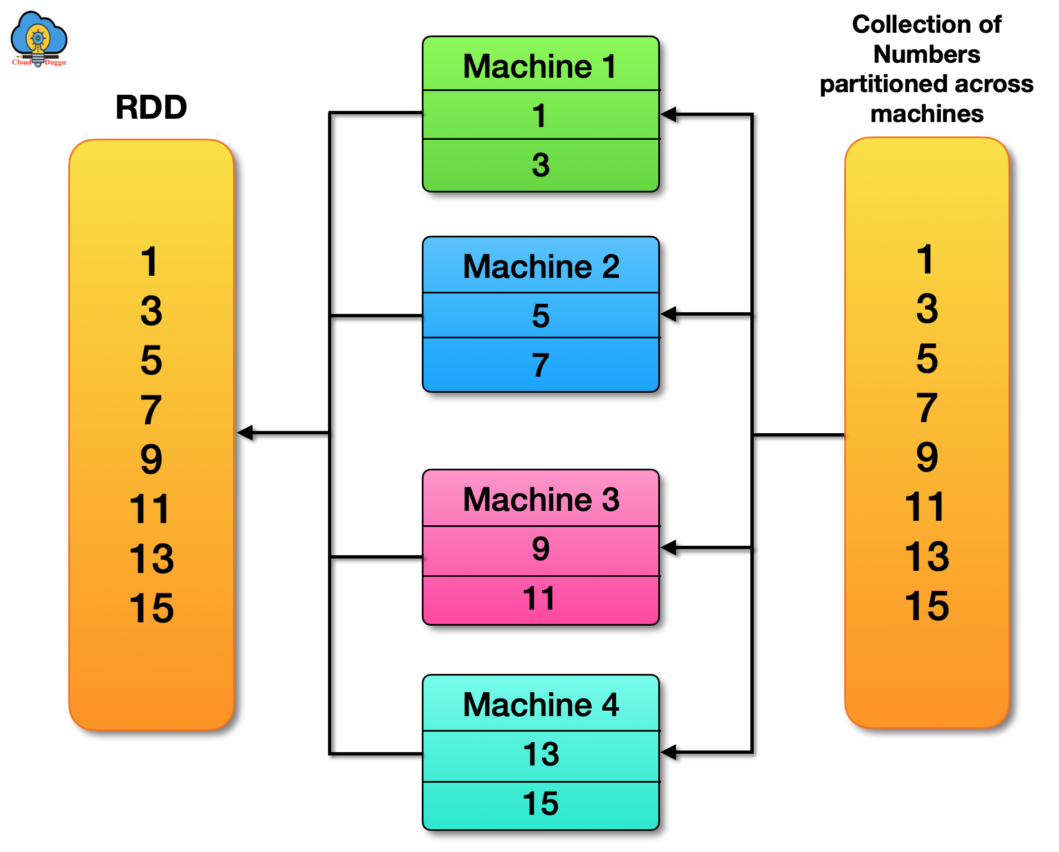
RDD Example: RDD[Integer] Partitioned

Slide 11
RDD Creation: from Python Collections
# 1. import required library
from pyspark.sql import SparkSession
# 2. create an instance of SparkSession
spark = SparkSession.builder.getOrCreate()
# 3. Create a Python collection
Numbers = [1, 3, 5, 7, 9, 11, 13, 15]
# 4. create an RDD[Integer] from a Python Collection
rdd = spark.sparkContext.parallelize(numbers)
# 5. get all elements as a list
rdd.collect()
[1, 3, 5, 7, 9, 11, 13, 15]

Slide 12
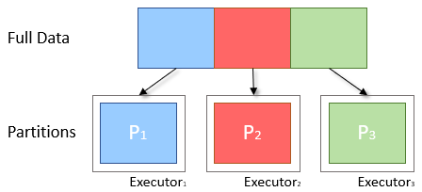
RDD Partitioning: Enables Parallelism

Slide 13
RDD Creation: Number of Partitions
# 1. import required library
from pyspark.sql import SparkSession
# 2. create an instance of SparkSession
spark = SparkSession.builder.getOrCreate()
# 3. create an RDD[Integer] from a Python Collection
rdd = spark.sparkContext.parallelize(range(0, 10,000,000))
# 4. count elements and get number of partitions
rdd.count()
10,000,000
# 5. find the number of partitions
rdd.getNumPartitions()
16
# each partition will have about 625000 elements
# 10,000,000 / 16 = 625000

Slide 14
RDD Summarized:
An RDD is the actual fundamental data Structure of Spark.
RDDs are immutable (Read-Only) collections of objects of varying types, which computes on the different nodes of a given cluster.
RDDs are the main logical data units in Spark.
RDDs are a distributed/partitioned collection of objects, which are stored in memory or on disks.

Slide 15
RDD Creation and Transformations
RDDs can be created from
Python collections,
Text files, ...
RDDs can created from transformations
target_rdd = source_rdd.<TRANSFORMATION>(func)
rdd2 = rdd.filter(lambda x: len(x) > 80)
rdd3 = rdd2.map(lambda x: (x, len(x)))

Slide 16
RDD Shorthand Notation
# spark denotes a SparkSession object
input_path = “/tmp/data7/”
rdd = spark.sparkContext.textFile(input_path)
rdd2 = rdd.filter(lambda x: len(x) > 80)
rdd3 = rdd2.map(lambda x: (x, len(x)))
OR
rdd3 = spark.sparkContext.textFile(input_path)
.filter(lambda x: len(x) > 80)
.map(lambda x: (x, len(x)))

Slide 17
RDD Shorthand Notation Penalty?
There is no performance Penalty for not writing short-hand notation.
The following are equivalent:
input_path = “/tmp/data7/”
rdd = spark.sparkContext.textFile(input_path)
rdd2 = rdd.filter(lambda x: len(x) > 80)
rdd3 = rdd2.map(lambda x: (x, len(x)))
OR
input_path = “/tmp/data7/”
rdd3 = spark.sparkContext.textFile(input_path)
.filter(lambda x: len(x) > 80)
.map(lambda x: (x, len(x)))

Slide 18
RDD Example: create RDD from a Python Collection
# create a Python collection
data = [1, 3, -9, 4, 7, -100, -200, 500, 79, 99]
# spark : an instance of SparkSession
# rdd: RDD[Integer]
# create an RDD[Integer] from array of integers
rdd = spark.sparkContext.parallelize(data)
rdd.count()
10
rdd.collect()
[1, 3, -9, 4, 7, -100, -200, 500, 79, 99]
# keep only positive elements
positives = rdd.filter(lambda n: n > 0)
positives.collect()
[1, 3, 4, 7, 500, 79, 99]

Slide 19
RDD Summary: RDD[T]
RDD is a low-level data abstraction in Spark
Each element is a data type of T
T can be any data type
Your data can be represented as an RDD
Python Collections
Text files, CSV files, log files, …
Unstructured and semi-structured data
RDD is a READ-ONLY: no synchronization is required
RDD is partitioned and distributed: parallelism
RDD is resilient: fault-tolerant: you will not lose data

Slide 20
RDD Example: create RDD from a Python Collection
# create an array of strings
data = [“fox is red”, “fox is gray”, “red fox”]
# spark : an instance of SparkSession
# rdd: RDD[String]
# create an RDD[String] from array of strings
rdd = spark.sparkContext.parallelize(data)
rdd.count()
3
rdd.collect()
[“fox is red”, “fox is gray”, “red fox”]

Slide 21
RDD Example: create RDD from a Text File
input_path = “/tmp/project77/samples.txt”
# let samples.txt to have 25,000,000,000 records
# spark : an instance of SparkSession
# rdd: RDD[String]
# create an RDD[String] from input path
rdd = spark.sparkContext.textFile(input_path)
rdd.count()
25,000,000,000

Slide 22
RDD map() Transformation
# source_rdd : RDD[V]
# target_rdd : RDD[T]
target_rdd = source_rdd.map(my_function)
# my_function() converts a V to T
def my_function(V):
return <convert-V-to-T>
#end-def

Slide 23
RDD Transformations Examples: 100 files
# ls –l /tmp/project77/
File_001.txt (has 500,000,000 records)
File_002.txt (has 500,000,000 records)
…
File_100.txt (has 500,000,000 records)
input_path = “/tmp/project77/”
# spark : an instance of SparkSession
# create rdd as RDD[String] from input path
rdd = spark.sparkContext.textFile(input_path)
rdd.count()
50,000,000,000

Slide 24
RDD Notation
RDD[Integer] : elements are integers
RDD[String] : elements are strings
RDD[(String, Integer)]: elements are (key, value) pairs
RDD[(String, Integer, Integer)]: elements are triplets
RDD[(String, (Integer, Integer, Integer))]: elements are (key, value) pairs
key is String
value is (Integer, Integer, Integer)

Slide 25
Demo of RDD Create your RDDs

