Slide 1
Map Transformation in PySpark
Mahmoud Parsian
Ph.D. in Computer Science

Slide 2
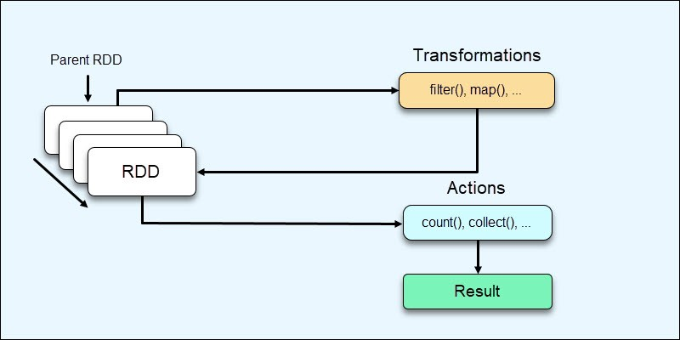
PySpark Operations: Transformations & Actions

Slide 3
PySpark Common Transformations
map(f)
1-to-1 transformation
filter(p)
Drops non-required elements
p is a Boolean predicate
flatMap(f)
1-to-Many transformation
mapValues(f)
map(f) is applied to V for (K, V) elements

Slide 4
map(): source_RDD → target_RDD
RDD.map(f, preservesPartitioning=False)
Return a new target RDD by applying a function to each element of this source RDD.
target_RDD = source_RDD.map(f)
If source_RDD has N elements then target_RDD will have exactly N elements

Slide 5
map(f): source_RDD → target_RDD
Return a new target RDD by applying a function f() to each element of this source RDD.
map(): is a 1-to-1 transformation
map(): source_RDD → f → target_RDD
target_RDD = source_RDD.map(f)
After applying map() transformation:
source_RDD.count() == target_RDD.count()

Slide 6
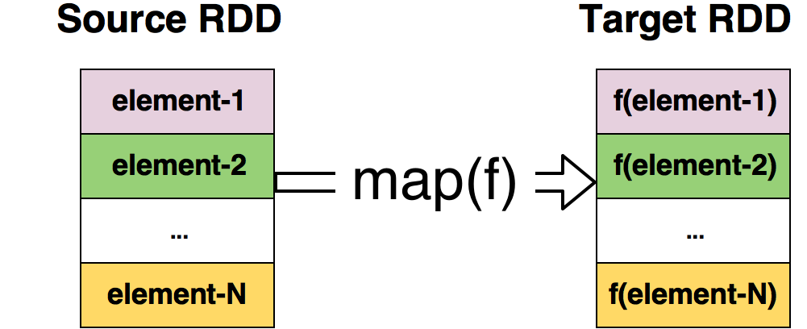
target_RDD = source_RDD.map(f)

Slide 7
Simple map() transformations: using lambda expression
Problem:
read a text file and then convert
all records to lowercase characters.
Solution:
Read data by textFile()
Apply map() transformation

Slide 8
Simple map() transformations: using lambda expression
map: source_RDD → target_RDD
# read a text file and create an RDD
# rdd1: RDD[String]
# spark : SparkSession
sc = spark.sparkContext
rdd1 = sc.textFile(”/tmp/data/samples.txt”)
# convert all characters to lowercase
# rdd2: RDD[String]
rdd2 = rdd1.map(lambda x: x.lower())

Slide 9
Simple map() transformations: using a function
def convert_to_lower(rec):
return rec.lower()
#end-def
# convert all characters to lowercase
# rdd2: RDD[String]
rdd2 = rdd1.map(convert_to_lower)

Slide 10
Simple map() transformations: using a function: Improved
def convert_to_lower(rec):
if (rec is None) or (len(rec) == 0): return None
return rec.lower()
#end-def
# convert all characters to lowercase
# drop elements, which are None
# rdd2: RDD[String]
rdd2 = rdd1.map(convert_to_lower)
.filter(lambda x: x is not None)

Slide 11
RDD operations: set of transformations
Problem:
Given
# rdd: RDD[String]
Convert it to
# rdd2: RDD[(String, Integer)]
# create (K, V) pairs: where
# K=record, V=len(record)

Slide 12
RDD operations: set of transformations
map(): source_RDD → target_RDD
# rdd: RDD[String]
# create (K, V) pairs:
# K=record, V=len(record)
# rdd2: RDD[(String, Integer)]
rdd2 = rdd.map(lambda x: (x, len(x)))
# rdd3: RDD[(String, Integer)]
rdd3 = rdd.map(lambda x: (x.lower(), len(x)))

Slide 13
PySpark parallelize() – then map()
>>> spark : SparkSession
>>> # create and RDD as rdd = RDD[Integer]
>>> rdd = spark.sparkContext.parallelize([1,2,2,2,4,4,5])
>>> # rdd : [1, 2, 2, 2, 4, 4, 5]
>>> unique = rdd.distinct()
>>> # unique : [1, 2, 4, 5]
>>> rdd2 = unique.map(lambda x : x+10)
>>> # rdd2 = [11, 12, 14, 15])
>>> rdd3 = rdd2.map(lambda x: (x, 1))
>>> # rdd3 : [(11, 1), (12, 1), (14, 1), (15, 1)]

Slide 14
map()– Create (Key, Value) pairs: using lambda expressions
# rdd : RDD[String]
# element format: <emp_id><,><dept_id><,><salary>
# create (emp_id, salary) pairs
# this function creates (emp_id, salary) pair
def create_pair(rec):
tokens = rec.split(“,”)
emp_id = tokens[0]
# dept_id = tokens[1] => NOT USED
salary = int(tokens[2])
return (emp_id, salary)
#end-def
>>> # create (emp_id, salary) pairs
>>> # rdd2: RDD[(String]
>>> rdd2 = rdd.map(lambda rec: create_pair(rec))

Slide 15
map()– Create (Key, Value) pairs: using function
# rdd : RDD[String]
# element format: <emp_id><,><dept_id><,><salary>
# create (emp_id, salary) pairs
# this function creates (emp_id, salary) pair
def create_pair(rec):
tokens = rec.split(“,”)
emp_id = tokens[0]
salary = int(tokens[2])
return (emp_id, salary)
#end-def
>>> # create (emp_id, salary) pairs
>>> # rdd2: RDD[(String]
>>> rdd2 = rdd.map(create_pair)

Slide 16
Find Average of Gene values
# SparkSession available as 'spark’.
# genes : RDD[String]
# element format: <gene_id><,><gene_value>
# example: ‘g23,1.45’
# genes = [‘g1,1.4’, ‘g1,1.2’, ‘g2,2.0’, ‘g2,3.2’, ‘g4,1.3’]
Step-1: create pairs as (gene_id, gene_value)
Step-2: find average of values per gene_id

Slide 17
find average of gene values – solution 1, step1
# create a (key, value) pair
def create_pair(rec):
tokens = rec.split(“,”)
gene_id = tokens[0]
gene_value = float(tokens[1])
return (gene_id, gene_value)
# end-def
# pairs : RDD[(String, Float)] = RDD[(gene_id, gene_value)]
pairs = rdd.map(create_pair)
OR
pairs = rdd.map(lambda rec: create_pair(rec))

Slide 18
find average of gene values – solution 1, step2
# pairs : RDD[(String, Float)] = RDD[(gene_id, gene_value)]
# grouped_by_gene_id : RDD[(gene_id, Iterable<gene_value)]
# grouped_by_gene_id :
# [(“g1”, [1.4, 1.2]), (“g2”, [2.0, 3.2], (“g4”, [1.3])]
grouped_by_gene_id = pairs.groupByKey()
# debug:
grouped_by_gene_id.mapValues(lambda values: list(values)).cpllect()
# Now find average:
# avg_by_gene_id = [(“g1”, 1.3), (“g2”, 2.6), (“g4”, 1.3)]
avg_by_gene_id = grouped_by_gene_id.mapVaues(
lambda values: sum(values)/len(values)
)

Slide 19
find average of gene values – solution 1, step2 explained
# [(“g1”, [1.4, 1.2]), (“g2”, [2.0, 3.2], (“g4”, [1.3])]
grouped_by_gene_id = pairs.groupByKey()
# Now find average:
# avg_by_gene_id = [(“g1”, 1.3), (“g2”, 2.6), (“g4”, 1.3)]
avg_by_gene_id = grouped_by_gene_id.mapVaues(
lambda values: sum(values)/len(values)
)
(g1, [1.4, 1.2]) -> (g1, (1.4 + 1.2)/2) -> (g1, 1.3)
(g2, [2.0, 3.2]) -> (g2, (2.0 + 3.2)/2) -> (g2, 2.6)
(g4, [1.3]) -> (g4, (1.3)/1) -> (g4, 1.3)

Slide 20
find average of gene values – solution 1, step2 explained
# [(“g1”, [1.4, 1.2]), (“g2”, [2.0, 3.2], (“g4”, [1.3])]
grouped_by_gene_id = pairs.groupByKey()
# Now find average: Using a function
def find_average(values):
return sum(values)/len(values)
#end-def
# avg_by_gene_id = [(“g1”, 1.3), (“g2”, 2.6), (“g4”, 1.3)]
avg_by_gene_id = grouped_by_gene_id.mapVaues(find_average)
(g1, [1.4, 1.2]) -> (g1, (1.4 + 1.2)/2) -> (g1, 1.3)
(g2, [2.0, 3.2]) -> (g2, (2.0 + 3.2)/2) -> (g2, 2.6)
(g4, [1.3]) -> (g4, (1.3)/1) -> (g4, 1.3)

Slide 21
Find total salary
Let rdd: RDD[(emp_id, salary, bonus)]
Then find total salary per employee
total_salary = salary + bonus
The new RDD will be [(emp_id, total_salary)]

Slide 22
Find total salary: 1. Create an RDD
# rdd: RDD[(emp_id, salary, bonus)]
# sc : spark.SparkContext
data = [(100, 23000, 2000),
(200, 33000, 5000),
(300, 28000, 1000),
(400, 65000, 4000)]
rdd = sc.parallelize(data)
rdd.count()
4

Slide 23
Find total salary: 2. map() using Lambda Expression
# rdd: RDD[(emp_id, salary, bonus)]
# x : (emp_id, salary, bonus) = (x[0], x[1], x[2])
rdd2 = rdd.map(lambda x:
(x[0], x[1]+x[2])
)
rdd2.collect()
[
(100, 25000),
(200, 38000),
(300, 29000),
(400, 69000)
]

Slide 24
Find total salary: 2. map() using function
# rdd: RDD[(emp_id, salary, bonus)]
# x : (emp_id, salary, bonus) = (x[0], x[1], x[2])
def find_total_salary(x):
return (x[0], x[1]+x[2])
#end-def
rdd2 = rdd.map(find_total_salary)
rdd2.collect()
[
(100, 25000),
(200, 38000),
(300, 29000),
(400, 69000)
]

Slide 25
Filtering in Spark
RDD.filter(f)
Return a new RDD containing only the elements that satisfy a Boolean predicate.
Boolean predicate : Function f returns True or False

Slide 26
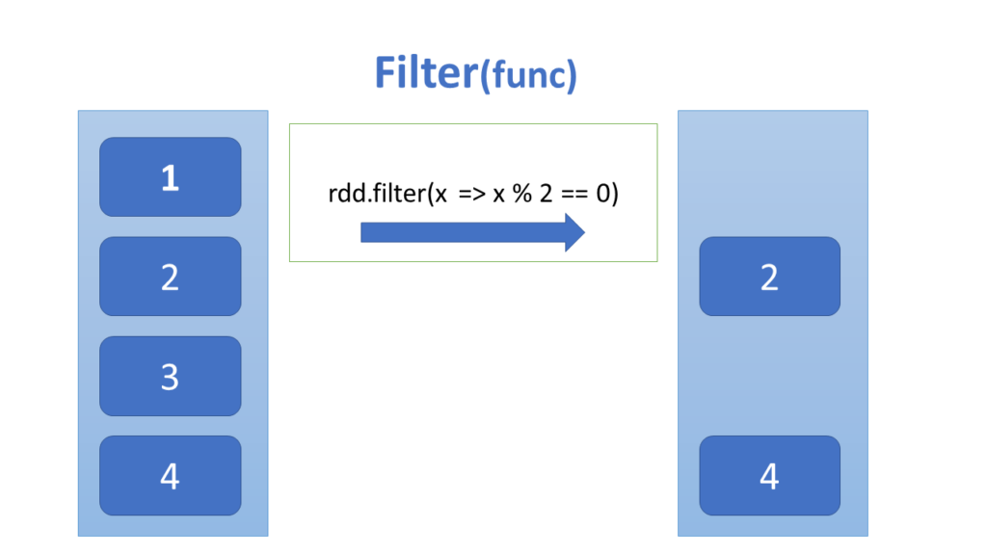
Filtering in Spark: RDD.filter(f)

Slide 27
PySpark parallelize() – Create RDD from a text file
$ cat /tmp/foxdata.txt
a red fox jumped of high
fox jumped over a high fence
red of fox jumped

Slide 28
Filter example 1: use Lambda Expressions
>>> input_path = /tmp/foxdata.txt”
>>> # records : RDD[String]
>>> records = spark.sparkContext.textFile(input_path)
>>> records.collect()
['a red fox jumped of high’, 'fox jumped over a high fence’, 'red of fox jumped']
>>> records.count()
3
>>> # filtered : RDD[String]
>>> filtered = records.filter(lambda rec: "jumped" in rec)
>>> filtered.collect()
['a red fox jumped of high', 'fox jumped over a high fence', 'red of fox jumped']
>>> filtered2 = records.filter(lambda rec: "red" in rec)
>>> filtered2.collect()
['a red fox jumped of high', 'red of fox jumped']

Slide 29
Filter example 1: use Functions
def contains_string(substring, record):
return substring in record
#end-def
>>> input_path = /tmp/foxdata.txt”
>>> # records : RDD[String]
>>> records = spark.sparkContext.textFile(input_path)
>>> records.collect()
['a red fox jumped of high’, 'fox jumped over a high fence’, 'red of fox jumped']
>>> records.count()
3
>>> # filtered : RDD[String]
>>> filtered = records.filter(lambda rec: contains_string(”red”, rec))
>>> filtered.collect()
['a red fox jumped of high', 'fox jumped over a high fence', 'red of fox jumped']
>>> filtered2 = records.filter(lambda rec: contains_string("jumped”, rec))
>>> filtered2.collect()
['a red fox jumped of high', 'red of fox jumped']

Slide 30
Filter example 2
>>> inputs = [-5, -7, 1, 2, 2, 3, 3, 8, 8, 9, 9]
>>> # records : RDD[Integer]
>>> nums = spark.sparkContext.parallelize(inputs)
>>> greater_than_5 = nums.filter(lambda x: x > 5)
>>> # greater_than_5 : [8, 8, 9, 9]
>>> less_than_0 = nums.filter(lambda x: x < 0)
>>> # less_than_0 : [-5, -7]
>>> greater_than_10 = nums.filter(lambda x: x > 10)
>>> # greater_than_10 : []

Slide 31
target_RDD = source_RDD.flatMap(f)
RDD.flatMap(f, preservesPartitioning=False)
Return a new RDD by first applying a function to all elements of this RDD, and then flattening the results.
flatMap(): 1-to-Many transformation
flatMap(): source_RDD → f → target_RDD
source_RDD.count() and targe_RDD.count() can be very different

Slide 32
flatMap() Example 1
>>> inputs = [ [-5, -7], [], [1, 2, 3], [8, 9], [] ]
>>> # nums : RDD[[Integer]]
>>> # spark : a SparkSession object
>>> nums = spark.sparkContext.parallelize(inputs)
>>> nums.count()
5
>>> flattened = nums.flatMap(lambda x: x)
>>> # flattened : [ -5, -7, 1, 2, 3, 8, 9]
>>> flattened.count()
7

Slide 33
flatMap() Example 1: what happened
[-5, -7] –-maps--> to 2 elements of target RDD
[] --maps--> to None (dropped)
[1, 2, 3] --maps--> to 3 elements of target RDD
[8, 9] –-maps--> to 2 elements of target RDD
[] --maps--> to None (dropped)
Therefore, target RDD will have 7 elements:
[-5, -7, 1, 2, 3, 8, 9]

Slide 34
flatMap() Example 1: Explanation
NOTE: empty lists [] are dropped
>>> inputs = [ [-5, -7], [], [1, 2, 3], [8, 9], [] ]
>>> # nums : RDD[[Integer]]
>>> nums = spark.sparkContext.parallelize(inputs)
>>> nums.count()
5
>>> flattened = nums.flatMap(lambda x: x)
>>> # flattened : [ -5, -7, 1, 2, 3, 8, 9]
>>> flattened.count()
7

Slide 35
flatMap() vs. map()
>>> inputs = [ [-5, -7], [], [1, 2, 3], [8, 9], [] ]
>>> # nums : RDD[[Integer]] (each element is a list)
>>> nums = spark.sparkContext.parallelize(inputs)
>>> # nums.collect() = [ [-5, -7], [], [1, 2, 3], [9, 9], [] ]
>>> nums.count()
5
>>> flattened = nums.flatMap(lambda x: x)
>>> # flattened : [ -5, -7, 1, 2, 3, 8, 9]
>>> flattened.count()
7
>>> mapped = nums.map(lambda x: x)
>>> # mapped.collect() : [ [-5, -7], [], [1, 2, 3], [8, 9], [] ]
>>> mapped.count()
5

Slide 36
flatMap() Example 2
def fun2(x):
if x > 0: return [x, 2*x, 3*x]
else: return []
#end-def
>>> inputs = [-1, -2, 0, 3, 10, 50]
>>> # nums : RDD[Integer]
>>> nums = spark.sparkContext.parallelize(inputs)
>>> nums.count()
6
>>> flattened = nums.flatMap(fun2)
>>> # flattened : [ 3, 6, 9, 10, 20, 30, 50, 100, 150]
>>> flattened.count()
9

Slide 37
flatMap() Example 2: what happened?
>>> inputs = [-1, -2, 0, 3, 10, 50]
>>> nums = spark.sparkContext.parallelize(inputs)
>>> nums.count()
6
>>> flattened = nums.flatMap(fun2)
-1 → []
-2 → []
0 → []
3 → [3, 6, 9]
10 → [10, 20, 30]
50 → [50, 100, 150]
>>> # flattened : [ 3, 6, 9, 10, 20, 30, 50, 100, 150]
>>> flattened.count()
9

Slide 38
flatMap() Example 3
Let’s assume that input record has the following format:
<continent><,><country><,><city><,><temperature>
PROBLEM: The goal is to find
average Temperature per country, and
average Temperature per city.
Input files are:
/tmp/data/Temperature/usa.txt
/tmp/data/Temperature/canada.txt
…
/tmp/data/Temperature/india.txt

Slide 39
flatMap() Example 3.1
# define input path
input_path = “/tmp/data/Temperature/”
# create SparkSession object
from pyspark.sql import SparkSession
spark = SparkSession.builder.getOrCreate()
# create RDD[String] from input files
records = spark.sparkContext.textFile(input_path)
# create (KEY, VALUE) pairs such as
(Country, Temperature)
(City, Temperature)

Slide 40
flatMap() Example 3.2
def create_pairs(rec):
tokens = rec.split(“,”)
continent = tokens[0]
country = tokens[1]
city = tokens[2]
temperature = tokens[3]
KV1 = (country, temperature)
KV2 = (city, temperature)
return [KV1, KV2]
#end-def

Slide 41
flatMap() Example 3.3
# records : RDD[String]
# pairs : RDD[(String, Integer)]
pairs = records.flatMap(create_pairs)
# sample pairs will be as:
(USA, 30)
(Cupertino, 30)
(USA, 70)
(Cupertino, 70)
(USA, 40)
(Cupertino, 40)
(INDIA, 78)
(Mumbai, 78)
…

Slide 42
flatMap() Example 3.4 group by country/city
# records : RDD[String]
# pairs : RDD[(String, Integer)]
pairs = records.flatMap(create_pairs)
grouped = pairs.groupByKey()
# grouped: RDD[](String, Iterable<Integer>)]
(USA, [30, 40, 70, …])
(Cupertino, [30, 40, 70, 65, …])
(INDIA, [78, 80, 56, 90, …])
(Mumbai, [78, 80, 90, 67, …])
…

Slide 43
flatMap() Example 3.5 find AVG by country/city
grouped = pairs.groupByKey()
# grouped: RDD[(String, Iterable<Integer>)]
(USA, [30, 40, 70, …])
(Cupertino, [30, 40, 70, 65, …])
…
avg = grouped.mapValues(lambda values:
sum(values) / len(values)
)
# avg : RDD[(String, Integer)]
# (USA, 52)
# (Cupertino, 65)
# (INDIA, 68)
# (Mumbai, 75)
…

Slide 44
mapValues() Transformation
RDD.mapValues(f)
target_rdd = source_rdd.mapValues(f)
Pass each value in the key-value pair RDD through a map function without changing the keys; this also retains the original RDD’s partitioning.
source_RDD: RDD[(K, V)]
target_RDD: RDD[(K, T)]
Where:
f : V → T

Slide 45
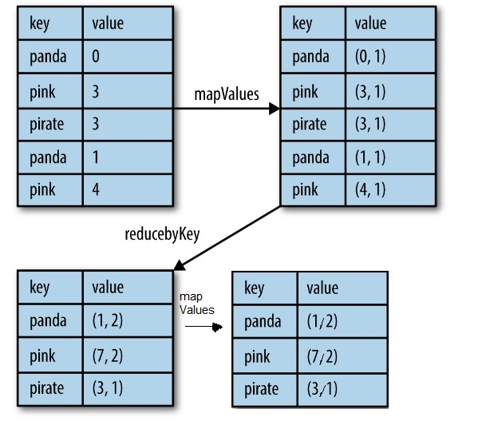
mapValues() Transformation: keys are unchanged Complete PySpark Solution: Next Slide

Slide 46
PySpark Solution for the previous slide
% /home/spark-3.3.1/bin/pyspark
Python 3.10.5 (v3.10.5:f377153967, Jun 6 2022, 12:36:10)
Welcome to Spark version 3.3.1
Spark context available as 'sc'
SparkSession available as 'spark'.
>>> pairs = [('panda', 0), ('pink', 3), ('pirate', 3), ('panda', 1), ('pink', 4)]
>>> rdd = sc.parallelize(pairs)
>>> rdd.collect()
[('panda', 0), ('pink', 3), ('pirate', 3), ('panda', 1), ('pink', 4)]
>>> rdd2 = rdd.mapValues(lambda v: (v, 1))
>>> rdd2.collect()
[('panda', (0, 1)), ('pink', (3, 1)), ('pirate', (3, 1)), ('panda', (1, 1)), ('pink', (4, 1))]
>>> reduced = rdd2.reduceByKey(lambda x, y: (x[0]+y[0], x[1]+y[1]))
>>> reduced.collect()
[('panda', (1, 2)), ('pink', (7, 2)), ('pirate', (3, 1))]
>>> final = reduced.mapValues(lambda x: float(x[0])/x[1])
>>> final.collect()
[('panda', 0.5), ('pink', 3.5), ('pirate', 3.0)]

Slide 47
mapValues() Transformation equivalent with map()
RDD.mapValues(f)
Pass each value in the key-value pair RDD through a map function without changing the keys; this also retains the original RDD’s partitioning.
target_RDD = source_RDD.mapValues(f)
source_RDD: RDD[(K, V)]
target_RDD: RDD[(K, T)]
Where:
f : V → T
# x : (K, V) : (x[0], x[1])
target_RDD = source_RDD.map(lambda x: (x[0], f(x[1])))

Slide 48
mapValues() Transformation Equivalent with map()
The following transformations (1) and (2) are equivalent:
source_RDD: RDD[(K, V)]
target_RDD: RDD[(K, T)]
Where:
f : V → T
# (1)
target_RDD = source_RDD.mapValues(f)
# (2)
# x : (K, V) : (x[0], x[1])
target_RDD = source_RDD.map(lambda x: (x[0], f(x[1])))

Slide 49
mapValues() Transformation: function f()
RDD.mapValues(f)
target_RDD = source_RDD.mapValues(f)
source_RDD: RDD[(K, V)]
target_RDD: RDD[(K, T)]
Where:
f : V → T
You can define function f as
a Python function
OR use a Lambda Expression

Slide 50
mapValues() Example 1
# spark : SparkSession object
tuples = [(“A”, 10), (“A”, 20), (“B”, 30)]
rdd = spark.sparkContext.parallelize(tuples)
# rdd : [(“A”, 10), (“A”, 20), (“B”, 30)]
# rdd.count(): 3
rdd2 = rdd.mapValues(lambda v: v * 10)
# rdd2 : [(“A”, 100), (“A”, 200), (“B”, 300)]
# rdd2.count(): 3
rdd3 = rdd.mapValues(lambda v: (v, 1))
# rdd3 : [(“A”, (10, 1)), (“A”, (20, 1)), (“B”, (30, 1))]
# rdd3.count(): 3

Slide 51
mapValues() Example 2
# spark : SparkSession object
tuples = [(“A”, [1,2]), (“A”, [3,4,5]), (“B”, [9])]
rdd = spark.sparkContext.parallelize(tuples)
# rdd : [(“A”, [1,2]), (“A”, [3,4,5]), (“B”, [9])]
# rdd.count(): 3
# FIND SUM and LENGTH of values
rdd2 = rdd.mapValues(lambda v: (sum(v), len(v)))
# rdd2 : [(“A”, (3, 2)), (“A”, (12, 3)), (“B”, (9, 1))]
# rdd2.count(): 3

Slide 52
mapValues() Example 3: use a function
def fun3(v):
return (sum(v), len(v))
#end-def
# spark : SparkSession object
tuples = [(“A”, [7,8]), (“A”, [3,4,5]), (“B”, [9])]
rdd = spark.sparkContext.parallelize(tuples)
# rdd : [(“A”, [7,8]), (“A”, [3,4,5]), (“B”, [9])]
# rdd.count(): 3
rdd2 = rdd.mapValues(fun3)
# rdd2 : [(“A”, (15, 2)), (“A”, (12, 3)), (“B”, (9, 1))]
# rdd2.count(): 3

Slide 53
Summary
Spark has a rich set of transformations such as mappers, filters, and reducers:
map(): 1-to-1
filter():
keep the desired elements
drop non-desired elements
flatMap(): 1-to-Many
mapValues(): apply a function to V of (K, V)

