Slide 1
RDD.filter(f) Filter Transformation in PySpark
Mahmoud Parsian
Ph.D. in Computer Science

Slide 2
PySpark Common Transformations
map(f)
1-to-1 transformation
filter(p)
Drops non-required elements
P is a Boolean predicate
flatMap(f)
1-to-Many transformation
mapValues(f)
map(f) is applied to V for (K, V) elements

Slide 3
Filtering in Spark
RDD.filter(f)
Return a new RDD containing only the elements that satisfy a Boolean predicate.
Function f() returns True or False
The main purpose of filter() transformation is to
Drop undesired elements
Keep desired elements:
which will be the elements of the new target RDD
target_rdd = source_rdd.filter(f)

Slide 4
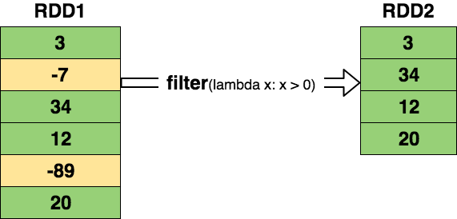
Filtering in Spark: PySpark Solution: Next Slide RDD2 = RDD1.filter(lambda x: x> 0)

Slide 5
PySpark Solution
# sc : SparkContext
numbers = [3, -7, 34, 12, -89, 20]
RDD1 = sc.parallelize(numbers)
RDD1.count()
6
RDD1.collect()
[3, -7, 34, 12, -89, 20]
RDD2 = RDD1.filter(lambda x: x > 0)
RDD2.count()
4
RDD2.collect()
[3, 34, 12, 20]

Slide 6
PySpark parallelize() – Create RDD from a text file
$ cat /tmp/foxdata.txt
a red fox jumped of high
fox jumped over a high fence
red of fox jumped

Slide 7
Filter example 1: use Lambda Expressions
>>> input_path = /tmp/foxdata.txt”
>>> # records : RDD[String]
>>> records = spark.sparkContext.textFile(input_path)
>>> records.collect()
['a red fox jumped of high’, 'fox jumped over a high fence’, 'red of fox jumped']
>>> records.count()
3
>>> # filtered : RDD[String]
>>> filtered = records.filter(lambda rec: "jumped" in rec)
>>> filtered.collect()
['a red fox jumped of high', 'fox jumped over a high fence', 'red of fox jumped']
>>> filtered2 = records.filter(lambda rec: "red" in rec)
>>> filtered2.collect()
['a red fox jumped of high', 'red of fox jumped']

Slide 8
Filter example 1: use Functions
def contains_string(substring, record):
return substring in record
#end-def
>>> input_path = /tmp/foxdata.txt”
>>> # records : RDD[String]
>>> records = spark.sparkContext.textFile(input_path)
>>> records.collect()
['a red fox jumped of high’, 'fox jumped over a high fence’, 'red of fox jumped']
>>> records.count()
3
>>> # filtered : RDD[String]
>>> filtered = records.filter(lambda rec: contains_string(”red”, rec))
>>> filtered.collect()
['a red fox jumped of high', 'fox jumped over a high fence', 'red of fox jumped']
>>> filtered2 = records.filter(lambda rec: contains_string("jumped”, rec))
>>> filtered2.collect()
['a red fox jumped of high', 'red of fox jumped']

Slide 9
Filter example 2
>>> inputs = [-5, -7, 1, 2, 2, 3, 3, 8, 8, 9, 9]
>>> # records : RDD[Integer]
>>> nums = spark.sparkContext.parallelize(inputs)
>>> nums2 = nums.filter(lambda x: x > 5)
>>> # nums2 : [8, 8, 9, 9]
>>> nums3 = nums.filter(lambda x: x < 0)
>>> # nums3 : [-5, -7]
>>> nums4 = nums.filter(lambda x: x > 10)
>>> # nums4 : []

Slide 10
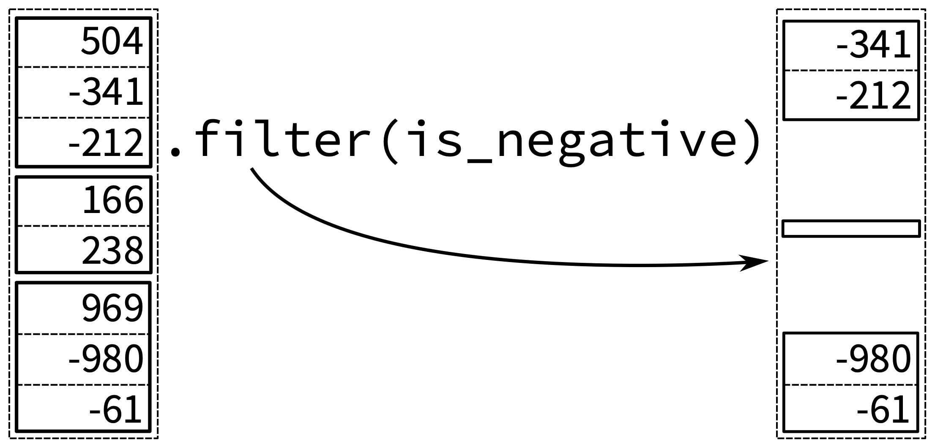
Filter example 3

Slide 11
Filter example 3: solution
# define a Boolean predicate:
# returns True OR False
def is_negative(n):
if n < 0:
return True
else:
return False
#end-def
numbers = [504, -341, -212, 166, 238, 969, -980, -61]
rdd = spark.sparkContext.parallelize(numbers)
rdd2 = rdd.filter(is_negative)
Rdd2.collect()
[-341, -212, -980, -61]

Slide 12
Summary
Spark has a rich set of transformations such as mappers, filters, and reducers
map(): 1-to-1
filter():
keep the desired elements
drop non-desired elements
flatMap(): 1-to-Many
mapValues(): apply a function to V of (K, V)

