Slide 1
RDD.flatMap(boolean-predicate) flatMap Transformation in PySpark
Mahmoud Parsian
Ph.D. in Computer Science

Slide 2
PySpark Common Transformations
map(f)
1-to-1 transformation
filter(p)
Drops non-required elements
P is a Boolean predicate
flatMap(f)
1-to-Many transformation
mapValues(f)
map(f) is applied to V for (K, V) elements

Slide 3
target_RDD = source_RDD.flatMap(f)
RDD.flatMap(f, preservesPartitioning=False)
Return a new RDD by first applying a function f()to all elements of this RDD, and then flattening the results.
map() : 1-to-1 transformation
flatMap(): 1-to-Many transformation

Slide 4
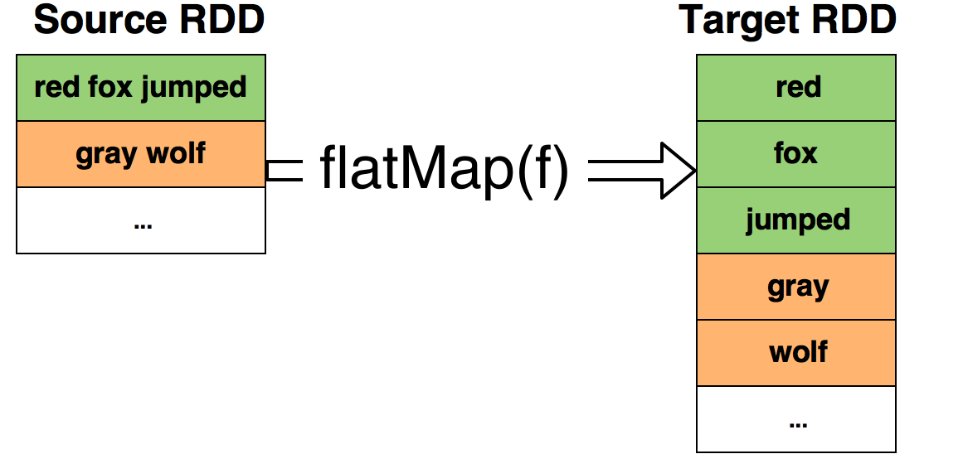
target_RDD = source_RDD.flatMap(f)

Slide 5
target_RDD = source_RDD.flatMap(f)
>>> sc
<SparkContext master=local[*] appName=PySparkShell>
>>> strings = ['red fox jumped', 'gray wolf']
>>> rdd = sc.parallelize(strings)
>>> rdd.count()
2
>>> rdd.collect()
['red fox jumped', 'gray wolf']
>>> flattened = rdd.flatMap(lambda x: x.split(" "))
>>> flattened.collect()
['red', 'fox', 'jumped', 'gray', 'wolf']
>>> flattened.count()
5

Slide 6
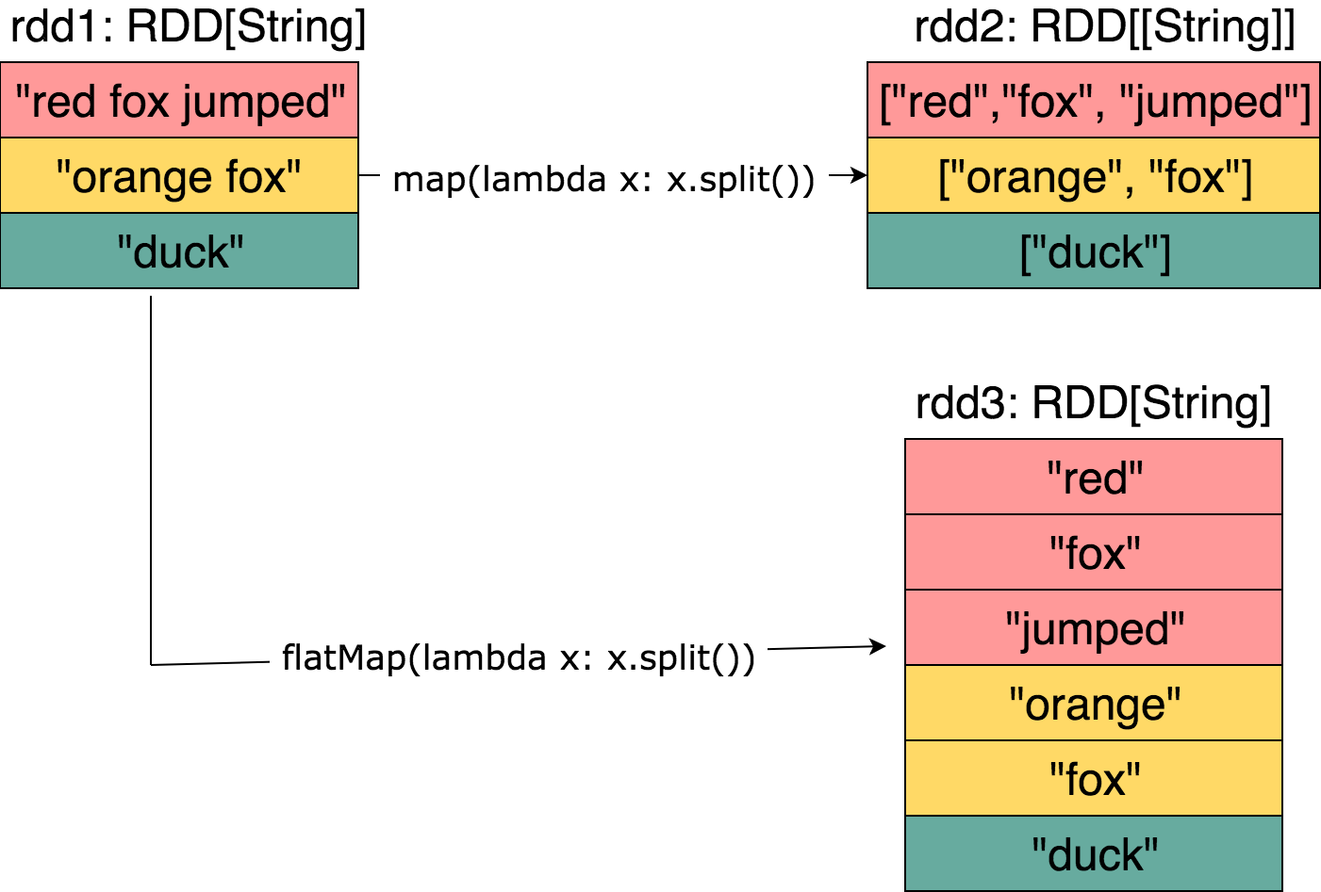
map() vs. flatMap()

Slide 7
target_RDD = source_RDD.flatMap(func)
RDD.flatMap(f, preservesPartitioning=False)
Return a new RDD by first applying a function f() to all elements of this RDD, and then flattening the results.
NOTE: source_RDD.count() and targe_RDD.count() can be very different

Slide 8
flatMap() Example 1
>>> # spark as SparkSession object
>>> inputs = [ [0, -5, -7], [], [1, 2, 3, 4], [6, 8], [] ]
>>> # nums : RDD[[Integer]]
>>> nums = spark.sparkContext.parallelize(inputs)
>>> nums.count()
5
>>> # NOTE: empty lists are dropped
>>> flattened = nums.flatMap(lambda x: x)
>>> # flattened : [0, -5, -7, 1, 2, 3, 4, 6, 8]
>>> flattened.count()
9

Slide 9
flatMap() Example 1: Explanation
NOTE: empty lists [] are dropped
[0, -5, -7] → maps to 3 elements {0, -5, -7}
[] → dropped
[1, 2, 3, 4] → maps to 4 elements {1, 2, 3, 4}
[6, 8] → maps to 2 elements {6, 8}
[] → dropped

Slide 10
flatMap() vs. map()
>>> inputs = [ [-5, -7], [1, 2, 3], [6, 7], [] ]
>>> # nums : RDD[[Integer]] (each element is a list)
>>> nums = spark.sparkContext.parallelize(inputs)
>>> # nums.collect() = [ [-5, -7], [1, 2, 3], [6, 7], [] ]
>>> nums.count()
4
>>> flattened = nums.flatMap(lambda x: x)
>>> # flattened : [ -5, -7, 1, 2, 3, 6, 7]
>>> flattened.count()
7
>>> mapped = nums.map(lambda x: x)
>>> # mapped.collect() : [ [-5, -7], [1, 2, 3], [6, 7], [] ]
>>> mapped.count()
4

Slide 11
flatMap() Example 2
def fun2(x):
if x > 0: return [x, 2*x, 3*x]
else: return []
#end-def
>>> # spark as a SparkSession object
>>> inputs = [100, -1, -2, 0, 3, 10]
>>> # nums : RDD[Integer]
>>> nums = spark.sparkContext.parallelize(inputs)
>>> nums.count()
6
>>> flattened = nums.flatMap(fun2)
>>> # flattened : [100, 200, 300, 3, 6, 9, 10, 20, 30]
>>> flattened.count()
9

Slide 12
flatMap() Example 2: what happened?
>>> inputs = [100, -1, -2, 0, 3, 10]
>>> nums = spark.sparkContext.parallelize(inputs)
>>> nums.count()
6
>>> flattened = nums.flatMap(fun2)
100 → [100, 200, 300]
-1 → []
-2 → []
0 → []
3 → [3, 6, 9]
10 → [10, 20, 30]
>>> # flattened : [100, 200, 300, 3, 6, 9, 10, 20, 30]
>>> flattened.count()
9

Slide 13
flatMap() Example 3
Let’s assume that input record has the following format:
<continent><,><country><,><city><,><temperature>
PROBLEM: The goal is to find
average Temperature per country, and
average Temperature per city.
Input files are:
/tmp/data/Temperature/usa.txt
/tmp/data/Temperature/canada.txt
…
/tmp/data/Temperature/india.txt

Slide 14
flatMap() Example 3.1
# define input path
input_path = “/tmp/data/Temperature/”
# create RDD[String] from input files
# spark as a SparkSession object
records = spark.sparkContext.textFile(input_path)
# create (KEY, VALUE) pairs such as
(Country, Temperature)
(City, Temperature)

Slide 15
flatMap() Example 3.2
def create_pairs(rec):
tokens = rec.split(“,”)
continent = tokens[0]
country = tokens[1]
city = tokens[2]
temperature = tokens[3]
KV1 = (country, temperature)
KV2 = (city, temperature)
return [KV1, KV2]
#end-def

Slide 16
flatMap() Example 3.3
# records : RDD[String]
# pairs : RDD[(String, Integer)]
pairs = records.flatMap(create_pairs)
# sample pairs will be as:
(USA, 30)
(Cupertino, 30)
(USA, 70)
(Cupertino, 70)
(USA, 40)
(Cupertino, 40)
(INDIA, 78)
(Mumbai, 78)
…

Slide 17
flatMap() Example 3.4 group by country/city
# records : RDD[String]
# pairs : RDD[(String, Integer)]
pairs = records.flatMap(create_pairs)
grouped = pairs.groupByKey()
# grouped: RDD[(String, Iterable<Integer>)]
(USA, [30, 40, 70, …])
(Cupertino, [30, 40, 70, 65, …])
(INDIA, [78, 80, 56, 90, …])
(Mumbai, [78, 80, 90, 67, …])
…

Slide 18
flatMap() Example 3.5 find AVG by country/city
grouped = pairs.groupByKey()
# grouped: RDD[(String, Iterable<Integer>)]
(USA, [30, 40, 70, …])
(Cupertino, [30, 40, 70, 65, …])
…
avg = grouped.mapValues(lambda values:
sum(values) / len(values)
)
# avg : RDD[(String, Integer)]
# (USA, 52)
# (Cupertino, 65)
# (INDIA, 68)
# (Mumbai, 75)
…

Slide 19
flatMap() Example: flattening Strings: are considered as Iterable
>>> # spark : SparkSession
>>> strings = ["abc", "xyzt", "", ""]
>>> rdd = spark.sparkContext.parallelize(strings)
>>> rdd.collect()
['abc', 'xyzt', '', '']
>>> rdd.count()
4
>>> rdd2 = rdd.flatMap(lambda x: x)
>>> rdd2.collect()
['a', 'b', 'c', 'x', 'y', 'z', 't']
>>> rdd2.count()
7

Slide 20
Summary
Spark has a rich set of transformations such as mappers, filters, and reducers
map(): 1-to-1
filter():
keep the desired elements
drop non-desired elements
flatMap(): 1-to-Many
mapValues(): apply a function to V of (K, V)

