Slide 1
Partitioning in Spark
Mahmoud Parsian
Ph.D. in Computer Science

Slide 2
What is Partitioning?
Partitioning is simply defined as dividing data into parts (chunks), in a distributed system.
Partitioning means, the division of the large dataset. Also, store them as multiple parts of the cluster.
Partitioning enables to process chunks in parallel.
data = { Partition-1, Partition-2, …, Partition-N}
Run Partitions in parallel

Slide 3
What is Spark Partitioning?
Spark partitioning is a way to split the data into multiple partitions (called chunks)
Spark executes transformations on multiple partitions in parallel and in-memory which allows completing the job faster.
You can also write partitioned data into a file system (multiple sub-directories) for faster reads by downstream systems.

Slide 4
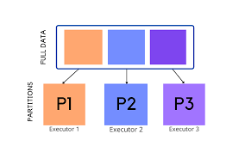
Spark Partitioning Example: 3 Partitions Each Partition {P1, P2, P3} can run in Parallel

Slide 5
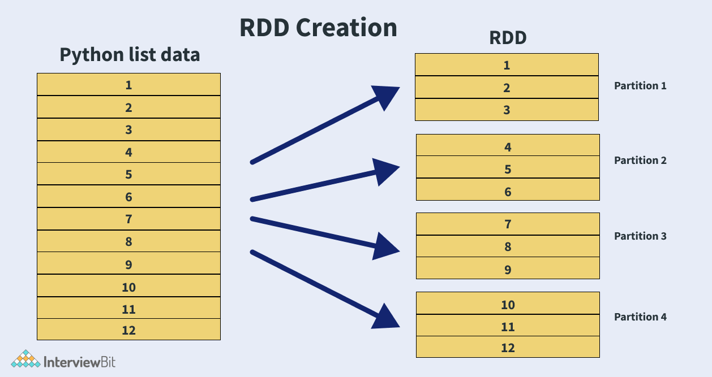
RDD Partitioning Example: 4 Partitions

Slide 6
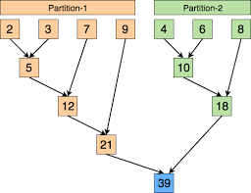
Partitions Enable Parallelism Partitions Run in Parallel

Slide 7
RDD Partitioning Example
Let an RDD to have 800,000,000,000 elements
Let number of partitions to be 40,000
Then each partition have about 20,000,000 elements
40,000 x 20,000,000 = 800,000,000,000
MAXIMUM parallelism is 40,000 tasks at a time
depends on the availability of resources in cluster

Slide 8
Understanding Basics of Partitioning
Create an RDD and examine the Partitions
>>># spark : SParkSession
>>> rdd = spark.sparkContext.parallelize(range(0,20))
>>> rdd.collect()
[0, 1, 2, 3, 4, 5, 6, 7, 8, 9, 10, 11, 12, 13, 14, 15, 16, 17, 18, 19]
>>> rdd.getNumPartitions()
16

Slide 9
Understanding Basics of Partitioning
Create a function to examine the content of Partition elements
# p denotes a single partition
>>> def debug_partition(p):
>>> print("partition elements=", list(p))
>>> #end-def

Slide 10
Understanding Basics of Partitioning
Examine the content of Partitions
>>> rdd.foreachPartition(debug_partition)
partition elements= [3, 4]
partition elements= [17]
partition elements= [6]
partition elements= [2]
partition elements= [10]
partition elements= [16]
partition elements= [5]
partition elements= [7]
partition elements= [11]
partition elements= [1]
partition elements= [0]
partition elements= [13, 14]
partition elements= [8, 9]
partition elements= [18, 19]
partition elements= [15]
partition elements= [12]

Slide 11
Understanding Basics of Partitioning
RePartition RDD Using RDD.coalesce(numPartitions)
RDD.coalesce(numPartitions):
Return a new RDD that is reduced into numPartitions partitions.
>>> rdd2 = rdd.coalesce(5)
>>> rdd2.getNumPartitions()
5
>>> rdd2.foreachPartition(debug_partition)
partition elements= [11, 12, 13, 14]
partition elements= [15, 16, 17, 18, 19]
partition elements= [0, 1, 2]
partition elements= [3, 4, 5, 6]
partition elements= [7, 8, 9, 10]

Slide 12
Understanding Basics of Partitioning: repartition
RDD.repartition(numPartitions):
Return a new RDD that has exactly numPartitions partitions.
>>> rdd3 = rdd2.repartition(4)
>>> rdd3.foreachPartition(debug_partition)
partition elements= [3, 4, 5, 6]
partition elements= [15, 16, 17, 18, 19]
partition elements= [0, 1, 2]
partition elements= [7, 8, 9, 10, 11, 12, 13, 14]
>>> rdd3.getNumPartitions()
4

Slide 13
References and Further Reading
Spark Partitioning & Partition Understanding
https://sparkbyexamples.com/spark/spark-partitioning-understanding/
Apache Spark Partitioning and Spark Partition
https://techvidvan.com/tutorials/spark-partition/
Data Algorithms with Spark (book) by Mahmoud Parsian

