Slide 1
RDD.mapPartitions(f) mapPartitions() in PySpark
Mahmoud Parsian
Ph.D. in Computer Science

Slide 2
PySpark Summarization Data Design Pattern
RDD.mapPartitions(f, preservesPartitioning=False)
Return a new RDD by applying a function f to each partition of this RDD.
mapPartitions(f)
target_RDD = source_RDD.mapPartitions(f)
f() is a custom function, accepting a single partition (comprised of thousands or millions) of source_RDD and returning a single element of targe_RDD
If source_RDD.getNumPartitions() = N
Then target_RDD.count() = N
Therefore, thousands or millions of source_RDD elements will be mapped to a single element of target_RDD.

Slide 3
PySpark Summarization Data Design Pattern
RDD.mapPartitions(f, preservesPartitioning=False)
Return a new RDD by applying a function f to each partition of this RDD.
mapPartitions(f)
Target_RDD = Source_RDD.mapPartitions(f)
Many-to-Many transformation
Each partition is mapped into an element of type T
T
Can be a simple data type (String, Integer, …)
Dictionary
Array/List
Tuple of N elements
…

Slide 4
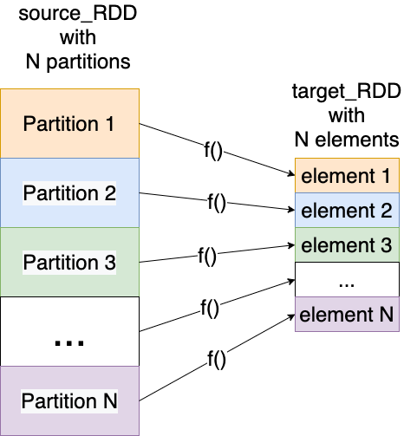
target_RDD = source_RDD.mapPartitions(f)

Slide 5
API: target_RDD = source_RDD.mapPartitions(f)
source_RDD has 800,000,000,000 elements (very big)
Number of partitions: 20,000
Maximum parallelism: 20,000 mappers executing f()
Average number of elements per partition: 40,000,000
800,000,000,000 = 20,000 x 40,000,000
target_RDD will have 20,000 elements (very small)

Slide 6
Implementation: target_RDD = source_RDD.mapPartitions(f)
source_RDD exists with N partitions
Define function f() in Python
def f(partition):
for element in partition:
<process element>
#end-for
return <one-element-for target_RDD>
#end-def
Then execute:
target_RDD = source_RDD.mapPartitions(f)
# target_RDD.count(): N

Slide 7
target_RDD = source_RDD.mapPartitions(f)
def f(partition):
for element in partition:
<process element>
#end-for
return <one-element-for target_RDD>
#end-def
Function f(partition) summarizes a partition (comprised of thousands or millions of source_RDD elements) into a single target element.

Slide 8
mapPartitions(): Scenarios
1. Given billions of numbers, find (count, minimum, maximum) for all numbers
2. Given billions of numbers, find (count, num_of_positives, num_of_negeative) for all numbers
3. Given billions of (web_query, frequency),
find top-10 web-queries
4. Given billions of numbers, find all Prime numbers

Slide 9
mapPartitions(): Examples-2
Given a sequence of DNA strings as
{A, T, C, G}, find base count for DNA
Input billions of DNA code
output:
DNA Code | Frequency
A | 1,346,400,500
T | 1,789,999,345
C | 670,000,897
G | 129,000,945

Slide 10
mapPartitions(): How does it Work?
Scenario:
Input dataset: billions of numbers
Find (count, minimum, maximum) for all numbers
This is a summarization data design pattern: you want to transform billions of numbers into a single triplet:
(count, minimum, maximum)

Slide 11
Solution-1: Sequential Processing in Python: will not scale-out
1. import sys
2. def find_min_max(file_name)
3. final_count = 0
4. final_min = sys.maxsize
5. final_max = -sys.maxsize
6. # iterate records
7. with open(file_name) as f:
8. for line in f:
9. num = int(trim(line))
10. final_count += 1
11. final_min = min(num, final_min)
12. final_max = max(num, final_max)
13. #end-for
14. #end-with
15. return (final_count, final_min, final_max)
16. #end-def

Slide 12
Solution-1: Sequential Processing in Python: small vs. large
The Python solution will work for small and medium size data: 100 million numbers
The Python solution will NOT work for large or huge size data: 100 billion numbers.
What about 100 Trillion numbers?
Million = 10⁶ = 1000,000
Billion = 10⁹ = 1000,000,000
Trillion = 10¹² = 1000,000,000,000

Slide 13
mapPartitions(): How does it Work?
def custom_function(partition):
for v in partition:
<process v>
#end-for
return <result-as-an-element-of-target-RDD>
#end-def
# source_rdd has N partitions
target_rdd = source_rdd.mapPartitions(custom_function)
target_rdd = [result_1, result_2, …, result_N]

Slide 14
mapPartitions(): How does it Work?

Slide 15
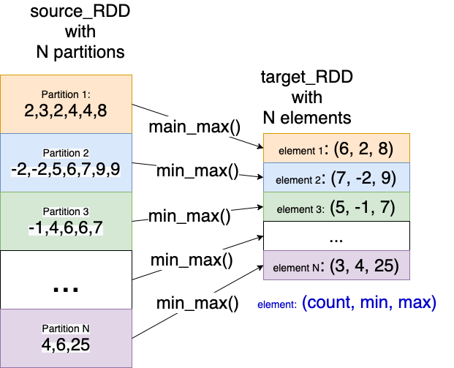
mapPartitions(): How does it Work?

Slide 16
mapPartitions(): How does it Work?
# source_rdd has N partitions
target_rdd = source_rdd.mapPartitions(custom_function)
# target_rdd = [result_1, result_2, …, result_N]
# target_rdd =
[
(count_1, min_1, max_1),
(count_2, min_2, max_2),
…,
(count_N, min_N, max_N)
]

Slide 17
mapPartitions(): How does it Work?
target_rdd =
[
(count_1, min_1, max_1),
(count_2, min_2, max_2),
…,
(count_N, min_N, max_N)
]
count = count_1 + count_2 + … + cont_N
minimum = min(min_1, min_2, …, min_N)
maximum = max(max_1, max_2, …, max_N)
final_result = (count, minimum, maximum)

Slide 18
mapPartitions(): How does it Work?
1. # x = (count_1, min_1, max_1)
2. # y = (count_2, min_2, max_2)
3. def add_triplets(x, y):
4. local_count = x[0] + y[0]
5. local_min = min(x[1], y[1])
6. local_max = max(x[2], y[2])
7. return (local_count, local_min, local_max)
8. #end-def
# final reduction: to summarize all
final_result = target_rdd.reduce(add_triplets)

Slide 19
mapPartitions(): How does reduce() Work?
Partition-1:
(2, -2, 4)
(3, -3, 3)
Partition-2:
(4, -1, 6)
(5, 0, 8)
(5, 1, 9)

Slide 20
mapPartitions(): How does reduce() Work?
Partition-1:
(2, -2, 4)
(3, -3, 3)
reduce(Partition-1): ➔ (5, -3, 4)
Partition-2:
(4, -1, 6)
(5, 0, 8)
(5, 1, 9)
reduce(Partition-2): ➔ (14, -1, 9)
reduce(Partition-1, Partition-2) ➔ (19, -3, 9)

Slide 21
Writing custom_function()
1. import sys
2. # partition : single partition with millions of numbers
3. def custom_function(partition):
4. local_count = 0
5. local_min = sys.maxsize
6. local_max = -sys.maxsize
7. # iterate partition one element/number in a time
for num in partition:
int_num = int(num.strip())
9. local_count += 1
10. local_min = min(int_num, local_min)
11. local_max = max(int_num, local_max)
12. #end-for
13. return [(local_count, local_min, local_max)]
14. #end-def

Slide 22
Final solution:
# step-1: define input path (your data files)
input_path = /tmp/data/project7/
# step-2: read all input and create an RDD
# spark : SparkContext
# rdd : RDD[String], assume rdd has N partitions
rdd = spark.sparkContext.textFile(input_path)
# step-3: apply mapPartitions() transformation
# triplets = [(count_1, min_1, max_1), …, (count_N, min_N, max_N)]
triplets = rdd.mapPartitions(custom_function)
# step-4: find the final result
final_result = triplets.reduce(add_triplets)
# final_result = (count, minimum, maximum)

Slide 23
Complete Solution of mapPartitions()
Link to Complete Solution of mapPartitions():
https://github.com/mahmoudparsian/data-algorithms-with-spark/tree/master/code/bonus_chapters/mappartitions/python/

Slide 24
Summary
Spark has a rich set of transformations such as mappers, filters, and reducers.
mapPartitions():
Is a summarization data design pattern
Convert each partition (comprised of thousands or millions of elements) of source RDD into a single element of target RDD

