Slide 1
Reducers in PySpark
Mahmoud Parsian
Ph.D. in Computer Science

Slide 2
Outline
What is a reduction
What is reduction of (key, value) pairs
RDD’s Reduction Transformations:
groupByKey()
reduceByKey()
aggregateByKey()
combineByKey()

Slide 3
What is a Reduction?
According to dictionary:
the action or fact of making a specified thing smaller
or less in amount, degree, or size.
2. a thing that is made smaller or less in size or amount.

Slide 4
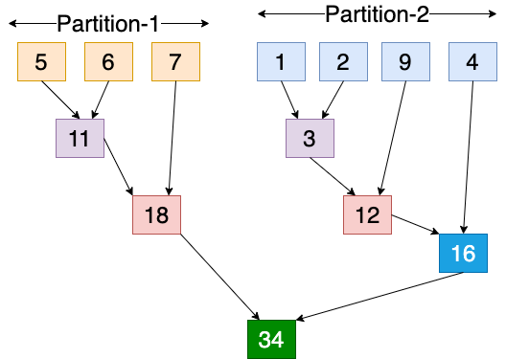
Reduction in Action: Add numbers in 2 Partitions

Slide 5
What is a Reduction Scenario?
Given a set of numbers,
Find average of these numbers
Find median of these numbers
Find standard deviation of these numbers
Find top-10 of these numbers
Find (minimum, maximum) of these numbers

Slide 6
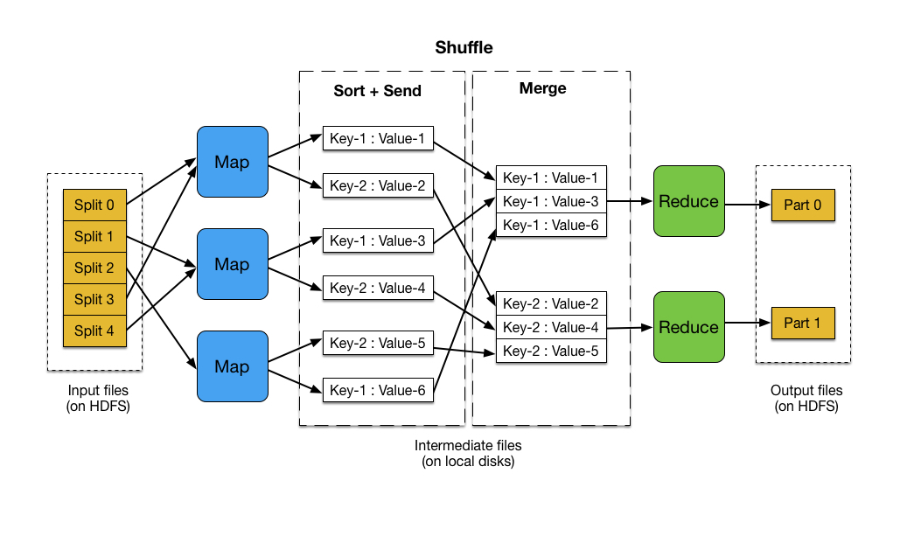
Reduction in MapReduce: Example-1

Slide 7
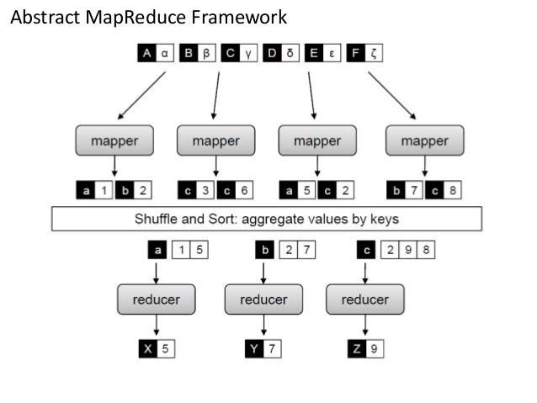
Reduction in MapReduce: Example-2

Slide 8
What is a Reduction Example?
Given a set of integer numbers: {4, 2, 2, 8, 3, 10, 6}
Find average of these numbers
Step-1: add these numbers: 35
Step-2: divide sum be length: 35/7 = 5.0
Find median of these numbers
Step-1: sort these numbers:
{2, 2, 3, 4, 6, 8, 10}
Step-2: get the middle number: 4

Slide 9
What is a Reduction Example? Partitioned?
Given a set of integer numbers: {4, 2, 2, 8, 3, 10, 6}
Find average of these numbers
Step-1: add these numbers: 35
Step-2: divide sum be length: 35/7 = 5.0
Partition-1: {4, 2, 2, 8} → 16
Partition-2: {3, 10, 6} → 19
Add(Partition-1, Partition-2) → 35

Slide 10
What is a Reduction Example? Partitioned?
Given a set of integer numbers: {4, 2, 2, 8, 3, 10, 6}
Find average of these numbers
Step-1: add these numbers: 35
Step-2: divide sum be length: 35/7 = 5.0
P1: Partition-1: {4, 2} → 6
P2: Partition-2: {2, 8, 3} → 13
P3: Partition-3: {10, 6} → 16
Add(P1, P2, P3) → Add(P1, Add(P2, P3)
Add(6, 29)
35

Slide 11
What is a Reduction Example? Partitioned?
Given a set of integer numbers: {4, 2, 2, 8, 3, 10, 6}
Find average of these numbers
Step-1: add these numbers: 35
Step-2: divide sum be length: 35/7 = 5.0
P1: Partition-1: {4, 2} → 6
P2: Partition-2: {2, 8} → 10
P3: Partition-3: {3, 10} → 13
P4: Partition-4: {6}
Add(P1, P2, P3, P4) → Add(P1, Add(P2, P3, P4))
Add(P1, Add(P2, Add(P3, P4)))
Add(6, Add(10, Add(13, 6)))
Add(6, Add(10, 19))
Add(6, 29)
35

Slide 12
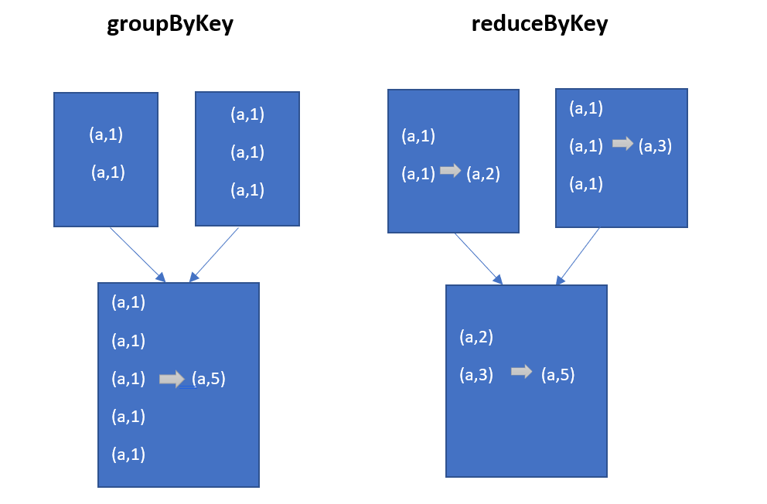
Reduction Example in Spark

Slide 13
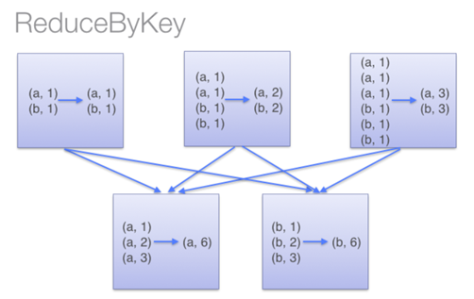
Reduction Example in Spark

Slide 14
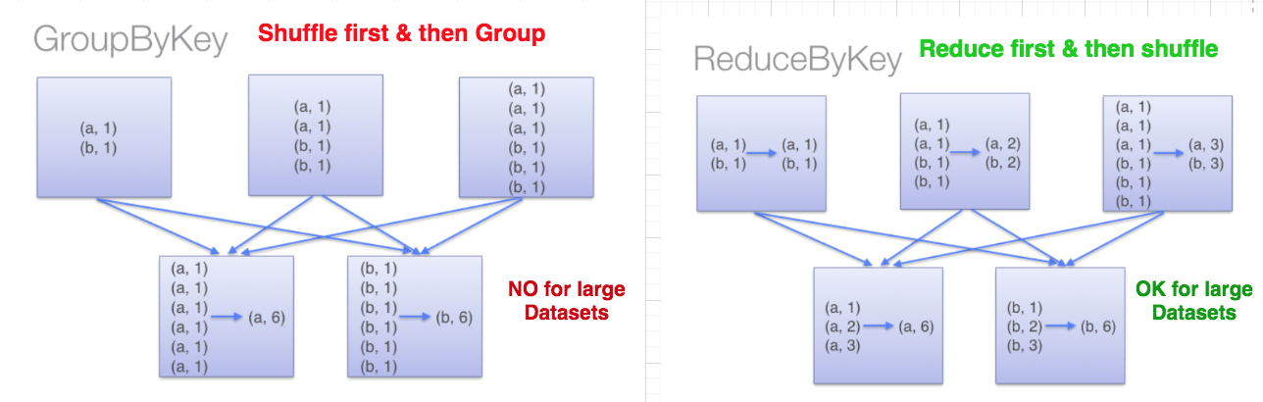
Reduction Example in Spark

Slide 15
What is a Reduction of (key, value) pairs?
Consider a set of billions of (key, value) pairs:
(gene_1, 2.0)
(gene_1, 3.0)
(gene_2, 4.0)
(gene_2, 5.0)
(gene_2, 3.0)
…
What is the average per gene?

Slide 16
What is a Reduction of (key, value) pairs?
Consider a set of billions of (key, value) pairs:
(gene_1, 2.0), (gene_1, 3.0)
(gene_2, 4.0), (gene_2, 5.0), (gene_2, 3.0)
What is the average per gene?
Step-1: Group by gene
(gene-1, [2.0, 3.0])
(gene-2, [4.0, 5.0, 3.0])
Step-2: Perform a reduction per (key, value)

Slide 17
What is a Reduction of (key, value) pairs?
Consider a set of billions of (key, value) pairs:
What is the average per gene?
Step-1: Group by gene
(gene-1, [2.0, 3.0])
(gene-2, [4.0, 5.0, 3.0])
Step-2: Perform a reduction per (key, value)
(gene-1, (2.0+3.0)/2) → (gene-1, 2.5)
(gene-2, (4.0+5.0+3.0)/3) → (gene-2, 4.0)
Final Result: {(gene-1, 2.5), (gene-2, 4.0)}

Slide 18
PySpark’s RDD Reduction Transformations
groupByKey()
reduceByKey()
aggregateByKey()
combineByKey()

Slide 19
RDD.groupByKey() Transformation
Group the values for each key in the RDD into a single sequence (as Iterable of values)
Given
RDD = [(A, v1), (A, v2), (A, v5), (A, v6),
(B, x), (B, y), (C, z)]
Then
RDD.groupByKey() ➔ Creates a NEW target RDD as:
[
(A, [v1, v2, v5, v6]),
(B, [x, y]),
(C, [z])
]

Slide 20
RDD.groupByKey() Example
Given
RDD = [(A, 3), (A, 4), (A, 5), (A, 6),
(B, 10), (B, 20), (C, 8)]
Then find average per key
grouped = RDD.groupByKey()
avg_per_key = grouped.mapValues(
lambda values: float(sum(values)) / len(values)
)
avg_per_key = [(A, 4.5), (B, 15), (C, 8)]

Slide 21
Summary
Spark has a rich set of reduction transformations:
groupByKey(): groups values by a key
reduceByKey(): Merge the values for each key using an associative and commutative reduce function.
aggregateByKey(): Aggregate the values of each key, using given combine functions and a neutral “zero value”.
combineByKey(): Generic function to combine the elements for each key using a custom set of aggregation functions.

Slide 22
Reading on reductions (links to URLs)
1.RDD.groupByKey() Examples
2. Duplicate Removal in RDD PySpark

