Slide 1
RDD.groupByKey() Reducer in PySpark
Mahmoud Parsian
Ph.D. in Computer Science

Slide 2
Outline
What is reduction of (key, value) pairs
Reduction Transformations:
groupByKey()
reduceByKey()
aggregateByKey()
combineByKey()

Slide 3
What is a Reduction of (key, value) pairs?
Consider a set of billions of (key, value) pairs:
(gene_1, 2.0)
(gene_1, 3.0)
(gene_2, 4.0)
(gene_2, 5.0)
(gene_2, 3.0)
…
What is the average per gene?

Slide 4
What is a Reduction of (key, value) pairs?
Consider a set of billions of (key, value) pairs:
(gene_1, 2.0), (gene_1, 3.0)
(gene_2, 4.0), (gene_2, 5.0), (gene_2, 3.0)
What is the average per gene?
Step-1: Group by gene
(gene-1, [2.0, 3.0])
(gene-2, [4.0, 5.0, 3.0])
Step-2: Perform a reduction per (key, value)

Slide 5
What is a Reduction of (key, value) pairs?
Consider a set of billions of (key, value) pairs:
What is the average per gene?
Step-1: Group by gene
(gene-1, [2.0, 3.0])
(gene-2, [4.0, 5.0, 3.0])
Step-2: Perform a reduction per (key, value)
(gene-1, (2.0+3.0)/2) → (gene-1, 2.5)
(gene-2, (4.0+5.0+3.0)/3) → (gene-2, 4.0)

Slide 6
PySpark Reduction Transformations
groupByKey()
similar to SQL’s GROUP BY
reduceByKey()
aggregateByKey()
combineByKey()

Slide 7
RDD.groupByKey() Transformation
Group the values for each key in the RDD into a single sequence (as Iterable of values)
RDD = [(A, a1), (A, a2), (A, a3), (A, a4)
(B, b1), (B, b2), (B, b3), (C, c1) ]
Then
RDD.groupByKey() ➔ creates a new RDD as:
[
(A, [a1, a2, a4, a3]), # order of values can be any
(B, [b3, b1, b2]), # order of values can be any
(C, [c1])
]

Slide 8
groupByKey(): creates Iterable values
RDD =[(A, 2), (A, 7), (A, 9), (A, 6)]
Then
RDD.groupByKey() ➔
(A, [2, 9, 6, 7])
[2, 9, 6, 7] → Iterable<Integer>

Slide 9
RDD.groupByKey() Transformation
Group the values for each key in the RDD into a single sequence.
Consider the following (key, value) pairs for an RDD:
rdd = [ (A, 1), (A, 2),
(B, 3), (B, 5), (B, 10), (B, 12),
(C, 7) ]
Then rdd.groupByKey() creates a new RDD as:
[ (A, [1, 2]), (B, [3, 5, 10, 12]), (C, [7]) ]

Slide 10
groupByKey() formalized
RDD.groupByKey()
Group the values for each key in the RDD into a single sequence.
Formalized:
Let a source_RDD have a key A with n values (from all partitions) as
{ (A, V₁), (A, V₂), …, (A, V_{n}) }
target_TDD = source_RDD.groupByKey()
# target_RDD: RDD[(A, [V₁, V₂, …, V_{n}])
# n (key, value) pairs is reduced to one (key, values)

Slide 11
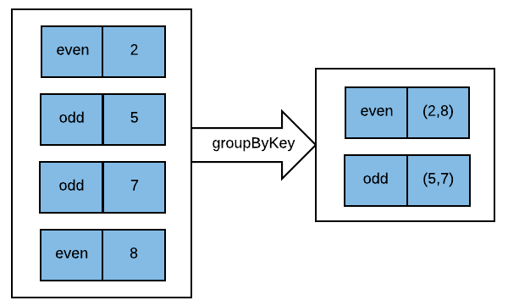
Target_RDD = Source_RDD.groupByKey()

Slide 12
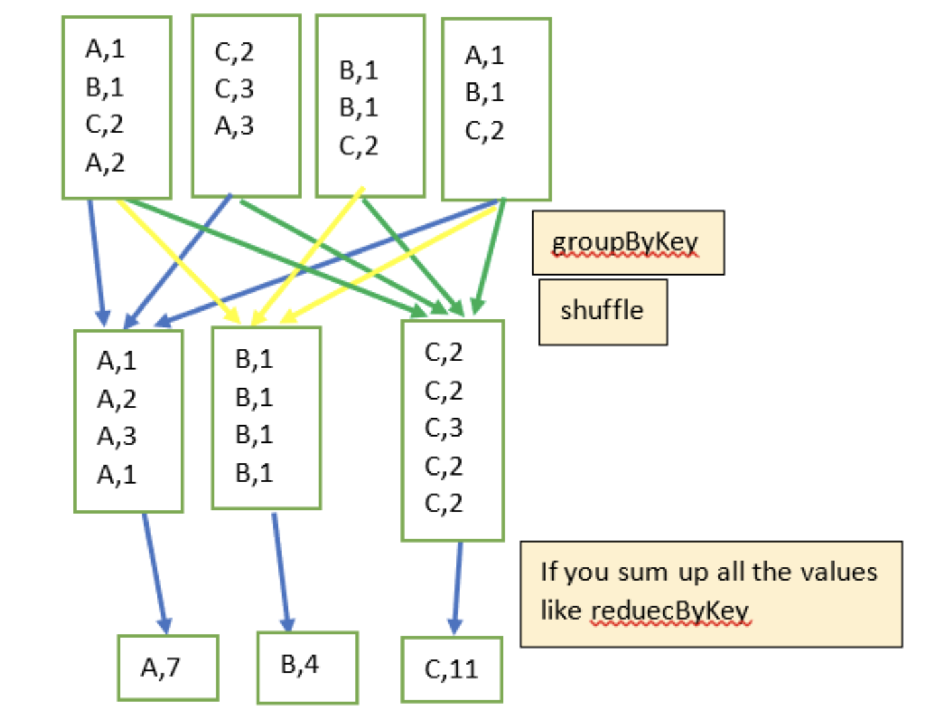
groupByKey() Shuffle

Slide 13
Example-1: groupByKey()
1. # spark : SparkSession object
2. pairs = [(‘A’, 2), (‘A’, 3), (‘B’, 4), (‘B’, 5), (‘B’, 9)]
3. rdd = spark.sparkContext.parallelize(pairs)
4. # rdd: [(‘A’, 2), (‘A’, 3), (‘B’, 4), (‘B’, 5), (‘B’, 9)]
5. grouped = rdd.groupByKey()
6. # grouped : [(‘A’, [2, 3]), (‘B’, [4, 5, 9])]
7. # find average by key
8. avg_by_key = grouped.mapValues(
lambda values: float(sum(values)) / len(values)
)
9. # avg_by_key: [(‘A’, 2.5), (‘B’, 6.0)]

Slide 14
Example-2: groupByKey() : create (K, V) pairs
$ cat sample.txt
A,2
A,3
B,4
B,5
B,9
Find average per key.

Slide 15
Example-2: groupByKey()
1. # spark : SparkSession object
2. rdd = spark.sparkContext.textFile(“sample.txt”)
3. # rdd : RDD[String]
3. # rdd: [‘A,2’, ‘A,3’, ‘B,4’, ‘B,5’, ‘B,9’]
Before using groupByKey(),
we need to create (key, value) pairs
Use a Python function to create (key, value) pairs

Slide 16
Example-2: groupByKey()
# create (key, value) pairs:
def create_key_value(rec):
tokens = rec.split(“,”)
the_key = tokens[0]
the_value = int(tokens[1])
return (the_key, the_value)
#end-def
Now, create a (key, value) pairs:
8. key_value_rdd = rdd.map(create_key_value)
9. # key_value_rdd : RDD[(String, Integer)]
10. # key_value_rdd: [(‘A’, 2), (‘A’, 3), (‘B’, 4), (‘B’, 5), (‘B’, 9)]

Slide 17
Example-2: groupByKey()
# key_value_rdd:
# [(‘A’, 2), (‘A’, 3), (‘B’, 4), (‘B’, 5), (‘B’, 9)]
3. grouped = key_value_rdd.groupByKey()
4. # grouped : [(‘A’, [2, 3]), (‘B’, [4, 5, 9])]
5. # find average by key
6. avg_by_key = grouped.mapValues(
lambda values: float(sum(values)) / len(values)
)
7. # avg_by_key: [(‘A’, 2.5), (‘B’, 6.0)]

Slide 18
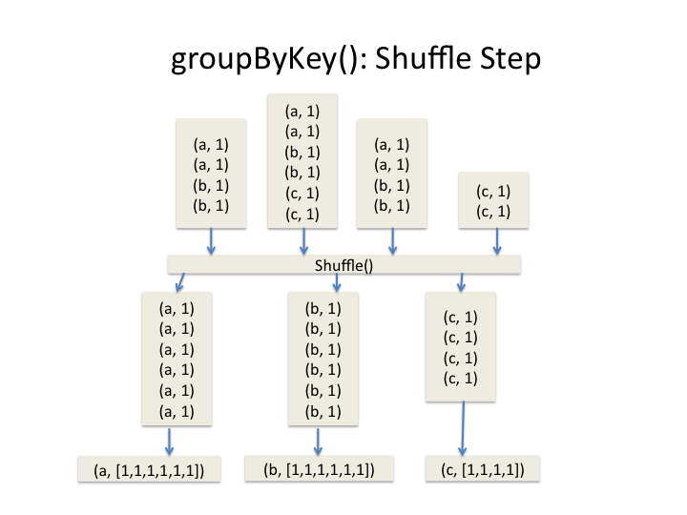
groupByKey() in Picture

Slide 19
Summary RDD.groupByKey()
# source_RDD : RDD[(K, V)]
# target_RDD : RDD[(K, [V1, V2, …]) target_RDD = source_RDD.groupByKey()

Slide 20
Final Example: groupByKey() to find median per key
1. # spark : SparkSession object
2. pairs = [(‘A’, 2), (‘A’, 3), (‘A’, 4), (‘A’, 1), (‘B’, 5), (‘B’, 9), (‘B’, 2)]
3. rdd = spark.sparkContext.parallelize(pairs)
4. # rdd: = [(‘A’, 2), (‘A’, 3), (‘A’, 4), (‘A’, 1), (‘B’, 5), (‘B’, 9), (‘B’, 2)]
5. grouped = rdd.groupByKey()
6. # grouped : [(‘A’, [2, 3, 4, 1]), (‘B’, [9, 2, 5])]
7. # find median by key
8. # Import statistics Library 9. import statistics
10. median_by_key = grouped.mapValues(statistics.median)
11. # median_by_key: [(‘A’, 2.5), (‘B’, 5.0)]

Slide 21
Pros & Cons RDD.groupByKey()
Pros:
Simple to use
Implements SQL’s GROUP BY
Ideal for GROUPING VALUES
When you NEED all values for reduction
Cons:
1. If values for a key is too many, then it might create Out of Memory problems

Slide 22
Complete Solution of groupByKey()
Link to Complete Solution of groupByKey():
https://github.com/mahmoudparsian/pyspark-algorithms/blob/master/code/chap02/sum_by_groupbykey.py

Slide 23
Summary
Spark has a rich set of reduction transformations
groupByKey(): groups values by a key
Similar to SQL’s GROUP BY

Slide 24
Reading on reductions
groupByKey() Example

