Slide 1
RDD.reduceByKey(f) Reducer in PySpark
Mahmoud Parsian
Ph.D. in Computer Science

Slide 2
Outline
What is reduction of (key, value) pairs
Reduction Transformations:
groupByKey()
reduceByKey()
aggregateByKey()
combineByKey()

Slide 3
What is a Reduction of (key, value) pairs?
Consider a set of billions of (key, value) pairs:
(gene_1, 2.0)
(gene_1, 3.0)
(gene_2, 4.0)
(gene_2, 5.0)
(gene_2, 3.0)
…
What is the sum of values per gene?

Slide 4
What is a Reduction of (key, value) pairs?
Consider a set of billions of (key, value) pairs:
(gene_1, 2.0), (gene_1, 3.0)
(gene_2, 4.0), (gene_2, 5.0), (gene_2, 9.0)
What is the sum of values per gene?
Final output by gene
(gene-1, 5.0)
(gene-2, 18.0)

Slide 5
Sum of values per Key
Consider a set of billions of (key, value) pairs:
(gene_1, 2.0), (gene_1, 3.0)
(gene_2, 4.0), (gene_2, 5.0), (gene_2, 9.0)
What is the sum of values per gene?
Solution-1: use groupByKey()
Solution-2: use reduceByKey()

Slide 6
Sum of values per Key: groupByKey()
Consider a set of billions of (key, value) pairs:
(gene_1, 2.0), (gene_1, 3.0)
(gene_2, 4.0), (gene_2, 5.0), (gene_2, 9.0)
What is the sum of values per gene?
Step-1: Group by gene
(gene-1, [2.0, 3.0])
(gene-2, [4.0, 5.0, 9.0])
Step-2: Perform a reduction per (key, value)

Slide 7
Sum of values per Key: groupByKey()
Consider a set of billions of (key, value) pairs:
What is the average per gene?
Step-1: Group by gene
(gene-1, [2.0, 3.0])
(gene-2, [4.0, 5.0, 9.0])
Step-2: Perform a reduction per (key, value)
(gene-1, (2.0+3.0)) → (gene-1, 5.0)
(gene-2, (4.0+5.0+9.0)) → (gene-2, 18.0)

Slide 8
groupByKey() Transformation
RDD.groupByKey()
Group the values for each key in the RDD into a single sequence (as Iterable of values)
RDD = [(A, v1), (A, v2), (A, v5), (A, v6)]
Then
RDD.groupByKey() ➔ (A, [v1, v2, v5, v6])

Slide 9
groupByKey() Transformation
RDD.groupByKey()
Group the values for each key in the RDD into a single sequence.
Consider the following (key, value) pairs for an RDD:
rdd = [ (A, 1), (A, 2), (C, 7)
(B, 3), (B, 5), (B, 10), (B, 12) ]
Then rdd.groupByKey() creates a new RDD as:
[
(A, [1, 2])
(B, [3, 5, 10, 12])
(C, [7])
]

Slide 10
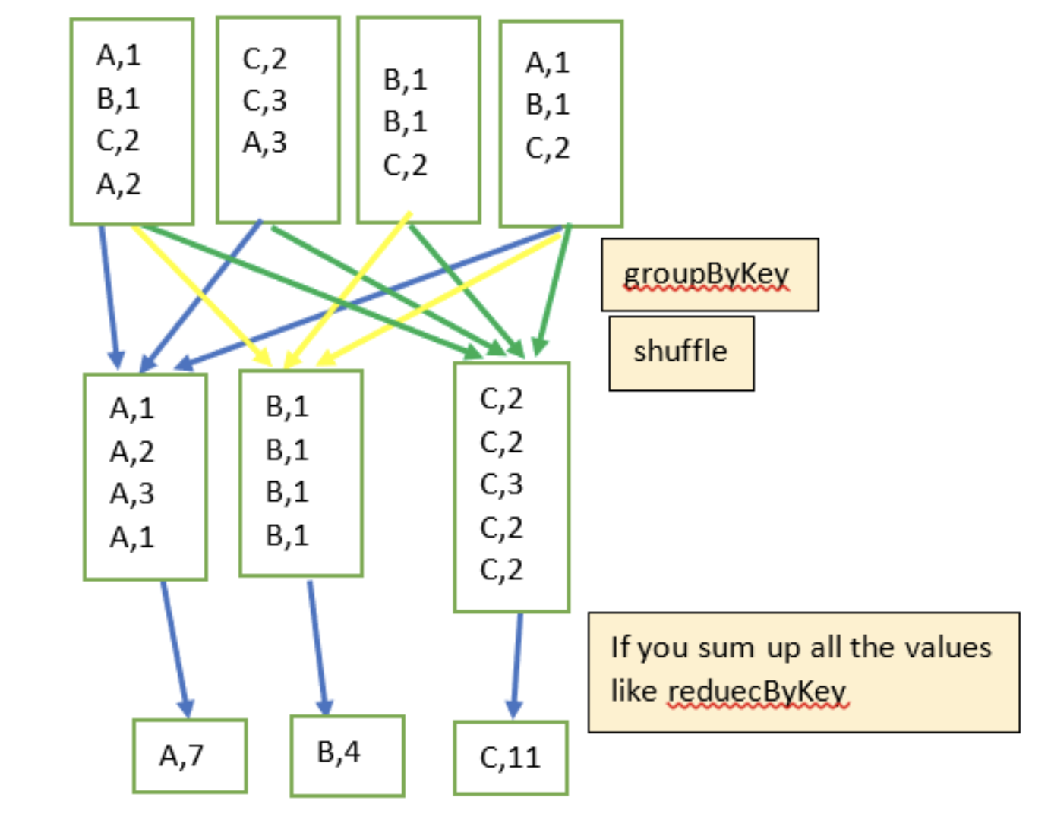
groupByKey() Shuffle

Slide 11
groupByKey() solution
1. # spark : SparkSession object
2. pairs = [(‘A’, 2), (‘A’, 3), (‘B’, 4), (‘B’, 5), (‘B’, 9)]
3. rdd = spark.sparkContext.parallelize(pairs)
4. # rdd: [(‘A’, 2), (‘A’, 3), (‘B’, 4), (‘B’, 5), (‘B’, 9)]
5. grouped = rdd.groupByKey()
6. # grouped : [(‘A’, [2, 3]), (‘B’, [4, 5, 9])]
7. # find average by key
8. sum_by_key = grouped.mapValues(lambda v: sum(v))
9. # sum_by_key: [(‘A’, 5.0), (‘B’, 18.0)]

Slide 12
Sum by Key: reduceByKey()
RDD.reduceByKey(func)
Merge the values for each key using an associative and commutative reduce function.
func must be associative and commutative
NOT all functions are associative and commutative

Slide 13
Sum by Key: reduceByKey()
RDD.reduceByKey(func)
Merge the values for each key using an associative and commutative reduce function.
# source_RDD : RDD[(K, V)]
# target_RDD : RDD[(K, V)]
target_RDD = source_RDD.reduceByKey(
lambda x, y: func(x,y))

Slide 14
Sum by Key: reduceByKey()
1. # spark : SparkSession object
2. pairs = [(‘A’, 2), (‘A’, 3), (‘B’, 4), (‘B’, 5), (‘B’, 9)]
3. rdd = spark.sparkContext.parallelize(pairs)
4. # rdd: [(‘A’, 2), (‘A’, 3), (‘B’, 4), (‘B’, 5), (‘B’, 9)]
5. sum_by_key = rdd.reduceByKey(lambda x, y: x+y)
6. # sum_by_key : [(‘A’, 5.0), (‘B’, 18.0)]

Slide 15
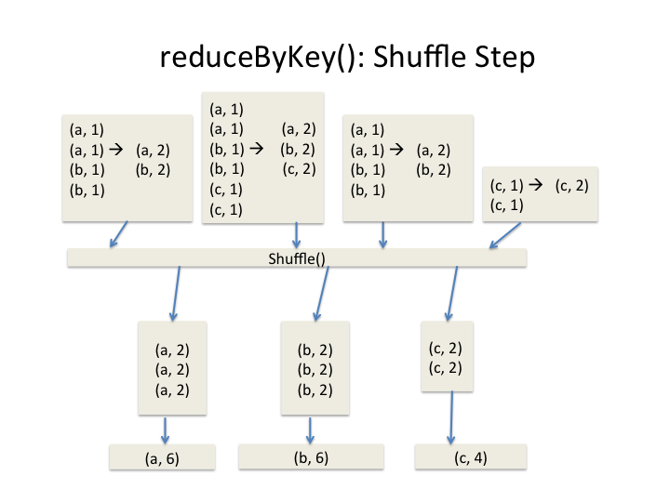
reduceByKey() in Picture

Slide 16
Summary RDD.reduceByKey()
# source_RDD : RDD[(K, V)]
# target_RDD : RDD[(K, V)] target_RDD = source_RDD.reduceByKey(
lambda a, b: func(a, b)
)
func: V x V → V
func must be associative
func must be commutative

Slide 17
reduceByKey(func): func must be associative
What is Associative Property?
This property states that when three or more numbers are added (or multiplied), the sum (or the product) is the same regardless of the grouping of the addends (or the multiplicands).
Grouping means the use of parentheses or brackets to group numbers.
Associative property involves 3 or more numbers.
Associative property can only be used with addition and multiplication and not with subtraction or division.
(a + (b + c)) = ((a + b) + c)

Slide 18
reduceByKey(func): func must be associative
(a + (b + c)) = ((a + b) + c)
Addition (+) is associative
(2 + (3 + 4)) = ((2 + 3) + 4)
(2 + 7) = (5 + 4)
9 = 9
Multiplicaion (*) is associative
(2 * (3 * 4)) = ((2 * 3) * 4)
(2 * 12) = (6 * 4)
24 = 24

Slide 19
reduceByKey(func): func must be associative
(a + (b + c)) = ((a + b) + c)
Division (/) is NOT associative
(2 / (3 / 4)) = ((2 / 3) / 4)
(2 / .75) = (.67 / 4)
2.67 = 0.17 ???
Subtraction (-) is NOT associative
(2 - (3 - 4)) = ((2 - 3) - 4)
(2 – (-1)) = ((-1) - 4)
3 = -5 ???

Slide 20
reduceByKey(func): average function is NOT associative
(a + (b + c)) = ((a + b) + c)
Avg(1, 2, 3) = (1+2+3)/3 = 2.0
P1: Partition-1: {1, 2}
P2: Partition-2: {3}
Avg(P1) = (1+2)/2 = 1.5
Avg(P2) = (3)/1 = 3.0
Avg(P1, P2) = (1.5+3.0)/2 = 2.25
2 = 2.25 ???

Slide 21
reduceByKey(func): Make average function to be associative
(a + (b + c)) = ((a + b) + c)
Avg(1, 2, 3) = (1+2+3)/3 = 2.0
TRICK: map(num) -> (num, 1)
P1: Partition-1: {1, 2} -> {(1, 1), (2, 1)}
P2: Partition-2: {3} -> {(3, 1)}

Slide 22
reduceByKey(func): Make average function to be associative
(a + (b + c)) = ((a + b) + c)
Avg(1, 2, 3) = (1+2+3)/3 = 2.0
TRICK: map(num) -> (num, 1)
P1: Partition-1: {1, 2} -> {(1, 1), (2, 1)}
P2: Partition-2: {3} -> {(3, 1)}
Avg(P1) = ((1+2), (1+1)) = (3, 2)
Avg(P2) = (3, 1)
Avg(P1, P2) = (3+3, 2+1) =>
(6, 3)
We need an additional map: 6/3 = 2.0

Slide 23
reduceByKey(func): func must be commutative
The commutative property states that the numbers on which we operate can be moved or swapped from their position without making any difference to the answer.
a + b = b + a
The property holds for Addition and Multiplication
The property does NOT hold for subtraction and division

Slide 24
reduceByKey(func): func must be commutative
a + b = b + a
The property holds for Addition and Multiplication
2 + 5 = 5 + 2 → 7 = 7
2 * 5 = 5 * 2 → 10 = 10
The property does NOT hold for subtraction and division
2 – 5 = 5 – 2 → -3 = 3 → NO
2 / 5 = 5 / 2 → 0.40 = 2.5 → NO

Slide 25
AVG of values per Key: reduceByKey()
Consider a set of billions of (key, value) pairs:
(gene_1, 2.0)
(gene_1, 3.0)
(gene_2, 4.0)
(gene_2, 5.0)
(gene_2, 3.0)
…
What is the AVERAGE of values per gene?

Slide 26
AVG: reduceByKey() solution: Try 1
1. # spark : SparkSession object
2. pairs = [(’A’, 1), (‘A’, 2), (‘A’, 3), (‘B’, 4), (‘B’, 5), (‘B’, 9)]
3. rdd = spark.sparkContext.parallelize(pairs)
4. # rdd: [(’A’, 1), (‘A’, 2), (‘A’, 3), (‘B’, 4), (‘B’, 5), (‘B’, 9)]
5. avg_by_key = rdd.reduceByKey(lambda x, y : (x+y)/2 )
THIS will NOT WORK: since AVG of AVG is NOT an AVG
P1: Partition-1: (A, 1), (A,2)
P2: Partition-2: (A, 3)
AVG(P1) → 1.5
AVG(P2) → 3.0
AVG(P1, P2) → 2.25

Slide 27
AVG: reduceByKey() solution: Try 2
1. # spark : SparkSession object
2. pairs = [(’A’, 1), (‘A’, 2), (‘A’, 3), (‘B’, 4), (‘B’, 5), (‘B’, 9)]
3. rdd = spark.sparkContext.parallelize(pairs)
4. # rdd: [(’A’, 1), (‘A’, 2), (‘A’, 3), (‘B’, 4), (‘B’, 5), (‘B’, 9)]
5. # avg_by_key = rdd.reduceByKey(lambda x, y : (x+y)/2 )
6. # create (value, count) per value
7. rdd2 = rdd.mapValues(lambda v: (v, 1))
8. # rdd2: [(’A’, (1, 1)), (‘A’, (2, 1)), (‘A’, (3, 1)),
9. # (‘B’, (4, 1)), (‘B’, (5, 1)), (‘B’, (9, 1))]
10. sum_count = rdd2.reduceByKey(lambda x, y:
11. (x[0]+y[0], x[1]+y[1]) )

Slide 28
AVG: reduceByKey() solution: Try 2
1. # rdd2: [(’A’, (1, 1)), (‘A’, (2, 1)), (‘A’, (3, 1)),
# (‘B’, (4, 1)), (‘B’, (5, 1)), (‘B’, (9, 1))]
# x = (sum1, count1)
# y = (sum2, count2)
sum_count = rdd2.reduceByKey(lambda x, y:
(x[0]+y[0], x[1]+y[1])
)
# sum_count : [(A, (6, 3)), (B, (18, 3))]
# find AVG per key
# p = (sum, count) = (p[0], p[1])
avg_by_key = sum_count.mapValues(lambda p: p[0]/p[1])
# avg_by_key = [(A, 2.0), (B, 6.0)]

Slide 29
Final Example: reduceByKey() to find median per key
1. # spark : SparkSession object
2. pairs = [(‘A’, 2), (‘A’, 3), (‘A’, 4), (‘A’, 1), (‘B’, 5), (‘B’, 9), (‘B’, 2)]
3. rdd = spark.sparkContext.parallelize(pairs)
4. # rdd: = [(‘A’, 2), (‘A’, 3), (‘A’, 4), (‘A’, 1), (‘B’, 5), (‘B’, 9), (‘B’, 2)]
Since you need all values to find median per key.
It is VERY HARD to come up with a proper solution using reduceByKey()
But it is very easy to find median per key by using groupByKey() transformation

Slide 30
Pros & Cons RDD.reduceByKey()
Pros:
Simple to use
Scales better than groupByKey()
Cons:
1. Must make sure that your func is associative and commutative

Slide 31
Complete Solution of reduceByKey()
reduceByKey() Example

Slide 32
Summary
Spark has a rich set of reduction transformations
reduceByKey():
Merge the values for each key using an associative and commutative reduce function.

