Slide 1
RDD.combineByKey(ƛ1, ƛ2, ƛ3) Reducer in PySpark
Mahmoud Parsian
Ph.D. in Computer Science

Slide 2
Outline
What is reduction of (key, value) pairs
Reduction Transformations:
groupByKey()
reduceByKey()
aggregateByKey()
combineByKey()

Slide 3
What is a Reduction of (key, value) pairs?
Consider a set of billions of (key, value) pairs:
(gene_1, 2.0)
(gene_1, 3.0)
(gene_2, 4.0)
(gene_2, 5.0)
(gene_2, 3.0)
…
What is the sum of values per gene?
What is the average of values per gene?

Slide 4
What is a Reduction of (key, value) pairs?
Consider a set of billions of (key, value) pairs:
(gene_1, 2.0), (gene_1, 3.0)
(gene_2, 4.0), (gene_2, 5.0), (gene_2, 9.0)
What is the sum of values per gene?
Final output by gene: [(gene-1, 5.0), (gene-2, 18.0)]
What is the average of values per gene?
Final output by gene: [(gene-1, 2.5), (gene-2, 6.0)]
What is the (sum, count) of values per gene?
Final output by gene: [(gene-1, (5, 2)), (gene-2, (18, 3))]

Slide 5
Sum of values per Key
Consider a set of billions of (key, value) pairs:
(gene_1, 2.0), (gene_1, 3.0)
(gene_2, 4.0), (gene_2, 5.0), (gene_2, 9.0)
What is the (sum, count) of values per gene?
Final output by gene: [(gene-1, (5, 2)), (gene-2, (18, 3))]
Solution: use combineByKey()

Slide 6
Review Reduction Transformations:
RDD.groupByKey():
rdd = [ (K, V₁), (K, V₂), …, (K, V_{n}) ]
rdd.groupByKey() → (K, [V₁, V₂, …, V_{n}])

Slide 7
Review Reduction Transformations:
RDD.reduceByKey(func):
Merge the values for each key using an associative and commutative reduce function.
# source_RDD : RDD[(K, V)]
reduceByKey(func(x,y)) → RDD[(K, V)]
Limitation: both source and target RDDs value types are THE SAME.
For example: V can String, Integer, tuple, array/list, dictionary

Slide 8
Review Reduction Transformations:
RDD.reduceByKey(func):
Merge the values for each key using an associative and commutative reduce function.
# source_RDD : RDD[(K, V)]
reduceByKey(func(x,y)) → RDD[(K, V)]
# source_RDD : RDD[(K, V)]
# V and T can be different data types
combineByKey(Lambda1, Lambda2, Lambda3) → RDD[(K, T)]

Slide 9
Review Reduction Transformations:
{ (K, V₁), (K, V₂), …, (K, V_{n}) }
groupByKey() → (K, [V_{1,} V₂, …, V_{n}])
# source_RDD : RDD[(K, V)]
reduceByKey(func(x,y)) → RDD[(K, V)]
# source_RDD : RDD[(K, V)]
# V and C can be different (C is called: Combined data type)
combineByKey(Lambda1, Lmabda2, Lambda3) → RDD[(K, C)]

Slide 10
combineByKey(): Mother of All Reductions
# source_RDD : RDD[(K, V)]
# V and C can be different (OR can be the same)
RDD.combineByKey(createCombiner, mergeValue, mergeCombiners) → RDD[(K, C)]
Generic function to combine the elements for each key using a custom set of aggregation functions.
Turns an RDD[(K, V)] into a result of type RDD[(K, C)], for a “combined type” C.
Users provide three functions:
createCombiner, which turns a V into a C (e.g., creates a one-element list)
mergeValue, to merge a V into a C (e.g., adds it to the end of a list)
mergeCombiners, to combine two C’s into a single one (e.g., merges the lists)

Slide 11
combineByKey(): Mother of All Reductions
# source_RDD : RDD[(K, V)]
# V and C can be different
RDD.combineByKey(createCombiner, mergeValue, mergeCombiners) → RDD[(K, C)]
createCombiner, which turns a V into a C
lambda v : createCombiner(v) → C
You apply this one time per partition
mergeValue, to merge a V into a C (e.g., adds it to the end of a list)
mergeCombiners, to combine two C’s into a single one (e.g., merges the lists)

Slide 12
combineByKey(): Mother of All Reductions
# source_RDD : RDD[(K, V)]
# V and C can be different
RDD.combineByKey(createCombiner, mergeValue, mergeCombiners) → RDD[(K, C)]
createCombiner, which turns a V into a C
lambda v : createCombiner(v) → C
You apply this one time per partition
mergeValue, to merge a V into a C
lambda C, v : mergeValue(C, v) → C
You apply this for all remaining elements per partition
mergeCombiners, to combine two C’s into a single one
lambda C1, C2 : mergeCombiners(C1, C2) → C

Slide 13
combineByKey(): Mother of All Reductions
# source_RDD : RDD[(K, V)]
# V and C can be different
RDD.combineByKey(createCombiner, mergeValue, mergeCombiners) → RDD[(K, C)]
createCombiner, which turns a V into a C
lambda v : createCombiner(v) → C
You apply this one time per partition
mergeValue, to merge a V into a C
lambda C, v : mergeValue(C, v) → C
You apply this for all remaining elements per partition
mergeCombiners, to combine two C’s into a single one
lambda C₁, C₂ : mergeCombiners(C₁, C₂) → C
You apply this between 2 partitions

Slide 14
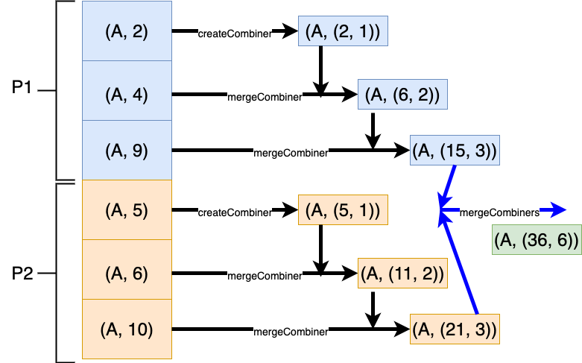
combineByKey(): Find AVG per key

Slide 15
combineByKey(): Mother of All Reductions
# source_rdd : RDD[(K, V)]
# V and C can be different
# target_rdd : RDD[(K, C)]
target_rdd = source_rdd.combineByKey(
createCombiner, mergeValue, mergeCombiners
)
Users provide three functions:
createCombiner, which turns a V into a C
mergeValue, to merge a V into a C
mergeCombiners, to combine two C’s into a single one

Slide 16
combineByKey() solution: find AVG per key
1. # spark : SparkSession object
2. pairs = [(‘A’, 2), (‘A’, 3), (‘B’, 4), (‘B’, 5), (‘B’, 9)]
3. rdd = spark.sparkContext.parallelize(pairs)
4. # rdd: [(‘A’, 2), (‘A’, 3), (‘B’, 4), (‘B’, 5), (‘B’, 9)]
5. # Let COMBINED type to be C = (C[0], C[1]) = (sum, count)
# C is a tuple of 2 values as (sum, count)
6. Combined = rdd.combineByKey(
lambda v : (v, 1),
lambda C, v: (C[0]+v, C[1]+1),
lambda C₁, C₂ : (C₁[0]+C₂[0], C₁[1]+C₂[1])
)

Slide 17
combineByKey() solution: find AVG per key
1. # rdd: [(‘A’, 2), (‘A’, 3), (‘B’, 4), (‘B’, 5), (‘B’, 9)]
2. # Let COMBINED type to be C = (C[0], C[1]) = (sum, count)
3. combined = rdd.combineByKey(
lambda v : (v, 1),
lambda C, v: (C[0]+v, C[1]+1),
lambda C₁, C₂ : (C₁[0]+C₂[0], C₁[1]+C₂[1])
)
4. # combined : [(A, (5, 2)), (B, (18, 3))]
5. # Now find avg per key

Slide 18
combineByKey() solution: find AVG per key
1. combined = rdd.combineByKey(
lambda v : (v, 1),
lambda C, v: (C[0]+v, C[1]+1),
lambda C₁, C₂ : (C₁[0]+C₂[0], C₁[1]+C₂[1])
)
2. # combined : [(A, (5, 2)), (B, (18, 3))]
3. # Now find avg per key
4. # p = (sum, count)
5. avg_per_key = combined.mapValues(lambda p: p[0] / p[1]))
6. # avg_per_key : [(A, 2.5), (B, 6.0)]

Slide 19
combineByKey(f1, f2, f3)
# source_RDD : RDD[(K, V)]
# target_RDD : RDD[(K, C)]
target_RDD = source_RDD.combineByKey(
f1,
f2,
f3
)

Slide 20
Complete Solution of combineByKey()
Average By Key: use combineByKey()
Mean and Standard Deviation by combineByKey()

Slide 21
Summary
Spark has a rich set of reduction transformations
RDD.combineByKey(f1, f2, f3):

