Slide 1
Introduction to GraphFrames
Mahmoud Parsian
Ph.D. in Computer Science

Slide 2
What is a GraphFrame?
GraphFrames is an external package for Apache Spark which provides:
DataFrame-based Graphs
High-level APIs in Python, Scala, Java
Create graphs using GraphFrames
Analyze graph using GraphFrames
Run graph algorithms using GraphFrames
GraphFrames Documentation:
https://graphframes.github.io/graphframes/docs/_site/index.html

Slide 3
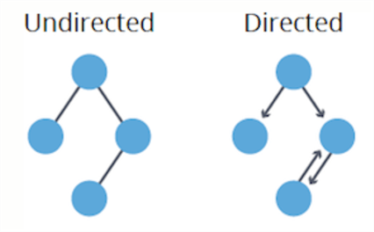
Graphs in GraphFrame
GraphFrames supports Directed Graphs

Slide 4
GraphFrames API
Create and analyze graphs by using DataFrames
GraphFrames API is Available in
Scala
Python
Java

Slide 5
Graph: Two Vertices and One Edge
vertex
vertex
edge
connection
San Diego
Santa Clara

Slide 6
Edge types:
unidirectional
edge
bidirectional
edge
2 uni edges
Notes:
TO-DO: In GraphX are they uni or bi? I think uni.. But to do bi, I think I have to do two edges, right?

Slide 7
Directed Multigraph

Slide 8
Graph: Two Vertices and One Directed Edge: Each Vertex has a Unique ID
vertexID: 3728
vertexID: 469
Edge label: 22
San Diego
Santa Clara

Slide 9
Directed Multigraph with/without labels
8
11
22
46
7
93
Notes:
TO-DO: Check if property is required on edge. If it is, fill in the rest.

Slide 10
Shortest Path:
4 hops
Notes:
TO-DO: Shortest path doesn’t take the edge labels/weights into account right? Is it even right to call them weights?

Slide 11
Create Graph by using GraphFrames
Requires a DataFrame of nodes:
vertices: DataFrame(…)
Requires a DataFrame of edges
edges: DataFrame(…)
Build a graph: place nodes and edges in a GraphFrame object.
graph = GraphFrame(vertices, edges)
We can then start processing the graph using GraphFrame algorithms.

Slide 12
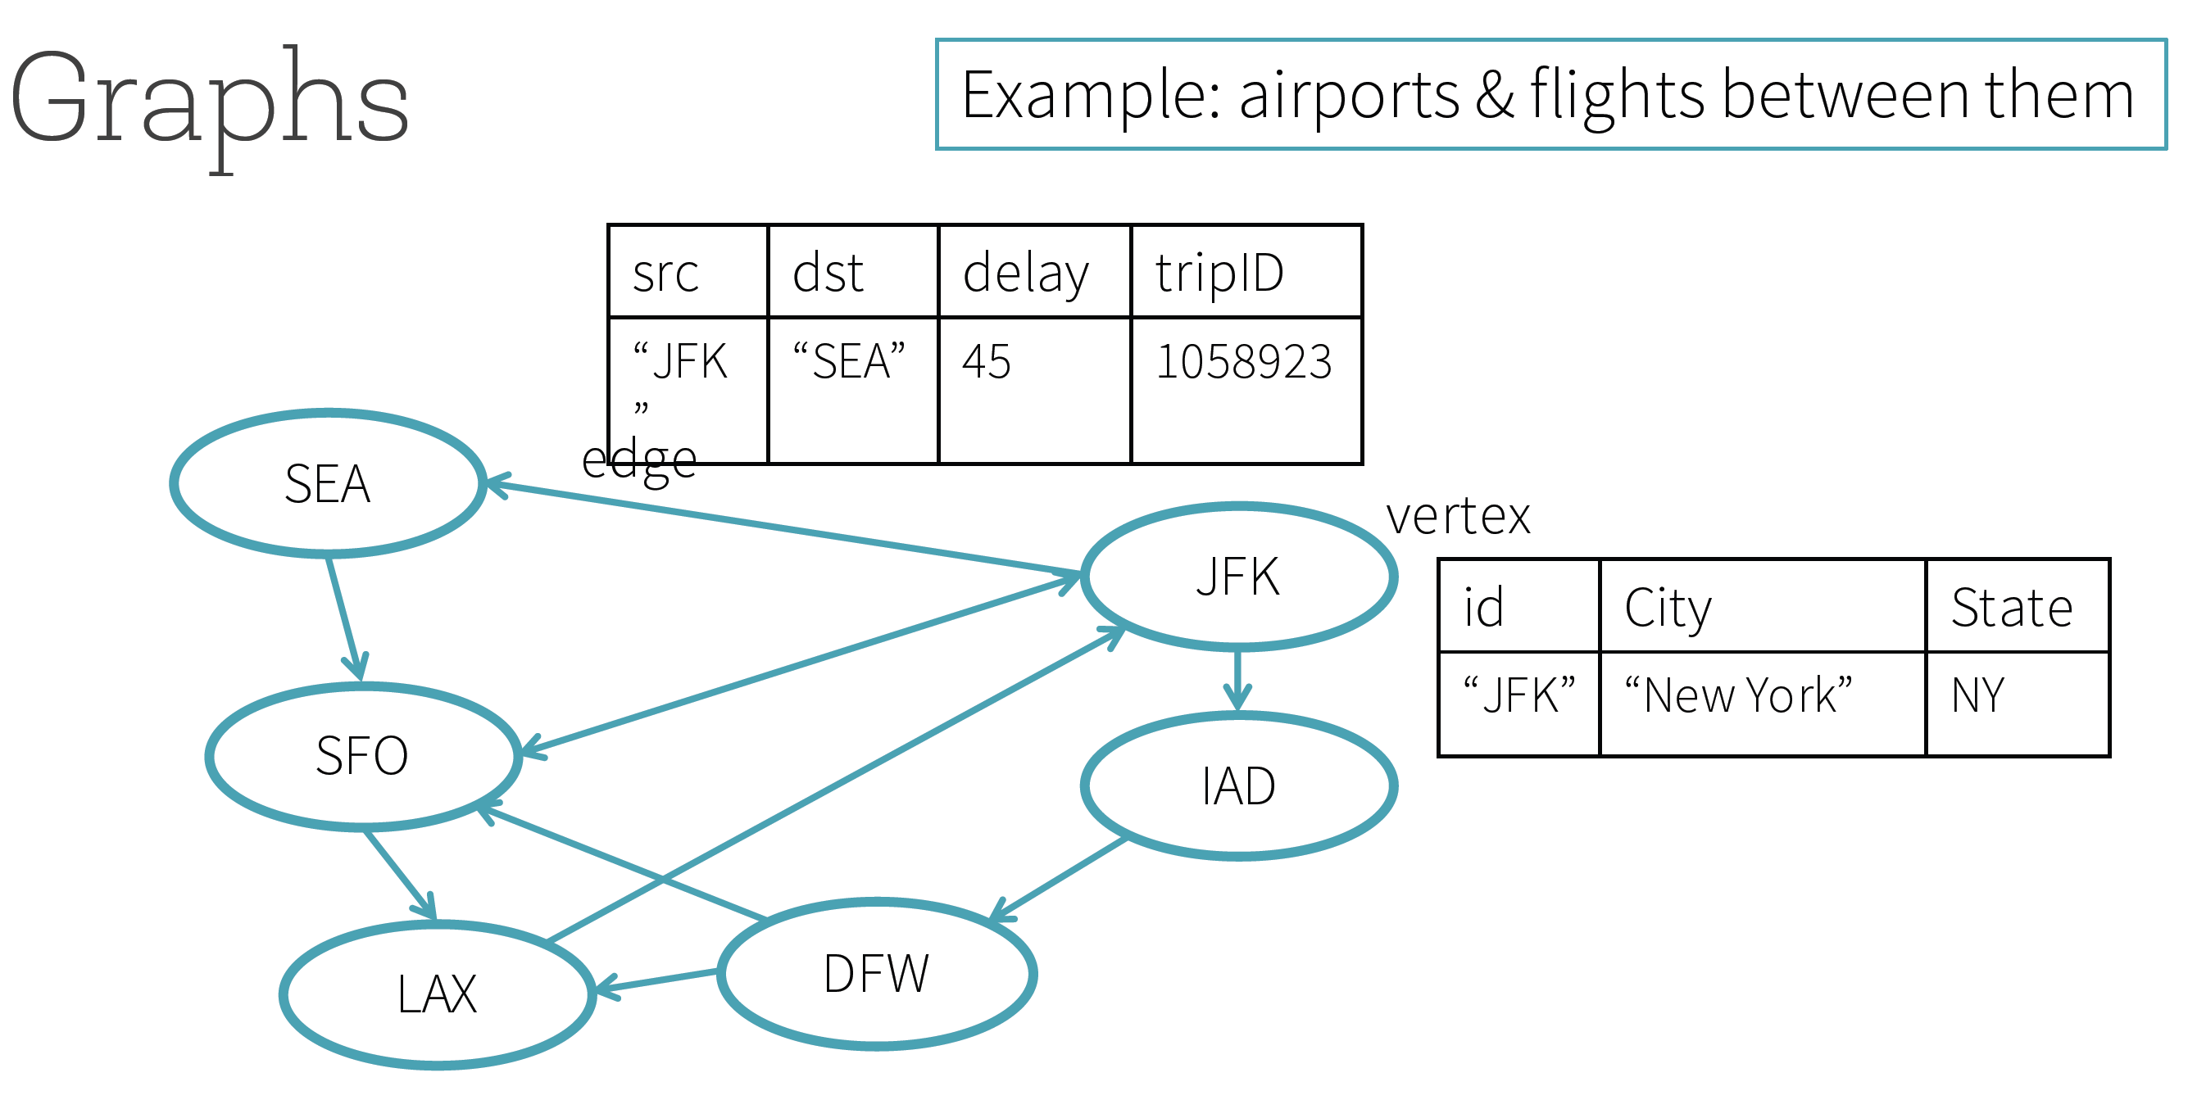
Create Graph

Slide 13
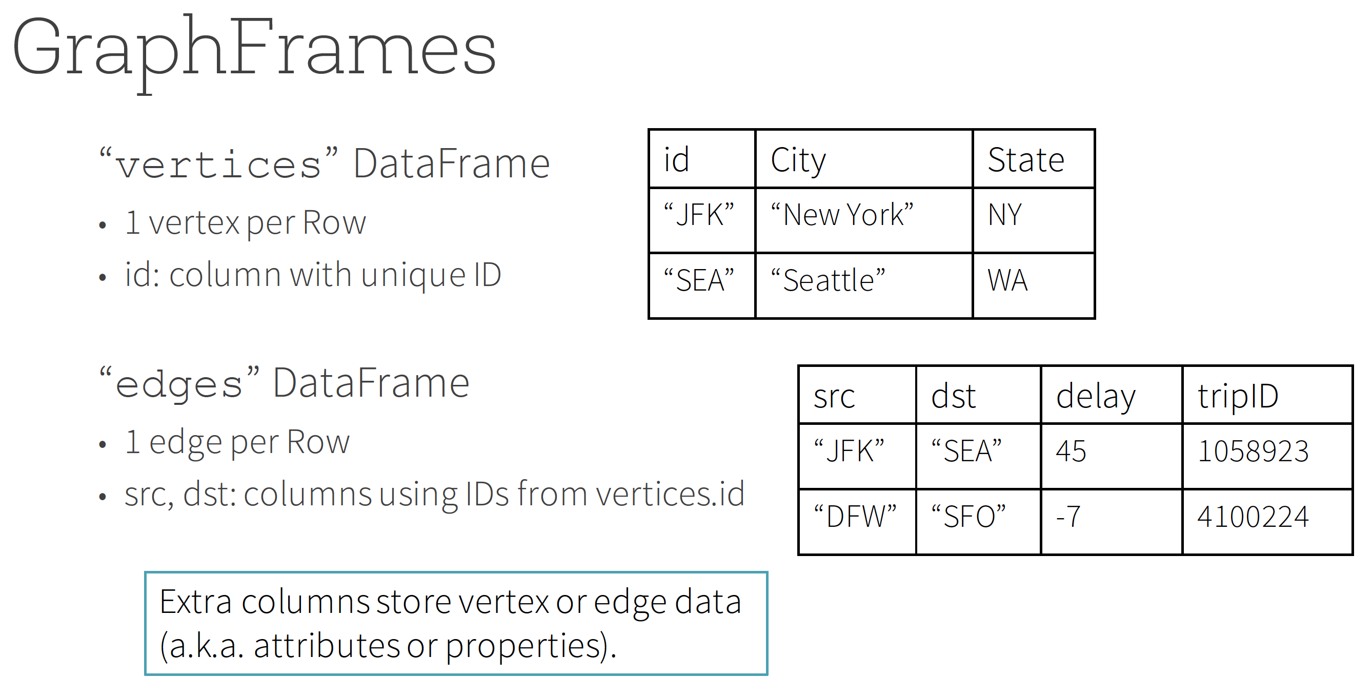
Create Graph

Slide 14
Create Nodes
vertices_list = [
("a", "Alice", 34),
("b", "Bob", 36),
("c", "Charlie", 30)
]
column_names_nodes = ["id", "name", "age"]
vertices = spark.createDataFrame(
vertices_list,
column_names_nodes
)
Notes:
Df of data points

Slide 15
Create Edges
edges_list = [
("a", "b", "friend"),
("b", "c", "follow"),
("c", "b", "follow")
]
column_names_edges = ["src", "dst", "relationship"]
edges = spark.createDataFrame(
edges_list,
column_names_edges
)
Notes:
Df of relationships

Slide 16
Create Graph
# import required library
from graphframes import GraphFrame
# vertices : DataFrame(id, name, age)
# id represents a unique node ID
# edges : DataFrame(src, dst, relationship)
# src: a node ID
# dst: a node ID
# Create a graph
graph = GraphFrame(vertices, edges)

Slide 17
Create Graph: GraphFrame API
class GraphFrame {
def vertices: DataFrame
def edges: DataFrame
# MOTIF FINDING is done by find()
def find(pattern: String): DataFrame
def degrees(): DataFrame
def pageRank(): GraphFrame
def connectedComponents(): GraphFrame
...
}

Slide 18
How to Create Graph using GraphFrames Package (high-level)
Build vertices_df as DataFrame()
Build edges_df as DataFrame()
Import required GraphFrame library
from graphframes import GraphFrame
4. Create graph as:
graph = GraphFrame(vertices_df, edges_df)

Slide 19
How to Create Graph using GraphFrames Package (detailed)
1. Build vertices_df as
DataFrame(id, V1, …, Vn)
Each row must have an “id” column, followed by any number of optional attributes V1, …, Vn
2. Build edges_df as
DataFrame(src, dst, E1, …, Em)
Each row must have src (source node) and dst (destination node) columns, followed by any number of optional attributes E1, …, Em

Slide 20
How to Create Graph using GraphFrames Package (detailed)
3. Import required GraphFrame library
from graphframes import GraphFrame
4. Create graph as:
graph = GraphFrame(vertices_df, edges_df)
Now graph is ready to be used for
analysis
running graph algorithms

Slide 21
Create Graph: Complete Code
Complete Code (as a URL link)
is given below:
Create Graph using GraphFrames

Slide 22
Apply transformations
How many “follow” relationships are represented in our dataset?
graph.edges.filter("relationship = 'follow'").count()
result: Long = 2

Slide 23
Algorithm Coverage
Collaborative Filtering
Alternating Least Squares
Community Detection
Triangle-Counting
K-core Decomposition
Graph Analytics
PageRank
Personalized PageRank
Shortest Path
Classification
Neural Networks

Slide 24
Use built in algorithms: Example PageRank
# graph : GraphFrame
# run PageRank algorithm for 20 iterations
results = graph.pageRank.resetProbability(0.01)
.maxIter(20)
.run()
# inspect the result of PageRank algorithm
results.vertices.select("id", "pagerank").show()

Slide 25
Motif Finding
Motif finding refers to searching for structural patterns in a graph.
grandson
mother

Slide 26
Motif Finding
Motif finding refers to searching for structural patterns in a graph.
grandson
mother
mother

Slide 27
Motif Language
Uses a domain specific language to find patterns within data
edge e from vertex a to vertex b
a → b
(a)-[e]->(b)
two edges from a to b and from b to c
a → b & b → c
(a)-[e]->(b); (b)-[e2]->(c)

Slide 28
GraphFrames Tutorials
URL Links:
1. GraphFrames in Jupyter: a practical guide
2. Getting Started with Graph Analytics

Slide 29
Summary
GraphFrames is an external package for Apache Spark which provides DataFrame-based Graphs:
Nodes are expressed as a DataFrame(id, n1, n2, n3, …)
Edges are expressed as a DataFrame(src, dst, e1, e2, e3, …)
GraphFrames provides high-level APIs in Scala, Java, and Python.
GraphFrames aims to provide both the functionality of GraphX and extended functionality taking advantage of Spark DataFrames.
GraphFrames are to DataFrames as GraphX is to RDDs.
GraphFrames provides extended functionality, which includes motif finding, DataFrame-based serialization, and highly expressive graph queries.

