Slide 1
Apache Spark
Kishore Pusukuri, Spring 2018

Slide 2
Recap
MapReduce
For easily writing applications to process vast amounts of data in-parallel on large clusters in a reliable, fault-tolerant manner
Takes care of scheduling tasks, monitoring them and re-executes the failed tasks
HDFS & MapReduce: Running on the same set of nodes → compute nodes and storage nodes same (keeping data close to the computation) → very high throughput
YARN & MapReduce: A single master resource manager, one slave node manager per node, and AppMaster per application

Slide 3
Today’s Topics
Motivation
Spark Basics
Spark Programming

Slide 4
History of Hadoop and Spark

Slide 5
Apache Hadoop & Apache Spark
Map Reduce
Hive
Pig
Other Applications
Spark Stream
Spark SQL
Processing
Resource manager
Yet Another Resource Negotiator (YARN)
Mesos etc.
Spark Core
Data Ingestion Systems
e.g., Apache Kafka, Flume, etc
Cassandra etc., other storage systems
Hadoop Database (HBase)
Hadoop Distributed File System (HDFS)
Data Storage
Hadoop
Spark
Notes:
Spark is not, despite the hype, a replacement for Hadoop. Nor mapreduce is dead. Spark can run on top of Hadoop, benefiting from yarn….. And underlying storage HDFS… spark can also run completely separately from Hadoop, integrating with alternative cluster managers like mesos, and alternative storage platforms such as cassandra

Slide 6
Apache Spark
** Spark can connect to several types of cluster managers (either Spark’s own standalone cluster manager, Mesos or YARN)
Processing
Spark Stream
Spark SQL
Spark ML
Other Applications
Resource manager
Spark Core
(Standalone Scheduler)
Mesos etc.
Yet Another Resource Negotiator (YARN)
Data Ingestion Systems
e.g., Apache Kafka, Flume, etc
S3, Cassandra etc., other storage systems
Hadoop NoSQL Database (HBase)
Data Storage
Hadoop Distributed File System (HDFS)
Hadoop
Spark

Slide 7
Apache Hadoop: No Unified Vision
Sparse Modules
Diversity of APIs
Higher Operational Costs

Slide 8
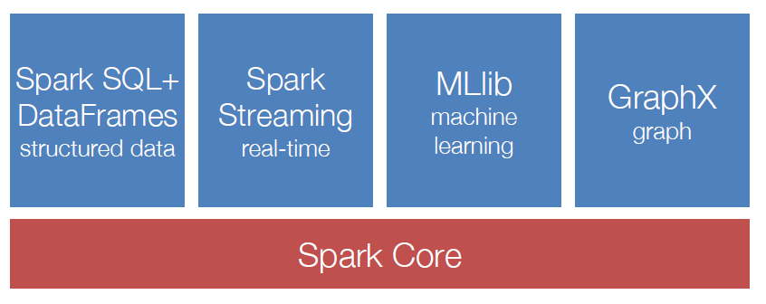
Spark Ecosystem: A Unified Pipeline

Slide 9
Spark vs MapReduce: Data Flow

Slide 10
Data Access Rates
With in a node:
CPU to Memory: 10 GB/sec
CPU to HardDisk: 0.1 GB/sec
CPU to SSD: 0.6 GB/sec
Nodes between networks: 0.125 GB/sec to 1 GB/sec
Nodes in the same rack: 0.125 GB/sec to 1 GB/sec
Nodes between racks: 0.1 GB/sec

Slide 11
Spark: High Performance & Simple Data Flow
Notes:
We avoid materializing data on HDFS after each iteration

Slide 12
Performance: Spark vs MapReduce (1)
Iterative algorithms
Spark is faster ← a simplified data flow
Avoids materializing data on HDFS after each iteration
Example: k-means algorithm, 1 iteration
HDFS Read
Map(Assign sample to closest centroid)
GroupBy(Centroid_ID)
NETWORK Shuffle
Reduce(Compute new centroids)
HDFS Write
Notes:
We avoid materializing data on HDFS after each iteration

Slide 13
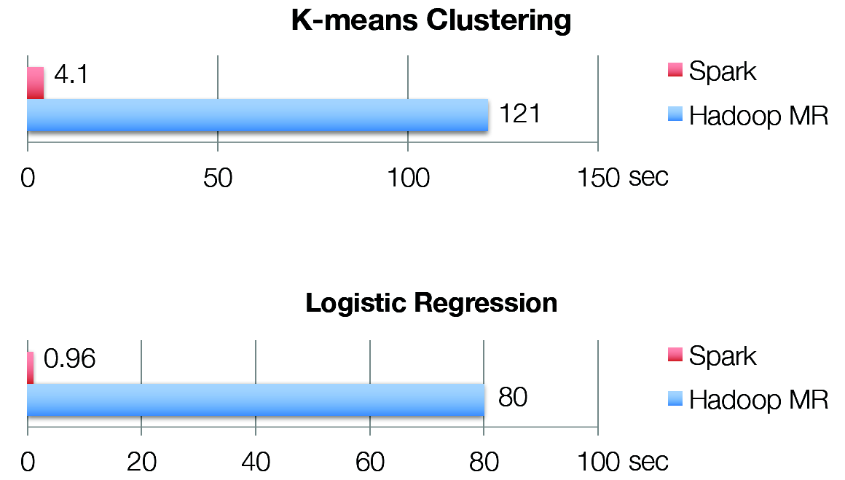
Performance: Spark vs MapReduce (2)

Slide 14
Code: Hadoop vs Spark (e.g., Word Count)
Simple/Less code
Multiple stages → pipeline
Operations
Transformations: apply user code to distribute data in parallel
Actions: assemble final output from distributed data

Slide 15
Motivation (1)
MapReduce: The original scalable, general, processing engine of the Hadoop ecosystem
Disk-based data processing framework (HDFS files)
Persists intermediate results to disk
Data is reloaded from disk with every query → Costly I/O
Best for ETL like workloads (batch processing)
Costly I/O → Not appropriate for iterative or stream processing workloads

Slide 16
Motivation (2)
Spark: General purpose computational framework that substantially improves performance of MapReduce, but retains the basic model
Memory based data processing framework → avoids costly I/O by keeping intermediate results in memory
Leverages distributed memory
Remembers operations applied to dataset
Data locality based computation → High Performance
Best for both iterative (or stream processing) and batch workloads

Slide 17
Motivation - Summary
Software engineering point of view
Hadoop code base is huge
Contributions/Extensions to Hadoop are cumbersome
Java-only hinders wide adoption, but Java support is fundamental
System/Framework point of view
Unified pipeline
Simplified data flow
Faster processing speed
Data abstraction point of view
New fundamental abstraction RDD
Easy to extend with new operators
More descriptive computing model

Slide 18
Today’s Topics
Motivation
Spark Basics
Spark Programming

Slide 19
Spark Basics(1)
Spark: Flexible, in-memory data processing framework written in Scala
Goals:
Simplicity (Easier to use):
Rich APIs for Scala, Java, and Python
Generality: APIs for different types of workloads
Batch, Streaming, Machine Learning, Graph
Low Latency (Performance) : In-memory processing and caching
Fault-tolerance: Faults shouldn’t be special case
Notes:
Scala is a functional programming language that runs in a JVM

Slide 20
Spark Basics(2)
There are two ways to manipulate data in Spark
Spark Shell:
Interactive – for learning or data exploration
Python or Scala
Spark Applications
For large scale data processing
Python, Scala, or Java
Notes:
We use some code snippets and spark shell in this class.

Slide 21
Spark Shell
The Spark Shell provides interactive data exploration (REPL)
REPL: Repeat/Evaluate/Print Loop
Notes:
We use some code snippets and spark shell in this class.

Slide 22
Spark Core: Code Base (2012)

Slide 23
Spark Fundamentals
Example of an application:
Spark Context
Resilient Distributed Data
Transformations
Actions

Slide 24
Spark: Fundamentals
Spark Context
Resilient Distributed Datasets (RDDs)
Transformations
Actions

Slide 25
Spark Context (1)
Every Spark application requires a spark context: the main entry point to the Spark API
Spark Shell provides a preconfigured Spark Context called “sc”

Slide 26
Spark Context (2)
Standalone applications → Driver code → Spark Context
Spark Context represents connection to a Spark cluster
Standalone Application (Driver Program)
Notes:
Cluster manager -- mesos, yarn, spark core standalone manager

Slide 27
Spark Context (3)
Spark context works as a client and represents connection to a Spark cluster
Notes:
Uses a directed acyclic graph of RDDs → create a schedule of spark tasks ..with the help of cluster manager assigns those tasks to worker nodes

Slide 28
Spark Fundamentals
Example of an application:
Spark Context
Resilient Distributed Data
Transformations
Actions

Slide 29
Resilient Distributed Dataset
RDD (Resilient Distributed Dataset) is the fundamental unit of data in Spark: An Immutable collection of objects (or records, or elements) that can be operated on “in parallel” (spread across a cluster)
Resilient -- if data in memory is lost, it can be recreated
Recover from node failures
An RDD keeps its lineage information → it can be recreated from parent RDDs
Distributed -- processed across the cluster
Each RDD is composed of one or more partitions → (more partitions – more parallelism)
Dataset -- initial data can come from a file or be created

Slide 30
RDDs
Key Idea: Write applications in terms of transformations on distributed datasets
Collections of objects spread across a Memory caching layer(cluster) that stores data in a distributed, fault-tolerant cache
Can fall back to disk when dataset does not fit in memory
Built through parallel transformations (map, filter, group-by, join, etc)
Automatically rebuilt on failure
Controllable persistence (e.g. caching in RAM)

Slide 31
RDDs -- Immutability
Immutability → lineage information → can be recreated at any time → Fault-tolerance
Avoids data inconsistency problems ← no simultaneous updates → Correctness
Easily live in memory as on disk → Caching → Safe to share across processes/tasks → Improves performance
Tradeoff: (Fault-tolerance & Correctness) vs (Disk Memory & CPU)

Slide 32
Creating a RDD
Three ways to create a RDD
From a file or set of files
From data in memory
From another RDD
Notes:
Created by starting with a file in Hadoop Distributed File System (HDFS) or an existing collection in the driver program
Similar to map or reduce… Map is similar to map reduce map.. Group-by is kind of reduce function.. There are other functions
May be persisted in memory for efficient reuse across parallel operations (caching)

Slide 33
Example: A File-based RDD
Notes:
mydata is a RDD… sc– the context.. Count is an action…

Slide 34
Spark Fundamentals
Example of an application:
Spark Context
Resilient Distributed Data
Transformations
Actions

Slide 35
RDD Operations
Two types of operations
Transformations: Define a new RDD based on current RDD(s)
Actions: return values

Slide 36
RDD Transformations
Set of operations on a RDD that define how they should be transformed
As in relational algebra, the application of a transformation to an RDD yields a new RDD (because RDD are immutable)
Transformations are lazily evaluated, which allow for optimizations to take place before execution
Examples: map(), filter(), groupByKey(), sortByKey(), etc.

Slide 37
Example: map and filter Transformations
Notes:
Talk about lineage here

Slide 38
RDD Actions
Apply transformation chains on RDDs, eventually performing some additional operations (e.g., counting)
Some actions only store data to an external data source (e.g. HDFS), others fetch data from the RDD (and its transformation chain) upon which the action is applied, and convey it to the driver
Some common actions
count() – return the number of elements
take(n) – return an array of the first n elements
collect()– return an array of all elements
saveAsTextFile(file) – save to text file(s)

Slide 39
Lazy Execution of RDDs (1)
Data in RDDs is not processed until an action is performed

Slide 40
Lazy Execution of RDDs (2)
Data in RDDs is not processed until an action is performed

Slide 41
Lazy Execution of RDDs (3)
Data in RDDs is not processed until an action is performed

Slide 42
Lazy Execution of RDDs (4)
Data in RDDs is not processed until an action is performed

Slide 43
Lazy Execution of RDDs (5)
Data in RDDs is not processed until an action is performed

Slide 44
Example: Log Mining
Load error messages from a log into memory, then interactively search for various patterns:
lines = spark.textFile(“hdfs://...”) HadoopRDD
errors = lines.filter(lambda s: s.startswith(“ERROR”)) FilteredRDD
messages = errors.map(lambda s: s.split(“\t”)[2])
messages.cache()
messages.filter(lambda s: “foo” in s).count()
Result: full-text search of Wikipedia in 0.5 sec (vs 20 sec for on-disk data)

Slide 45
RDD and Partitions (More Parallelism)

Slide 46
RDD Graph: Data Set vs Partition Views
Much like in Hadoop MapReduce, each RDD is associated to (input) partitions

Slide 47
RDDs: Data Locality
Data Locality Principle
Same as for Hadoop MapReduce
Avoids network I/O, workers should manage local data
Data Locality and Caching
First run: data not in cache, so use HadoopRDD’s locality preferences (from HDFS)
Second run: FilteredRDD is in cache, so use its locations
If something falls out of cache, go back to HDFS

Slide 48
RDDs -- Summary
RDD are partitioned, locality aware, distributed collections
RDD are immutable
RDD are data structures that:
Either point to a direct data source (e.g. HDFS)
Apply some transformations to its parent RDD(s) to generate new data elements
Computations on RDDs
Represented by lazily evaluated lineage DAGs composed by chained RDDs

Slide 49
Lifetime of a Job in Spark

Slide 50
Anatomy of a Spark Application
Cluster Manager (YARN/Mesos)

Slide 51
Typical RDD pattern of use
Hadoop job uses RDD to transform some input object, like a “recipe” for generating a cooked version of the object.
The task might further transform the RDD with additional RDDs, in the style of a functional program.
Eventually, some task consumes the RDD output (or perhaps several of these RDDs) as part of a MapReduce-style computation.

Slide 52
Spark: Key Techniques for Performance
Spark is an “execution engine for computing RDDs” but also decides when to perform the actual computation, where to place tasks (on the Hadoop Cluster), and whether to cache RDD output.
Avoids recomputing an RDD by saving its output if it will be needed again, and to arrange for tasks to run close to these cached RDDs (or in a place where later tasks will use the same RDD output)

Slide 53
Why is this a good strategy?
If MapReduce jobs were arbitrary programs, this wouldn’t help.
But in fact the MapReduce model is valuable because it often applies the same transformations again and again on input files.
Also, MapReduce is often run again and again until a machine learning model converges, or some huge batch of input is consumed, and by caching RDDs, Spark can avoid wasteful effort.

Slide 54
Iterative Algorithms: Spark vs MapReduce

Slide 55
Today’s Topics
Motivation
Spark Basics
Spark Programming

Slide 56
Spark Programming (1)
Creating RDDs
# Turn a Python collection into an RDD
sc.parallelize([1, 2, 3])
# Load text file from local FS, HDFS, or S3
sc.textFile(“file.txt”)
sc.textFile(“directory/*.txt”)
sc.textFile(“hdfs://namenode:9000/path/file”)
# Use existing Hadoop InputFormat (Java/Scala only)
sc.hadoopFile(keyClass, valClass, inputFmt, conf)

Slide 57
Spark Programming (2)
Basic Transformations
nums = sc.parallelize([1, 2, 3])
# Pass each element through a function
squares = nums.map(lambda x: x*x) // {1, 4, 9}
# Keep elements passing a predicate
even = squares.filter(lambda x: x % 2 == 0) // {4}

Slide 58
Spark Programming (3)
Basic Actions
nums = sc.parallelize([1, 2, 3])
# Retrieve RDD contents as a local collection
nums.collect() # => [1, 2, 3]
# Return first K elements
nums.take(2) # => [1, 2]
# Count number of elements
nums.count() # => 3
# Merge elements with an associative function
nums.reduce(lambda x, y: x + y) # => 6

Slide 59
Spark Programming (4)
Working with Key-Value Pairs
Spark’s “distributed reduce” transformations operate on RDDs of key-value pairs
Python: pair = (a, b)
pair[0] # => a
pair[1] # => b
Scala: val pair = (a, b)
pair._1 // => a
pair._2 // => b
Java: Tuple2 pair = new Tuple2(a, b);
pair._1 // => a
pair._2 // => b

Slide 60
Spark Programming (5)
Some Key-Value Operations
pets = sc.parallelize([(“cat”, 1), (“dog”, 1), (“cat”, 2)])
pets.reduceByKey(lambda x, y: x + y) # => {(cat, 3), (dog, 1)}
pets.groupByKey() # => {(cat, [1, 2]), (dog, [1])}
pets.sortByKey() # => {(cat, 1), (cat, 2), (dog, 1)}

Slide 61
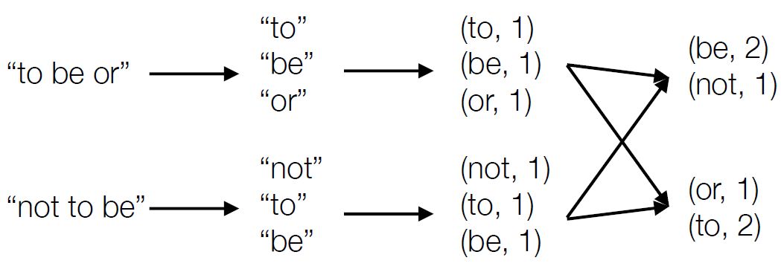
Example: Word Count
lines = sc.textFile(“hamlet.txt”)
counts = lines.flatMap(lambda line: line.split(“ “))
.map(lambda word: (word, 1))
.reduceByKey(lambda x, y: x + y)

Slide 62

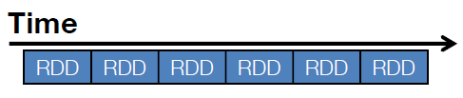
Example: Spark Streaming
Represents streams as a series of RDDs over time (typically sub second intervals, but it is configurable)
val spammers = sc.sequenceFile(“hdfs://spammers.seq”)
sc.twitterStream(...)
.filter(t => t.text.contains(“Santa Clara University”))
.transform(tweets => tweets.map(t => (t.user, t)).join(spammers))
.print()

Slide 63
Spark: Combining Libraries (Unified Pipeline)
# Load data using Spark SQL
points = spark.sql(“select latitude, longitude from tweets”)
# Train a machine learning model
model = KMeans.train(points, 10)
# Apply it to a stream
sc.twitterStream(...)
.map(lambda t: (model.predict(t.location), 1))
.reduceByWindow(“5s”, lambda a, b: a + b)

Slide 64
Spark: Setting the Level of Parallelism
All the pair RDD operations take an optional second parameter for number of tasks
words.reduceByKey(lambda x, y: x + y, 5)
words.groupByKey(5)
visits.join(pageViews, 5)

Slide 65
MapReduce vs Spark (Summary)
Performance:
While Spark performs better when all the data fits in the main memory (especially on dedicated clusters), MapReduce is designed for data that doesn’t fit in the memory
Ease of Use:
Spark is easier to use compared to Hadoop MapReduce as it comes with user-friendly APIs for Scala (its native language), Java, Python, and Spark SQL.
Fault-tolerance:
Batch processing: Spark → HDFS replication
Stream processing: Spark RDDs replicated

Slide 66
Summary
Spark is a powerful “manager” for big data computing.
It centers on a job scheduler for Hadoop (MapReduce) that is smart about where to run each task: co-locate task with data.
The data objects are “RDDs”: a kind of recipe for generating a file from an underlying data collection. RDD caching allows Spark to run mostly from memory-mapped data, for speed.
Online tutorials: spark.apache.org/docs/latest

