Slide 1
Introduction to Apache Spark
Patrick Wendell - Databricks
Notes:
Preamble:
* Excited to kick off first day of training
* This first tutorial is about using Spark CORE
* We’ve got a curriculum jammed packed with material, so let’s go ahead and get started

Slide 2
What is Spark?
Fast and Expressive Cluster Computing Engine Compatible with Apache Hadoop
Up to 10× faster on disk, 100× in memory
2-5× less code
Efficient
Usable
General execution graphs
In-memory storage
Rich APIs in Java, Scala, Python
Interactive shell
Notes:
Generalize the map/reduce framework

Slide 3
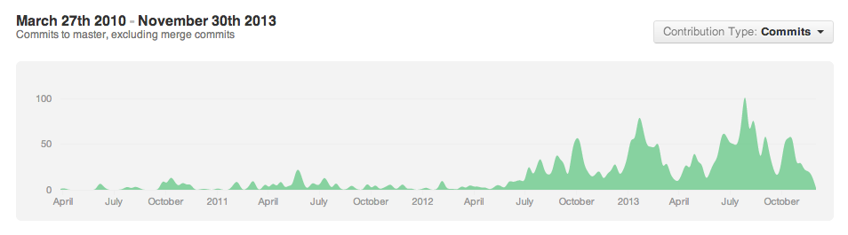



























The Spark Community
+You!
Notes:
One of the most exciting things you’ll find
Growing all the time
NASCAR slide
Including several sponsors of this event are just starting to get involved…
If your logo is not up here, forgive us – it’s hard to keep up!

Slide 4
Today’s Talk
The Spark programming model
Language and deployment choices
Example algorithm (PageRank)

Slide 5
Key Concept: RDD’s
Write programs in terms of operations on distributed datasets
Resilient Distributed Datasets
Collections of objects spread across a cluster, stored in RAM or on Disk
Built through parallel transformations
Automatically rebuilt on failure
Operations
Transformations (e.g. map, filter, groupBy)
Actions (e.g. count, collect, save)
Notes:
RDD ➔ Colloquially referred to as RDDs
(e.g. caching in RAM)
Lazy operations to build RDDs from other RDDs
Return a result or write it to storage

Slide 6

Example: Log Mining
Load error messages from a log into memory, then interactively search for various patterns
Base RDD
Transformed RDD
Cache 1
lines = spark.textFile(“hdfs://...”)
errors = lines.filter(lambda s: s.startswith(“ERROR”))
messages = errors.map(lambda s: s.split(“\t”)[2])
messages.cache()
results
Worker
tasks
Block 1
Driver
Action
messages.filter(lambda s: “mysql” in s).count()
Cache 2
messages.filter(lambda s: “php” in s).count()
Worker
Cache 3
. . .
Full-text search of Wikipedia
60GB on 20 EC2 machine
0.5 sec vs. 20s for on-disk
Worker
Block 2
Block 3
Notes:
Add “variables” to the “functions” in functional programming

Slide 7
Scaling Down
Notes:
Gracefully

Slide 8
Fault Recovery
RDDs track lineage information that can be used to efficiently recompute lost data
msgs = textFile.filter(lambda s: s.startsWith(“ERROR”))
.map(lambda s: s.split(“\t”)[2])
HDFS File
Filtered RDD
Mapped RDD
filter (func = startsWith(…))
map (func = split(...))

Slide 9
Programming with RDD’s

Slide 10
SparkContext
Main entry point to Spark functionality
Available in shell as variable sc
In standalone programs, you’d make your own (see later for details)

Slide 11
Creating RDDs
# Turn a Python collection into an RDD
sc.parallelize([1, 2, 3])
# Load text file from local FS, HDFS, or S3
sc.textFile(“file.txt”)
sc.textFile(“directory/*.txt”)
sc.textFile(“hdfs://namenode:9000/path/file”)
# Use existing Hadoop InputFormat (Java/Scala only)
sc.hadoopFile(keyClass, valClass, inputFmt, conf)

Slide 12
Basic Transformations
nums = sc.parallelize([1, 2, 3])
# Pass each element through a function
squares = nums.map(lambda x: x*x) // {1, 4, 9}
# Keep elements passing a predicate
even = squares.filter(lambda x: x % 2 == 0) // {4}
# Map each element to zero or more others
nums.flatMap(lambda x: => range(x))
# => {0, 0, 1, 0, 1, 2}
Range object (sequence of numbers 0, 1, …, x-1)
Notes:
All lazy

Slide 13
Basic Actions
nums = sc.parallelize([1, 2, 3])
# Retrieve RDD contents as a local collection
nums.collect() # => [1, 2, 3]
# Return first K elements
nums.take(2) # => [1, 2]
# Count number of elements
nums.count() # => 3
# Merge elements with an associative function
nums.reduce(lambda x, y: x + y) # => 6
# Write elements to a text file
nums.saveAsTextFile(“hdfs://file.txt”)
Notes:
Launch computations

Slide 14
Working with Key-Value Pairs
Spark’s “distributed reduce” transformations operate on RDDs of key-value pairs
Python: pair = (a, b) pair[0] # => a pair[1] # => b
Scala: val pair = (a, b) pair._1 // => a pair._2 // => b
Java: Tuple2 pair = new Tuple2(a, b); pair._1 // => a pair._2 // => b

Slide 15
Some Key-Value Operations
pets = sc.parallelize( [(“cat”, 1), (“dog”, 1), (“cat”, 2)])
pets.reduceByKey(lambda x, y: x + y) # => {(cat, 3), (dog, 1)}
pets.groupByKey() # => {(cat, [1, 2]), (dog, [1])}
pets.sortByKey() # => {(cat, 1), (cat, 2), (dog, 1)}
reduceByKey also automatically implements combiners on the map side

Slide 16
Example: Word Count
lines = sc.textFile(“hamlet.txt”)
counts = lines.flatMap(lambda line: line.split(“ ”)) .map(lambda word => (word, 1)) .reduceByKey(lambda x, y: x + y)
“to” “be” “or”
(to, 1) (be, 1) (or, 1)
(be, 2) (not, 1)
“to be or”
“not” “to” “be”
(not, 1) (to, 1) (be, 1)
(or, 1)
(to, 2)
“not to be”

Slide 17
Other Key-Value Operations
visits = sc.parallelize([ (“index.html”, “1.2.3.4”), (“about.html”, “3.4.5.6”), (“index.html”, “1.3.3.1”) ])
pageNames = sc.parallelize([ (“index.html”, “Home”), (“about.html”, “About”) ])
visits.join(pageNames) # (“index.html”, (“1.2.3.4”, “Home”)) # (“index.html”, (“1.3.3.1”, “Home”)) # (“about.html”, (“3.4.5.6”, “About”))
visits.cogroup(pageNames) # (“index.html”, ([“1.2.3.4”, “1.3.3.1”], [“Home”])) # (“about.html”, ([“3.4.5.6”], [“About”]))

Slide 18
Setting the Level of Parallelism
All the pair RDD operations take an optional second parameter for number of tasks
words.reduceByKey(lambda x, y: x + y, 5)
words.groupByKey(5)
visits.join(pageViews, 5)

Slide 19
Using Local Variables
Any external variables you use in a closure will automatically be shipped to the cluster:
query = sys.stdin.readline()
pages.filter(lambda x: query in x).count()
Some caveats:
Each task gets a new copy (updates aren’t sent back)
Variable must be Serializable / Pickle-able
Don’t use fields of an outer object (ships all of it!)

Slide 20
Under The Hood: DAG Scheduler
General task graphs
Automatically pipelines functions
Data locality aware
Partitioning aware to avoid shuffles
B:
A:
F:
Stage 1
groupBy
C:
D:
E:
join
Stage 2
map
filter
Stage 3
= RDD
= cached partition
Notes:
NOT a modified version of Hadoop

Slide 21
More RDD Operators
map
filter
groupBy
sort
union
join
leftOuterJoin
rightOuterJoin
reduce
count
fold
reduceByKey
groupByKey
cogroup
cross
zip
sample
take
first
partitionBy
mapWith
pipe
save ...

Slide 22
How to Run Spark

Slide 23
Language Support
Python
lines = sc.textFile(...) lines.filter(lambda s: “ERROR” in s).count()
Standalone Programs
Python, Scala, & Java
Interactive Shells
Python & Scala
Performance
Java & Scala are faster due to static typing
…but Python is often fine
Scala
val lines = sc.textFile(...) lines.filter(x => x.contains(“ERROR”)).count()
Java
JavaRDD<String> lines = sc.textFile(...); lines.filter(new Function<String, Boolean>() { Boolean call(String s) { return s.contains(“error”); } }).count();

Slide 24
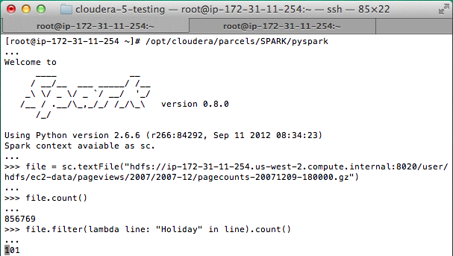
Interactive Shell
The Fastest Way to Learn Spark
Available in Python and Scala
Runs as an application on an existing Spark Cluster…
OR Can run locally
Notes:
The barrier to entry for working with the spark API is minimal

Slide 25
… or a Standalone Application
import sys
from pyspark import SparkContext
if __name__ == "__main__":
sc = SparkContext( “local”, “WordCount”, sys.argv[0], None) lines = sc.textFile(sys.argv[1])
counts = lines.flatMap(lambda s: s.split(“ ”)) \ .map(lambda word: (word, 1)) \ .reduceByKey(lambda x, y: x + y) counts.saveAsTextFile(sys.argv[2])

Slide 26
Create a SparkContext
import org.apache.spark.SparkContext
import org.apache.spark.SparkContext._
val sc = new SparkContext(“url”, “name”, “sparkHome”, Seq(“app.jar”))
Scala
Cluster URL, or local / local[N]
App name
Spark install path on cluster
List of JARs with app code (to ship)
import org.apache.spark.api.java.JavaSparkContext;
JavaSparkContext sc = new JavaSparkContext(
“masterUrl”, “name”, “sparkHome”, new String[] {“app.jar”}));
Java
from pyspark import SparkContext
sc = SparkContext(“masterUrl”, “name”, “sparkHome”, [“library.py”]))
Python
Notes:
Mention assembly JAR in Maven etc
Use the shell with your own JAR`

Slide 27
Add Spark to Your Project
Scala / Java: add a Maven dependency on
groupId: org.spark-project artifactId: spark-core_2.10 version: 0.9.0
Python: run program with our pyspark script

Slide 28
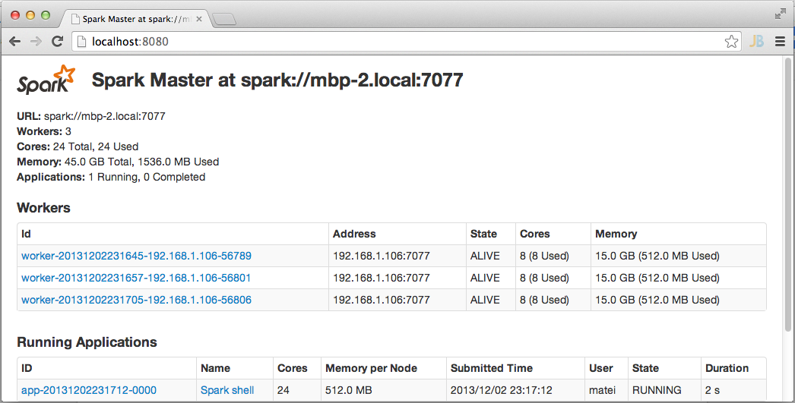
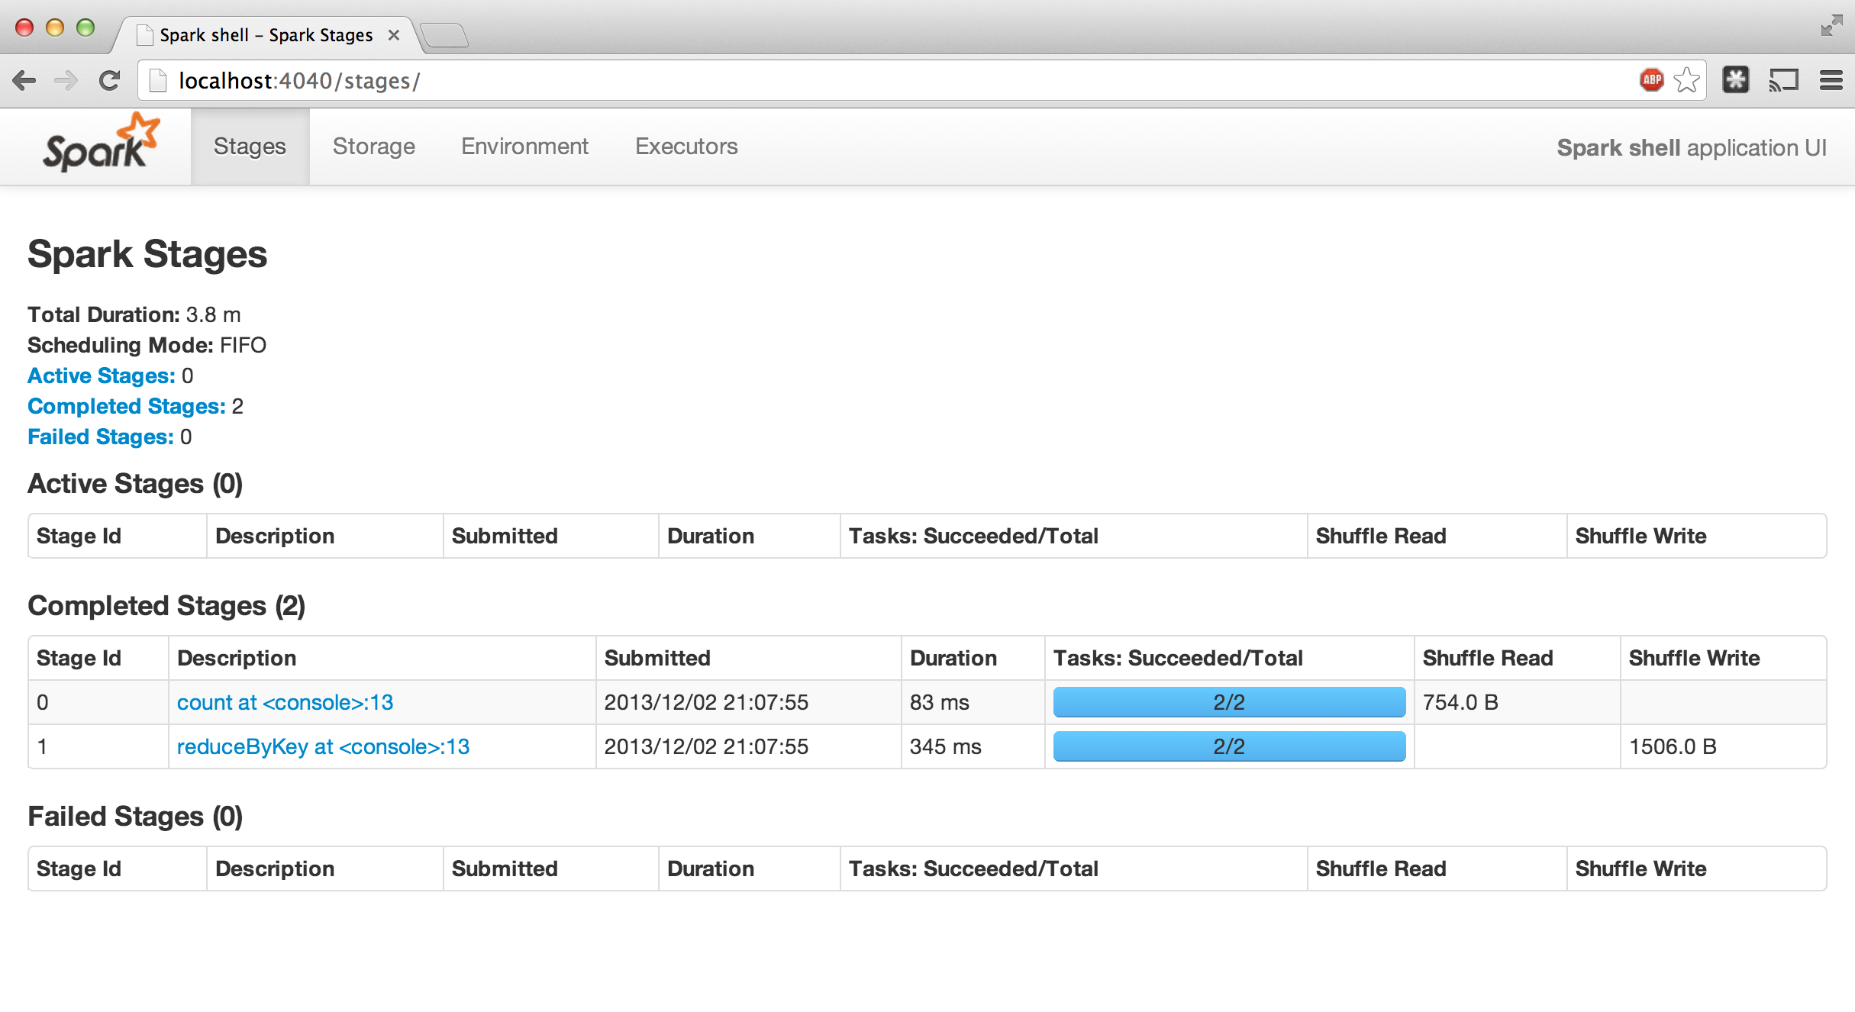
Administrative GUIs
http://<Standalone Master>:8080 (by default)

Slide 29
Software Components
Spark runs as a library in your program (1 instance per app)
Runs tasks locally or on cluster
Mesos, YARN or standalone mode
Accesses storage systems via Hadoop InputFormat API
Can use HBase, HDFS, S3, …
Your application
SparkContext
Cluster manager
Local threads
Worker
Worker
Spark executor
Spark executor
HDFS or other storage

Slide 30
Local Execution
Just pass local or local[k] as master URL
Debug using local debuggers
For Java / Scala, just run your program in a debugger
For Python, use an attachable debugger (e.g. PyDev)
Great for development & unit tests

Slide 31
Cluster Execution
Easiest way to launch is EC2: ./spark-ec2 -k keypair –i id_rsa.pem –s slaves \ [launch|stop|start|destroy] clusterName
Several options for private clusters:
Standalone mode (similar to Hadoop’s deploy scripts)
Mesos
Hadoop YARN
Amazon EMR: tinyurl.com/spark-emr

Slide 32
Example Application: PageRank
Notes:
To Skip to the next section, go to slide 51

Slide 33
Example: PageRank
Good example of a more complex algorithm
Multiple stages of map & reduce
Benefits from Spark’s in-memory caching
Multiple iterations over the same data

Slide 34
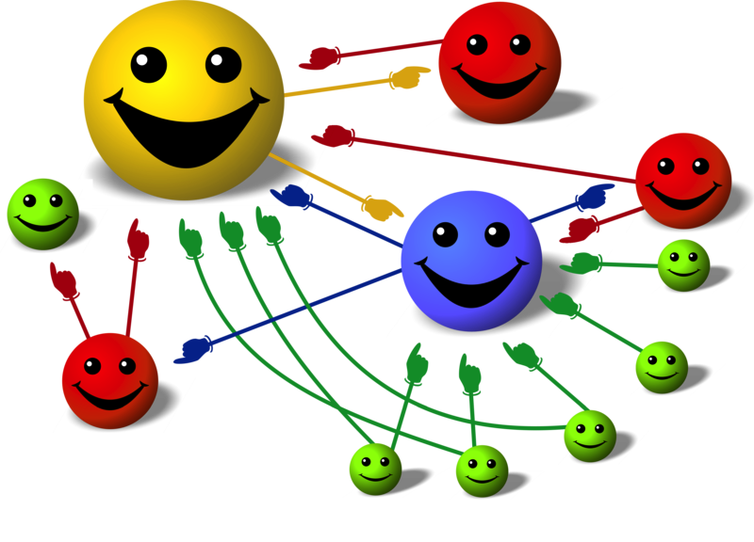
Basic Idea
Give pages ranks (scores) based on links to them
Links from many pages ➔ high rank
Link from a high-rank page ➔ high rank
Image: en.wikipedia.org/wiki/File:PageRank-hi-res-2.png

Slide 35
Algorithm
Start each page at a rank of 1
On each iteration, have page p contribute rank_{p} / |neighbors_{p}| to its neighbors
Set each page’s rank to 0.15 + 0.85 × contribs
1.0
1.0
1.0
1.0

Slide 36
Algorithm
Start each page at a rank of 1
On each iteration, have page p contribute rank_{p} / |neighbors_{p}| to its neighbors
Set each page’s rank to 0.15 + 0.85 × contribs
1.0
1
0.5
1
1.0
0.5
1.0
0.5
0.5
1.0

Slide 37
Algorithm
Start each page at a rank of 1
On each iteration, have page p contribute rank_{p} / |neighbors_{p}| to its neighbors
Set each page’s rank to 0.15 + 0.85 × contribs
1.85
0.58
1.0
0.58

Slide 38
Algorithm
Start each page at a rank of 1
On each iteration, have page p contribute rank_{p} / |neighbors_{p}| to its neighbors
Set each page’s rank to 0.15 + 0.85 × contribs
1.85
0.58
0.5
1.85
0.58
0.29
1.0
0.5
0.29
0.58

Slide 39
Algorithm
Start each page at a rank of 1
On each iteration, have page p contribute rank_{p} / |neighbors_{p}| to its neighbors
Set each page’s rank to 0.15 + 0.85 × contribs
1.31
0.39
. . .
1.72
0.58

Slide 40
Algorithm
Start each page at a rank of 1
On each iteration, have page p contribute rank_{p} / |neighbors_{p}| to its neighbors
Set each page’s rank to 0.15 + 0.85 × contribs
Final state:
1.44
0.46
1.37
0.73

Slide 41
Scala Implementation
val links = // load RDD of (url, neighbors) pairs
var ranks = // load RDD of (url, rank) pairs
for (i <- 1 to ITERATIONS) {
val contribs = links.join(ranks).flatMap {
case (url, (links, rank)) =>
links.map(dest => (dest, rank/links.size))
} ranks = contribs.reduceByKey(_ + _) .mapValues(0.15 + 0.85 * _)
} ranks.saveAsTextFile(...)

Slide 42
PageRank Performance
Notes:
54 GB Wikipedia dataset

Slide 43
Other Iterative Algorithms
Time per Iteration (s)
Notes:
100 GB datasets

Slide 44
Conclusion

Slide 45
Conclusion
Spark offers a rich API to make data analytics fast: both fast to write and fast to run
Achieves 100x speedups in real applications
Growing community with 25+ companies contributing

Slide 46
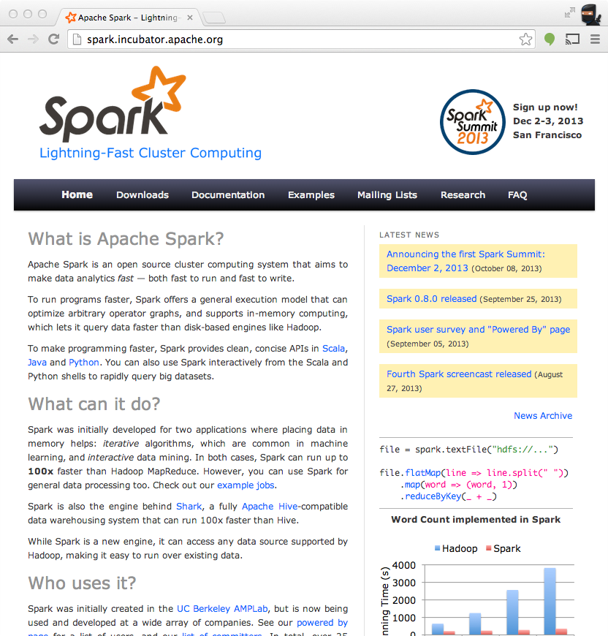
Get Started
Up and Running in a Few Steps
Download
Unzip
Shell
Project Resources
Examples on the Project Site
Examples in the Distribution
Documentation
http://spark.incubator.apache.org

Slide 47
Datasets And Dataframes
https://spark.apache.org/docs/latest/sql-programming-guide.html

Slide 48
Dataset
A Dataset is a distributed collection of data.
Like RDDs: Strong typing, ability to use powerful lambda functions
Plus the benefits of Spark SQL’s optimized execution engine.
A Dataset can be constructed from JVM objects and then manipulated using functional transformations (map, flatMap, filter, etc.).
The Dataset API is available in Scala and Java.
Python does not have the support for the Dataset API. But due to Python’s dynamic nature, many of the benefits of the Dataset API are already available
i.e. you can access the field of a row by name naturallyrow.columnName).
The case for R is similar to Python

Slide 49
DataSets
Datasets are similar to RDDs, however, instead of using Java serialization or Kryo they use a specialized Encoder to serialize the objects for processing or transmitting over the network.
While both encoders and standard serialization are responsible for turning an object into bytes, encoders are code generated dynamically and use a format that allows Spark to perform many operations like filtering, sorting and hashing without deserializing the bytes back into an object
Data sets also expose more internals to query planning (expressions, fields, etc)
https://spark.apache.org/docs/latest/sql-getting-started.html#creating-datasets

Slide 50
Creating Datasets
See code here:
https://spark.apache.org/docs/latest/sql-getting-started.html#creating-datasets

Slide 51
Dataframes
A DataFrame is a Dataset organized into named columns.
It is conceptually equivalent to a table in a relational database or a data frame in R/Python, but with richer optimizations under the hood.
DataFrames can be constructed from a wide array of sources such as: structured data files, tables in Hive, external databases, or existing RDDs.
The DataFrame API is available in Scala, Java, Python, and R.
In Scala and Java, a DataFrame is represented by a Dataset of Rows.
In the Scala API, DataFrameis simply a type alias of Dataset[Row].
While, in Java API, users need to use Dataset<Row> to represent a DataFrame.

Slide 52
Creating Dataframes
import org.apache.spark.sql.Dataset;
import org.apache.spark.sql.Row;
Dataset<Row> df = spark.read().json("examples/src/main/resources/people.json");
// Displays the content of the DataFrame to stdout
df.show();
// +----+-------+
// | age| name|
// +----+-------+
// |null|Michael|
// | 30| Andy|
// | 19| Justin|
// +----+-------+
https://spark.apache.org/docs/latest/sql-getting-started.html#creating-dataframes

Slide 53
Creating Dataframes
import org.apache.spark.sql.Dataset;
import org.apache.spark.sql.Row;
Dataset<Row> df = spark.read().json("examples/src/main/resources/people.json");
// Displays the content of the DataFrame to stdout
df.show();
// +----+-------+
// | age| name|
// +----+-------+
// |null|Michael|
// | 30| Andy|
// | 19| Justin|
// +----+-------+
https://spark.apache.org/docs/latest/sql-getting-started.html#creating-dataframes

Slide 54
RDDs or Datasets and Dataframes?
Probably Datasets and Dataframes
Finer grained expressiveness allows more fully decoupled DAG for scheduler
This means more opportunities for parallelism.

