Slide 1
PySpark + LLM Integration
A module for
Big Data Modeling
using PySpark
Compiled by:
Mahmoud Parsian
Ph.D. in Computer Science
Last Updated: July 29, 2025

Slide 2
This presentation includes:
Introduction to LLMs and PySpark
Motivations and architectures for integration
Working integration examples
Code snippets using UDFs
UDF = User Defined Function
Testing, deployment, cost, and monitoring tips

Slide 3
Learning Goals of This Module
Understand what Large Language Models (LLMs) are and how they work
Learn the basics of PySpark and distributed processing (covered in previous modules)
Explore integration architectures of PySpark with LLM APIs
Implement real-world examples such as sentiment analysis and summarization
Understand deployment, testing, cost, and privacy considerations

Slide 4
What is an LLM?
LLM = Large Language Model
Trained on massive text data:
Books, papers, articles
Log files
Web Pages
User’s data
GitHub pages
Wiki pages
Can understand and generate human language

Slide 5
What is an LLM?
A large language model (LLM) is an artificial intelligence (AI) program designed to understand and generate human language.
LLMs learn patterns and rules of language by being trained on large amounts of text data, often from the internet. This allows them to perform various natural language processing (NLP) tasks.

Slide 6
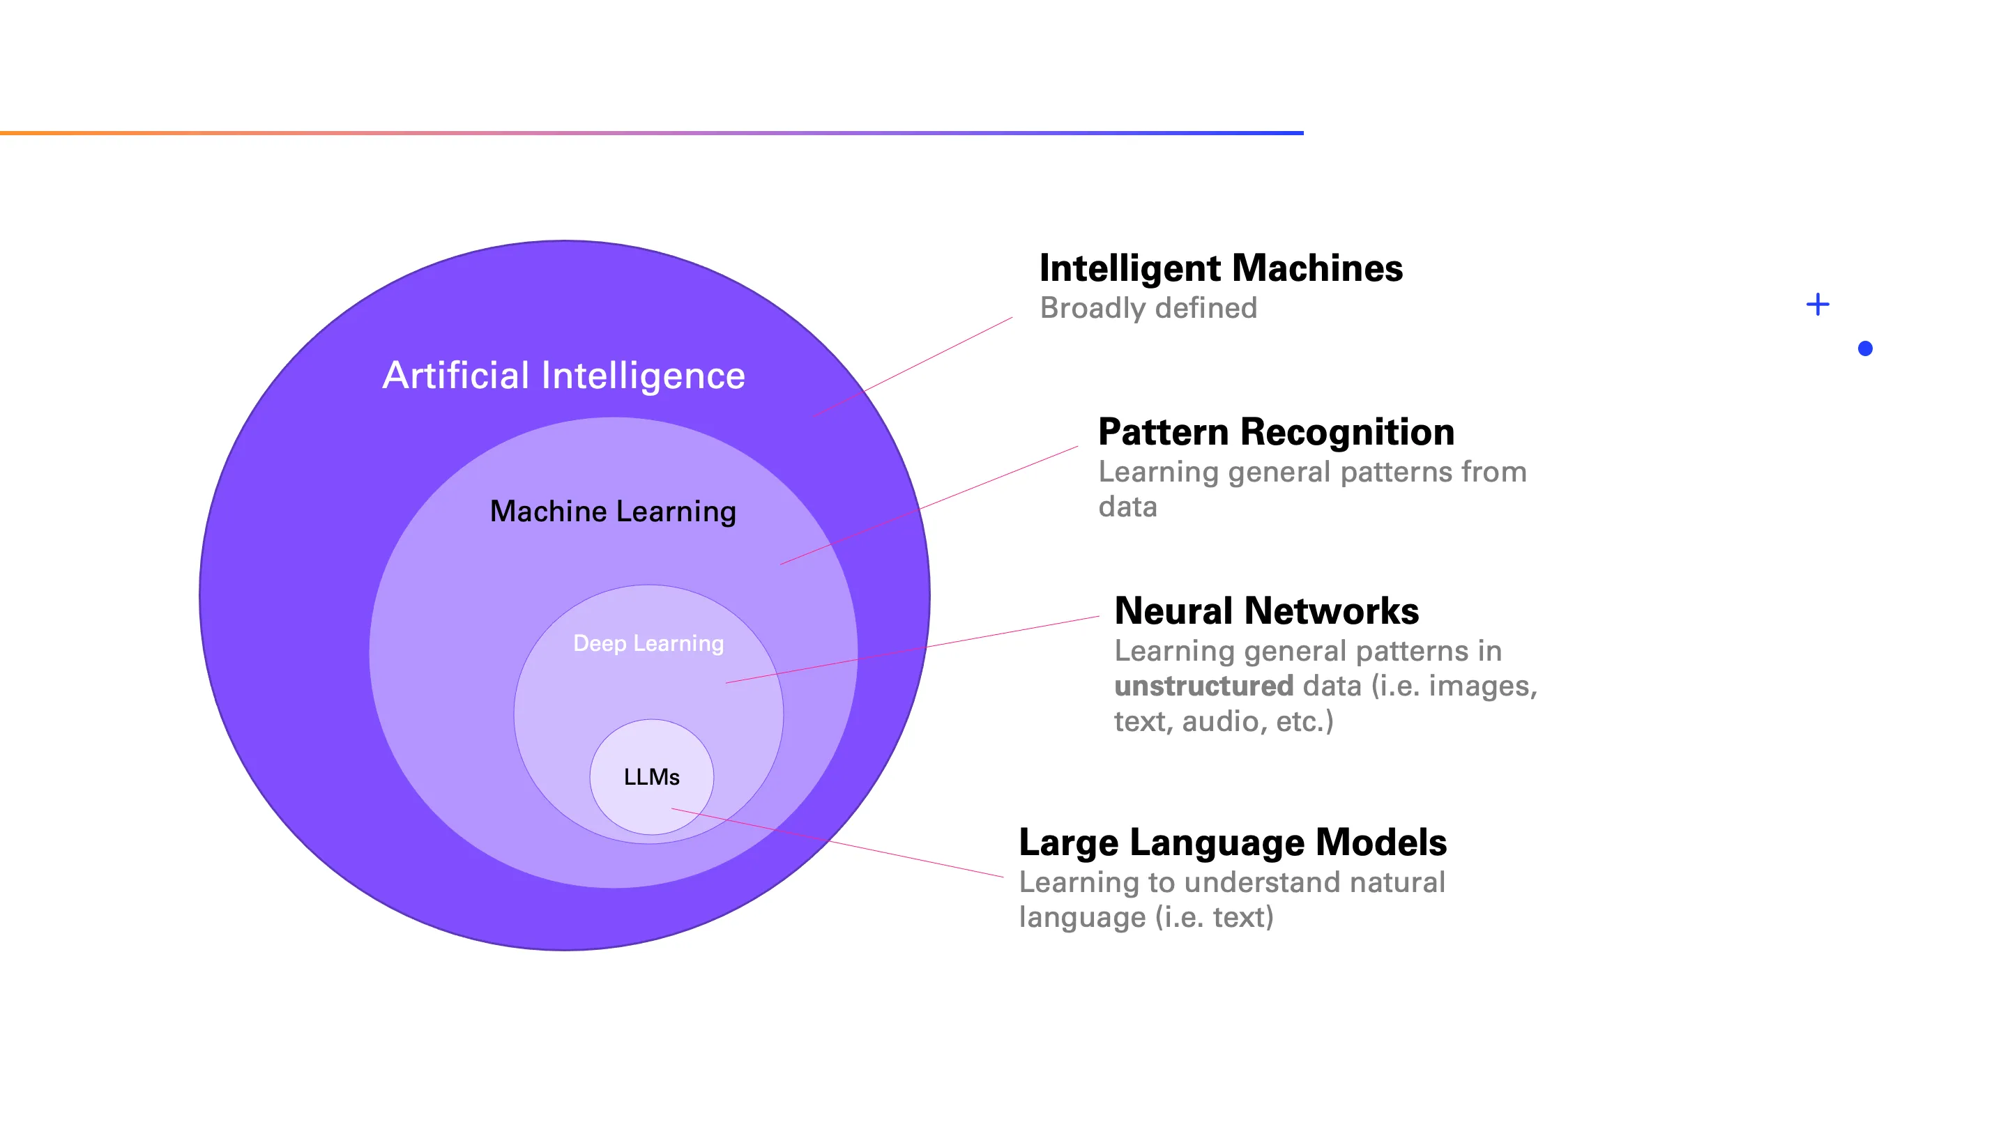
What is an LLM?

Slide 7
What is a Large Language Model (LLM)?
Definition:
LLMs are deep learning models trained on large corpora of text.
Created Model Size > 800 GB
Examples:
GPT-4, Claude, LLaMA, Mistral
BERT, LaMDA
Capabilities:
Text generation
Code generation
Summarization
Classification
Embeddings

Slide 8
What is a Large Language Model (LLM)?
Definition: A Large Language Model (LLM) is an AI model trained to understand and generate human language.
Built on Deep Learning: uses neural networks (especially transformers) to process text data.
Learns from Massive Text Datasets: Books, websites, Wikipedia, social media, and more.
Examples: GPT (OpenAI), Claude (Anthropic), Gemini (Google), LLaMA (Meta)

Slide 9
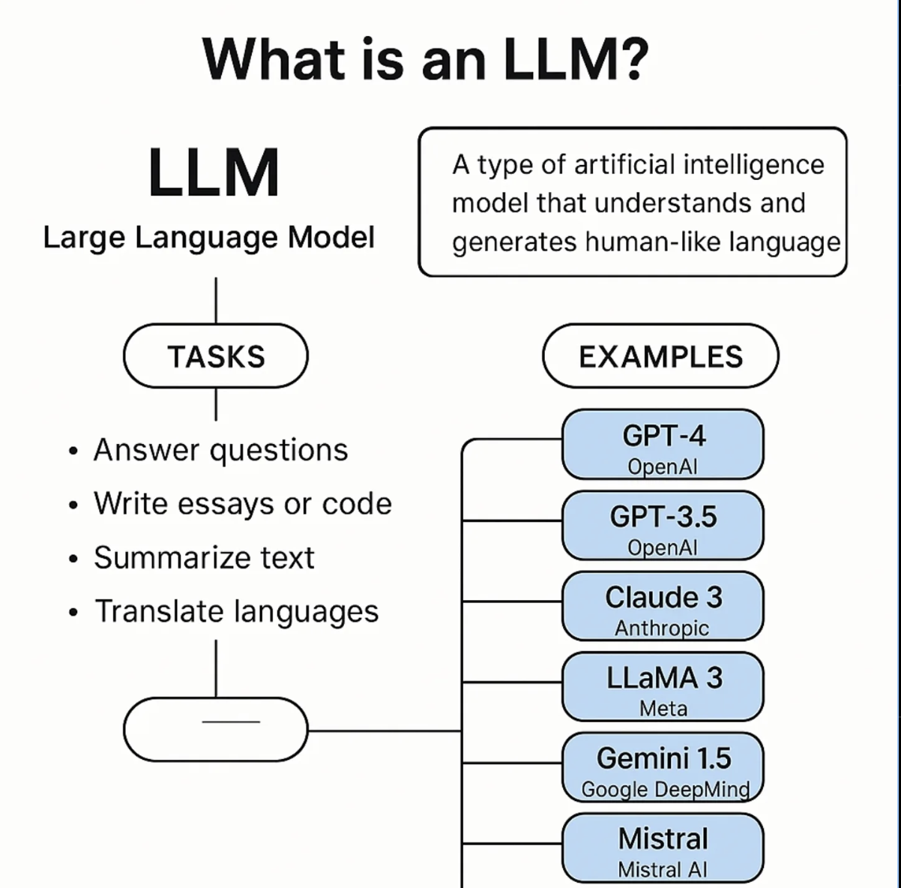

Slide 10
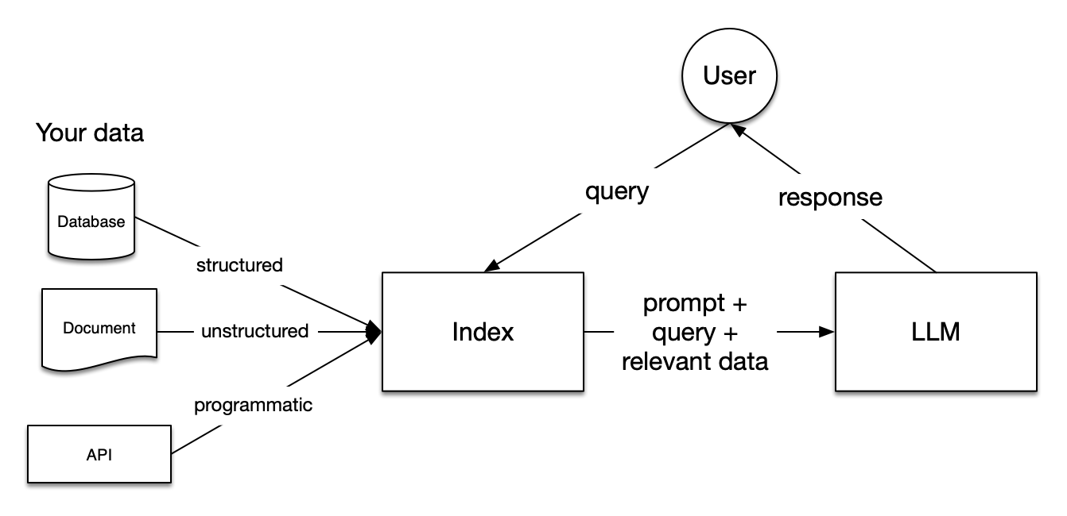
User Queries using LLM

Slide 11
Key Characteristics of an LLM
Networks and Deep Learning: LLMs use neural networks, which are layers of interconnected computing nodes similar to the human brain's structure. They use deep learning, a type of machine learning that analyzes large amounts of training data through these networks to learn and improve.
Transformer Architecture: LLMs use a specific type of neural network called a transformer model. Introduced in 2017, transformers revolutionize AI by using a technique called self-attention. This allows them to analyze the entire input sequence simultaneously and detect relationships between words, regardless of their distance from each other in the text.
Large Datasets and Parameters: The term "large" in LLM refers to the amount of data they are trained on and the number of parameters (variables) they have. These parameters represent the model's knowledge gained from the training data. Some LLMs have billions or even hundreds of billions of parameters.
Self-Supervised Learning and Fine-tuning: During training, LLMs use self-supervised learning, meaning they learn from the data without explicit instructions, identifying statistical relationships between words and their context. To specialize in specific tasks, they are often fine-tuned or prompt-tuned with additional, task-specific data.
Generative Capabilities: A core function of LLMs is their ability to generate human-like text in response to user prompts. This makes them a type of generative AI.
Source: Google AI

Slide 12
What Can LLMs Do?
Natural Language Processing (NLP) Tasks:
Text generation
Summarization
Translation
Sentiment analysis
Chatbots / virtual assistants
Beyond Text:
LLMs can also write code,
Solve math problems,
Generate SQL, and more.
Prompting:
Just give an instruction or question → LLM responds intelligently.

Slide 13
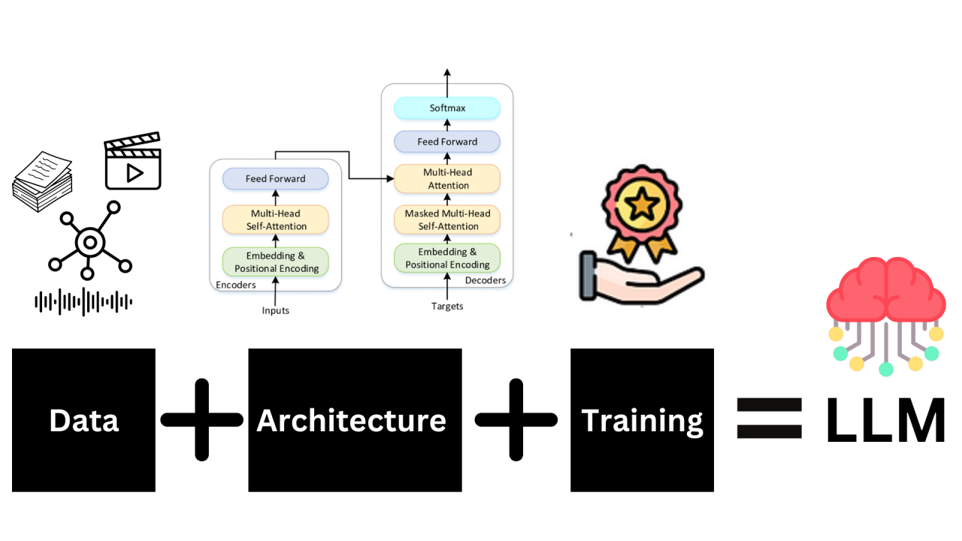
Building an LLM

Slide 14
How Does an LLM Work?
Step-by-step:
1. Breaks input into "tokens" (words or word parts).
2. Uses attention mechanisms to understand context.
3. Predicts the next word (token) one at a time.
Transformer Architecture (key innovation):
Introduced by Google in 2017 (“Attention is All You Need”).
Self-supervised Training:
Learns patterns by predicting masked or next words in sentences.
(Include a simple transformer diagram or attention flow visual)

Slide 15
What is a Transformer?
Transformers have emerged as a groundbreaking technology, reshaping how computers understand human language.
Unlike traditional models that process words one after another, Transformers can look at an entire sentence all at once, making them incredibly efficient at picking up the nuances of language.

Slide 16
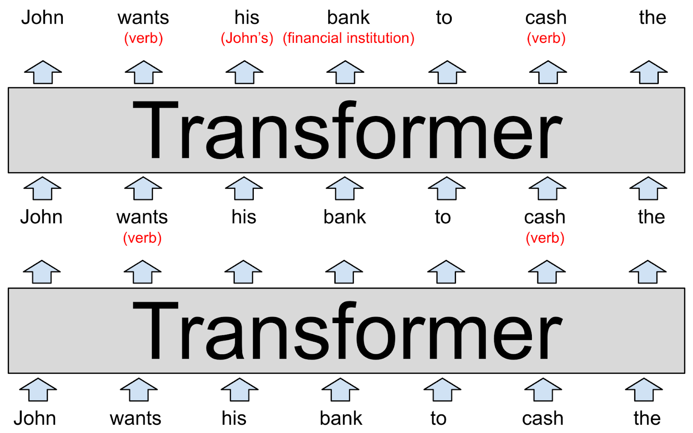
Transformer Example

Slide 17
Transformer Architecture: Encoder and Decoder
The architecture of Transformers stands on two pillars:
the encoder and
the decoder
In large language models (LLMs), encoders and decoders are fundamental components of the transformer architecture.
The encoder processes the input sequence (like a sentence) and converts it into a numerical representation called an embedding.
The decoder then takes this embedding and generates a new sequence, such as a translation or a response

Slide 18
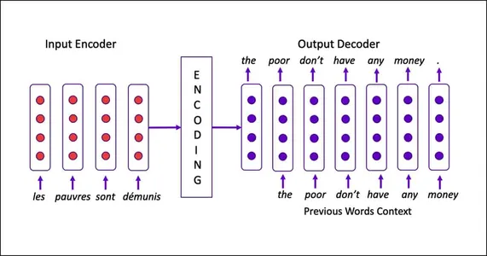
Transformer Architecture: Encoder and Decoder

Slide 19

What is PySpark?

Slide 20
What is PySpark? Spark + Python = PySpark
Spark is a multi-language engine for executing data engineering, data science, and machine learning on single-node machines or clusters.
Spark Python API (PySpark)
Used for big data processing and analysis
Enables distributed data transformations and actions

Slide 21
Why Integrate LLMs with PySpark?
To enable intelligent processing of big data
For semantic understanding of unstructured data
To enhance ML/NLP pipelines in PySpark

Slide 22
Why Integrate LLMs with PySpark?
Combine:
PySpark → Big data processing
LLMs → Intelligence (NLP, NLU, reasoning)
Use Cases:
Summarizing massive documents
Extracting structured info from unstructured data
Semantic enrichment of rows

Slide 23
Architectures for Integration
1. PySpark ↔ LLM API
(e.g. OpenAI, HuggingFace)
2. PySpark + UDFs calling LLMs
3. PySpark streaming + LLMs in real-time pipelines

Slide 24
Architectures for Integration
+---------+ +-------------+ +----------+
| PySpark | --> | LLM Service | --> | Enhanced |
| Job | | (API) | | DataFrame|
+---------+ +-------------+ +----------+
LLM via REST API (e.g., OpenAI, Cohere, local LLM)
Can be batched, streamed, or partitioned

Slide 25
Example 1: Sentiment Analysis of Reviews
Read review data using PySpark
Create a DataFrame as df
Send batches to LLM for sentiment classification
Append LLM results to DataFrame df

Slide 26
Code: Sentiment Analysis Integration
# 1. import required libraries
from pyspark.sql.functions import udf
from pyspark.sql.types import StringType
# 2. create a DataFrame:
df = spark.read.csv('movie_reviews.csv')
# 3. define UDF as classification algorithm by calling LLM
@udf(returnType=StringType())
def classify_sentiment(text):
call LLM
# 4. Use UDF and add a new column to df
df = df.withColumn('sentiment', classify_sentiment(df.review))

Slide 27
Example 2: Summarizing Articles
1. Load article dataset
DataFrame(review, …)
2. Use LLM to summarize each article
summary = LLM_CALL(review)
3. Store summary in new column
DataFrame(review, summary, …)

Slide 28
Code: Summarization UDF
# 1. import required libraries
from pyspark.sql.functions import udf
from pyspark.sql.types import StringType
from openai import OpenAI
# 2. create a DataFrame(‘content’, …)
df = …
# 3. define a UDF as a summarize function
@udf(returnType=StringType())
def summarize(text):
call LLM API using OpenAI
# 4. add a new column to df
df = df.withColumn('summary', summarize(df.content))

Slide 29
Example 3: Extracting Entities
Use LLM to extract names, dates, products
Store entities as JSON in new column
Helpful for knowledge graphs and indexing

Slide 30
Code: Entity Extraction
# 1. import required libraries
from pyspark.sql.functions import udf
from pyspark.sql.types import StringType
from openai import OpenAI
# 2. Create a DataFrame(‘text’, …)
df = …
# 3. define a UDF as a summarize function
@udf(returnType=StringType())
def extract_entities(text):
call LLM using OpenAI
# 4. add a new column to df
df = df.withColumn('entities’, extract_entities(df.text))

Slide 31
Example 4: Classifying Support Tickets
Read tickets dataset
Classify ticket topic using LLM
Route tickets accordingly

Slide 32
Streaming LLM Integration
Use Spark Structured Streaming
Apply LLM UDF on real-time input
Example: real-time social media tagging

Slide 33
LLM API Integration
Choose LLM API provider:
OpenAI,
Anthropic,
HuggingFace
Use API key and rate-limiting strategies
Design UDF with retries and caching

Slide 34
Best Practices
Batch API calls for speed
Use broadcast joins for context
Rate-limit LLM usage in production
Challenge: Rate limits and throughput

Slide 35
Testing Integration
1. Mock LLM calls for testing
2. Test PySpark UDFs independently
3. Use small data subsets first
4. Validate your Input/Output by a well-defined golden dataset

Slide 36
Evaluating Outputs
Manual checks for semantic quality
Use BLEU/ROUGE for summaries
Compare LLM output vs. classic NLP tools

Slide 37
Cost Considerations Nothing is FREE
LLMs can be expensive at scale
Cache results wherever possible
Use open-source LLMs when feasible

Slide 38
Security & Privacy
Avoid sending PII to external APIs
Mask sensitive fields in UDFs
Use on-prem LLMs for strict privacy
PII = Personally Identifiable Information

Slide 39
Deployment Options
Private Clusters (you own and manage cluster)
Databricks notebooks
PySpark on EMR or GCP Dataproc
Kubernetes Spark jobs with LLM sidecar

Slide 40
Monitoring Integration
Log API usage and errors
Track inference latency
Alert on failure spikes

Slide 41
Advanced Use Cases
LLM for code generation from logs
Multi-hop question answering over big data
Conversational analytics using chat history

Slide 42
Summary
LLMs bring intelligence to PySpark workflows
UDF-based design enables flexible integration
Key considerations:
Testing
Validation
Cost control

Slide 43
Mini-Project Prompt
Project Idea:
Build a PySpark + LLM pipeline that:
Ingests customer feedback at scale
Extracts entities, sentiment, and summarizes trends
Stores enriched data for analytics and reporting

Slide 44
Q&A / Discussion
Where could you apply this in your projects?
What are the biggest limitations today?
What would you automate using LLMs + Spark?

Slide 45
References
Understanding & Building LLM Applications!
Integrating Generative AI with Spark
Integrating LLMs and Agents with PySpark
Transformer Architecture & LLMs
Transformer Architecture in LLMs
Understanding Encoder And Decoder LLMs
Navigating the Basics of Large Language Models

