Slide 1
Big Data Modeling & Analytics (course outline)
Mahmoud Parsian
Ph.D. in Computer Science

Slide 2
Main Course Components
1. Introduction to MapReduce Paradigm (25%)
2. Spark and PySpark (60%)
3. Serverless SQL Access to Big Data (15%)

Slide 3
Data Analysis
1. MapReduce
2.
Spark
PySpark
3.
Amazon
Athena (SQL)
Data Analysis
Transformations & Actions
Mappers
Filters
Reducers
Input
Desired
Output

Slide 4
1. MapReduce Paradigm
MapReduce is a programming paradigm/model that enables massive scalability across hundreds or thousands of servers in a cluster.
MapReduce has 3 functions:
map()
reduce()
combine()

Slide 5
1. MapReduce Programs
For MapReduce, we will NOT use any concrete implementations (such as Hadoop)
For MapReduce, we will focus on learning MapReduce paradigm/model that enables massive scalability across hundreds or thousands of servers in a cluster.
For MapReduce, we will write only pseudo-code (examples are given in Lin, J., & Dyer, C. (2010). Data-intensive text processing with MapReduce)

Slide 6
1. MapReduce Components
MapReduce has 3 functions:
map()
Mapper function
reduce()
Reducer function
combine()
Optional combiner function

Slide 7
MapReduce Paradigm
MapReduce is a foundation model/paradigm for distributed computing using clusters
MapReduce concrete implementations:
Apache Hadoop implements MapReduce
Apache Spark implements superset of MapReduce
Apache Tez implements MapReduce

Slide 8
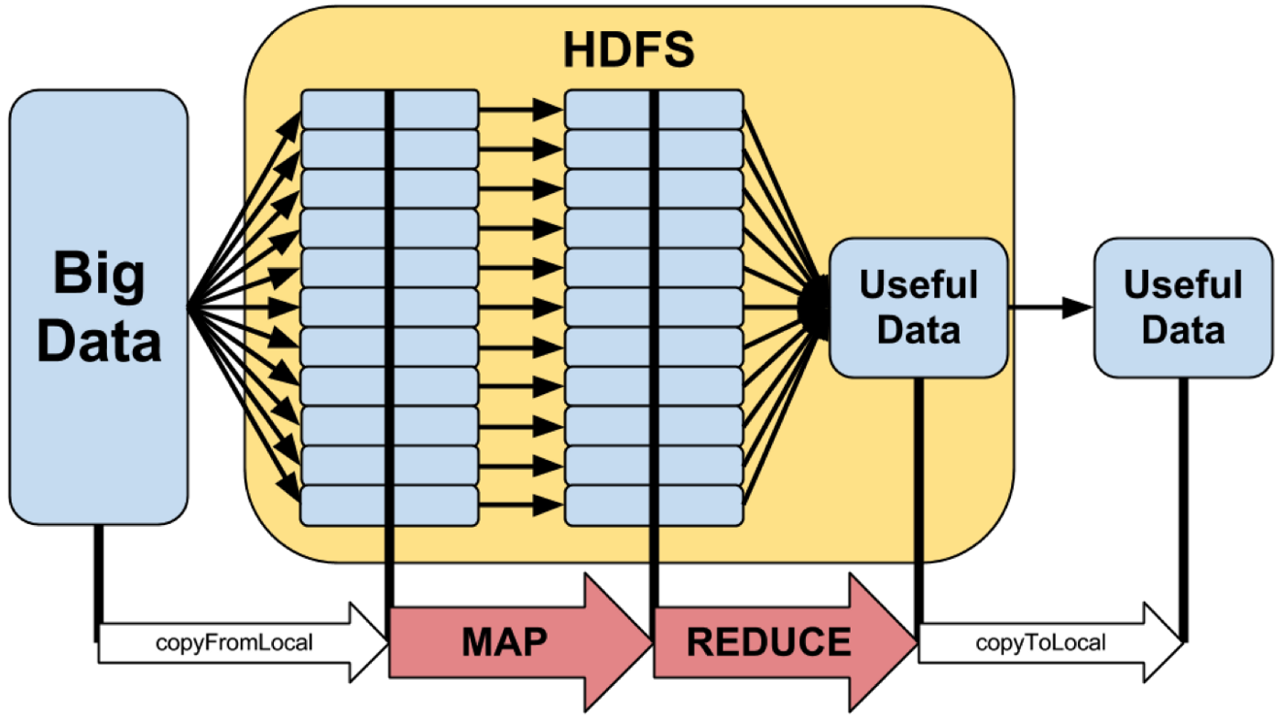
MapReduce Paradigm: High-Level

Slide 9
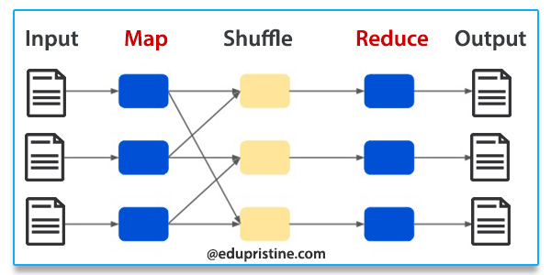
MapReduce Paradigm

Slide 10
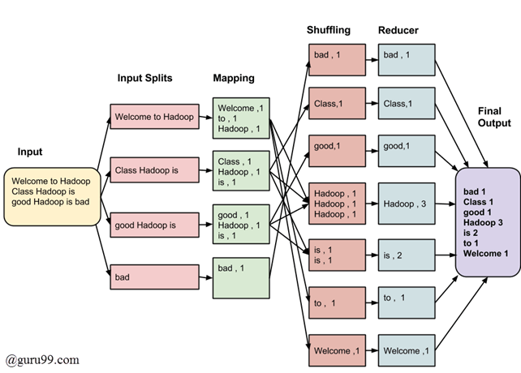
MapReduce Paradigm Example-1

Slide 11
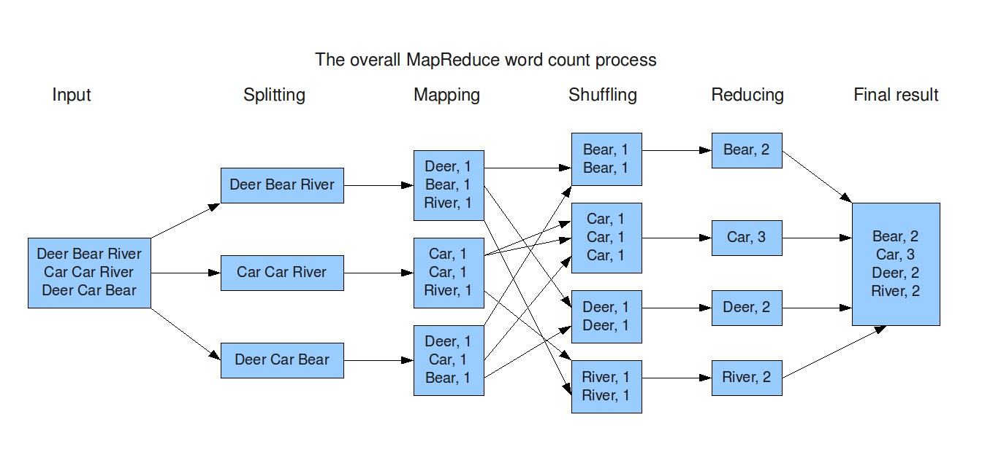
MapReduce Paradigm Example-2

Slide 12
Solving a Problem with MapReduce (1)
Input data is partitioned by a partitioner into chunks and sent to Mappers
Assume your input is comprised of 80,000,000,000 records, which might be partitioned into 40,000 chunks
Number of partitions: 40,000
Each partition will have about 2,000,000 records
Maximum mapper parallelism can be 40,000 mappers
80,000,000,000 = 40,000 x 2,000,000
A mapper function, map(K, V) is executed on all partitions in parallel (as much as possible – depends on resources available).
The map(K, V) generates any number of (key, value) pairs such as:
{(K1, V1), (K2, V2), …}. For example, K can be a record number and V can be the actual input record

Slide 13
Solving a Problem with MapReduce (2)
All mappers output go to Sort & Shuffle phase, which groups values by unique keys (similar to GROUP BY in SQL). Sort & Shuffle creates (key, value) pairs as:
(K_1, [v1, v2, …])
(K_2, [u1, u2, …])
…
(K_n, [t1, t2, …])
Where { K_1, K_2, … K_n } are the unique keys created by all mappers

Slide 14
Solving a Problem with MapReduce (3)
Output of Sort & Shuffle goes to reducers
A reducer operates on (key, value) pairs where key is in
{ K_1, K_2, …, K_n } and value is an associated value for the key.
Therefore, the following reducers can be executed in parallel:
reduce(K_1, [v1, v2, …])
reduce(K_2, [u1, u2, …])
…
reduce(K_n, [t1, t2, …])
Each reducer can create any number of new (key, value) pairs.

Slide 15
2. Apache Spark
Apache Spark is a multi-language (Java, Python, Scala) engine for executing data engineering, data science, and machine learning on single-node machines or clusters.
PySpark is a Python API for Spark
Spark is a superset of MapReduce
Spark web site: https://spark.apache.org

Slide 16
2. Apache Spark Programs
For Apache Spark , we will use PySpark and write actual executable programs:
>>> # spark is an instance of SparkSession object
>>> rdd = spark.sparkContext
.parallelize(range(0, 100))
>>> rdd.count()
100
>>> sum_of_values = rdd.reduce(lambda x, y: x+y)
>>> sum_of_values
4950

Slide 17
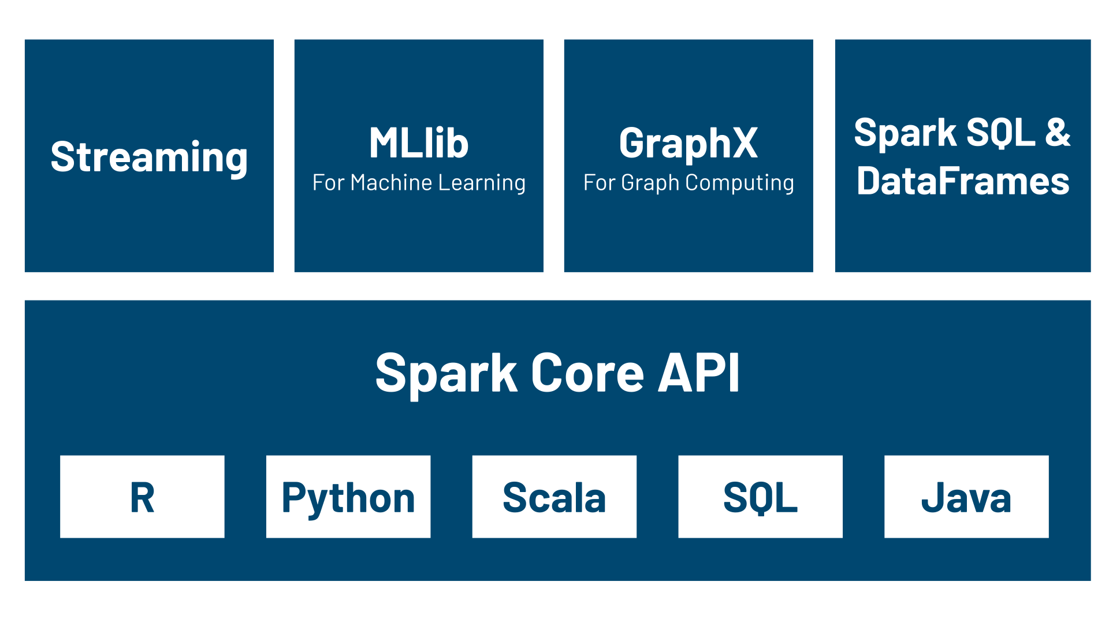
Apache Spark: Components

Slide 18
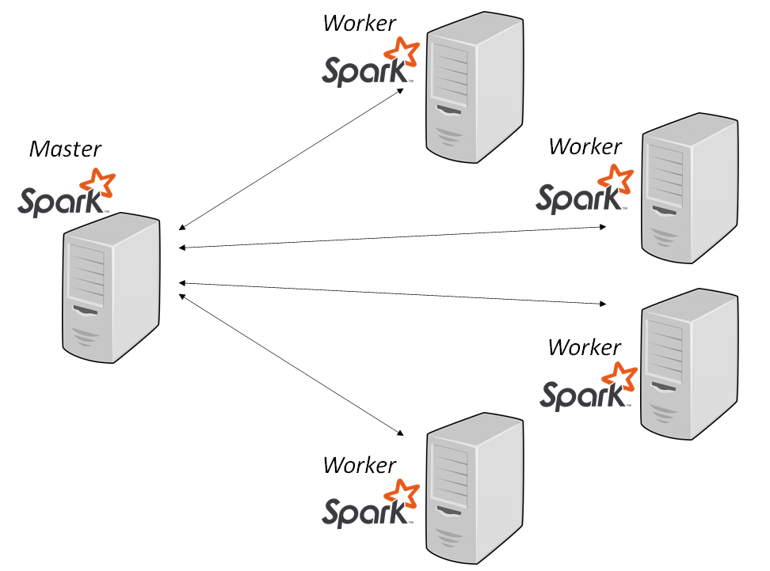
Apache Spark: runs in a cluster

Slide 19
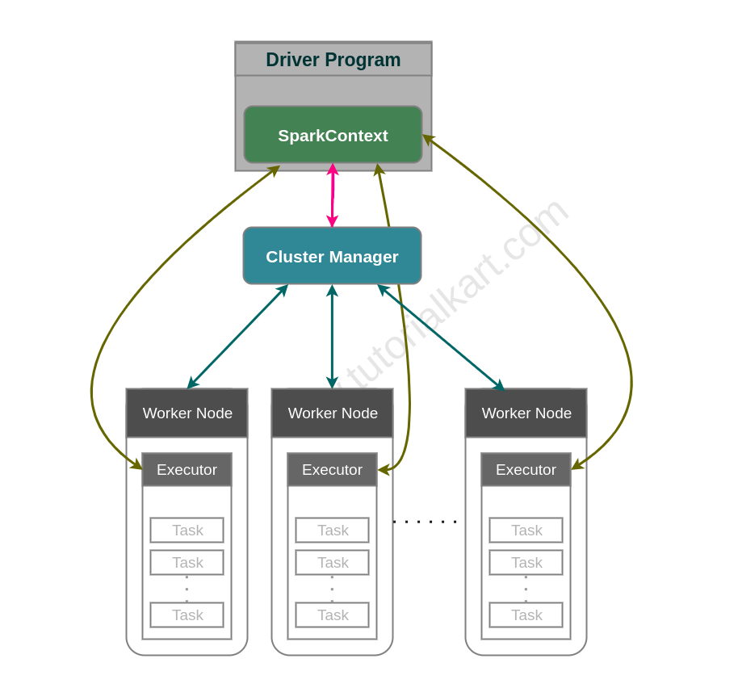
Apache Spark: Cluster Manager

Slide 20
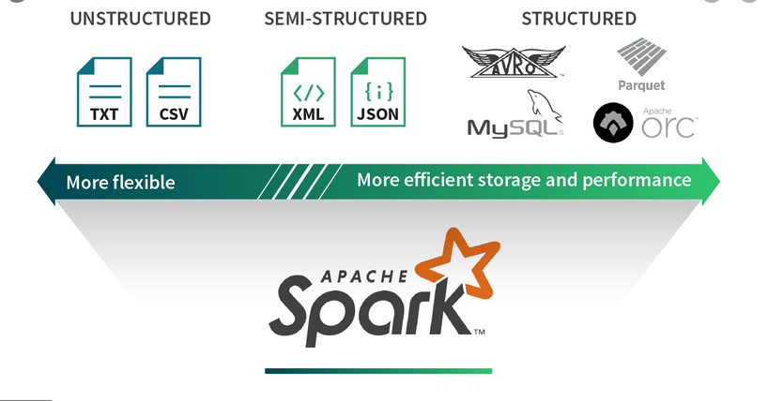
Spark Data Abstractions: Read/Write from/to Many DataSources

Slide 21
Spark Data Abstractions
Your data can be represented as an RDD or DataFrame
Resilient Distributed Datasets (RDD)
Data is represented as a data type T (integer, string, tuples, arrays, …)
Billions of data points (elements/records)
DataFrame
Data is represented as a table of rows and named columns
Billions of rows of data

Slide 22
Spark Data Abstractions: RDDs Billions of data elements Each element: (String, (Float, Float))
(gene-1, (3.0, 4.5))
Element-1:
Element-2:
(gene-2, (1.0, 1.5))
Element-3:
(gene-1, (2.1, 1.6))
…
(gene-8, (3.1, 5.1))

Slide 23
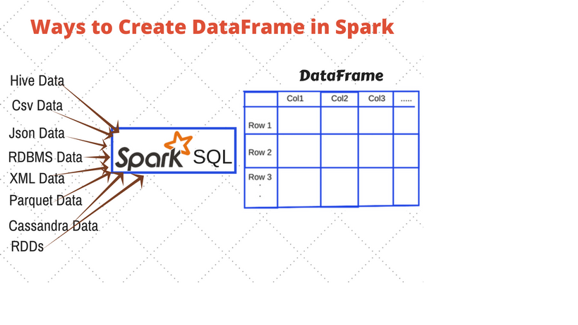
Spark Data Abstractions: DataFrame

Slide 24
3. Main Course Components Serverless SQL Access to Big Data (15%)
Amazon Athena
Google BigQuery
Snowflake

Slide 25
Amazon Athena
Interactive query service
Serverless. Zero infrastructure. Zero administration.
Put your data in S3
Access your data by SQL
Pay by query
Fast performance

Slide 26
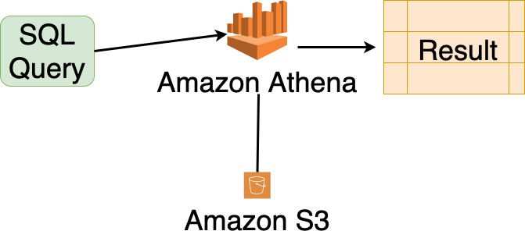
Amazon Athena

